Slide 1




RASID: A Robust WLAN Device-Free Passive Motion Detection System
Ahmed E. Kosba†, Ahmed Saeed ‡, Moustafa Youssef ‡
†Alexandria University, Egypt
‡ Egypt-Japan University for Science and Technology (E-JUST), Egypt
Notes:
Hello everyone
I am Ahmed Saeed from Egypt Japan University for Science and Technology and this work is a joint work with my colleague Ahmed Kosba and my advisor Prof. Moustafa Youssef.
And what I am introducing today is RASID which is a robust WLAN device free passive motion detection system
Before discussing device free passive systems let’s first discuss device based active systems

Slide 2
Outline
Introduction
device-based active systems
device-free passive systems
potential applications of device-free passive systems
Challenges and Related Work
Identifying Effective Signal Features
RASID System
Evaluation
Summary

Slide 3
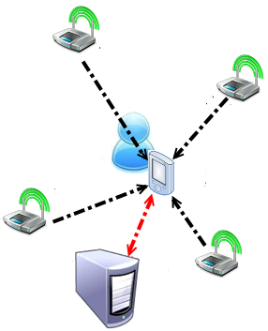
Device-Based Active System
User carries a device
Participates actively in the localization process
GPS
Cellular based
WLAN signal strength based
Notes:
In typical localization systems you are carrying a device and you query this device for your location (hence it’s a device based active system) and examples of these typical systems include GPS, Cellular based systems and WLAN signal strength based systems like Horus.
In systems like horus your mobile phone uses the signal strength values it can measure from available access points to calculate your location. And in these systems human motion in the area of interest is considered a typical source of noise and what we are doing is that we use this noise as a source of information to detect human motion.
And that way we enable device free localization.

Slide 4
Can we detect a user that is not carrying any devices and is not interacting with the system?

Slide 5
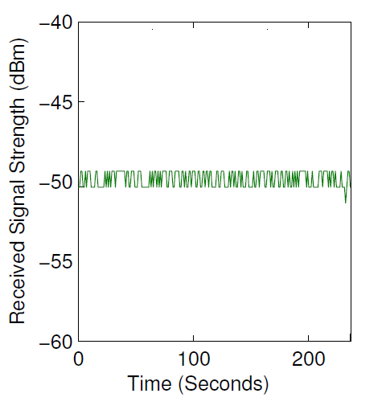

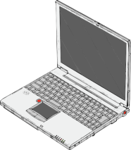
Observation
No human presence
Relatively stable received signal strength (RSS) behavior
Notes:
So the basic idea here is that in a typical wireless setup when there is no human presence we get a relatively stable RSS behavior

Slide 6

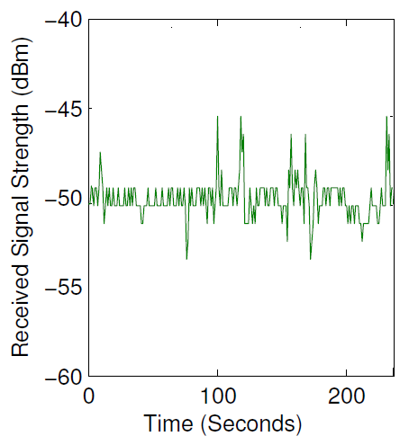
Observation
Human presence
Changes in RSS behavior
Could be used for human detection
Device-free passive motion detection
Notes:
But as soon as a human starts moving in the area the RSS behavior changes and we start getting really noisy reading
And this change could be used for human motion detection without requiring the user to carry any device nor participate in the process in anyway in what we call device-free passive motion detection

Slide 7
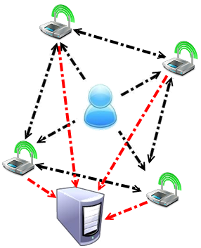
Active vs. Passive
Mobile device interacting with infrastructure
Active
Infrastructure components interacting with each other
Passive

Slide 8
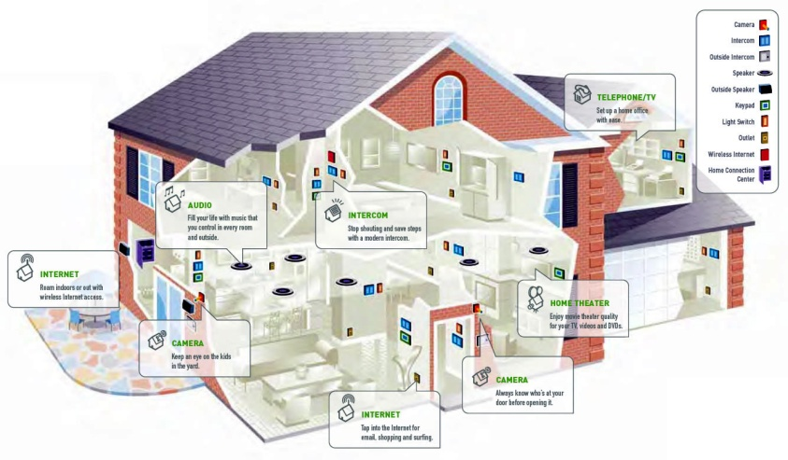
Potential Applications
Intrusion detection
Smart homes
Border protection
Assisting installed security systems
Notes:
The motivation of our work is that we are enabling a free added value on top of already available, widely deployed Wi-Fi networks. Another thing is that WLAN motion detection does not require line of sight unlike other motion detection sensor like infra red sensors.
And this system has numerous applications including intrusion detection, so you’ll have a data network in your office by day and by night you’ll be able to use to secure the office.
Other applications include smart homes, border protection and assisting already installed security systems.

Slide 9
Outline
Introduction
Challenges and Related Work
device-free passive systems challenges
related work
our contributions
Identifying Effective Signal Features
RASID System
Evaluation
Summary

Slide 10
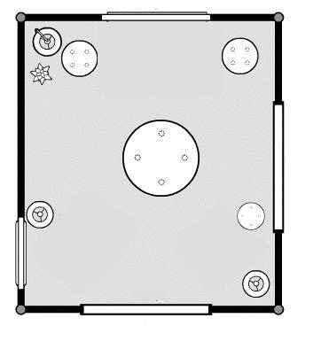
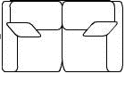
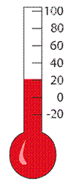
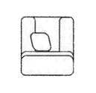
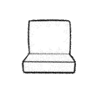
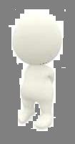
Device-free Passive System Challenges
Noisy signal readings
Changing environment
Constructing signals profiles once will not work
Large overhead of constructing signal profiles for both motion and silence
Notes:
But developing such a system is quite challenging and some of the challenges include the noisy nature of the wireless signal
Also indoor environment are constantly changing like moving the furniture and humidity and temperature changes.
And to be able to differentiate between signal behavior in human presence and human absence learning signal behavior in human presence would require a significant overhead

Slide 11
Related Work
Moving average detection [Youssef et al, Mobicom’07]
detects RSS mean shifts
Moving variance detection [Youssef et al, Mobicom’07]
detects RSS variance changes
human present vs. no human present
Maximum likelihood Classification [Moussa et al, PerDev’09]
learns RSS behavior in human presence and absence
Notes:
So there has been some work in human motion detection using WLAN networks
The moving average detection technique compares the long term behavior of the RSS (the mean RSS value of large window) to the short term behavior of the RSS (the mean RSS value of a short window) and based on a threshold makes the detection decision
The moving variance records the RSS variance when there is no human present and the measures the RSS variance of a short window and if their difference is above a certain threshold decides that there is a human present
The maximum likelihood classification learns the behavior of the signal when a human is present and when there is no human present and then compare classifies new readings accordingly

Slide 12
Our Contributions
Identifying best signal feature for motion detection
Using anomalous behavior of RSS to detect human motion
robust to changes in the environment
robust parameters to different deployments
Minimal deployment overhead
without harming the system’s performance
Notes:
Our contribution is that we first compared different signal features to determine which feature is the most suitable for motion detection
And we then we detect anomalous behavior in the feature to determine whether a human is present or not
And finally we present a system that requires minimal deployment overhead, and can adapt to changes in the environment and is robust to different deployment
I’ll explain what I mean by that

Slide 13
Outline
Introduction
Challenges and Related Work
Identifying Effective Signal Features
sensitivity to human motion
resistivity to temporal variations
RASID System
Evaluation
Summary

Slide 14
Feature Selection
Received Signal Strength Mean
vs. Received Signal Strength Standard Deviation
Mean: a measure of central tendency
Standard deviation: a measure of dispersion
Compared according to two metrics
sensitivity to human motion
resistivity to temporal variation
Notes:
But before going into the details let’s first compare the different signal features
We compare two features the mean and the standard deviation of the RSS according to two metrics
Sensitivity to human presence and resistivity to temporal variations

Slide 15
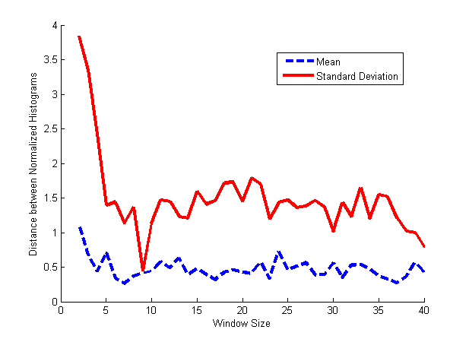
Feature Selection (Sensitivity to Human Motion)
Received Signal Strength Mean
vs. Received Signal Strength Standard Deviation
Distance between
feature motion Histogram
feature Silence Histogram
Standard deviation is more sensitive to human motion
Notes:
First to compare there sensitivity to human motion we constructed a histogram for each feature when there a human present and when there is no human present and measured the distance between the histograms
The distance between standard deviation histogram was larger that the mean’s which means that standard deviation is more sensitive to human motion

Slide 16
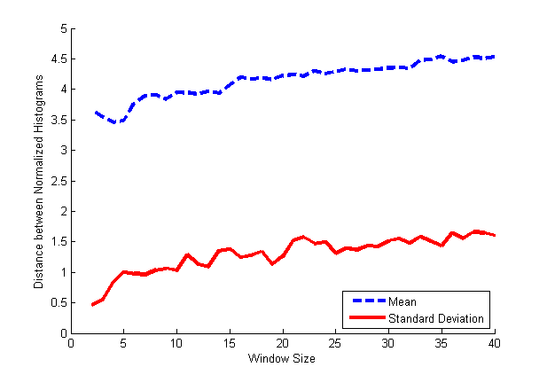
Feature Selection (Resistivity to Temporal Variation)
Received Signal Strength Mean
vs. Received Signal Strength Standard Deviation
Distance between
feature silence histogram
feature silence histogram collected two weeks later
Standard deviation is less affected by temporal variations
Standard deviation is a better feature
Notes:
And to compare there resistivity to temporal variations we constructed a histogram for each feature when there was no human presence and then constructed the same histogram two weeks later and as you can see the distance between the standard deviation’s histogram is smaller meaning that it’s less affected by temporal variation
And our conclusion is that standard deviation is a better signal feature
Next I’ll explain how our system works

Slide 17
Outline
Introduction
Challenges and Related Work
Identifying Effective Signal Features
RASID System
system operation
system architecture
Evaluation
Summary

Slide 18
System Operation
Offline training phase
constructs silence profile of RSS
Online monitoring phase
detects anomalous behavior of the RSS
updates the constructed silence profile
handles noisy readings
Notes:
RASID works in two phases and offline phase where the system learns the behavior of the signal when there is no human present and we call it that the silence profile
And the second phase is the monitoring phase where we detect anomalous behavior from the constructed profile to detect human motion, update that profile to adapt to changes in the environment and handle noisy readings

Slide 19
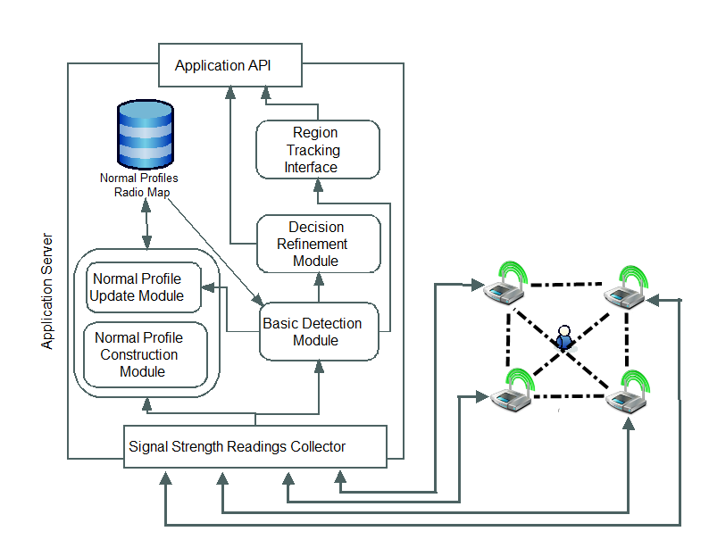
RASID Architecture
Online Phase
Offline Phase

Slide 20
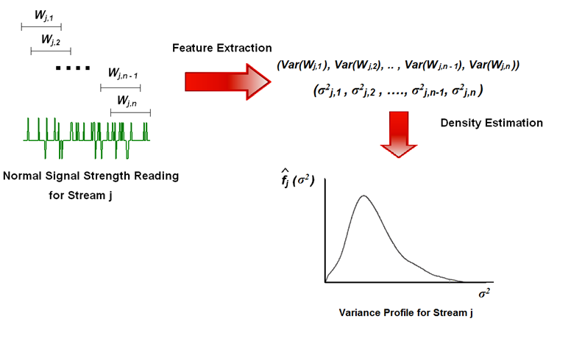
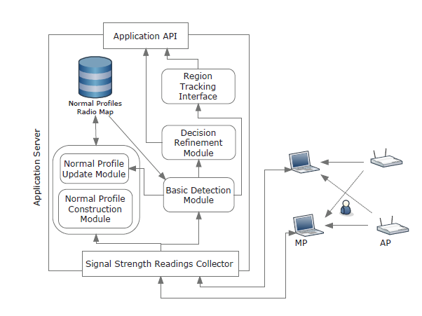
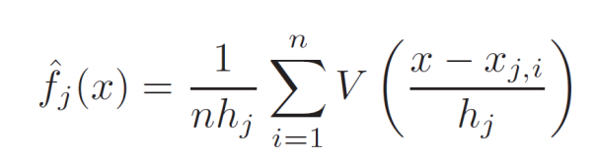
Silence Profile Construction
Calculates variance values of a moving sliding window over RSS readings
Estimates density function of the variance using Kernel Density Estimation.
Two minutes training phase
Notes:
First RASID constructs a silence profile of the signal by measuring the variance of sliding window over the constructed training data and using kernel density estimation to estimate the probability density function of the variance of the RSS

Slide 21

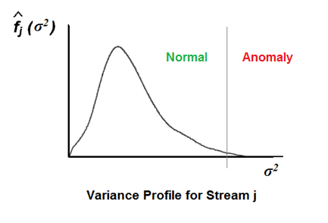
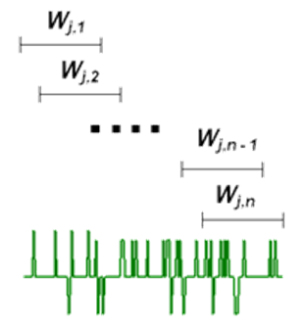
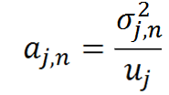
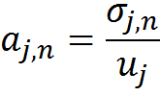
Basic Detection Module
Decides if there is any anomaly for any new signal reading
Calculates an anomaly score for each stream, to express the significance of the generated alarms
Feature extraction
Critical Value
Notes:
Then it calculates the variance of the latest window of readings and according to the variance’s distribution and a certain significance value decides whether this readings are anomalous or not and it assigns an anomaly score for each stream
But what about changes in the environment ?

Slide 22
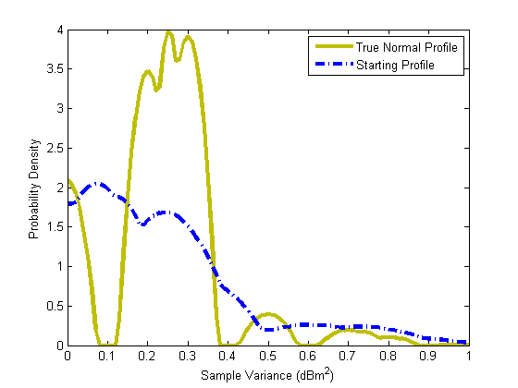
Normal Profile Update Module
The Environment Changes
Notes:
Due to changes in the environment we can face something like this
We’ll start with a certain profile and after a while this profile would totally change due to changes in the environment like furniture movement and temperature and humidity changes

Slide 23
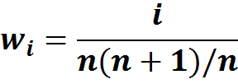
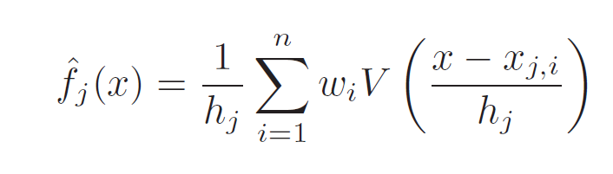
Normal Profile Update Module
Updates stored normal profile to account for changes in the environment
Groups readings that are not anomalous on average
Add the group to the silence profile
Linear weights are used to give recent readings more weight in the normal profile
And the density function becomes
Notes:
And what we do is that we update the constructed silence profile with new readings that our system consider not anomalous and we give recent readings more weight in density function

Slide 24
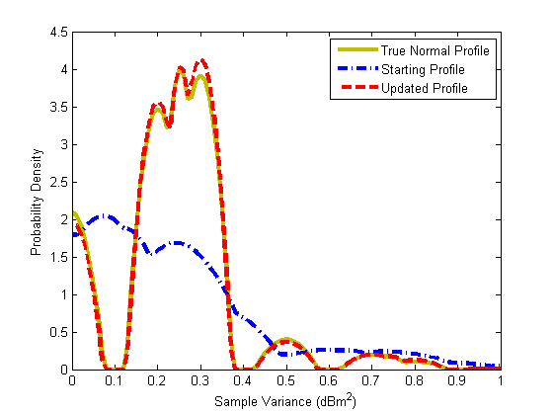
Normal Profile Update Module
The Environment Changes
Notes:
And we can get a result like this
In blue you can see the start profile and in yellow the true profile and in red the update profile and it almost matches the true profile
But still we are dealing with noisy readings …

Slide 25
Decision Refinement Module
Studies the sum of the anomaly scores of all streams
Uses Exponential Smoothing to avoid the noisy samples
Notes:
And what we do for that is that we fuse the information we get from all streams by summing their anomaly score smoothing this sum and if this value passes a certain threshold the system decides that there is a human in the area

Slide 26

Region Tracking Interface
Visualizes the output of the system on the map of the area of interest
Identifies the regions of the detected entity
Silence
Motion
Notes:
And to make the system easier to use we have implemented a tracking interfaces that shows the regions that the system thinks a human is moving in

Slide 27
Outline
Introduction
Challenges and Related Work
Identifying Effective Signal Features
RASID System
Evaluation
experimental environment
modules effect on performance
RASID vs. earlier device-free passive systems
Summary

Slide 28
Experiments Environment
Testbed 1: an office with an area of 2000 ft²
Equipment:
Four Cisco APs
Three Dell Laptops with a D-Link Airplus G+ card
Testbed 2: two floor home building of 1500 ft2 each
Same equipment covering larger area
Notes:
We evaluated RASID in two typical WLAN setups one in an office apartment and the other in a two floor home building using the same number of access points and laptops
It is also important to note that we used the same system parameters for both deployments

Slide 29
Experiments Environment
Data Collection:
One hour and 15 minutes of data was collected.
Sampling rate of 1 sample/second
Silence data and three motion sets collected
Two minutes only training for the entire site
Notes:
We collected a total of one hour and fifteen minutes for each deployment with a sample rate of 1 sample per second and one long silence period and there separate motion sets and we used only two minutes of the silence period for training

Slide 30
Evaluation Metrics
False Positive (FP) rate
probability that the system generates an alarm while there is no human motion
False Negative (FN) rate
probability that the system fails to detect the human motion
F-measure
a single value to measure the effectiveness of the detection system

Slide 31
Modules Effect on Performance
Testbed 1 | Basic Detection | Profile Update | Decision Refinement (RASID Overall Performance)
F-measure | 0.8683 | 0.8989 | 0.9574
Enhancement w.r.t. the F-measure | - | 3.52% | 10.26%
Testbed 2
F-measure | 0.8167 | 0.8422 | 0.9311
Enhancement w.r.t. the F-measure | - | 3.1% | 14%
More than 10% gain in performance over basic module
Notes:
And the result we got is as shown here
And as you can see there is a significant incremental enhancement with each technique we add to the system

Slide 32
Overall System Performance
Testbed 1 | Decision Refinement (RASID Overall Performance)
FN Rate | 4.6%
FP Rate | 3.78%
F-measure | 0.9574
Testbed 2
FN Rate | 9.66%
FP Rate | 3.72%
F-measure | 0.9311
High performance
with low overhead
Same parameters used
parameters robustness
Notes:
And it’s clear that RASID achieved high performance with only two minutes of training
And it achieved parameters robustness as the same parameters was used for each deployment

Slide 33
Comparison with other Systems Overhead
Moving Average | Moving Variance | Maximum Likelihood | RASID
No overhead | Minimal (Normal Profiles) | Worst (Normal and Motion Profiles) | Minimal (Normal Profiles)
Notes:
Also we compared RASID to earlier work and when it comes to overhead RASID requires minimal overhead as it requires only two minutes of training which is the same as the moving variance technique
While the moving average technique does not require any training
And the maximum likelihood requires extensive training to capture both silence and motion profiles

Slide 34
Comparison with other Systems Accuracy- Robustness
F-measure
Testbed 1
Performance robust over time
Notes:
We compare the performance of the three systems with respect to the f-measure and RASID out performed the three systems and maintained its performance over time in the first deployment

Slide 35
Comparison with other Systems Accuracy- Robustness
F-measure
Testbed 2
RASID achieves parameters robustness
RASID maintains robustness overtime
Notes:
And it maintained its performance with the same parameters in the second deployment.
While maximum likelihood is a little better when using the system on the same day as the training day but when overtime the maximum likelihood technique behavior degrades badly while RASID maintains its performance

Slide 36
Summary and Future Work
RASID, WLAN device-free motion detection
leverages conventional WiFi networks for human motion detection
easy to deploy even in large WiFi setups
robust to changes in the environment
Future work
human tracking
differentiating between moving entities classes
studying the effect of network heterogeneity on the system performance
Notes:
In summary we introduced device free motion detection system

Slide 37

Thank you ! Ahmed Saeed ahmed.saeed@ejust.edu.eg Wireless Research Center http://wrc.ejust.edu.eg

Slide 38

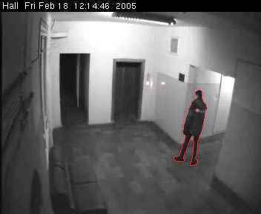

Device Free Motion Detection
Tomographic Imaging, physical contact based, etc ..
IR
Computer Vision
RADAR

Slide 39
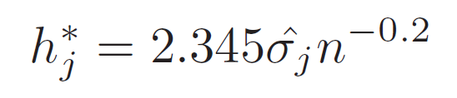
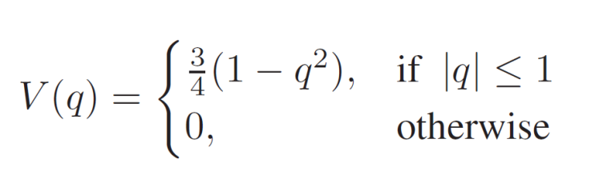
Density Function Estimation (Non Parametric Estimation)
Number of Samples
Bandwidth using Scott’s Rule
Kernel Function

Slide 40
Density Function Estimation with Normal Profile Updates
Each Sample is weighted
to give recent readings more
priority

Slide 41
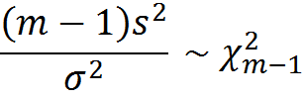

Parametric Estimation
Using the signal Variance as the feature
Variance of m independent samples is distributed
Signal Strength Values are normally distributed
A reading is window of readings is considered anomalous if it exceeds
Notes:
Comparison with different device free techniques
Comparsion with DfP techniques
Demo

Slide 42
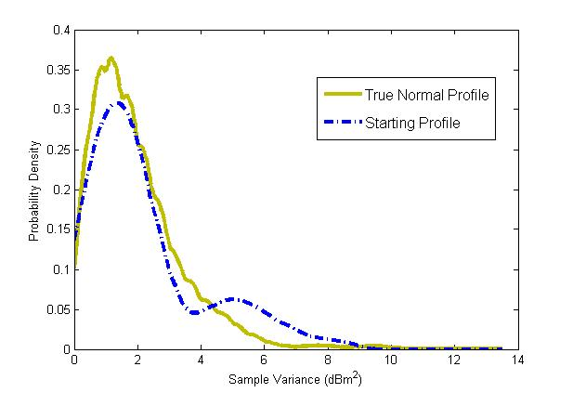
Normal Profile Update Module
No Environment Changes
Notes:
Switch slides and emphasize on the figure

Slide 43
Comparison with other Systems
We compare the performance of our system to other WLAN DfP Detection techniques:
Moving Average and Moving Variance
Maximum likelihood Classification (PerDev’09)

