Slide 1



Towards a Characterization of White Spaces Databases Errors An Empirical Study
Ahmed Saeed*, Khaled A. Harras†, and Moustafa Youssef‡
*Georgia Institute of Technology
†Carnegie Mellon University Qatar
‡ Egypt-Japan University of Science and Technology (E-JUST)

Slide 2
Outline
Introduction
A Large Scale Urban Study
When to Use Spectrum Sensing?
SPOC: Signal Prediction & Observation Combiner
Conclusion and Future Work

Slide 3
Outline
Introduction
A Large Scale Urban Study
When to Use Spectrum Sensing?
SPOC: Signal Prediction & Observation Combiner
Conclusion and Future Work

Slide 4
Introduction
White spaces are frequencies in the TV band that are not used by licensed services
FCC ruling in 2008 enabling unlicensed usage of white spaces which motivated research on white space detecting and utilization
White space detection methods help White Space Devices (WSDs) know if they lie in the protected area (coverage area) of nearby TV stations
Current regulations specify two main ways for detecting white space opportunities
Geo-location spectrum databases that rely on empirically constructed propagation models
Spectrum sensing for detecting incumbents activity that require sensing at a sensing threshold of -114dbm which requires complex and expensive sensing devices

Slide 5
Introduction Geo-location Spectrum Databases
Assumes comprehensive database of all TV stations covering the area of interest and that each WSD knows its location
Propagation models use TV transmitter parameters to determine its protected area
Earlier work by Murty et al. on Senseless Spectrum Database found the Longley-Rice model to be the most accurate model
Longley-Rice model takes into statistical analyses of both terrain information and radio measurements data to better estimate signal propagation
However, the L-R model does not perfectly match the collected measurements

Slide 6
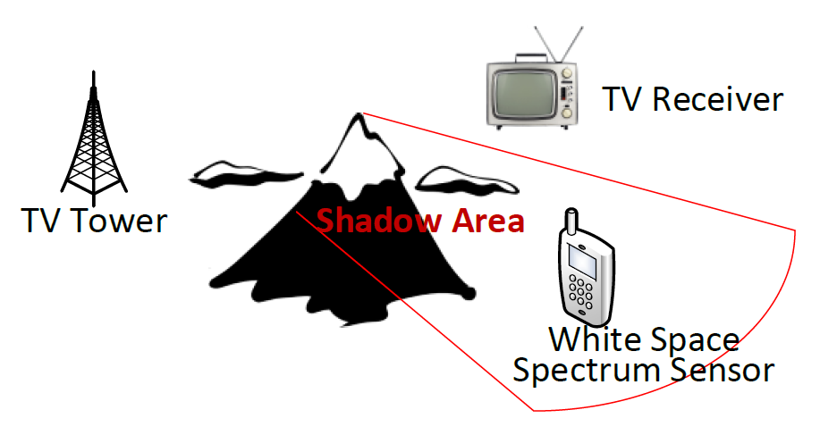
Introduction Spectrum Sensing
True coverage area
Uses WSDs to detect the signal strength of TV transmitters
Sensing at a threshold of near minimum decodable signal strength (i.e. -84 dBm) can cause the hidden node problem
The hidden node problem occurs when an obstruction between the spectrum sensor and the TV station causes a miss detection of the channel occupied by the TV station
TV Tower
Area protected by spectrum sensing with a -84 dBm threshold

Slide 7
Introduction Spectrum Sensing (Cont’d)
Addressing the hidden node problem requires lowering the sensing threshold (-114 dbm) severely below the actual decodable signal strength values (-84 dbm)
Using Low sensing thresholds ensures accurate detection of TV signal however overprotects the TV station just to avoid hidden node problems
True coverage area
TV Tower
Area protected by spectrum sensing with protective threshold

Slide 8
Introduction Main Hypothesis
Area protected by spectrum sensing with a -84 dBm threshold
Area protected by spectrum databases
Area protected by fusing both techniques

Slide 9
Goals
Empirically study the accuracy of the Longley-Rice propagation model
Fuse both techniques to overcome their individual drawbacks and detect the actual protected area

Slide 10
Outline
Introduction
A Large Scale Urban Study
When to Use Spectrum Sensing ?
SPOC: Signal Prediction & Observation Combiner
Conclusion and Future Work

Slide 11
A Large Scale Urban Study Introduction
The accuracy of propagation models has gained attention recently
In the work on V-Scope by Zhang et al. proposes the fusion of spectrum databases with and improved spectrum sensing approach shows a significant improvement in white space detection, yet still performs spectrum sensing at -114 dbm
We conduct a large scale study to validate the accuracy of the Longley-Rice model and characterize cases where sensing can be performed with a sensing threshold of -84 dBm (minimum decodable TV signal strength)

Slide 12
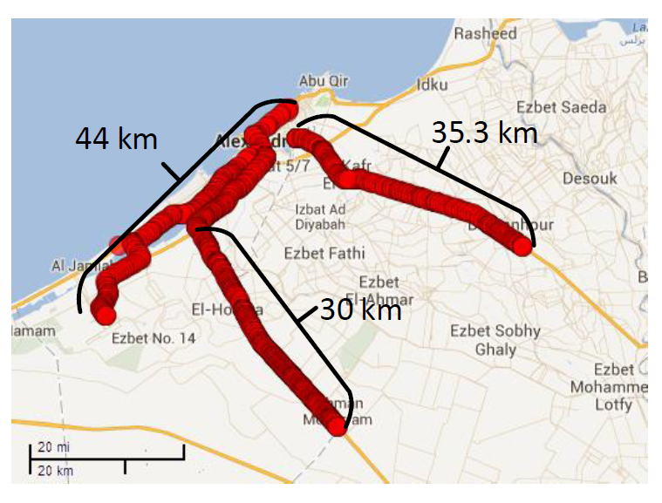
A Large Scale Urban Study Methodology – Area Covered
Survey across the governorate of Alexandria, Egypt covered an area of around 3000 km² with a driving path of 190 km
The driving paths pass through areas with large buildings, desert, farm lands, at the edge of water bodies, and also across areas of different population densities

Slide 13
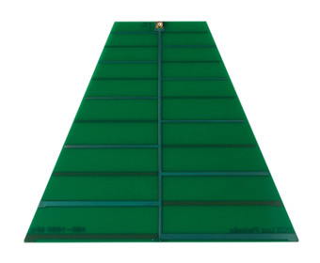
A Large Scale Urban Study Methodology - Setup
A USRP N210 with a WBX 50-2200 MHz Rx/Tx daughterboard and a log periodic LP0410 antenna connected to a Dell XPS-L502X laptop with a battery DC/AC power inverter as a power source.
Location determination through a Garmin GLO GLONASS and GPS sensor.

Slide 14
A Large Scale Urban Study Methodology – Data Collection
We scanned the available 4 UHF TV channels available in the covered area
Power readings were collected by centering the receiver's frequency at the middle of the luminance portion of the signal with a bandwidth of 250 KHz
Energy detection was used as means of detection a TV station’s presence
The threshold used (and applied to propagation models as well) is -80dBm not -84 dBm due to the high noise floor on the USRP receiver.

Slide 15
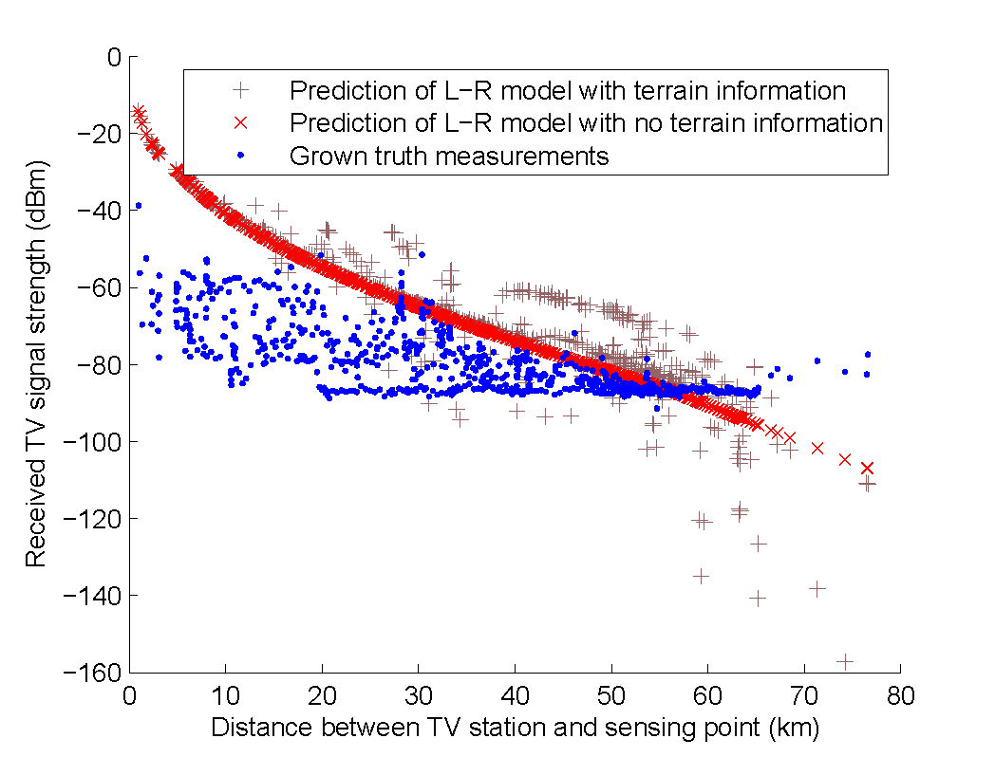
A Large Scale Urban Study Observations
We compare the collected readings with predictions of L-R model with and without terrain information
Observation 1: The propagation model overestimates the signal strength up to 97.5% of the collected readings
Observation 2: The measured RSS readings are correlated with predictions of the L-R model

Slide 16
Outline
Introduction
A Large Scale Urban Study
When to Use Spectrum Sensing?
SPOC: Signal Prediction & Observation Combiner
Conclusion and Future Work

Slide 17
When to Use Spectrum Sensing? Introduction
Crowdsourcing spectrum sensing at the -84 dBm threshold (the same threshold used to determine the protected area in a propagation model) can help amend the predictions of the propagation models
We need to ensure that a spectrum sensor is not in a hidden node problem or malfunctioning
Avoid the reason current regulations enforce the -114 dBm threshold
We define a set of conditions that a spectrum sensory reading must satisfy in order to be used to amend the predictions of propagation models

Slide 18
When to Use Spectrum Sensing?
Cases for Spectrum Sensory Readings
Area protected by spectrum sensing at -114 dBm
A spectrum sensory reading can be:
True negative: no TV reception can be made in its vicinity
Area protected by spectrum databases
False negative: malfunctioning nodes that can’t detect a nearby TV station
True coverage area
True positive: nodes that can detect a nearby TV station

Slide 19
When to Use Spectrum Sensing?
Cases for Spectrum Sensory Readings
A cluster of readings below the threshold near the border of the protected area of the TV station but has true positive reports in its vicinity
A cluster of readings that are measured by malfunctioning nodes
Two clusters of readings that are taken by nodes exhibiting a hidden node problem
False negative detection of TV signal
True positive detection of TV signal
True negative detection of TV signal

Slide 20
When to Use Spectrum Sensing ?
Conditions of Used Sensory Information (Cont’d)
Condition 1: Readings must be grouped into a co-located clusters with all readings contained in that clusters below the sensing threshold.
Ensures that we have only small clusters of readings all confirming the same decision
Ignores some noisy readings that give false negatives
False negative reading
False negative reading
True negative reading
True negative reading
True positive reading
True positive reading

Slide 21
When to Use Spectrum Sensing ?
Conditions of Used Sensory Information (Cont’d)
Condition 2: Readings belonging to the same cluster must have a positive correlation with the modeling of the signal propagation in the area covered by the cluster (Observation 2).
Detects some hidden node cases and the rest of noisy or malfunctioning clusters
False negative reading
False negative reading
False negative reading
True negative reading
True negative reading
True negative reading
True positive reading
True positive reading
True positive reading

Slide 22
When to Use Spectrum Sensing ? Conditions of Used Sensory Information (Cont’d)
Condition 3: Clusters must not be fully enclosed within the protected area of the TV station covering their area.
Detects the rest of hidden node problems by taking into account only the modeling mispredictions near the border of the protected area
False negative reading
False negative reading
False negative reading
True negative reading
True negative reading
True negative reading
True positive reading
True positive reading
True positive reading

Slide 23
Outline
Introduction
A Large Scale Urban Study
When to Use Spectrum Sensing ?
SPOC: Signal Prediction & Observation Combiner
Conclusion and Future Work

Slide 24
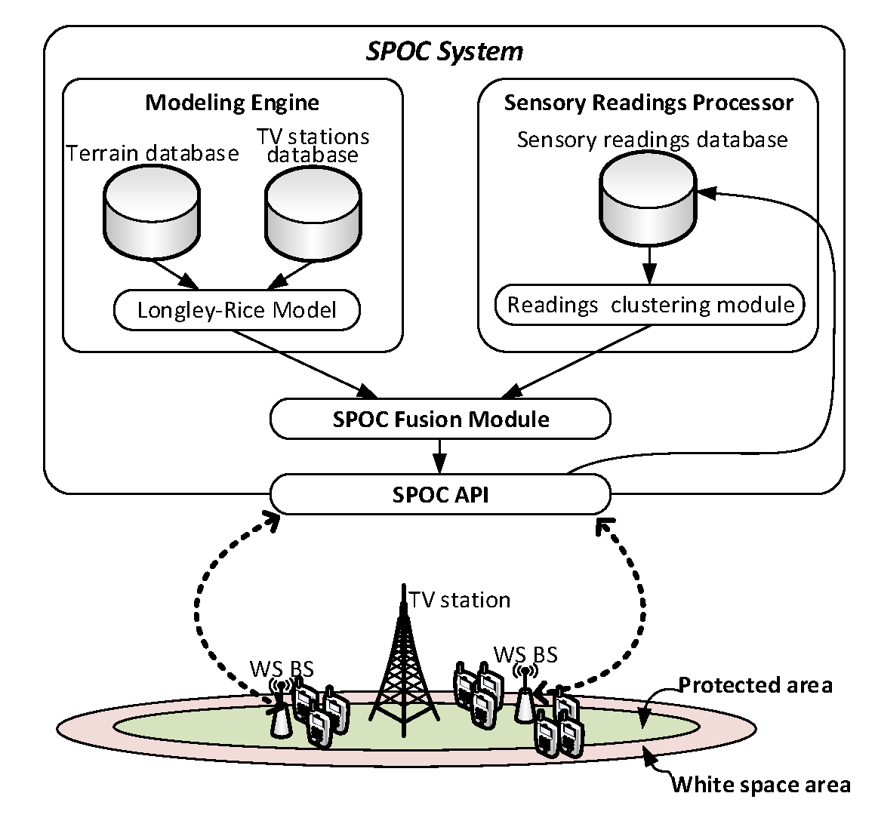
SPOC: Signal Prediction & Observation Combiner System Architecture
WSDs communicate with SPOC servers through White Space Base Stations
Base stations are connected to SPOC through the internet.
WSDs can query SPOC for white spaces availability or submit their raw spectrum sensory readings
no sensing threshold required
all readings can enhance the database decision by either supporting positive white space detection decisions or contradicting noisy decisions

Slide 25
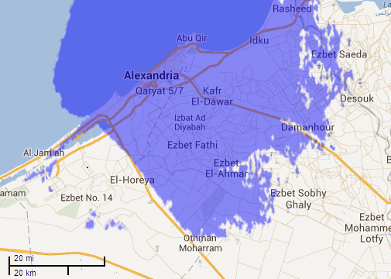
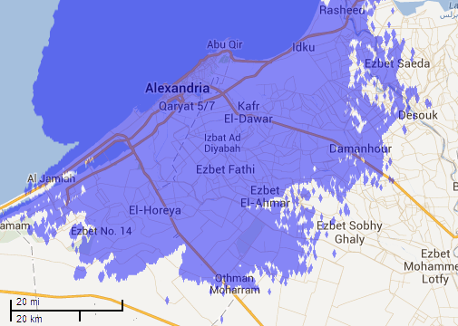
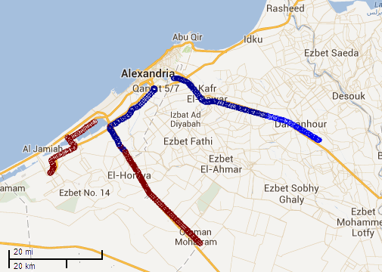
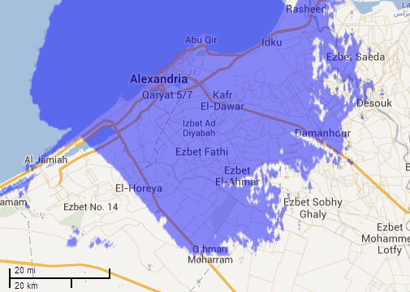
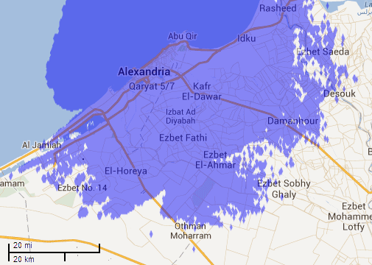
SPOC: Signal Prediction & Observation Combiner Illustration of SPOC Three Main Components
Modeling Engine output
Readings Clustering Output
Fusion Output
Clusters co-located readings that either consider white spaces available (brown and light blue) or not available (dark blue).
The fusion module groups the readings and modeling and produces a new coverage area
The coverage area of a TV tower operating at 567 MHz

Slide 26
SPOC: Signal Prediction & Observation Combiner System Architecture (Cont’d)
Readings Clustering Module:
Continuously collects readings from its WSDs clients and stores only readings below the threshold
Clusters co-located readings using DBSCAN (condition 1)
Checks correlation with propagation model (condition 2)
Defines the area covered by each cluster

Slide 27
SPOC: Signal Prediction & Observation Combiner System Architecture (Cont’d)
Readings Clustering Module (Cont’d):
Defines the area covered by each cluster that might be considered a white space available area
The shape of the deduced area relies on the minimum cluster size and whether the area is defined by
Convex hull of the clustered points
Alpha-shape (concave hull) of the clustered points

Slide 28

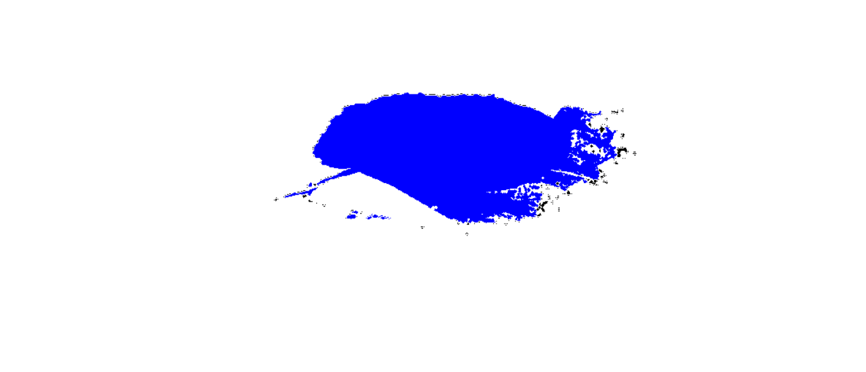

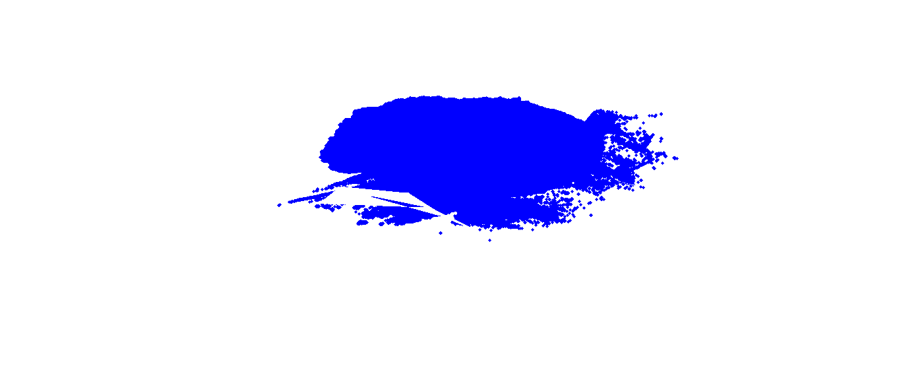
SPOC: Signal Prediction & Observation Combiner Preliminary Results
100 km
Red: eligible clusters that satisfy condition 3
Yellow: ineligible clusters that doesn’t satisfy condition 3
Detected using image processing approach
The estimated protected area is the main image, the clusters area are overlaid with color of the background
Edge detection on the resulting image defines the border of the actual protected area
130 km
Initial model prediction
Convex (Large Cluster Sizes)
Convex/concave (small cluster sizes)
Concave (Large Cluster Sizes)

Slide 29
Conclusion and Ongoing/Future Work
Spectrum sensing and geo-location databases both have inaccuracies
Even L-R model overestimates the signal power by up to 97.5%
Fusion of both conventional approaches can be used to enhance the overall white space detection decision and overcome their individual drawbacks
More fusion algorithms should be designed, implemented and evaluated to show the potential increase in white spaces in terms of
Increased white space area
The new approach's safety and efficiency

Slide 30
Questions?
Ahmed Saeed (ahmed.saeed@gatech.edu)

