Slide 1


A Low-Cost Large-Scale Framework for Cognitive Radio Routing Protocols Testing
Ahmed Saeed†, Mohamed Ibrahim†, Khaled A. Harras‡, Moustafa Youssef†
† Egypt-Japan University for Science and Technology (E-JUST), Egypt
‡Carnegie Mellon Qatar, Qatar

Slide 2
Outline
Introduction
Related Work and Problem Formulation
CogFrame Routing Framework
CogFrame Benchmark
Case Study: LAUNCH Protocol
Summary

Slide 3
Introduction
FCC ruling in 2008 enabling unlicensed usage of unused portions of the UHF spectrum motivated a boost in cognitive radio research.
Most of the evaluations made for new work in cognitive radio research is either through simulation or on small-scale testbeds in controlled environments
Simulations provide a tool for testing large-scale CRNs but can’t capture realistic environment conditions, especially given the dynamic nature of CRNs
Real small scale testbeds focus on the flexibility of designing and evaluating new PHY and MAC protocols/solutions

Slide 4
Introduction (Cont’d)
Testing routing protocols for CRNs requires a larger scale testbed
Enable the formation and testing of multi-hop paths between different pairs of nodes
Hides the PHY/MAC implementations while providing a small subset of the PHY/MAC parameters for cross layering

Slide 5
Outline
Introduction
Related Work and Problem Formulation
Hardware-based testbeds
Software-based testbeds
Problem Formulation
CogFrame Routing Framework
CogFrame Benchmark
Case Study: LAUNCH Protocol
Summary

Slide 6
Hardware-based testbeds
Large scale testbeds like Orbit and Emulab offer both PHY and MAC layers prototyping by using GNU Radio over USRPs connected to general purpose hosts
SORA architecture presents a new software and hardware stack that addresses increasing the processing power dedicated to PHY and MAC operations
BEE2 FPGA is used as an emulation board to connect RF-frontends representing primary users and secondary users.
Issues:
Prohibitive monetary cost of a large-scale testbed
Require the development and maintenance of the whole protocol stack

Slide 7
Software-based testbeds
Hydra is a flexible wireless network testbed for the development of MAC and PHY protocols using Click Router for MAC and GNU Radio for PHY using USRPs as RF-frontend
Iris Radio Architecture provides a reconfiguration framework for the development of a cognitive radio MAC and PHY layers, enabling seamlessly changing of protocol modules based on observations in the traffic
Issues:
Require building the whole stack and configuring it
Require special RF-frontends to support software defined radio libraries

Slide 8
Problem Formulation
Design of a framework that enables low-cost large-scale testing of cognitive radio routing protocols
Goals:
Flexible Cross-Layer Interaction Spectrum sensing and spectrum management capabilities
Complex Scenario Implementation and Emulation Complex PU and SU scenarios (i.e. mobility, realistic channel conditions, etc)
Low Code Development Overhead The developer of the routing protocol should not be involved in coding the MAC and PHY layer
Low Cost Large Realistic Experiments Large scale testbed with this special purpose hardware could be prohibitive

Slide 9
Outline
Introduction
Related Work and Problem Formulation
CogFrame Routing Framework
CogFrame Benchmark
Case Study: LAUNCH Protocol
Summary

Slide 10
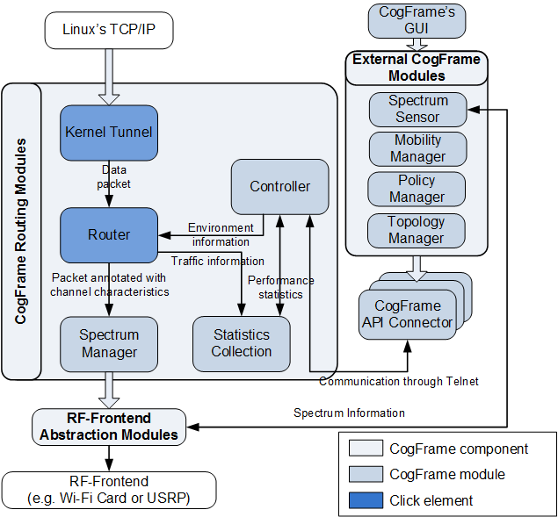
CogFrame Routing Framework
Built on top of Click software router architecture
Enabling the deployment of the framework on any hardware
Support of cognitive radio operations on Wi-Fi cards (e.g. channel selection and sensing)

Slide 11
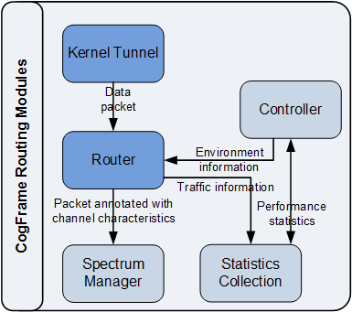
CogFrame Routing Framework Routing Modules
Routing protocol designers using CogFrame will still write Click elements for their protocol
CogFrame abstracts the MAC and PHY layers and allow the interaction between them and the routing protocol
Spectrum Manager Configures the Wi-Fi interface to work on the specified channel and the specified power
Controller Handles feature of the Click router to enable other programs interface with the router
Statistics Collector Collects information on spectrum utilization and traffic patterns

Slide 12
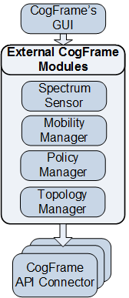
CogFrame Routing Framework External Modules
Not part of the Click router but are responsible for providing functionalities that are required by a CRN testbed
Spectrum Sensor Provides information about the state of the spectrum sensed by the Wi-Fi card
Mobility Manager Responsible for informing the router about current node position
Policy Manager Provides the router with the operation constraints to ensure compliance to the regularity rules
Topology Manager Responsible for enforcing certain network topologies on the participating nodes by emulating different channel qualities on individual links to neighboring nodes
GUI Eases the configuration of different external components as well as monitoring the status of the framework

Slide 13
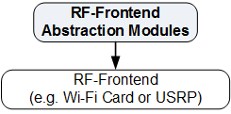
CogFrame Routing Framework External Modules
This module is responsible for abstracting the functionality of the PHY and MAC layers
Provides an API to handle the spectrum management and spectrum sensing functionalities
CogFrame natively supports WiFi cards by using ioctl commands to control the WiFi card
Allows a modular extension to CogFrame to support other hardware, such as USRP and WARP boards.

Slide 14
Outline
Introduction
Related Work and Problem Formulation
CogFrame Routing Framework
CogFrame Benchmark
Case Study: LAUNCH Protocol
Summary

Slide 15
CogFrame Benchmark
CogFrame implemented on two Lenovo G570 laptops with Atheros AR9285 802.11abgn
Switching time The figure shows that the median switching time is 52.9ms which conforms to typical WiFi channel switching times

Slide 16
CogFrame Benchmark
CogFrame implemented on two Lenovo G570 laptops with Atheros AR9285 802.11abgn
Maximum Throughput The maximum achievable throughput on each channel and the loss in data rate can be due to the collision with existing APs on the same channels

Slide 17
CogFrame Benchmark Comparison with Other Evaluation Methods
Framework | Max. Throughput (Mbps) | Switch. Time (ms) | Cost ($) | Development overhead
USRP N200 | 56 | 5 | Machines cost + 1500 per node | High
ns-2 | User Defined | User Defined | One machine | Low
CogFrame | 56 | 52.9 | Machines cost | Low

Slide 18
Outline
Introduction
Related Work and Problem Formulation
CogFrame Routing Framework
CogFrame Benchmark
Case Study: LAUNCH Protocol
Summary

Slide 19
Case Study: LAUNCH Protocol
Compare the performance of a recently proposed location-aided routing protocol (LAUNCH) for using both ns-2 simulations and CogFrame
Highlight the differences between the two evaluation methods and argue for the practicality of CogFrame
Only two implement modules implemented to realize LAUNCH

Slide 20
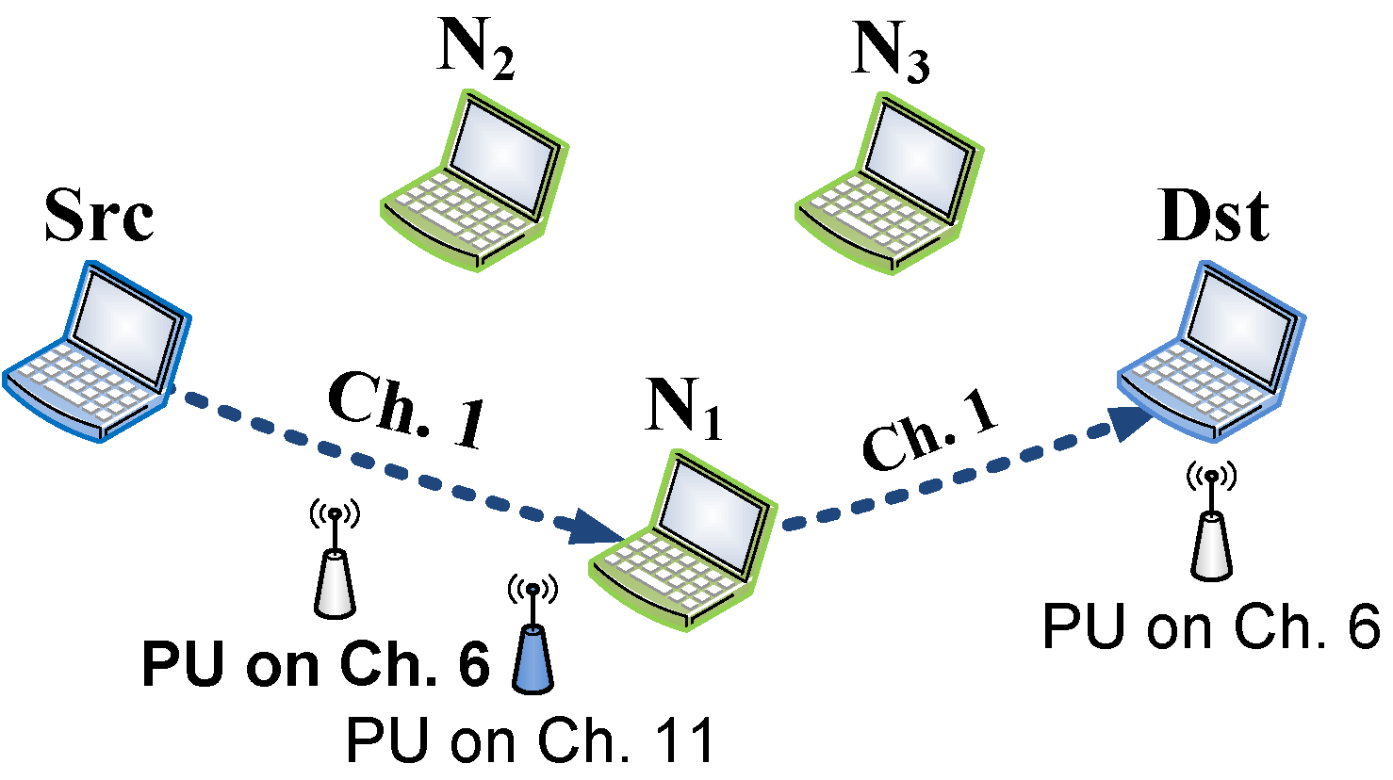
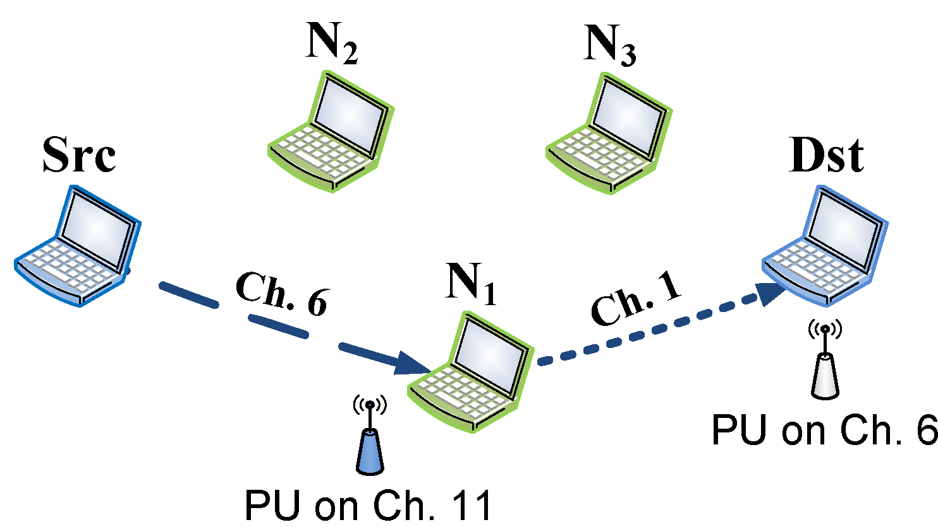
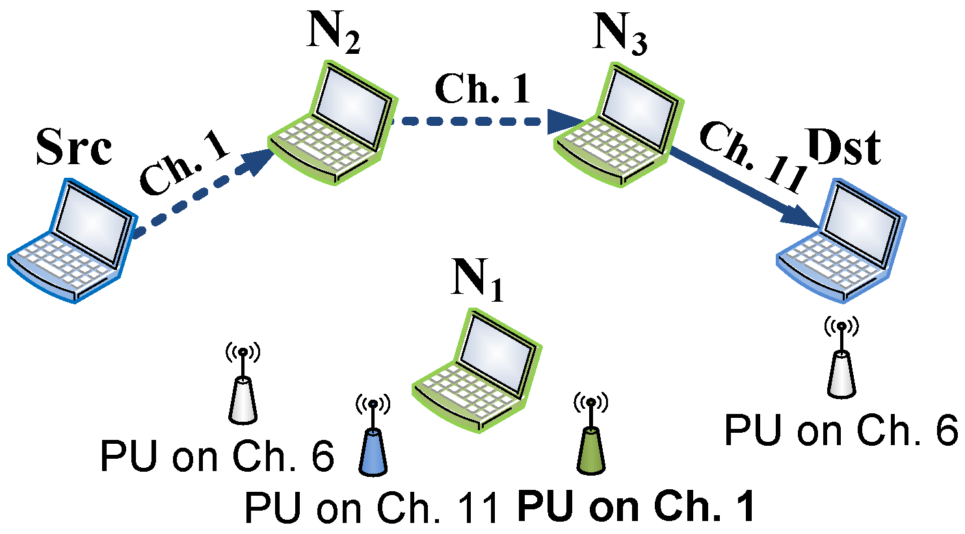
Case Study: LAUNCH Protocol Scenario
The scenario includes changing behavior of different PUs leading to changing the channel
The source selects the node closest to the destination N1 as a next hop on Channel 6. N2 in turn selects Channel 1 to communicate with the destination.
At time 280s a PU appears on Channel 6 at N1. Channel between source and N1 is changed to Channel 1.
At time 420s another PU appears on Channel 1 at N. The source is forced to choose a new route to the destination through N2 then N3.

Slide 21
Case Study: LAUNCH Protocol Performance Comparison
Simulations results have almost no loss ratio and minimal delay
CogFrame results show the effect of real channel conditions and dynamics lead to frequent delays and losses
These results highlight that simulation can be far from reality and that CogFrame can be used to efficiency and quickly implement CRNs routing protocol

Slide 22
Summary
CogFrame as a new configurable, cost efficient, flexible framework for the rapid development of CRNs routing protocols
CogFrame allows the protocol designer to focus on the design issues for the routing protocol by abstracting the MAC and PHY layers
CogFrame leverages the functionalities of standard computers and Wi-Fi cards, saving the cost of special purpose RF-frontends while giving the flexibility for supporting other RF-frontend
A benchmark of the performance of CogFrame showed it advantages over traditional ns-2 simulations boards
Future Work:
Enhancing the GUI to facilitate developing the protocol with a drag-and-drop user interface,
providing an interface to allow the interaction between ns-2 simulations and CogFrame,
and extending the framework to support transport layer protocols for CRNs

