Slide 1

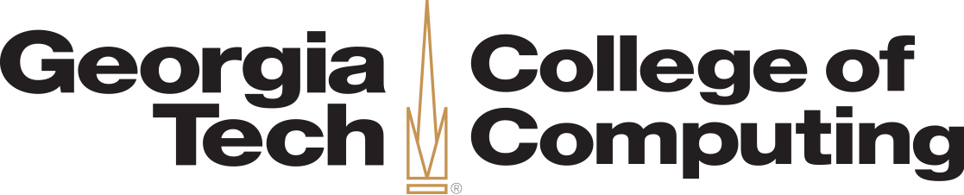
Vision: The Case for Symbiosis in the Internet of Things
Ahmed Saeed*, Mostafa Ammar*, Khaled A. Harras†, and Ellen Zegura* *Georgia Institute of Technology
†Carnegie Mellon University Qatar

Slide 2
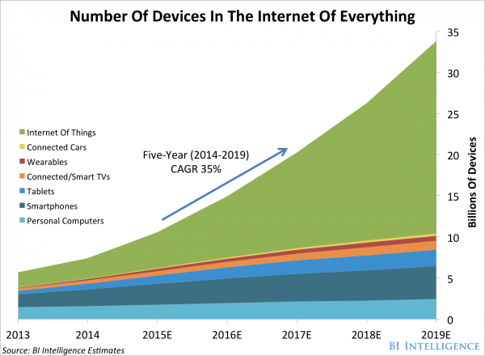
“13.5 million health and fitness trackers were sold globally last year” – GfK’s trends data
“Industrial Internet” has the potential to add $10 to $15 trillion to global GDP over the next 20 years” — GE
“By equipping street lights with sensors and connecting them to the network, cities can dim lights to save energy, only bringing them to full capacity when the sensors detect motion. This can reduce energy costs by 70-80%.” — John Chambers, Cisco

Slide 3
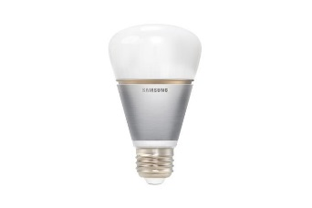
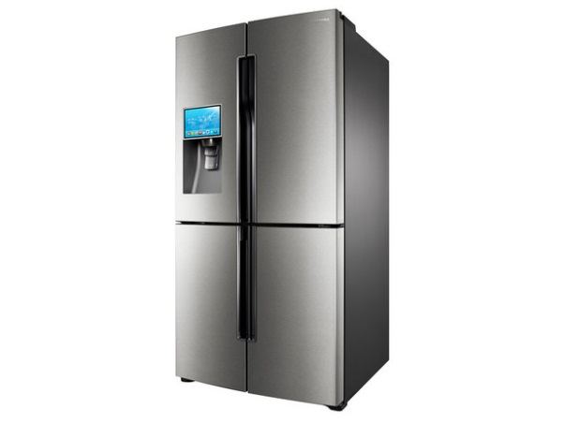
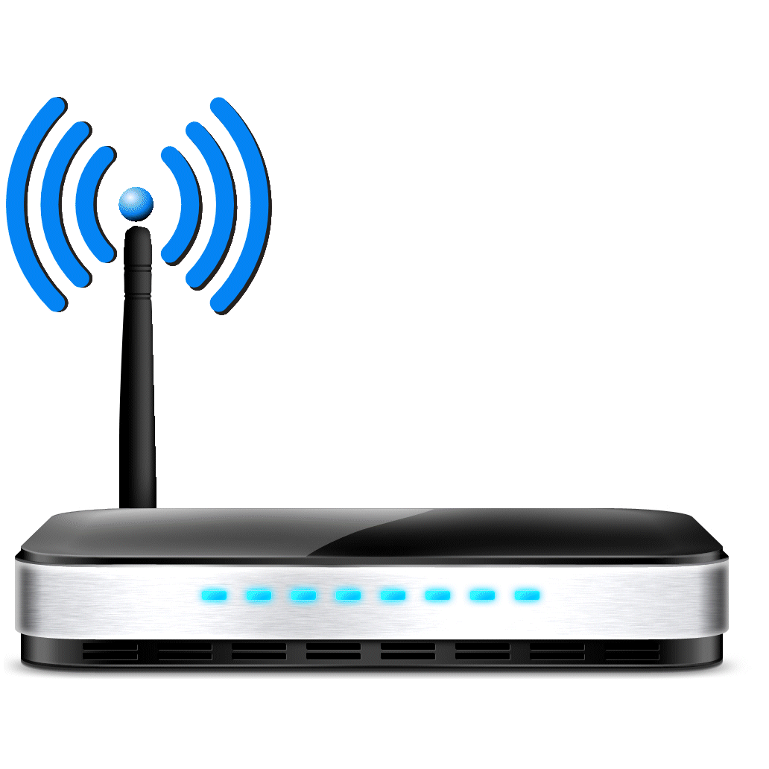
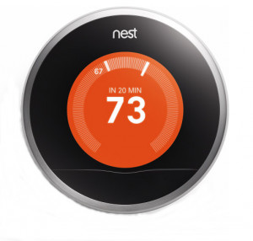
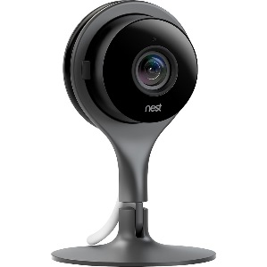
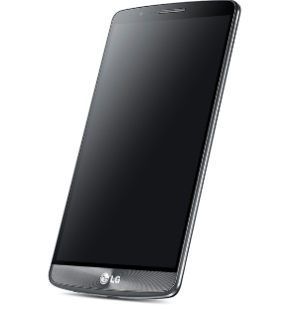

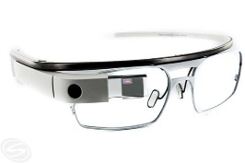
IoT in a Home Network
Cloud Analysis, Control, and Storage
Cloud and Mobile Devices Play a central role in data processing and storage

Slide 4
IoT in a Home Network
Plugged devices doing very little processing
Cloud Analysis, Control, and Storage

Slide 5
IoT in a Home Network
Cloud Analysis, Control, and Storage
Devices generating very fine-grain, private, data

Slide 6
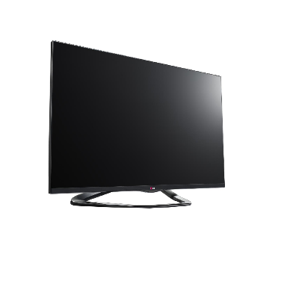
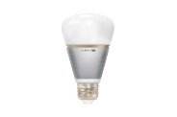


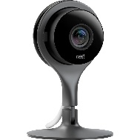
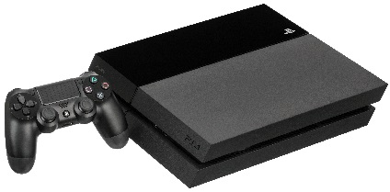
IoT in a Home Network
Fine-grain private information stored and analyzed in the cloud
Cloud Analysis, Control, and Storage
Congested and High Latency WAN
Wasted Processing Resources

Slide 7
The Complete Home Network
“Within three years, 50% of IT networks will transition from having excess capacity to handle the additional IoT devices to being network constrained with nearly 10% of sites being overwhelmed.” – IDC Bandwidth
Cloud Analysis, Control, and Storage
Using commercial cloud services is unsatisfactory because RTTs are too high. This situation is unlikely to change due to the focus on improving bandwidth rather than end-to-end latency. – Satyanarayanant et. al Latency
“39% [of Americans] say they are “very concerned” or “somewhat concerned” about government monitoring of their activity on search engines.” – PEW Research Privacy

Slide 8
Symbiosis in the Internet of Things
Cloud 1. Storage of Summaries 2. Long Term Analysis
Devices can cooperate to match the services provided by the cloud

Slide 9
Outline
Motivation
SymbIoT Design Goals
SymbIoT Strawman Architecture
Feasibility Study
Conclusion

Slide 10
SymbIoT Design Goals
Cloud
Reducing Internet bandwidth consumption
Matching and improving on cloud’s performance
Improving resources utilization with the same LAN
Two examples of flows that will be much less congested

Slide 11
Outline
Motivation
SymbIoT Design Goals
SymbIoT Strawman Architecture
Feasibility Study
Conclusion

Slide 12
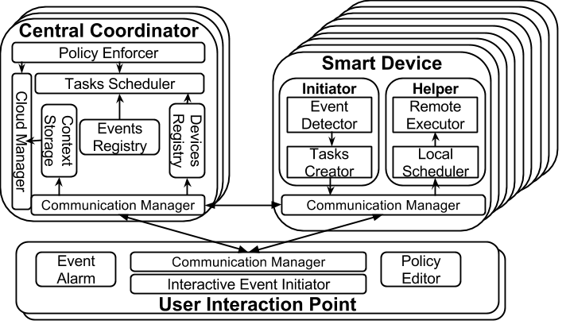
SymbIoT Strawman Architecture

Slide 13

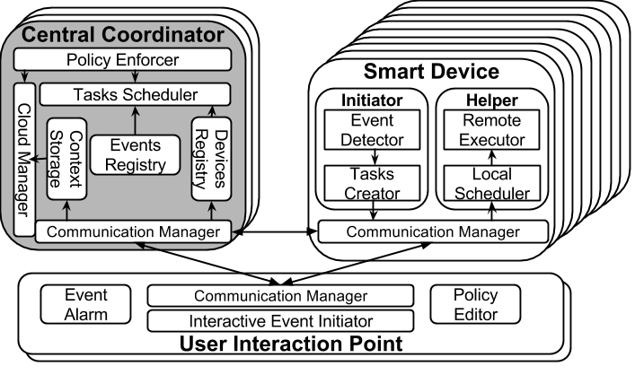
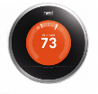


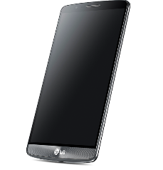
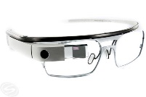
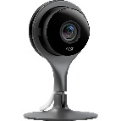
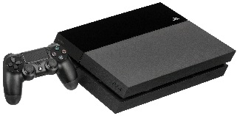
SymbIoT Strawman Architecture

Slide 14
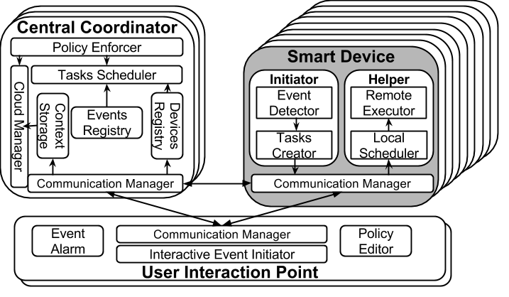
SymbIoT Strawman Architecture

Slide 15
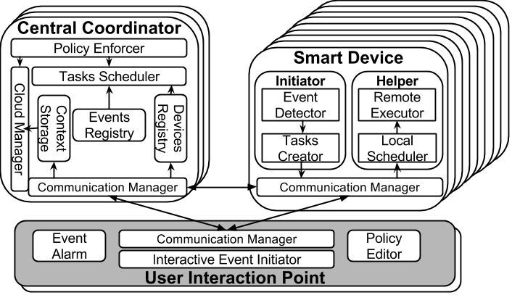
SymbIoT Strawman Architecture

Slide 16
Outline
Motivation
SymbIoT Design Goals
SymbIoT Strawman Architecture
Feasibility Study
Conclusion

Slide 17
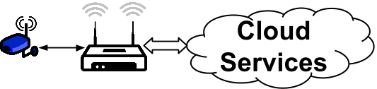
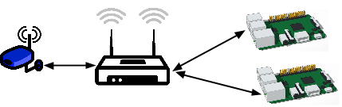
Feasibility Study: Setup
To obtain our results we compare a sample video tagging service running on
A Laptop representing a cloud service
Two Raspberry Pies representing two lower end processing nodes in SymbIoT

Slide 18
Feasibility Study: Results
Video Processor | RTT | Processing Time Per Frame | Latency Per Frame | Internet Bandwidth used | Service Cost
Cloud (Minimal latency) | 30 ms | 17 ms | 46 ms | 69.1 Mbps | $9.95 – $29.95 per month
Cloud (Maximal latency) | 220 ms |  | 198 ms | 13.9 Mbps
SymbIoT | < 1 ms | 553 ms | 542 ms | 0 Mbps | Free
Cloud can be matched for a latency tolerant application using only 20 Raspberry Pies
For more latency sensitive applications more powerful devices in the LAN can be assigned the task based on the chosen policy

Slide 19
Conclusion
Current architecture of IoT deployment:
Unnecessarily overloads WANs
Introduces high latency
Jeopardizes user privacy
Underutilizes processing power already available in the network
SymbIoT is a new architecture that enables the utilization of any underutilized nodes in the network to lessen the burden on WANs
Preserves privacy by minimizing, and controlling, data traveling outside the networks
Has the potential to match the performance of modern clouds at a much lower cost

