Slide 1
GRADUATE COURSE • MS / PhD
NATURAL LANGUAGE
PROCESSING
Course Overview & Introduction
From linguistic structure to large language models
MS and PhD level

Slide 2
Can a machine understand language?
OPENING QUESTION
“I saw the man with the telescope.”
Interpretation A
Interpretation B
The NLP challenge
I used a telescope to see the man.
The man had a telescope.
Words are visible. Meaning, context and intent are not.
How can computational systems represent, infer and generate meaning?
NLP | GRADUATE COURSE OVERVIEW
02

Slide 3
Can a machine understand language?
OPENING QUESTION
“'I went to the bank.'.”
How can computational systems represent, infer and generate meaning?
NLP | GRADUATE COURSE OVERVIEW
02
Notes:
Without additional context, a computer may not know the intended meaning.
This tells us something fundamental about NLP: processing words is not the same as understanding language.
An effective NLP system must learn patterns, relationships, context and, in many cases, knowledge about the world."

Slide 4
What is Natural Language Processing?
FOUNDATIONS
NLP is a subfield of Artificial Intelligence that focuses on developing computational methods to analyze, understand, interpret, and generate human language.
Analyze
Understand
Generate
Identify patterns, entities, sentiment, topics and linguistic structure.
Infer relationships, intent, context, meaning and relevant evidence.
Produce summaries, translations, answers and conversational responses.
NLP connects computer science, linguistics, statistics, machine learning and cognitive science.
NLP | GRADUATE COURSE OVERVIEW
03

Slide 5
Where do we encounter NLP?
APPLICATIONS
Search & retrieval
Sentiment analysis
Machine translation
Question answering
Find relevant information
Estimate opinions and emotion
Transfer meaning across languages
Respond using text or evidence
Summarization
Dialogue systems
Information extraction
Writing assistance
Compress information faithfully
Support conversation
Identify entities and relations
Draft, revise and transform text
Graduate-level lens: what can a system do, why does it work, when does it fail, and how do we know?
NLP | GRADUATE COURSE OVERVIEW
04

Slide 6
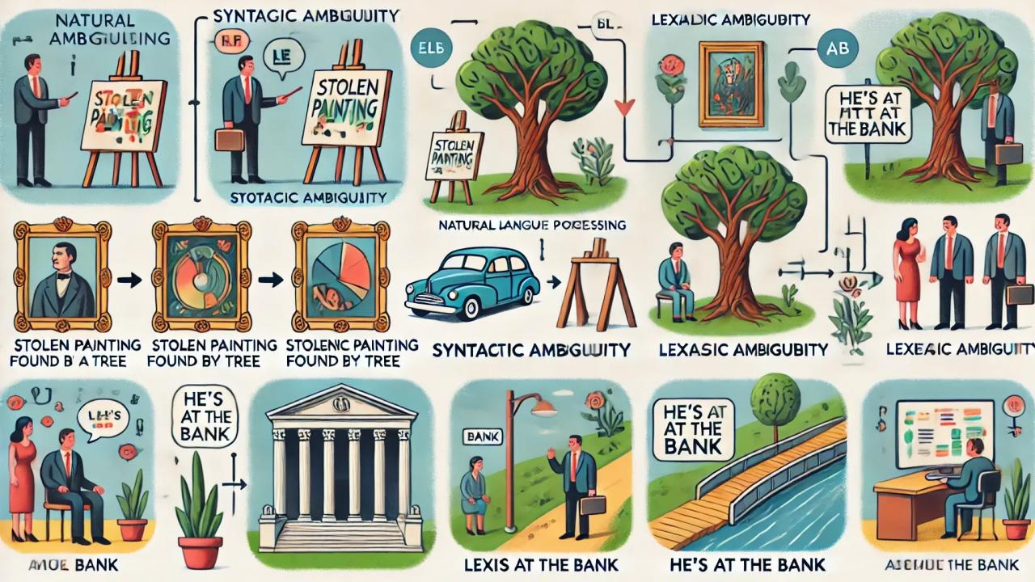
Why is human language difficult for machines?
CORE CHALLENGES
Ambiguity
Context
Variation
“bank” may mean a financial institution or river edge.
“Brilliant” may be praise or sarcasm.
Dialects, spelling, slang and code-switching.
Structure
World knowledge
Data & fairness
Word order and long-distance dependencies matter.
Meaning may require facts beyond the sentence.
Training data can be incomplete or biased.
The same sentence can be grammatical, meaningful, misleading or harmful depending on context.
NLP | GRADUATE COURSE OVERVIEW
05

Slide 7
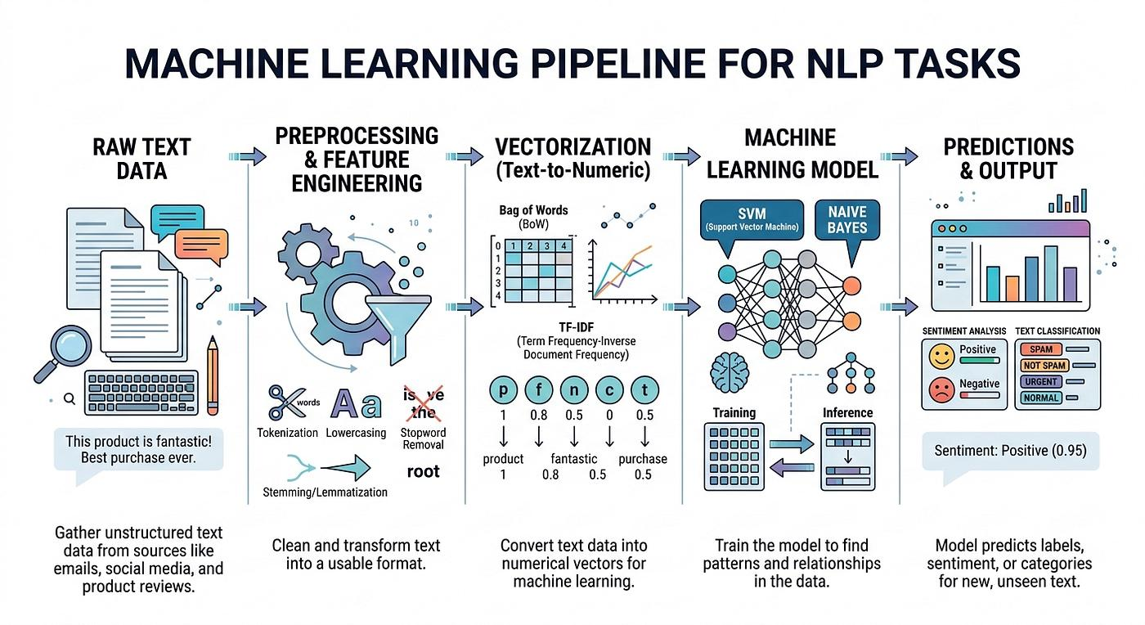
A simplified NLP workflow
FROM TEXT TO TASK
Raw text
Pre-processing
Representation
Model
Output
Evaluation
“The film was not good.”
Tokenize, normalize
Features, embeddings
Classifier or Transformer
Negative sentiment
F1, accuracy, errors
Conceptual pipeline only: end-to-end neural models may learn several stages jointly.
NLP | GRADUATE COURSE OVERVIEW
06

Slide 8
How NLP approaches have evolved
A CHANGING TOOLKIT
Rule-based & symbolic
Statistical & feature-based
Neural & foundation models
• Hand-crafted rules
• Grammars and lexicons
• Explicit linguistic structure
Strength: interpretable structure
Limitation: costly to scale
• Probabilistic models
• n-grams and feature engineering
• Linear classifiers and HMMs
Strength: measurable and efficient
Limitation: feature dependence
• Distributed representations
• RNNs, CNNs, Transformers
• Pre-training and prompting
Strength: learned representations
Limitation: data, compute, opacity
These paradigms coexist. Modern research combines linguistic insight, statistical rigor and neural models.
NLP | GRADUATE COURSE OVERVIEW
07

Slide 9
What should you gain from this course?
GRADUATE LEARNING GOALS
Model literacy
Mathematical foundations
Explain major NLP model families and assumptions.
Understand objectives, optimization and inference.
Research reading
Practical judgment
Critique methods, datasets, baselines and claims.
Select representations, models and evaluation strategies.
Critical evaluation
Research direction
Diagnose errors, bias, factuality and limitations.
Identify open problems for MS/PhD investigation.
PhD emphasis: move beyond reproducing results to questioning assumptions and designing stronger experiments.
NLP | GRADUATE COURSE OVERVIEW
08

Slide 10
Course roadmap at a glance
14-WEEK STRUCTURE
01
Linear classification
02
Neural classification
03
Word embeddings
Perceptron, logistic regression, sentiment
Multiclass learning, MLPs, optimization
Word2Vec, GloVe, subword and bias
04
Language modeling
05
Transformers
06
Pre-training
n-grams, RNNs, attention
Self-attention, decoding, efficient variants
BERT, BART, T5, tokenization
07–08
Structured prediction
09
Large language models
10
Explanations
POS, HMMs, constituency/dependency parsing
Prompting, ICL, instruction tuning, RLHF
Interpretability, probing, reasoning
11
QA & dialogue
12
MT & summarization
13–14
Multilingual & ethics
Reading comprehension, retrieval, chatbots
Translation, alignment, factuality
Cross-lingual NLP, grounding, responsible AI
Progression: classification → representations → language structure → foundation models → responsible NLP.
NLP | GRADUATE COURSE OVERVIEW
09

Slide 11
Weeks 1–2 | Learning to classify language
COURSE FOUNDATIONS
Binary classification
Multiclass learning
Neural classification
Perceptron, logistic regression, loss functions and gradient descent.
Multiclass perceptron and softmax regression.
Feedforward networks, backpropagation, dropout, batch normalization and Adam.
Illustrative task: sentiment analysis
Research questions
Input: “The plot was engaging, but the ending felt rushed.”
Output: positive / mixed / negative, depending on label design.
• Which features capture sentiment?
• How do imbalance and fairness affect results?
• What makes a baseline strong?
NLP | GRADUATE COURSE OVERVIEW
10

Slide 12
Week 3 | From words to vectors
REPRESENTATIONS
A word embedding maps a discrete token to a dense numerical vector.
king
queen
man
woman
[0.75, 0.25, 0.55]
[0.70, 0.65, 0.52]
[0.35, 0.20, 0.25]
[0.32, 0.60, 0.24]
Methods
Key idea
Critical issue
Skip-gram, GloVe, subword embeddings
Distributional context shapes representation
Embeddings can encode social bias
NLP | GRADUATE COURSE OVERVIEW
11

Slide 13
Week 4 | Language modeling and attention
SEQUENCE PREDICTION
A language model assigns probabilities to sequences and predicts likely continuations.
Natural
language
models
learn
patterns
n-gram models
Neural sequence models
Attention
Estimate next-token probability from a limited preceding context.
RNNs and LSTMs learn sequential representations, with limitations.
Weight relevant context dynamically; self-attention connects tokens.
Key concepts: smoothing • perplexity • context window • recurrence • attention
NLP | GRADUATE COURSE OVERVIEW
12

Slide 14
Week 5 | Transformers: the architecture shift
ATTENTION AT SCALE
Tokens
Embeddings + position
Self-attention
Feed-forward blocks
Output head
Input sequence
Meaning + order
Context mixing
Nonlinear transformation
Task / next token
Core building blocks
Research lens
• Scaled dot-product and multi-head attention
• Positional information
• Encoder, decoder and encoder–decoder designs
• Greedy, beam search and nucleus sampling
Efficiency, long-context behavior, scaling and generation quality.
NLP | GRADUATE COURSE OVERVIEW
13

Slide 15
Week 6 | Pre-training and text-to-text models
TRANSFER LEARNING
BERT
BART
T5
Bidirectional encoder; masked language modeling; fine-tuning.
Denoising sequence-to-sequence pre-training for generation and comprehension.
A unified text-to-text framework for many NLP tasks.
Tokenization matters
Evaluation & transfer
WordPiece and Byte Pair Encoding represent text as subword units, helping models handle rare and unseen words.
Benchmarks such as GLUE assess multiple capabilities. Fine-tuning and transfer choices influence performance.
NLP | GRADUATE COURSE OVERVIEW
14

Slide 16
Weeks 7–8 | Structured prediction
LANGUAGE STRUCTURE
Some NLP tasks predict a structured output, not one label for an entire sentence.
The
student
reads
papers
DET
NOUN
VERB
NOUN
Sequence labeling
Constituency parsing
Dependency parsing
POS tagging, HMMs, Viterbi decoding
Grammar rules, PCFGs and CKY parsing
Head-dependent relations between words
NLP | GRADUATE COURSE OVERVIEW
15

Slide 17
Week 9 | Modern large language models
FOUNDATION MODELS
LLMs learn broad language patterns from large-scale text and can be adapted through prompting, tuning and alignment.
Pre-training
Prompting / ICL
Instruction tuning
Preference alignment
Learn general patterns
Instructions and examples
Train to follow tasks
Human feedback / preferences
Critical questions
• What does few-shot performance measure?
• How factual and robust are generated answers?
• What data, compute and evaluation are missing?
NLP | GRADUATE COURSE OVERVIEW
16

Slide 18
Week 10 | Explanations and model analysis
TRUST, BUT VERIFY
Local explanations
Probing & analysis
Reasoning traces
Which input features influenced this prediction?
What linguistic information is encoded in representations?
Do generated explanations faithfully reflect model computation?
A useful distinction
An explanation that sounds convincing is not automatically a faithful explanation of how a model reached its output.
Themes: interpretability, feature attribution, probing, annotation artifacts and chain-of-thought analysis.
NLP | GRADUATE COURSE OVERVIEW
17

Slide 19
Week 11 | Question answering and dialogue
LANGUAGE IN INTERACTION
Reading comprehension
Open-domain QA
Dialogue systems
Answer questions using a supplied passage; test robustness and adversarial examples.
Retrieve evidence from a large corpus or web; connect retrieval with generation.
Task-oriented and open-domain conversation; context and response quality.
Retrieval-augmented generation (RAG), simplified
Question
Retrieve
Evidence
Generate
Answer
Retrieval can improve grounding, but it does not guarantee that the final answer is correct.
NLP | GRADUATE COURSE OVERVIEW
18

Slide 20
Week 12 | Machine translation and summarization
GENERATION TASKS
Machine translation
Text summarization
From word alignment and phrase-based systems to neural and pre-trained translation.
Evaluation: adequacy, fluency and automatic metrics.
Extractive selection and abstractive generation.
Evaluation: coverage, coherence, relevance and factual consistency.
A compact example
Source: “The committee met for three hours and approved the revised policy after extensive discussion.”
Summary: “The committee approved the revised policy after a lengthy meeting.”
Research challenge: concise output must preserve meaning without adding unsupported claims.
NLP | GRADUATE COURSE OVERVIEW
19

Slide 21
Weeks 13–14 | Multilinguality, grounding and ethics
RESPONSIBLE NLP
Multilingual NLP
Language grounding
Ethics & accountability
Cross-lingual transfer, multilingual embeddings, morphology and low-resource languages.
Meaning, world knowledge, vision-language links and limits of text-only learning.
Bias, exclusion, toxicity, documentation, auditing and societal impact.
Questions to carry into research
• Whose language varieties are represented?
• Who benefits, and who may be harmed?
• Can the system be audited and challenged?
• What evidence supports claims of understanding?
NLP | GRADUATE COURSE OVERVIEW
20

Slide 22
How to study NLP at MS and PhD level
RESEARCH PRACTICE
Read actively
Reproduce carefully
Question the evidence
Identify the problem, assumptions, method, data, baselines and limitations.
Track preprocessing, splits, hyperparameters, seeds and evaluation.
Run ablations, inspect errors, test generalization and report uncertainty.
A practical paper-reading checklist
• What exact task is being solved?
• What is the strongest relevant baseline?
• Could leakage or annotation artifacts explain the result?
• Which examples fail, and why?
• Can results generalize beyond the benchmark?
NLP | GRADUATE COURSE OVERVIEW
21

Slide 23
LET'S DISCUSS
What should an NLP system
be able to understand?
Choose a language technology you use. What does it do well, where does it fail, and what evidence would convince you that it works?
Suggested starting point
Jacob Eisenstein, Introduction to Natural Language Processing
Plus the seminal papers listed throughout the course roadmap.
NATURAL LANGUAGE PROCESSING • MS / PhD

