Slide 1
ARAB YOUTH SPACE HACKATHON 2026 · 813 CHALLENGE · PROOF OF CONCEPT
BenthosAI
Seabed depth and water clarity from space
Theme: Water Quality & Inland/Coastal Water Intelligence
Abu Dhabi Maritime Academy · AD Ports Group
Team BenthosAI: Dr Muhammad Saeed (lead), Akram Habib, Meera Alqubaisi, Mansour Alketbi, Mayed Abdulla

Slide 2
1 THE PROBLEM
Ships are most at risk where the water is least surveyed
1
Hardest water to survey
Shallow coastal water is costly and unsafe for survey boats, and its seabed shifts after storms and dredging.
Who is affected
Port authorities and harbour masters: safe depth in channels and berths
Hydrographic offices: which chart areas to re-survey first
Dredging contractors: siltation between surveys
Environment agencies: water clarity over seagrass and coral
2
Out-of-date charts
Many coastal charts are decades old; channels silt up between surveys.
3
Turbidity goes unmeasured
Turbid water hides habitats and hazards, and nobody maps it routinely.

Slide 3
2 BUSINESS USE CASE
A fast, honest first look before sending a boat
1
2
3
End user
Decision
Today
Port hydrographer or coastal manager planning surveys and monitoring change
Where to survey first · has the channel silted · is the water clear · where can the map be trusted
Vessel surveys: accurate, but days to weeks and costly per area; charts updated rarely
What BenthosAI delivers
A dated depth map with a 95 % uncertainty for every pixel and an IHO S-44 grade, showing where a vessel survey is still needed
A turbidity (water-clarity) map from the same images: water-quality monitoring at no extra cost
Free data, minutes on a laptop, repeatable every ~5 days

Slide 4
3 DATA
Only free, public satellite data in the proof of concept
Dataset | What it gives | Used here
Sentinel-2 L2A (ESA Copernicus) | Multispectral images, 10 m, every ~5 days | 3 dates, Aug–Sep 2022, tile T39QXG (Microsoft Planetary Computer)
ICESat-2 ATL24 (NASA) | Green-laser seabed depths along tracks | 7 passes 2019–2023 on 3 tracks: calibration and independent test
EOT20 tide model (DGFI-TUM) | Global ocean tides | Laser depths reduced to LAT (chart datum)
Hyperspectral (EnMAP / PRISMA) | Hundreds of narrow bands | Not used in the PoC; next step for seabed type, chlorophyll and sediment
Confidential training data stay private. Our production model is also trained on ≈240,000 AD Ports Group multibeam soundings. These soundings and the trained weights are not in the repository; everything a reviewer runs uses public data.

Slide 5
4 HOW IT WORKS
From image to depth, uncertainty and turbidity
1
2
3
4
5
6
Clean
Water quality
Features
Calibrate
Fuse + U95
Test
Reflectance, clouds (SCL), water mask (NDWI + SWIR), sun-glint removal
NDTI turbidity, red-edge sediment signal, “seabed visible?” test
Stumpf log-ratio and Lyzenga log-bands
On ICESat-2 depths, one fit per image date
3 dates weighted; conformal 95 % interval per depth band
Unseen laser tracks; RMSE, bias, IHO S-44
Leak-free testing
Honest outputs
ICESat-2 repeats the same ground track, so we split by track and swap roles (2 folds): 1218 ↔ 0006 + 0448
A 100 m buffer removes neighbouring pixels, so no information leaks
Every pixel carries depth, ±U95 and a flag: valid · turbid · optically deep · land/cloud
Unreadable water is flagged, not guessed

Slide 6
5 THE MODEL
Physics-based features and gradient boosting
Inputs: 7 features per pixel
Learner: gradient-boosted trees
Calibration, fusion, uncertainty
pSDB: Stumpf ln(1000·R_blue) / ln(1000·R_green)
X_B01…X_B04: Lyzenga ln(R_i − R∞,i), deep-water signal removed
B05 turbidity: red-edge sediment signal
NDTI: (red − green)/(red + green)
No coordinates, so the model reads water colour instead of memorising a place
scikit-learn HistGradientBoostingRegressor
300 trees · learning rate 0.05 · ≤ 15 leaves · ≥ 10 pixels per leaf · L2 1.0 · seed 42
Depth-balanced weights (0–2, 2–5, > 5 m; capped ×5), so deeper water is not swamped by shallows
Target: ICESat-2 ATL24 depth below LAT (≥ 3 photons, confidence ≥ 0.6, spread ≤ 0.5 m)
One fit per image date absorbs that day's tide, haze and water colour
3 dates fused, weighted by out-of-sample error (leave one beam pair out)
U95 = q_band·(σ + γ): σ = spread between dates; split-conformal per depth band
Baselines: Stumpf and Lyzenga (robust Huber regression)
Production pipeline
Pipeline v1.4.3 (weights confidential, available to the committee on request): LightGBM on 13 physics-based features with monotone (physical) constraints, trained on ≈240,000 AD Ports multibeam soundings at 7 sites and tested leave-one-site-out; a U-Net ensemble is kept as a challenger.

Slide 7
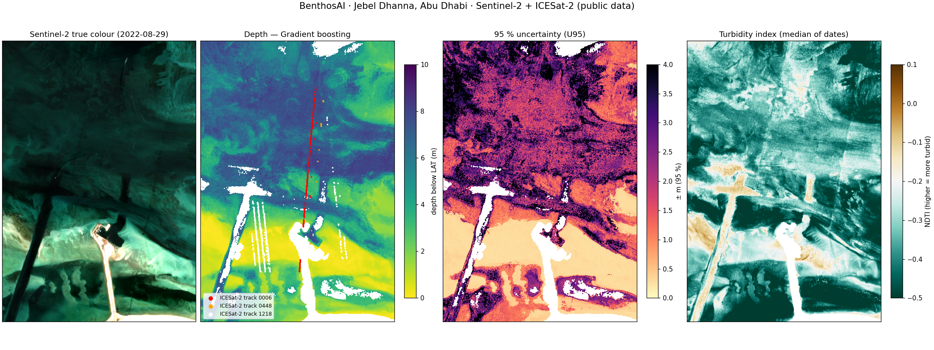
6 WHAT IT PRODUCES
Jebel Dhanna, Abu Dhabi: depth, uncertainty and turbidity
True colour · depth below LAT · 95 % uncertainty · NDTI turbidity. ICESat-2 tracks: 1218 white, 0006 red, 0448 orange. Output of notebooks/02_main_analysis.ipynb (final model trained on all tracks).

Slide 8
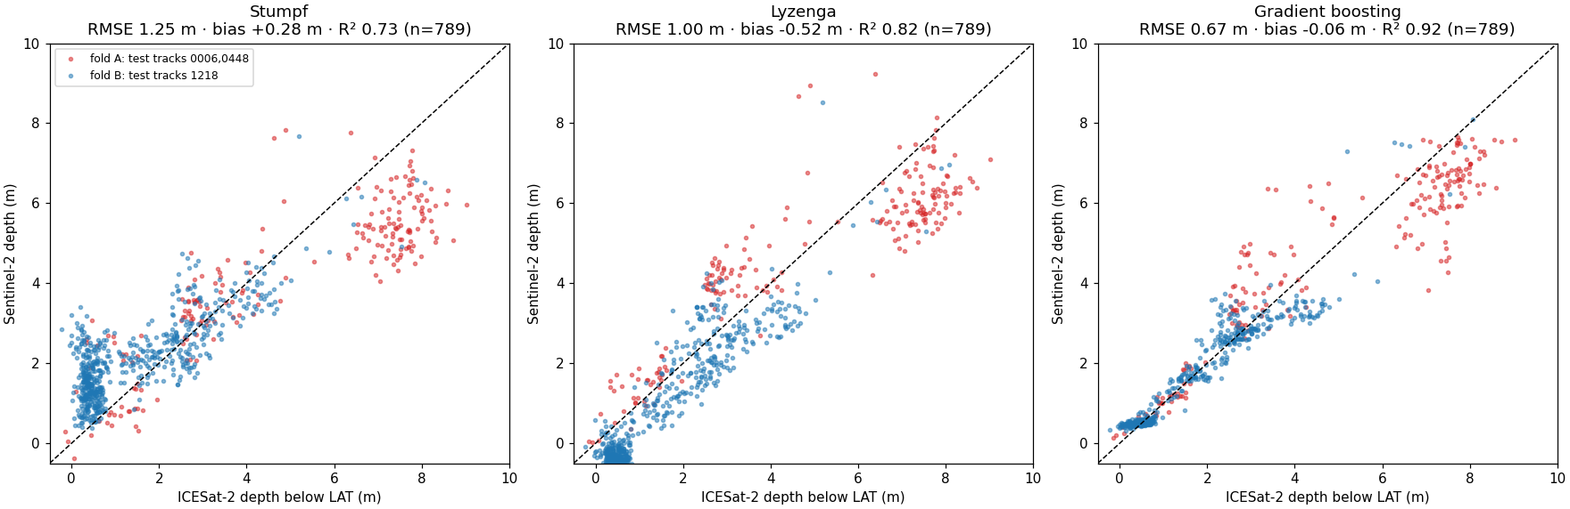
7 ACCURACY AND LIMITATIONS
Tested on laser tracks the models never saw
0.67 m
0.92
86 %
97 %
Model | RMSE | MAE | Bias | R² | Ord 2 | U95 cov.
Stumpf | 1.25 | 1.00 | +0.28 | 0.73 | 59 % | 99 %
Lyzenga | 1.00 | 0.86 | -0.52 | 0.82 | 67 % | 90 %
Gradient boosting | 0.67 | 0.42 | -0.06 | 0.92 | 86 % | 97 %
RMSE, UNSEEN TRACKS
R²
IHO S-44 ORDER 2
U95 COVERAGE
Gradient boosting | n | RMSE m | Bias m | Ord 2
Depth 0–2 m | 431 | 0.20 | +0.09 | 100 %
Depth 2–5 m | 243 | 0.77 | +0.10 | 81 %
Depth 5–12 m | 115 | 1.29 | -0.97 | 46 %
Fold A (test 0006+0448) | 207 | 1.11 | -0.28 | 63 %
Fold B (test 1218) | 582 | 0.41 | +0.02 | 95 %
Predicted vs ICESat-2 depth, cross-track (789 pixels)
Production model: internal validation
Limitations
Optical reach ≈ 10–12 m in clear water; less when turbid (flagged)
Laser passes 2019–2023 vs images 2022; the dredged site has changed
Reference is satellite laser, not a certified survey; not for navigation
Confidential: ≈240,000 multibeam soundings, 7 Abu Dhabi sites, whole sites held out
Khalifa Port 2021: RMSE 0.26 m · S-44 Order 2 99.8 %
All sites, < 12 m (38,345 pts): RMSE 0.85 m · bias −0.02 m

Slide 9
8 IMPACT
Why it matters
~5 days
$0 data
±U95
REVISIT BETWEEN VESSEL SURVEYS
FREE SATELLITE AND TIDE DATA
TRUST LEVEL ON EVERY PIXEL
What this changes
Safer navigation: spot shoaling in channels and approaches early
Lower survey cost: send vessels only to uncertain or changing areas
Water quality: turbidity maps for dredging plumes, habitats and coastal works from the same images
Regional scale: any clear Arab-region coast (Gulf, Red Sea) with ICESat-2 coverage; runs on a laptop in minutes

Slide 10
9 NEXT STEPS
From proof of concept to an operational service
Technical
Partnerships
Hyperspectral (EnMAP / PRISMA) for seabed type, chlorophyll and sediment
Time series: depth and turbidity change maps for siltation monitoring
More sites across the Gulf and Red Sea; automatic tide reduction everywhere
Simple web app: draw an area → maps and report (desktop prototype exists)
Pilot with port and hydrographic partners in the UAE
Grade against IHO S-44 with independent surveys
Compute and data support for regional scale-up
Reproducible today: notebook, sample data, results and README run end to end in under a minute on a laptop

Slide 11
10 TEAM BENTHOSAI
Thank you
Dr Muhammad Saeed
Team lead: SDB pipeline, model and validation
Akram Habib
Faculty co-lead: port use case, review and approvals
Meera Alqubaisi
Reproducibility testing
Mansour Alketbi
Presentation, PDF export and demo video
Mayed Abdulla
Submission checklist and hyperspectral next step
Abu Dhabi Maritime Academy · AD Ports Group · Arab Youth Space Hackathon 2026, 813 Challenge

