Slide 1
FRESH AND ROTTEN FRUITS CLASSIFICATION USING “VGG16 AND RESNET50 ALGORITHM”
Saidur Rahman Saeed
ID: 171-15-8892
Nusrat Jahan
Senior Lecturer
Department of Computer Science & Engineering
Daffodil International University
Thursday 09 September 2021

Slide 2
Introduction
Fruit diagnosis and early identification the production of healthy fruit industry is more important.
Rotting fruits are waste a lot of money
Hazardous for our health
This research offers an overview of detect fresh and rotten fruits.
Offers less expenses but huge productivity.

Slide 3
Motivation
Easy to detect fresh fruits.
Fresh Fruits is important for our health not rotten fruits.
Helpful for fruit sellers and the buyers.
Less waste of money
Concern about health issues.

Slide 4
Expected Outcome
Help to all over people and save their valuable time.
99.55% of the Rotten fruits can be identified appropriately.
Enable users to scan quickly and get the results.
Provide full hygienic fruits
prevent this dilemma, by deep learning technological intelligence system.

Slide 5
Background Study
Brahimi et al | classification to a CNN model | The precision of this model was 99.18%.
VenkataRamiReddy | classification to a CNN model | The precision of this model was 97.5%.
Nyarko | RGB-D ,CTI, 3D point clouds, | IoU score of 0.95% achieved by En-UNet is 0.866% and the UNet score of 0.66%.
Saidur Rahman Saeed | VGG16 AND RESNET50 | 99.55% accuracy

Slide 6
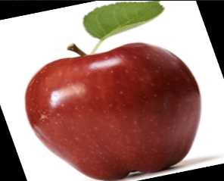

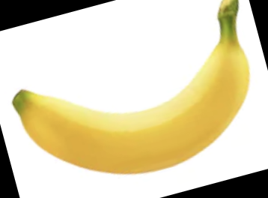
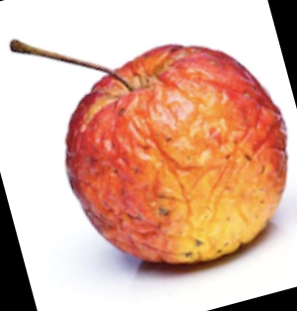
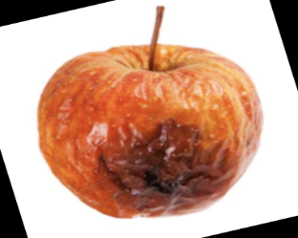
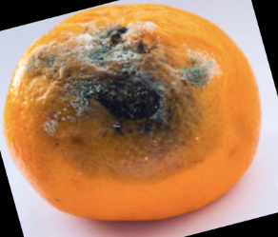
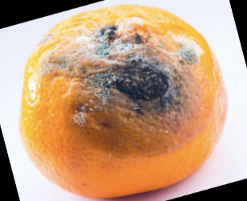
Data Collection, Selection & Analysis
Total 10,901data
Classified based on fresh fruits.
gathered our data from the Kaggle
The data increase procedure augmentation method
Utilized zoom, shred, rotation, horizontal flip, vertical flip etc for data increase.
Figure 3.2: Data augmentation and background removal

Slide 7
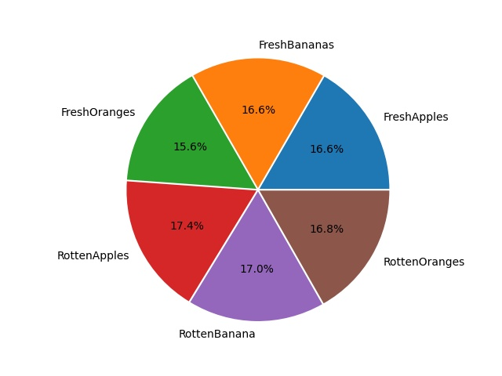
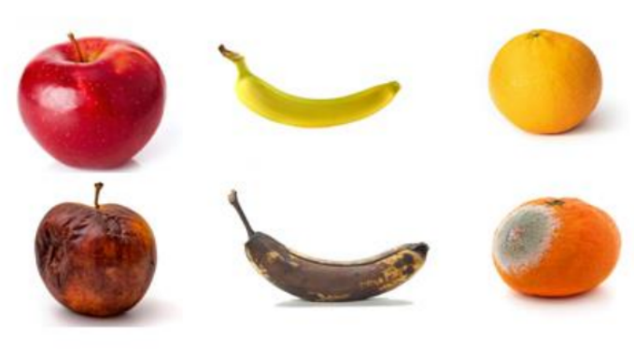
Dataset
Figure 3.3: Dataset representations Figure 3.4: Dataset representations

Slide 8
Statistical Analysis
Training and Testing image number of each class
Training data size
Testing data size
Table 3.1 Training data size Table 3.2 Testing data size
Fruits Name | Amount
Fresh Apples | 1817
Fresh Bananas | 1816
Fresh Oranges | 1700
Rotten Apples | 1900
Rotten Banana | 1850
Rotten Oranges | 1830
Fruits Name | Amount
Fresh Apples | 395
Fresh Bananas | 381
Fresh Oranges | 388
Rotten Apples | 601
Rotten Banana | 503
Rotten Oranges | 403

Slide 9
RESEARCH METHODOLOGY
Data Collection, Selection & Analysis
Total 10,901data,
Input Fresh Fruits to system.
Input Rotten Fruits to the system
Apply VGG16, ResNet 50
Figure 3.1: Methodology diagram
Data collection
Preprocessing
Data Augmentation
Dataset
Apply VGG16, ResNet50
Evaluation

Slide 10
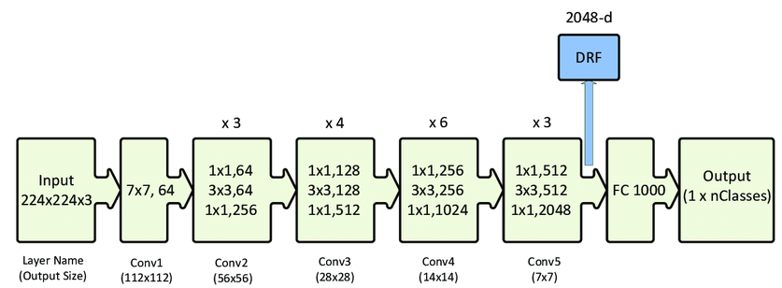
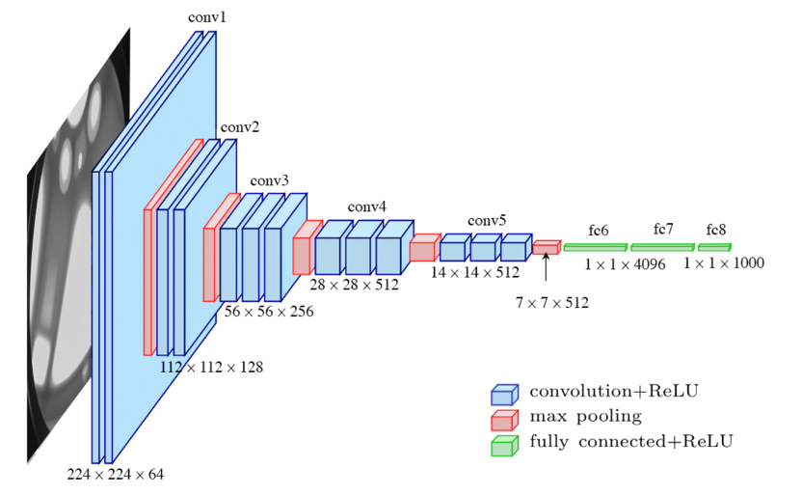
RESEARCH METHODOLOGY
Apply VGG16, ResNet50
In our work we used most usable CNN architecture VGG16 and ResNet50. The basic structure of these two architecture is given bellow:
VGG16 architecture & ResNet50 architecture
Figure 3.6: VGG16 architecture Figure 3.5: Basic ResNet50 architecture.

Slide 11
Algorithms implementation
CNN structure | Image size | Epochs | Parameter usages | Highest Accuracy
VGG16 | 224*224 | 15 | activation = 'softmax' loss ='categorical_crossentropy' | 99.55%
ResNet50 | 224*224 | 15 | activation = 'softmax' loss ='categorical_crossentropy' | 78.39%
Table 4.1 Algorithms implementation

Slide 12
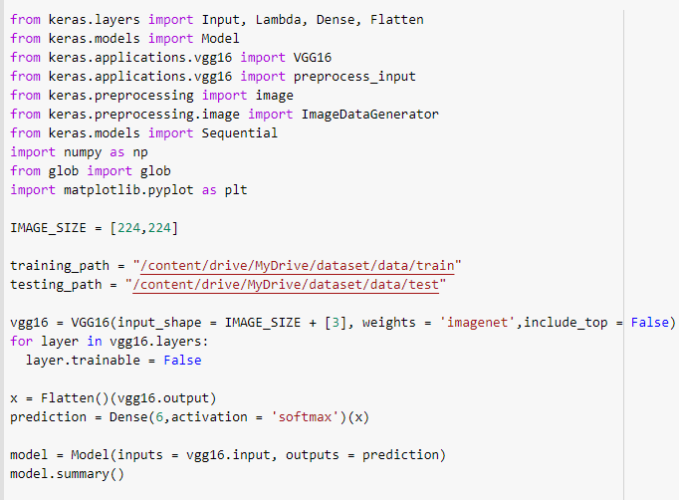
Implementation
We used python to implement our project.
Python is the best fit for deep learning and AI-based projects include simplicity and consistency, access to great libraries.
It is the framework for AI and machine learning (ML)/deep learning, flexibility, platform independence, and a wide community.
These add to the overall popularity of the language.
Sample python code

Slide 13
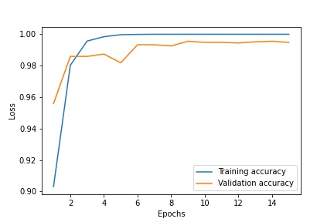
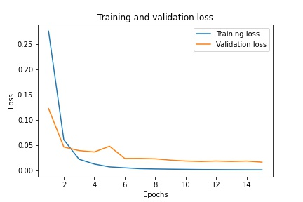
Evaluations
Figure 4.1: Training vs validation accuracy of vgg16 Figure 4.2: Training vs validation loss of vgg16

Slide 14
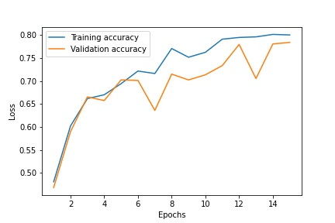
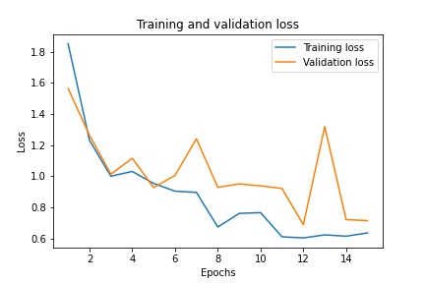
Evaluations
Figure 4.3: Training vs validation accuracy of
ResNet 50
Figure 4.4: Training vs validation loss of
ResNet 50

Slide 15
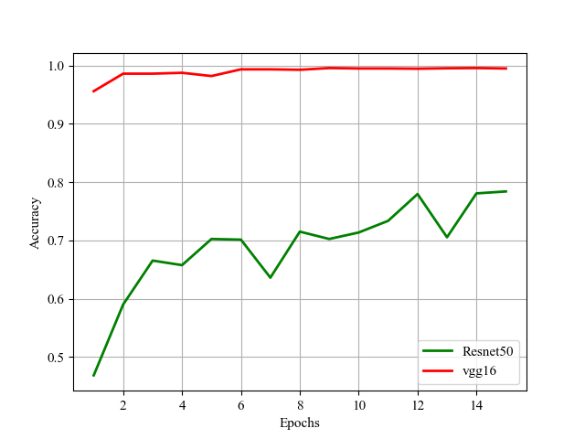
Evaluations
Figure 4.5 Two models comparison

Slide 16
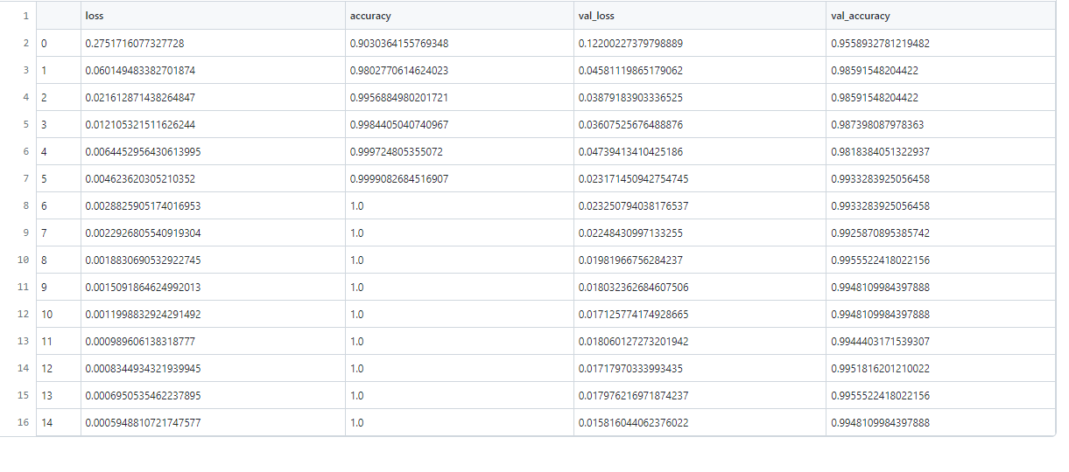
Result Analysis

Slide 17
Conclusion
I'm implements, every algorithm & works carefully.
I'm studied the efficiency of models & algorithms and found the best algorithm for detecting fresh & rotten fruits.
Introduce a CNN-based vgg16 model which focuses on fresh and rotten fruits categorization
I Think this will be helpful also for fruits seller and buyers

Slide 18
Future Work
The instructions for the further production of the work are given below:
Since a huge quantity of data is required by CNN, I will add more data to increase the efficiency of this model.
more classes will be used with greater precision
In future we will produce a web app & android.

Slide 19
References
[1] Azizah, L.M.R., Umayah, S.F., Riyadi, S., Damarjati, C., Utama, N.A. (2017). Deep learning implementation using convolutional neural network in mangosteen surface defect detection. In 2017 7th IEEE International Conference on Control System, Computing and Engineering (ICCSCE), pp. 242-246. https://doi.org/10.1109/iccsce.2017.8284412
[2] VenkataRamiReddy, C., Kishore, K.K., Bhattacharyya, D., Kim, T.H. (2014). Multi-feature fusion based facial expression classification using DLBP and DCT. International Journal of Software Engineering and Its Applications, 8(9): 55-68. https://doi.org/10.14257/ijseia.2014.8.9.05
[3] Wang, L., Li, A., Tian, X. (2013). Detection of fruit skin defects using machine vision system. In 2013 Sixth International Conference on Business Intelligence and Financial Engineering, pp. 44-48. https://doi.org/10.1109/bife.2013.11
[4] Emmanuel Karlo Nyarko, Ivan Vidović, Kristijan Radočaj, Robert Cupec, A nearest neighbor approach for fruit recognition in RGB-D images based on detection of convex surfaces, Expert Systems with Applications, Volume 114, 2018, Pages 454-466, ISSN 0957-4174, https://doi.org/10.1016/j.eswa.2018.07.048.
[5] Roy, K., Chaudhuri, S.S. & Pramanik, S. Deep learning based real-time Industrial framework for rotten and fresh fruit detection using semantic segmentation. Microsyst Technol 27, 3365–3375 (2021). https://doi.org/10.1007/s00542-020-05123-x
[6] Ni X, Li C, Jiang H (2020) Blueberry harvest ability trait extraction from 2D images and 3D point clouds based on deep learning and photogrammetric reconstruction. In 2020 ASABE Annual International Virtual Meeting (p. 1). American Society of Agricultural and Biological Engineers.
[7] Brahimi, M., Boukhalfa, K. & Moussaoui Deep learning for tomato disease: classifcation and symptoms visualization. Appl. Artif. Intell. 31, 299–315 (2017).
[8] M. Mehedi Hasan, M. Omar Faruk, B. Biswas Biki, M. Riajuliislam, K. Alam and S. Farjana Shetu, "Prediction of Pneumonia Disease of Newborn Baby Based on Statistical Analysis of Maternal Condition Using Machine Learning Approach," 2021 11th International Conference on Cloud Computing, Data Science & Engineering (Confluence), 2021, pp. 919-924, doi: 10.1109/Confluence51648.2021.9377169.
[9] H. Qassim, A. Verma and D. Feinzimer, "Compressed residual-VGG16 CNN model for big data places image recognition," 2018 IEEE 8th Annual Computing and Communication Workshop and Conference (CCWC), 2018, pp. 169-175, doi: 10.1109/CCWC.2018.8301729.
[10] E. Rezende, G. Ruppert, T. Carvalho, F. Ramos and P. de Geus, "Malicious Software Classification Using Transfer Learning of ResNet-50 Deep Neural Network," 2017 16th IEEE International Conference on Machine Learning and Applications (ICMLA), 2017, pp. 1011-1014, doi: 10.1109/ICMLA.2017.00-19.

Slide 20


