Slide 1
Deep Neural Networks in Text Classification using Active Learning
Mirsaeid Abolghasemi
San Jose State University
CMPE-297 Sec 49 - Advanced Deep Learning - Short story assignment
Fall 2020

Slide 2
1 Introduction
Three main scenarios for Active Learning:
Pool-based: the learner has an availability to the closed collection of unlabeled cases, known as the pool.
Stream-based: the learner has the option to hold or release one case at a time.
Membership query synthesis: The learner makes the labeling of new artificial cases. When the pool-based setup does not work on a single case, it is called batch-Mode Active Learning on a batch of cases.

Slide 3
1 Introduction (Cont.)
Interestingly, while NNs are common, there are few researchers in the field of NLP and fewer in the case of text classification on NN-based active learning.
The following may be the reasons for it:
Most DL models need a huge amount of data, which contrasts strongly with Active Learning which expects small datasets as necessary.
The total Active Learning approaches focused on the generation of creating data, which is inevitably much more complicated for text than, for instance, images, in which data augmentation is widely used in classification tasks.
NNs lack uncertain information, which makes the use of a leading class of query approaches more difficult.

Slide 4
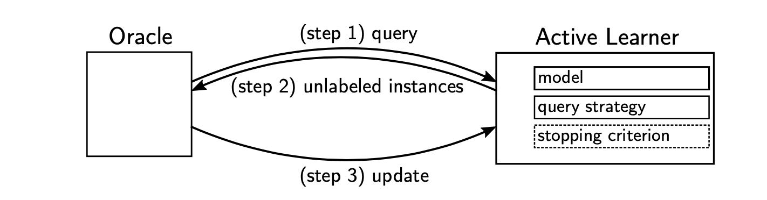
2 Active Learning
There are three steps the Active Learning process which is:
Step 1: The oracle sends a request for unlabeled instances to the active learner (query)
Step 2: Active Learner selects and passes the unlabeled instance to the oracle(based on the selected query strategy.)
Step 3: The oracle labels these instances and returns back to the active learner (update).

Slide 5
2 Active Learning (Cont.)
The key parts of Active Learner which are Model, Query strategy, and Stopping criterion (optional).
The main part for Active Learner is the query strategy which is uncertainty-based.

Slide 6
2.1 Query Strategies
The most common query strategies of Active Learning are classified based on the input information of a strategy.
The input information for this study is classified into four categories:
Random
Data-Based
Model-Based
Prediction-Based

Slide 7
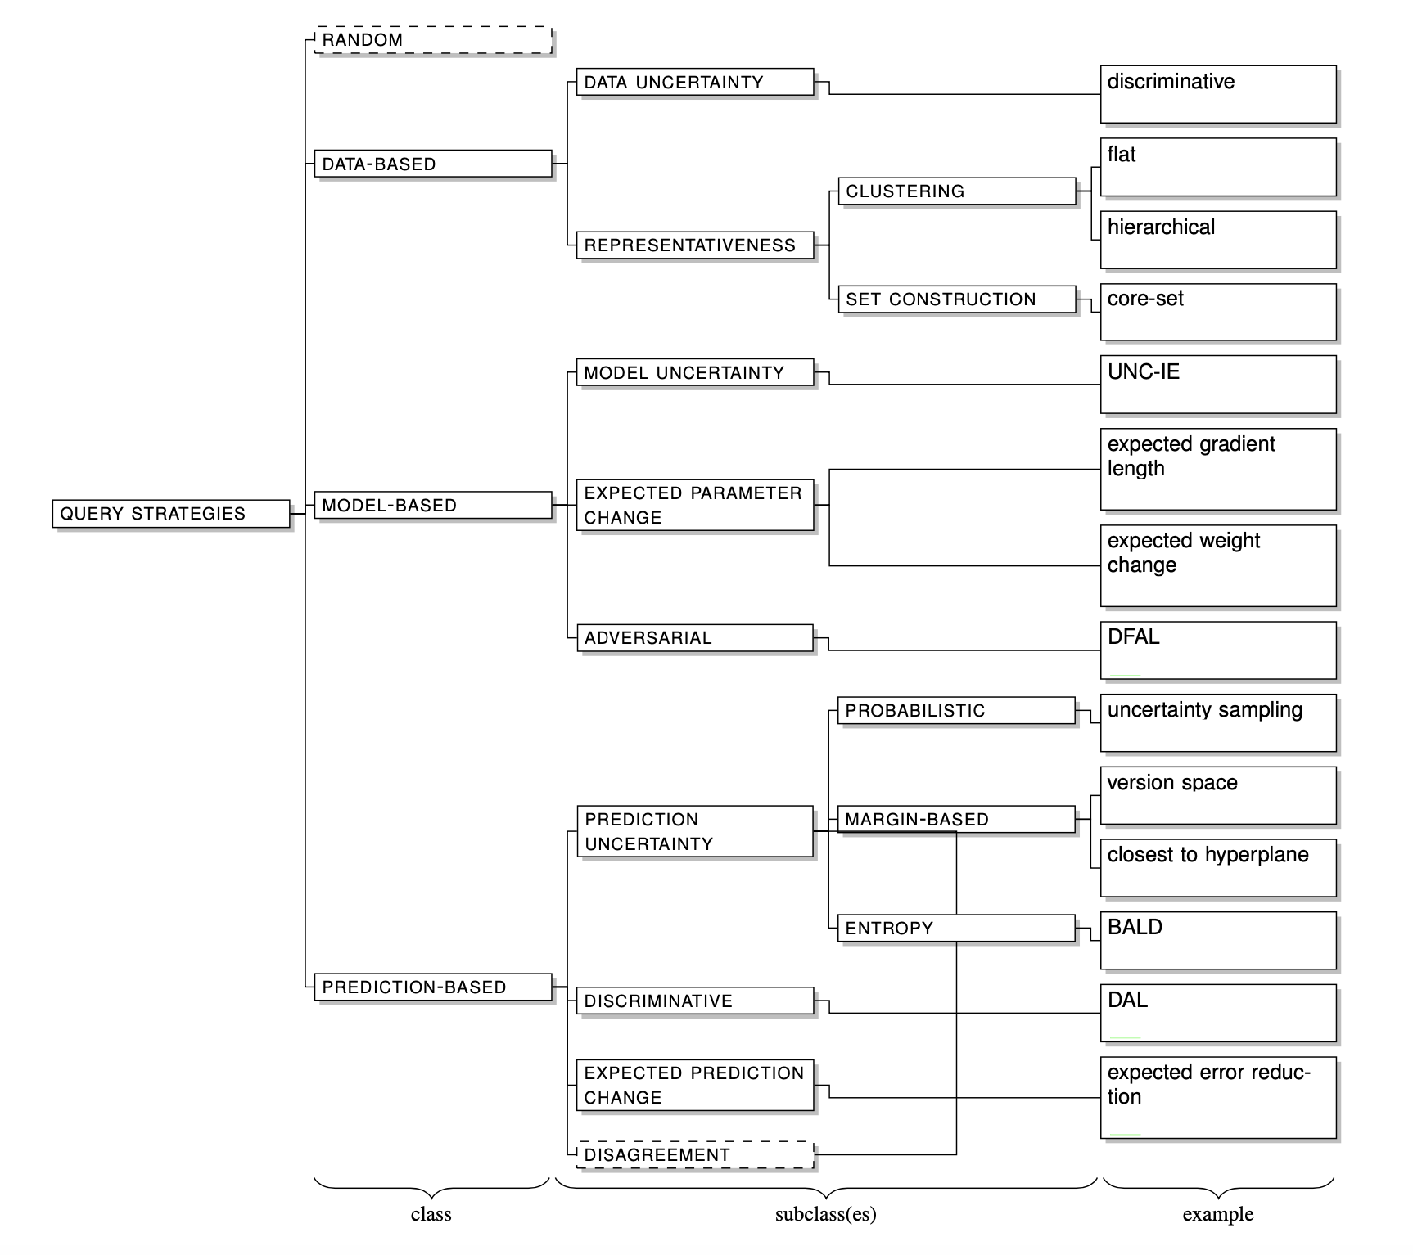
2.1 Query Strategies (Cont.)
Categorization of query strategies

Slide 8
2.1 Query Strategies (Cont.)
Data-based: Data-based strategies have the lowest level of knowledge, i.e. they only operate on the raw input data and optionally the labels of the labeled pool. It is categorized into:
Strategies: Strategies rely on data-uncertainty. It may use the input information about:
Data distribution
Label distribution
Label correlation.
Representativeness: geometrically compact a collection of points, requires lesser descriptive instances to describe the whole specifications.

Slide 9
2.1 Query Strategies (Cont.)
Ensembles: an ensemble is a combination of the outcome of some other strategies by a query strategy.
Ensembles consist of basic query strategies
Ensembles may be hybrids, for instance, a combination of multiple categories of query strategies. Also, the outcome of ensembles typically depends on the conflict between the individual classifiers.

Slide 10
2.2 Neural-Network-Based Active Learning
For this part, it will be discussed that neural networks in Active Learning applications are not more common and why. This will be focused on NLP techniques.
Two key themes can be applied to this:
Uncertainty estimation in NNs
The contrast of NNs requiring between big data and Active Learning dealing with small data.

Slide 11
3 Active Learning for Text Classification
The classical methods implement the representation of the bag-of-words (BoW).
BoW representations are high-dimensional and sparse.
The following new representation in word embeddings replaced BoW representations:
Word2vec
GloVe
fastText

Slide 12
3.2 Text Classification for Active Learning
Classic Active Learning for text classification was heavily focused on prediction-uncertainty and ensembling.
Popular models contained Support Vector Machines(SVMs), Naive Bayes, logistic regression, and neural networks.
However, Olsson has covered a large ensemble-based Active Learning for NLP in detail
According to recent research, no prior survey covered classical Active Learning for text classification.
Concerning current text classification NN-based Active Learning, the applicable models are mainly CNN- and LSTM-based deep architectures.

Slide 13
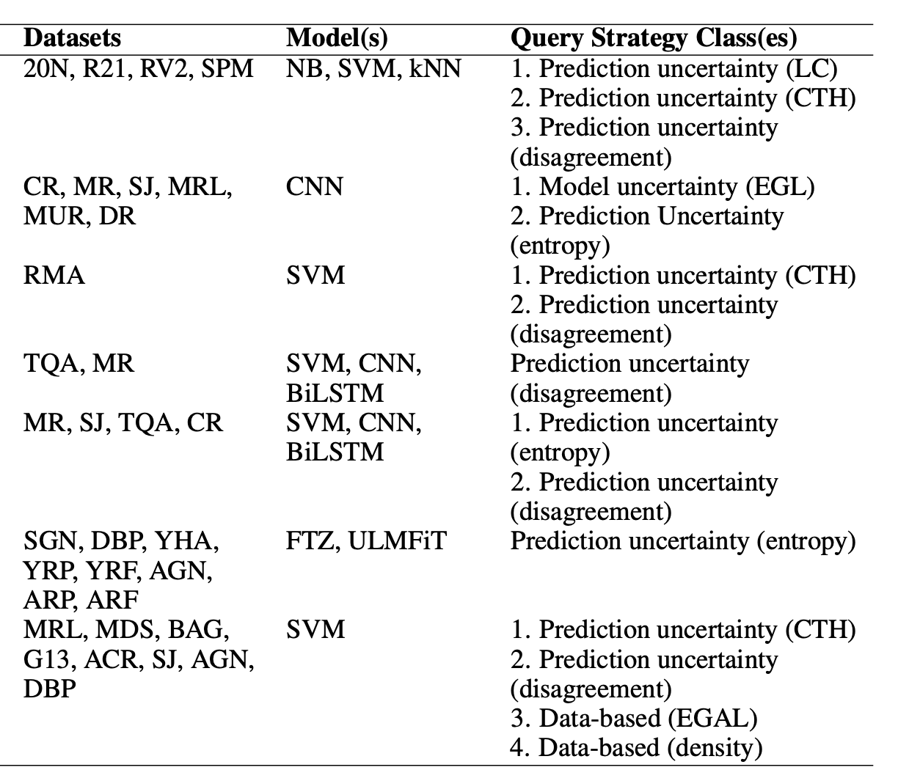
3.3 Commonalities and Text classification recent work on Active Learning:
Models in Table 1:
Naive Bayes (NB)
Support Vector Machine (SVM)
k-Nearest Neighbours (kNN)
Convolutional Neural Network (CNN)
[Bidirectional] Long Short-Term Memory ([Bi]LSTM)
FastText.zip (FTZ)
Universal Language Model Fine-tuning (ULMFiT).
Query strategies in Table 1:
Least confidence (LC)
Closest-to-hyperplane (CTH)
expected gradient length (EGL)
Based on the table, It is clear that a vast majority of such query strategies belong to the prediction-uncertainty and disagreement- based sub-classes.

Slide 14
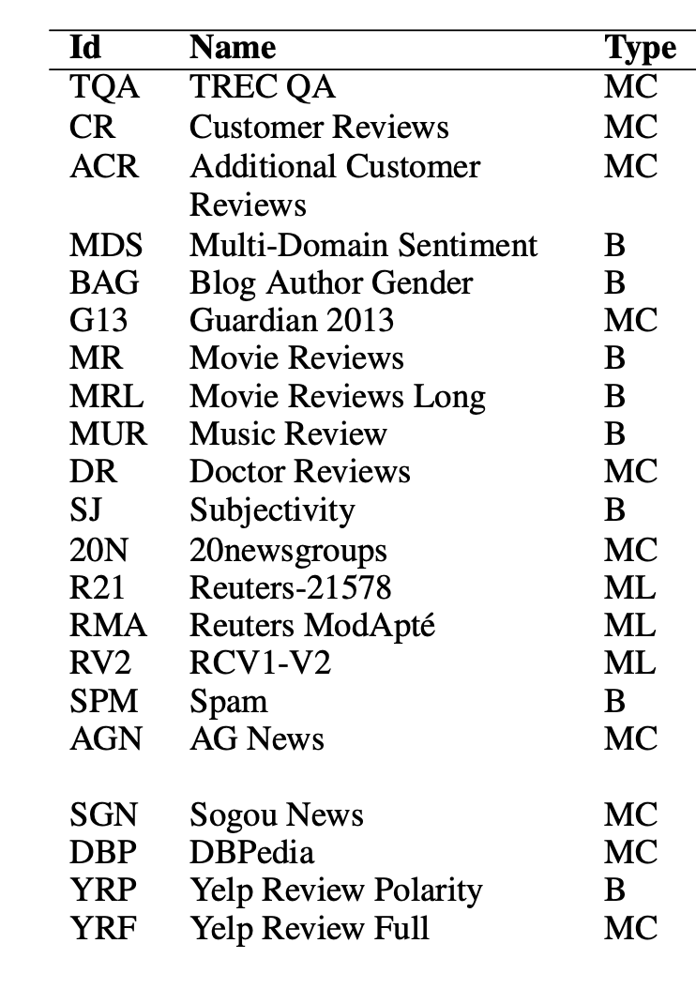
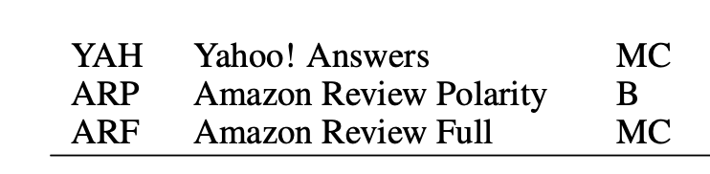
The short keys of a collection
of widely-used text classification datasets.
The column "Type" shows the classification setting:
B = binary
MC = multi-class
ML = multi-class multi-label

Slide 15
5 Outcomes of the Research and Conclusions:
Uncertainty Estimates in Neural Networks: In collaboration with NN models, uncertainty-based strategies were successfully utilized, and the most critical aspect of query strategies in the latest NN-based Active Learning has been discovered. Because of inaccurate uncertainty estimates, or restricted scalability, the uncertainty in NNs is still challenging.
Representations: The implementation of NLP text representations has progressed from bag-of-words to text embedding. These representations bring numerous benefits, including non-sparse vectors, disambiguation capabilities, and accuracy improvements for several tasks.

Slide 16
5 Conclusions (Cont.)
Small Data DNNs: In large datasets, DL methods are typically used. Active Learning plans to keep the data collection as small as necessary, though. Small data sets were explained why they could challenge DNNs and also DNN- based Active Learning as a direct result.
Learning to Learn: There are lots of query strategies, which were classified non-exhaustively. This raises the issue of selecting the best strategy. Several variables, such as data, model, or task, depending on the correct choice and which vary between the various processes during the Active Learning process. This means that learning to learn (or meta-learn) has become popular and can be used to learn the best option, or also to learn query strategies in general.

Slide 17
6 Reference:
This presentation is a short story of the following paper:
C. Schröder and A. Niekler, “A Survey of Active Learning for Text Classification using Deep Neural Networks,” arXiv.org, August 17, 2020. [Online]. Available: https://arxiv.org/abs/2008.07267 (Accessed: October 05, 2020).

