Slide 1
Skin Cancer Detection WebApp
CIS-HACKATHON
TEAM PSR
-Prabhudev Betsurmath
-Saeedahamed N Bandi
-Rakshit Nayak

Slide 2
PROJUST DESCRIPTION
The model has been built using fastai deep learning library which is a high level api for pytorch. The classifier has been trained using Kaggle MNIST HAM10000 dataset which contains 10015 images of seven categories of pigmented skin lesions.
As a preprocessing step, I have applied random undersampling to data to alleviate the class-imbalance problem. The classifier has been built with transfer learning technique using a pretrained Densenet169 model.

Slide 3
The final classifer achieved an accuracy of 91.2% and a F1-score of 91.7% on validation data. You can check out the jupyter notebook that goes along to follow all the steps which have been taken to build the model.

Slide 4
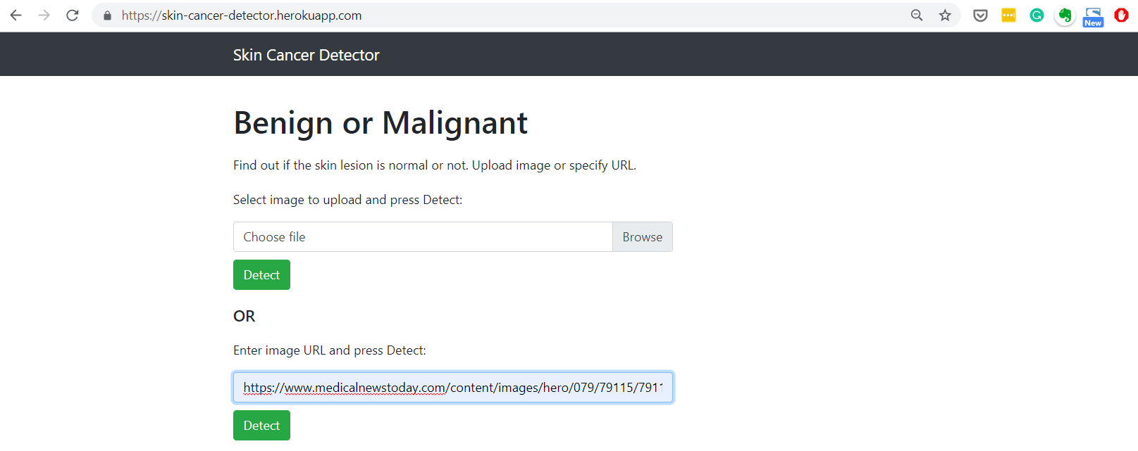
WebApp UI

Slide 5
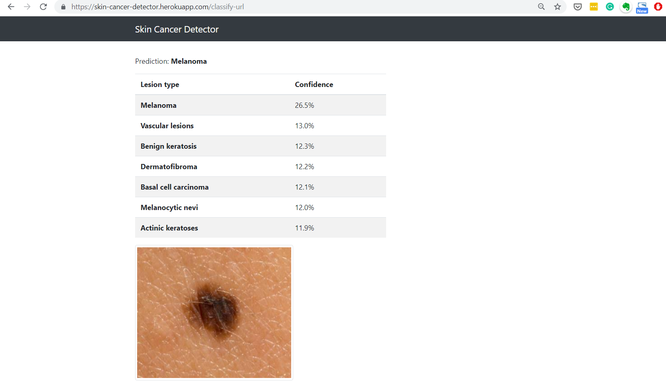

Slide 6
THANKYOU

