Slide 1
Network Energy Modeling

Slide 2

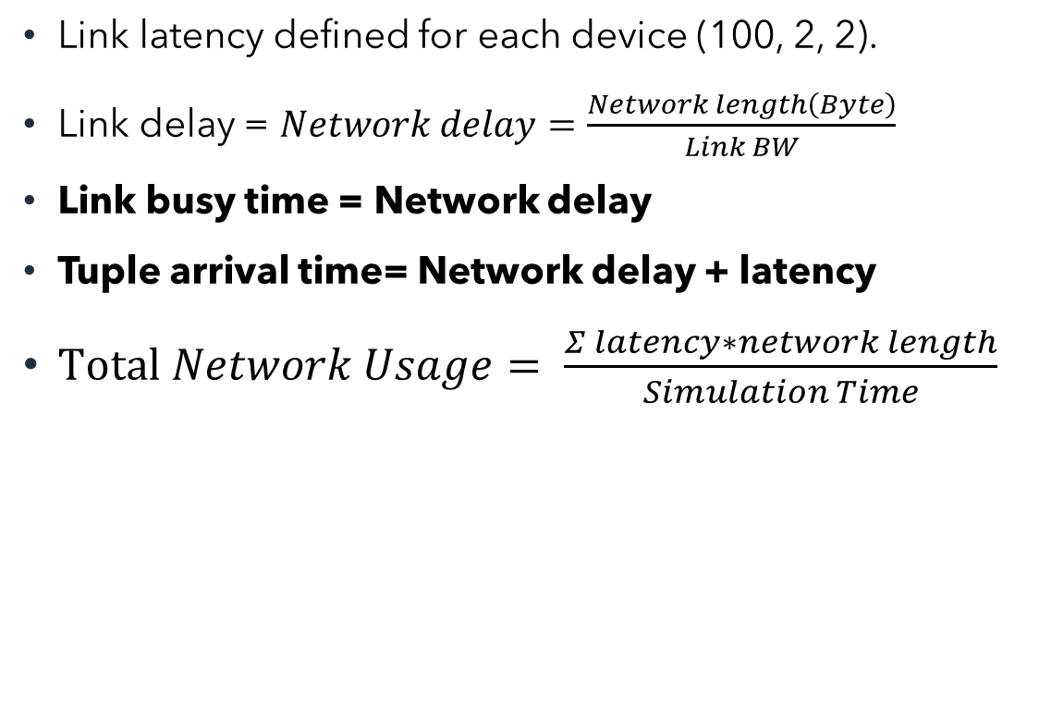
Background
Cloud
Link latency defined for each device (100, 2, 2).
Link delay = $Network delay=\frac{Network length\left(Byte\right)}{Link BW}$
Link busy time = Network delay
Tuple arrival time= Network delay + latency
$Total Network Usage= \frac{Σ latency∗network length}{Simulation Time}$
Default BW=10000
Latency=100
Modified BW=100000
Proxy server
Latency=2
Default BW=10000
Router
Modified BW=100000
Latency=2
Delay = Network length(byte)/ link BW
Delay = 2000/10000 = 0.2
Default BW=10000
Smart camera
Link busy time= Network delay
Tuple arrives to north module after network delay + latency
Latency=1msec
Default BW=10000

Slide 3
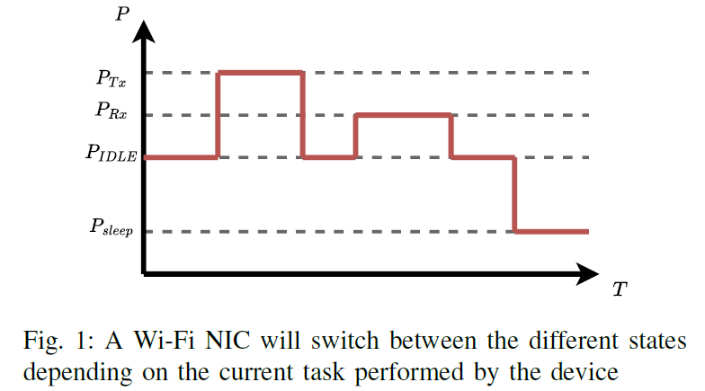
A Wi-Fi Energy Model for Scalable Simulation ^{[1]}
A flow-based simulation model
For large scale and heterogeneous network infrastructure
Similar accuracy compared to the energy model of the packet-based simulator ns-3
Focus on the energy of the network card, excluding the other devices’ components
P_Idle: The NIC does not perform any operation,
Tx: The NIC actively sends data
Rx: The NIC actively receives data
P_Sleep: Deactivates parts of the circuitry to reduce the power usage
^{[1].} Courageux-Sudan, Clément, Anne-Cécile Orgerie, and Martin Quinson. "A Wi-Fi Energy Model for Scalable Simulation." 24th IEEE International Symposium on a World of Wireless, Mobile and Multimedia Networks (WoWMoM). 2023.

Slide 4
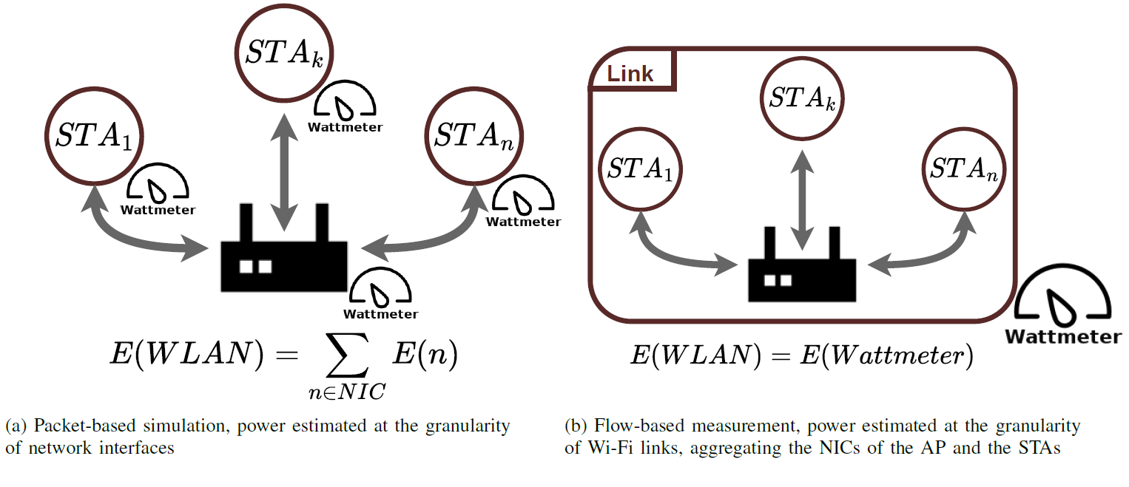
Wi-Fi Energy Model ^{[1]}
Wi-Fi link describes the aggregation of an Access Point (AP), the communication channel, and the Stations (STA) attached to the AP.
Power Saving Mechanisms, MIMO configurations, control and management frames are not considered in the current energy model.
This model is homogeneous.

Slide 5
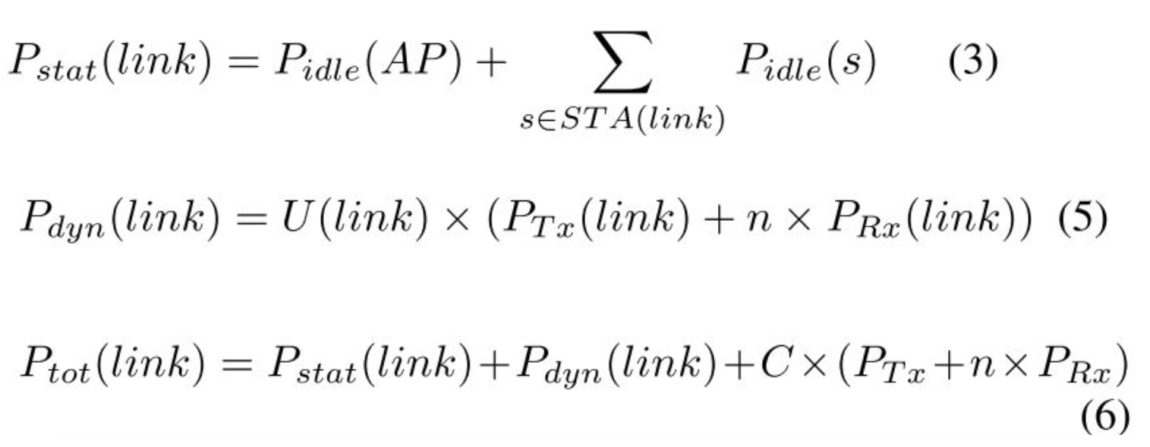
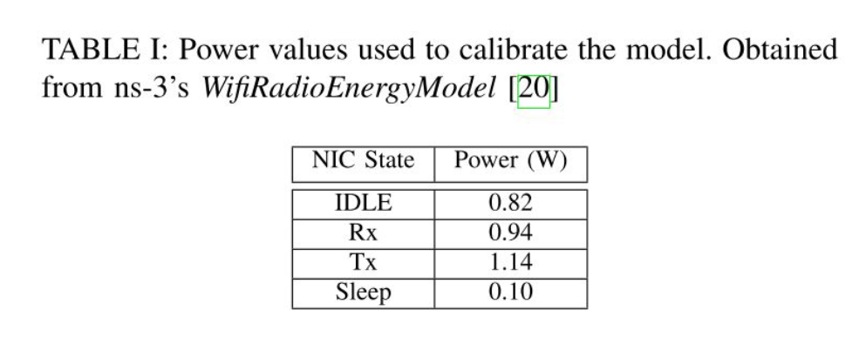
Wi-Fi Energy Model
Control packets

Slide 6
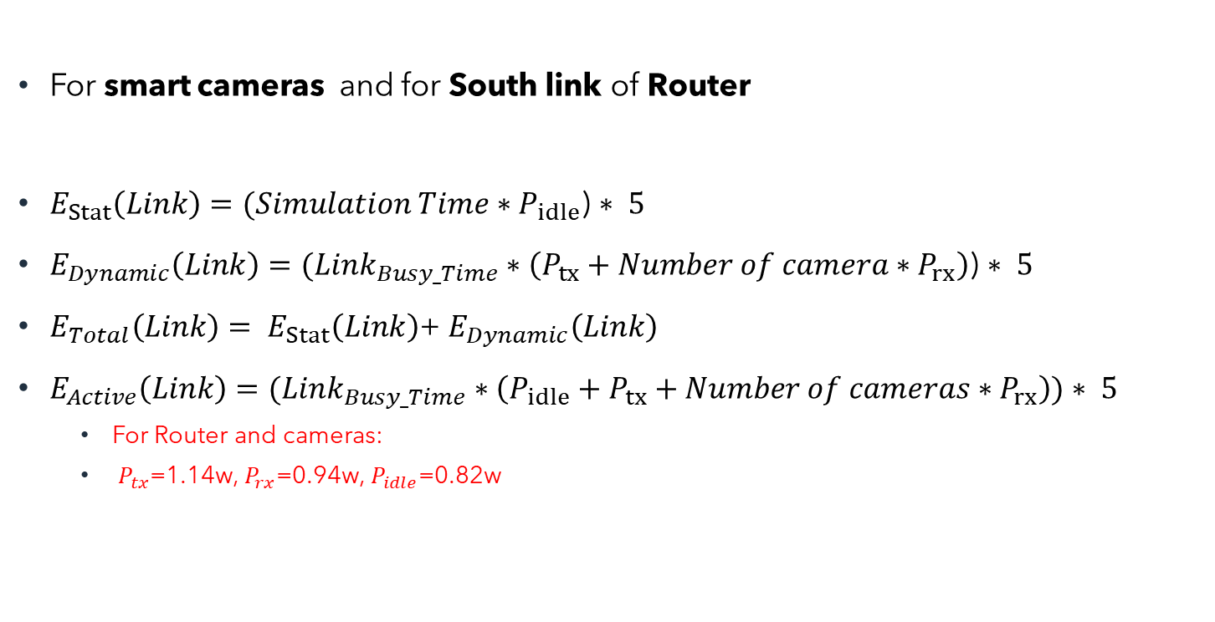
Wi-fi Network Energy^{[1]}
cloud
For smart cameras and for South link of Router
$E_{Stat}\left(Link\right)=(Simulation Time∗P_{idle}$) $∗ 5$
$E_{Dynamic}\left(Link\right)=(Link_{Busy_Time}∗\left(P_{tx}+Number of camera∗P_{rx}\right)$) $∗ 5$
$E_{Total}\left(Link\right)= E_{Stat}\left(Link\right)$+ $E_{Dynamic}\left(Link\right)$
$E_{Active}\left(Link\right)=(Link_{Busy_Time}∗\left(P_{idle}+P_{tx}+Number of cameras∗P_{rx}\right))$ $∗ 5$
For Router and cameras:
$P_{tx}$=1.14w, $P_{rx}$=0.94w, $P_{idle}$=0.82w
Proxy
server
Wi-Fi network
router
Smart camera
Smart camera
Smart camera
Smart camera

Slide 7
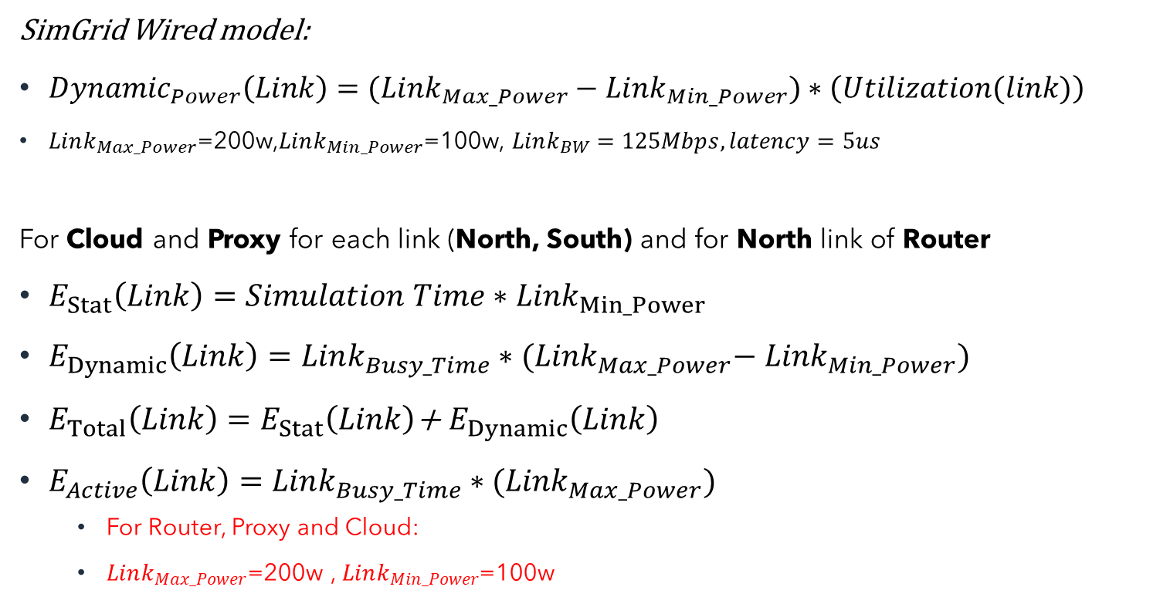
Wired Model^{[2]}
SimGrid Wired model:
${Dynamic}_{Power}\left(Link\right)=(Link_{Max_Power}−Link_{Min_Power})∗\left(Utilization(link)\right)$
$Link_{Max_Power}$=200w,$Link_{Min_Power}$=100w, $Link_{BW}=125Mbps, latency=5us$
For Cloud and Proxy for each link (North, South) and for North link of Router
$E_{Stat}\left(Link\right)=Simulation Time∗{Link}_{Min_Power}$
$E_{Dynamic}\left(Link\right)=Link_{Busy_Time}∗{(Link}_{Max_Power}−$ ${Link}_{Min_Power})$
$E_{Total}\left(Link\right)=E_{Stat}\left(Link\right)$+ $E_{Dynamic}\left(Link\right)$
$E_{Active}\left(Link\right)=Link_{Busy_Time}∗{(Link}_{Max_Power})$
For Router, Proxy and Cloud:
$Link_{Max_Power}$=200w , $Link_{Min_Power}$=100w
cloud
Wired network
Proxy
server
Wired network
router
Smart camera
Smart camera
Smart camera
Smart camera
^{[2].} Casanova, Henri. "Simgrid: A toolkit for the simulation of application scheduling." Proceedings First IEEE/ACM International Symposium on Cluster Computing and the Grid. IEEE, 2001.

Slide 8
Energy Results

Slide 9
Calibration
For calibration of power parameters:
Extract power parameters from literatures
Extract correlation between BW and Power
literatures
Micro benchmarking
Real calibration
What equipment needed!

Slide 10
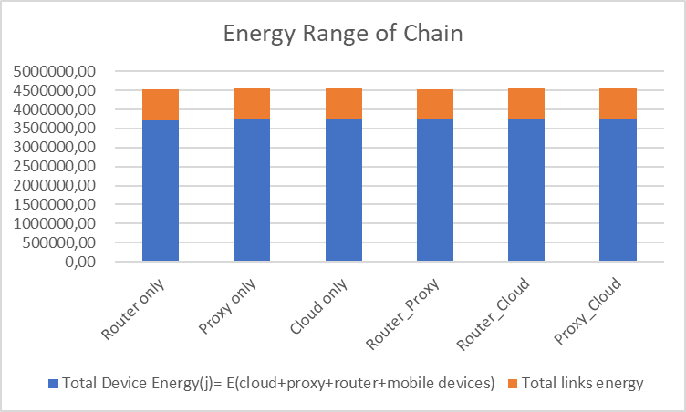
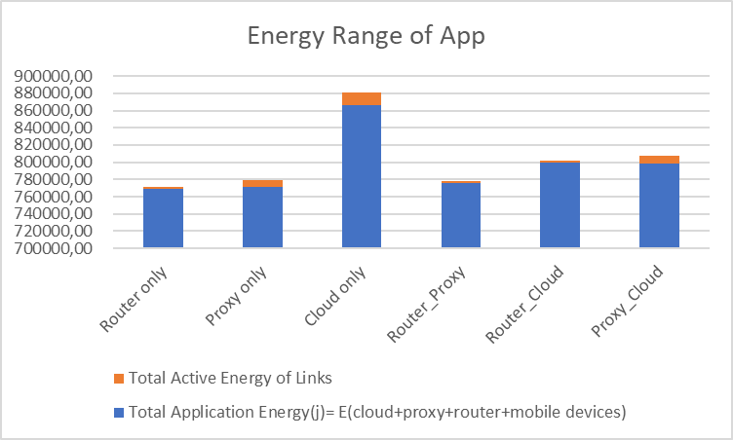
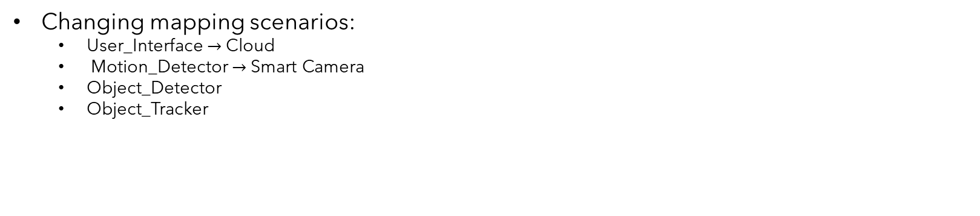
Energy Range for Labeling
Changing mapping scenarios:
User_Interface $→$ Cloud
Motion_Detector $→$ Smart Camera
Object_Detector
Object_Tracker
Different mapping scenarios

Slide 11
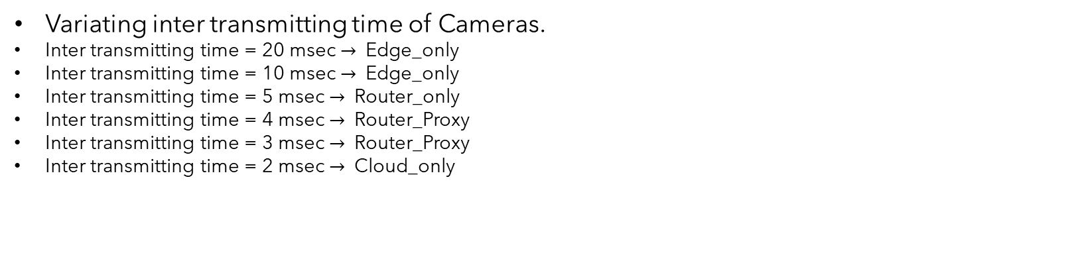
Energy Range for Labeling
Variating inter transmitting time of Cameras.
Inter transmitting time = 20 msec $→$ Edge_only
Inter transmitting time = 10 msec $→$ Edge_only
Inter transmitting time = 5 msec $→$ Router_only
Inter transmitting time = 4 msec $→$ Router_Proxy
Inter transmitting time = 3 msec $→$ Router_Proxy
Inter transmitting time = 2 msec $→$ Cloud_only

Slide 12
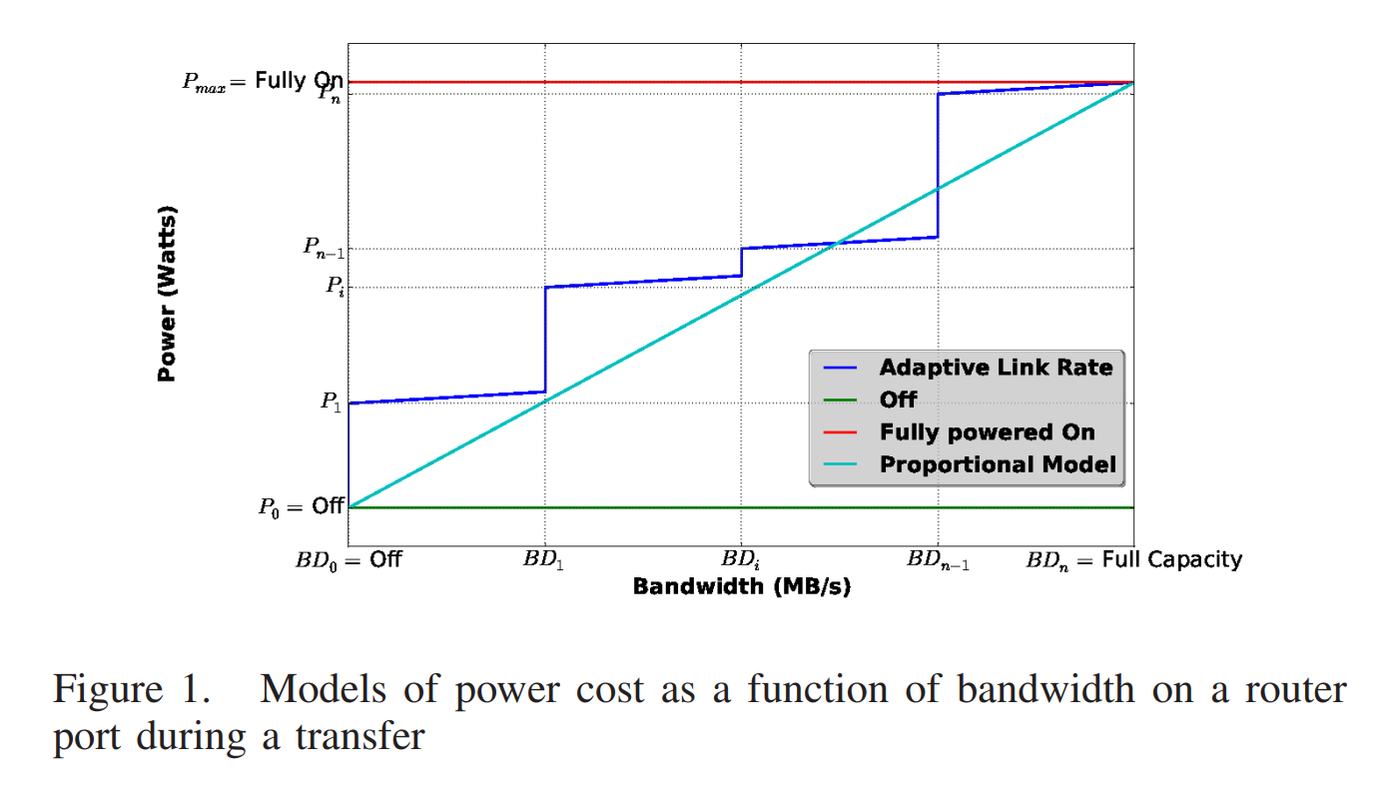
ECOFEN: an End-to-end energy Cost mOdel and simulator For Evaluating power consumption in large-scale Networks
Classical models include models with link rate switching which have a strong dependence to the link rate and a slight dependence to transmission rate.
Another classical but less realistic model is the proportional power cost model. This model is not realistic for current network equipments.
A. -C. Orgerie, L. Lefèvre, I. Guérin-Lassous and D. M. Lopez Pacheco, "ECOFEN: An End-to-end energy Cost mOdel and simulator For Evaluating power consumption in large-scale Networks," 2011 IEEE International Symposium on a World of Wireless, Mobile and Multimedia Networks, Lucca, Italy, 2011, pp. 1-6, doi: 10.1109/WoWMoM.2011.5986203.

Slide 13
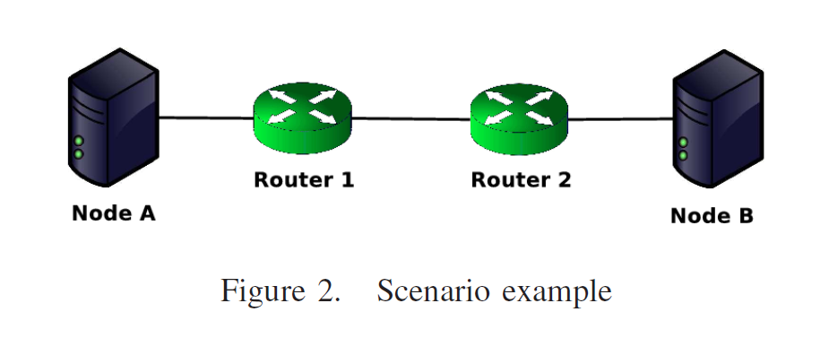
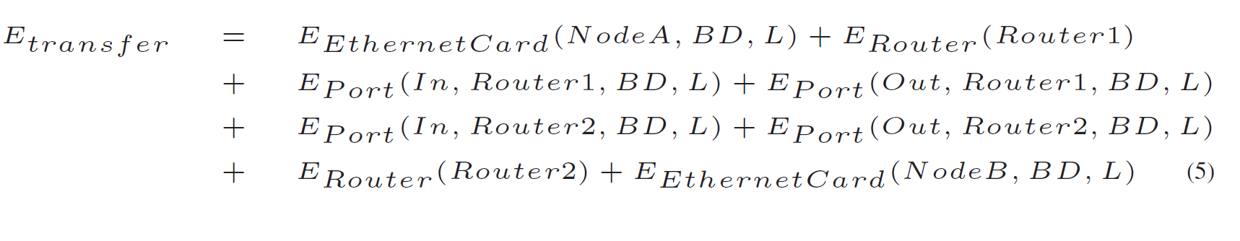
ECOFEN Energy Model

Slide 14
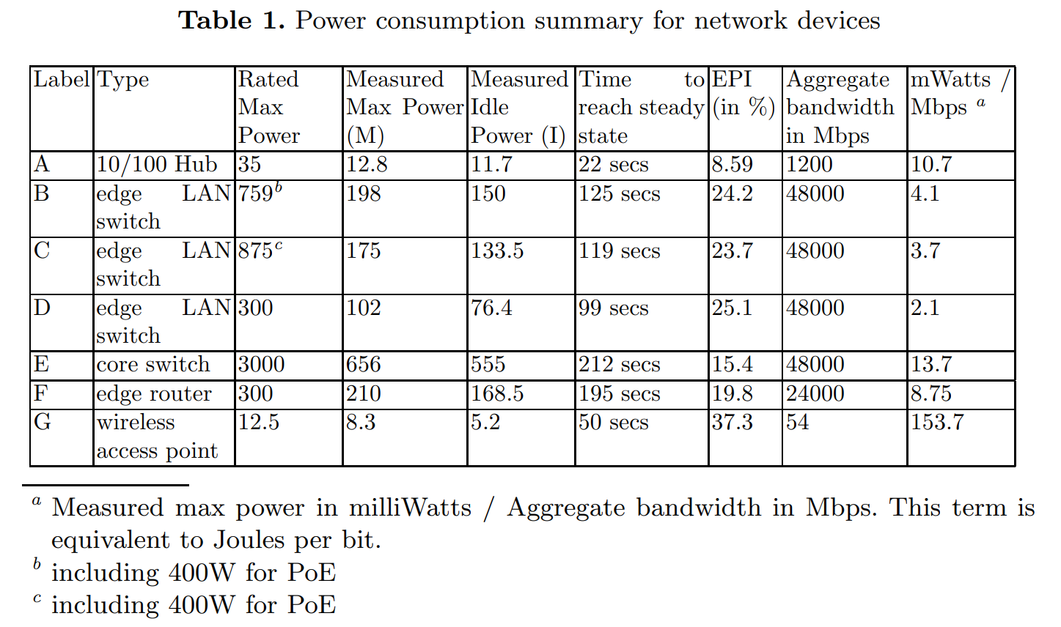
A Power Benchmarking Framework for Network Devices
Mahadevan, Priya, et al. "A power benchmarking framework for network devices." NETWORKING 2009: 8th International IFIP-TC 6 Networking Conference,, Aachen Germany, May 11-15, 2009. Proceedings 8. Springer Berlin Heidelberg, 2009.

Slide 15
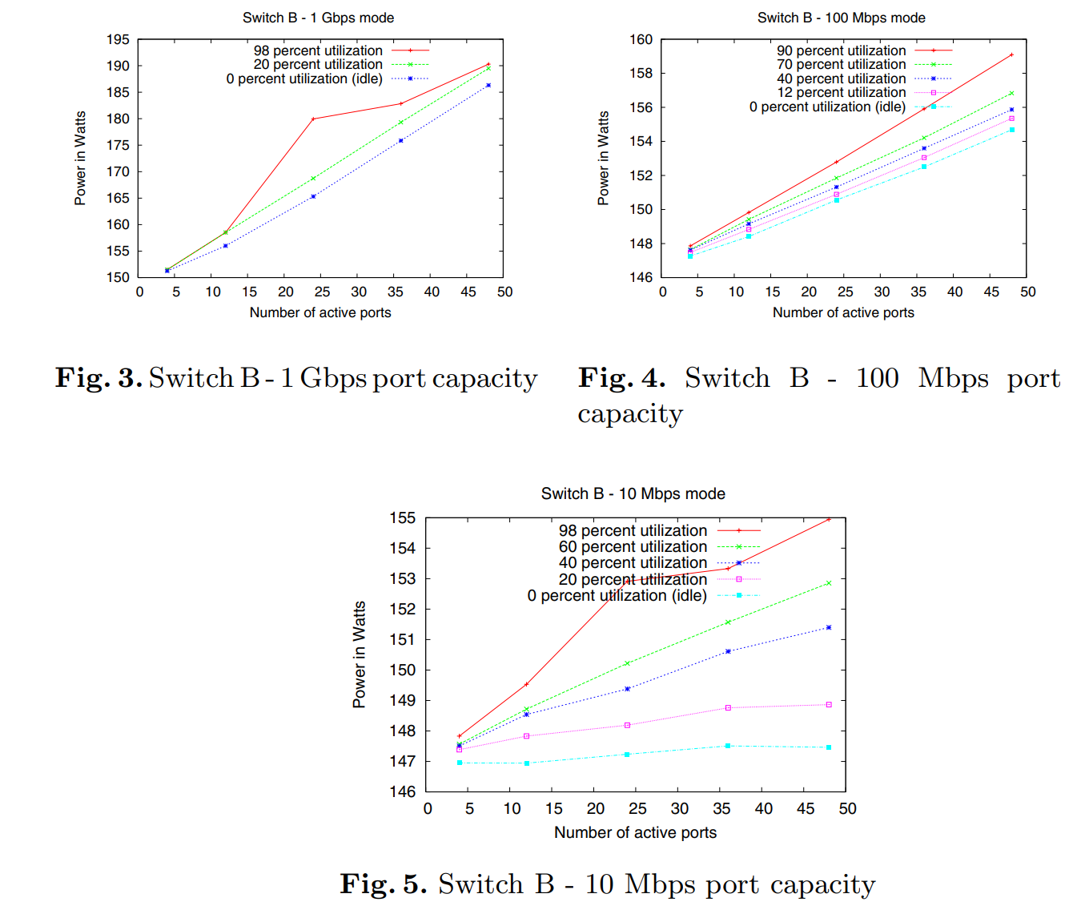
Effect of Port Capacity on Power Consumption

Slide 16
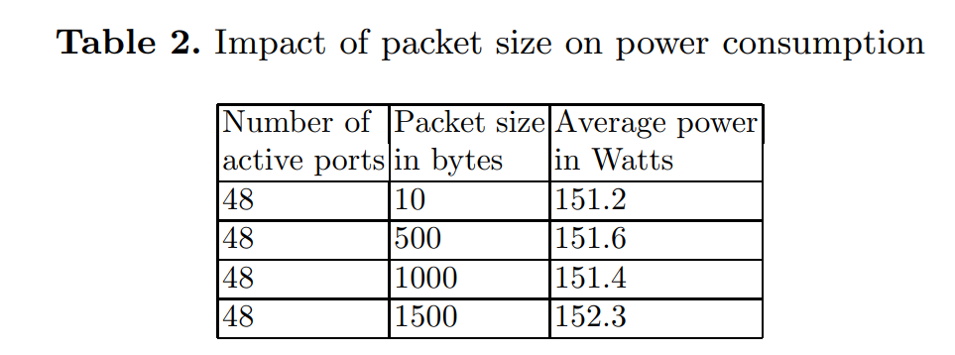
Impact of Packet Size on Power Consumption

Slide 17
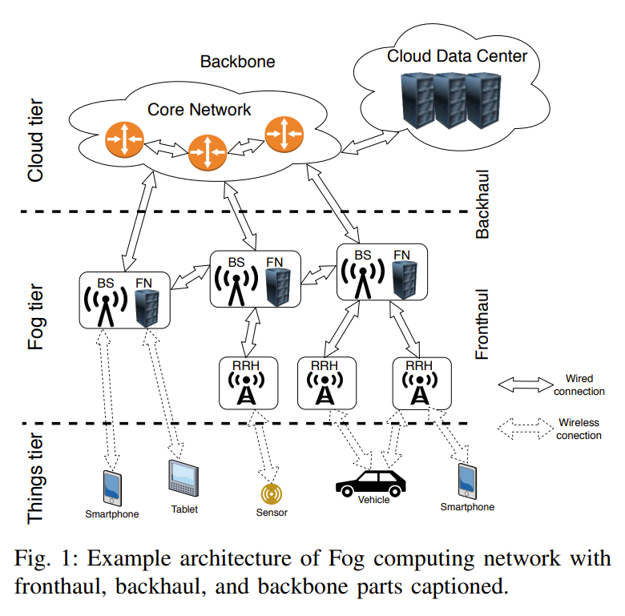
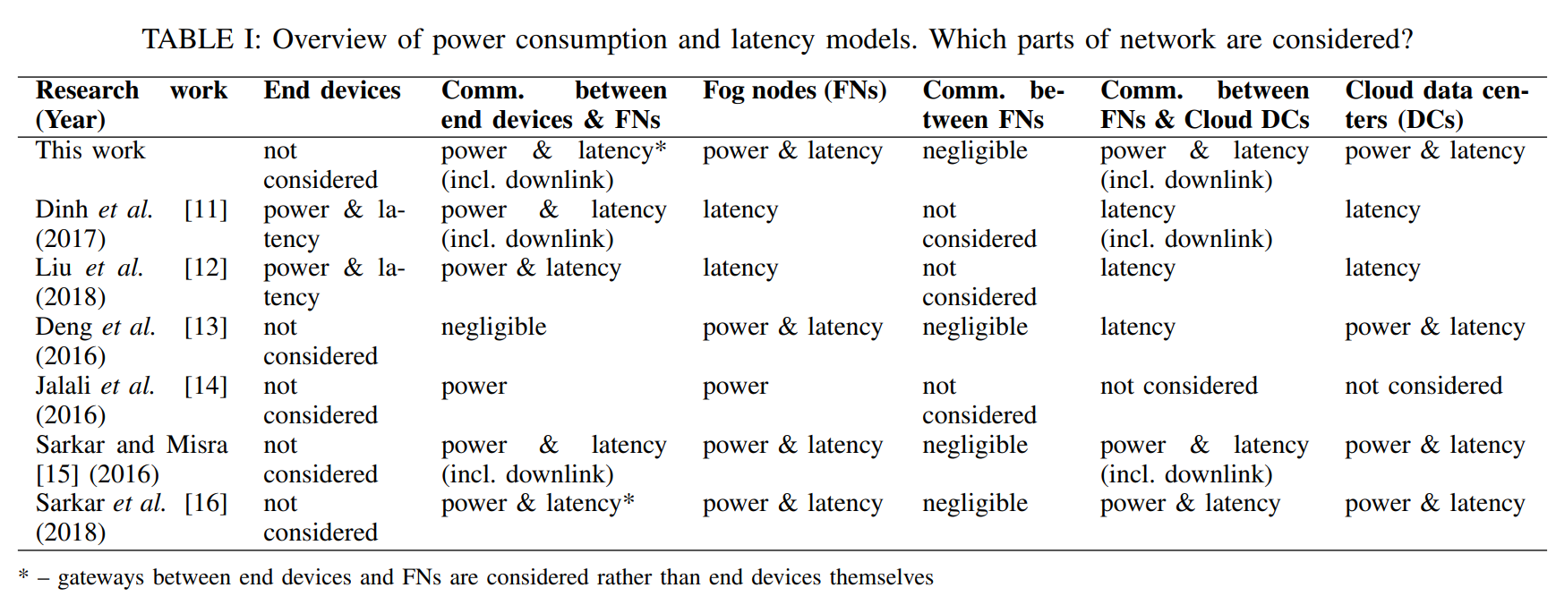
Power Consumption and Delay in Wired Parts of Fog Computing Networks
Computation
Communication
Kopras, Bartosz, Filip Idzikowski, and Paweł Kryszkiewicz. "Power consumption and delay in wired parts of fog computing networks." 2019 IEEE Sustainability through ICT Summit (StICT). IEEE, 2019.

Slide 18
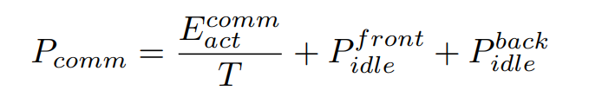


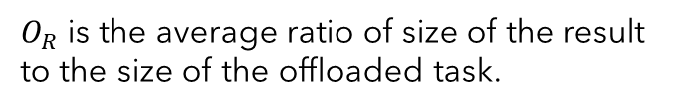
Power Consumption and Delay in Wired Parts of Fog Computing Networks
Energy-per-bit cost of transmitting data through the core, backhaul, and fronthaul networks is equal to the number of devices through which data flows multiplied by the average parameter,
$O_{R}$ is the average ratio of size of the result to the size of the offloaded task.
It needs to know the number of devices through which data flows

Slide 19
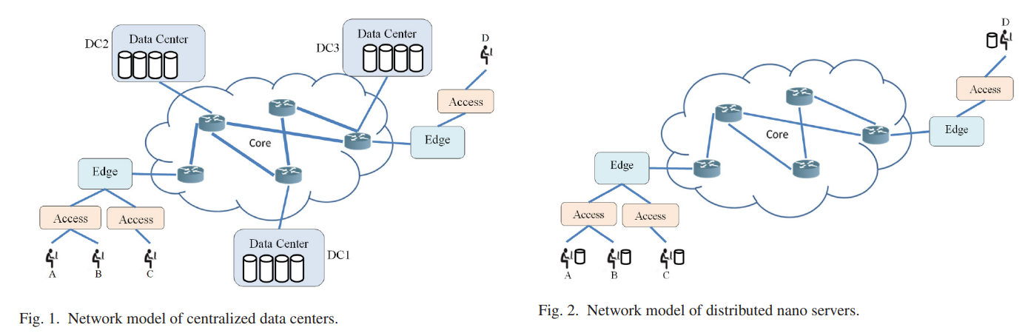
Fog Computing May Help to Save Energy in Cloud Computing
Jalali, Fatemeh, et al. "Fog computing may help to save energy in cloud computing." IEEE Journal on Selected Areas in Communications 34.5 (2016): 1728-1739.

Slide 20
Energy Consumption Models
For shared equipment: Flow-based model
For equipment in end user premises (which are not shared): Time-based model

Slide 21
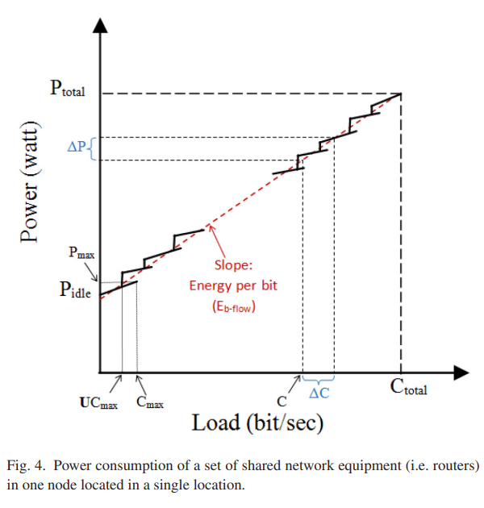
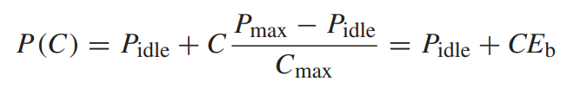
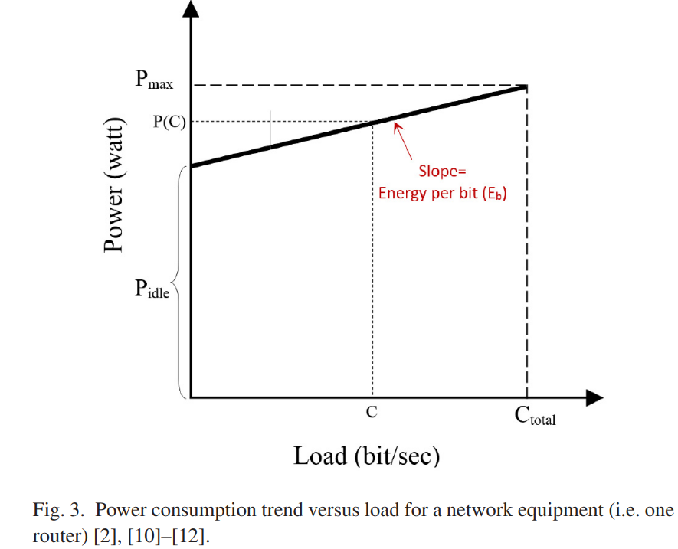


Flow-based energy model

Slide 22
MEASUREMENTS ON DELAY AND HOP-COUNT OF THE INTERNET
One of their goals was to understand how geographical distance affects the delay and hop-count, how different the delay and hop-count would be for hosts in different countries.
We measured the round-trip delays and hop-counts from a host at Computer Science Department of UCLA to 3,219 hosts in four continents.
Their results show that, in the continental US, more than 90% of hosts can be reached within 18 hops and the roundtrip delays to more than 90% of hosts are less than 153ms for our measurement packets.
We also observed no strong correlation between hop-count and delay, although the average round-trip delay does increase with the hop-count.
We also observed that the hop-count and delay to hosts in different countries demonstrate country specific patterns.
Fei, Aiguo, et al. "Measurements on delay and hop-count of the internet." IEEE GLOBECOM’98-Internet Mini-Conference. 1998.

Slide 23
Total latency^{[3]}
Cloud
Propagation delay
Total latency= Processing latency of nodes + Network latency
Network latency= Transmission delay + Propagation delay
Latency=100
Proxy server
Latency=2
Router
Transmission delay = Data size(byte)/ link BW = 2000/10000 = 0.2
Smart camera
Latency=1msec

Slide 24
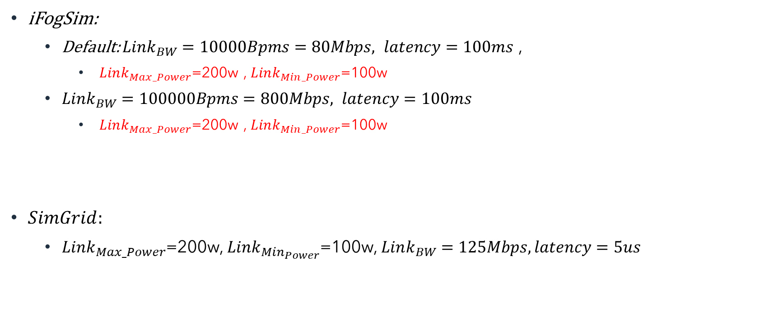
Links power
iFogSim:
Default: $Link_{BW}=10000Bpms=80Mbps, latency=100ms$ ,
$Link_{Max_Power}$=200w , $Link_{Min_Power}$=100w
$Link_{BW}=100000Bpms=800Mbps, latency=100ms$
$Link_{Max_Power}$=200w , $Link_{Min_Power}$=100w
$SimGrid:$
$Link_{Max_Power}$=200w, $Link_{Min_{Power}}$=100w, $Link_{BW}=125Mbps, latency=5us$

Slide 25
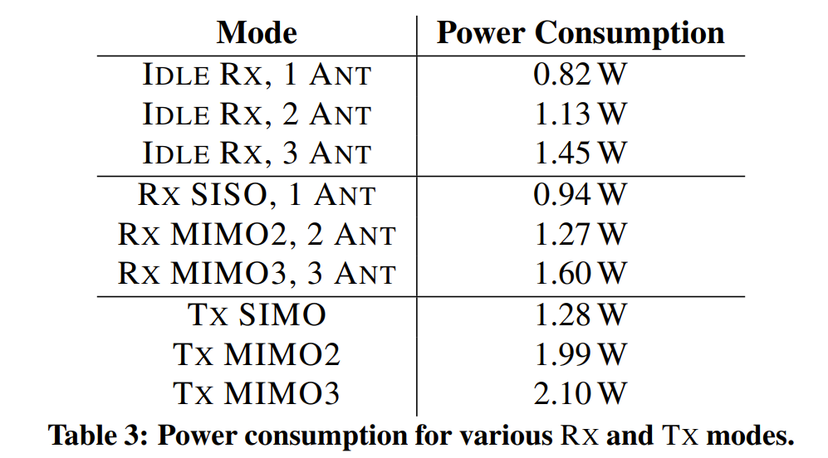
Power values for different states of laptops and desktop computers ^{[2]}
Network adapter is Intel 5300 (Which is common for laptops and desktop computers, and it is based on IEEE 802.11n wireless networking standard)
^{[2].} Halperin, Daniel, et al. "Demystifying 802.11 n power consumption." Proceedings of the 2010 international conference on Power aware computing and systems. USENIX Association, 2010.

Slide 26

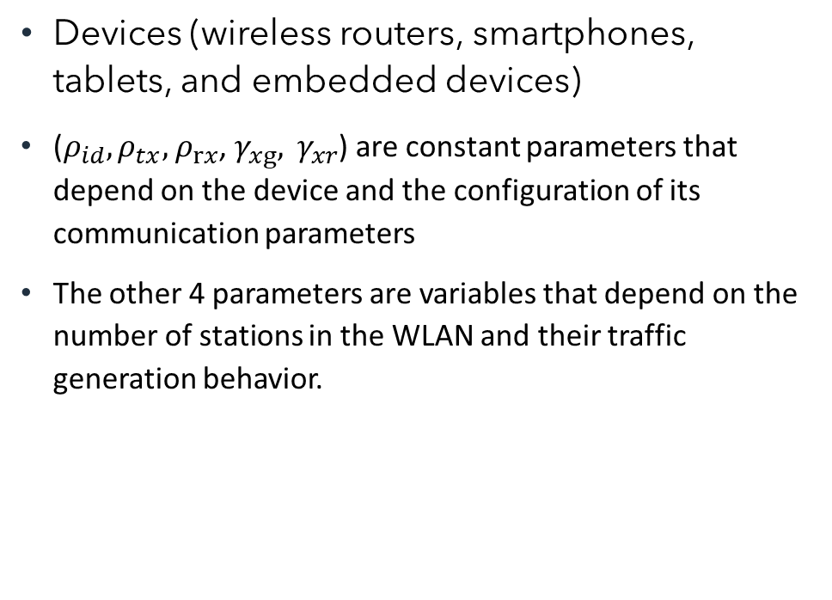
Per frame energy model
Devices (wireless routers, smartphones, tablets, and embedded devices)
($ρ_{id}, ρ_{tx},$ $ρ_{rx}$, $γ_{xg}, γ_{xr}$) are constant parameters that depend on the device and the configuration of its communication parameters
The other 4 parameters are variables that depend on the number of stations in the WLAN and their traffic generation behavior.

Slide 27
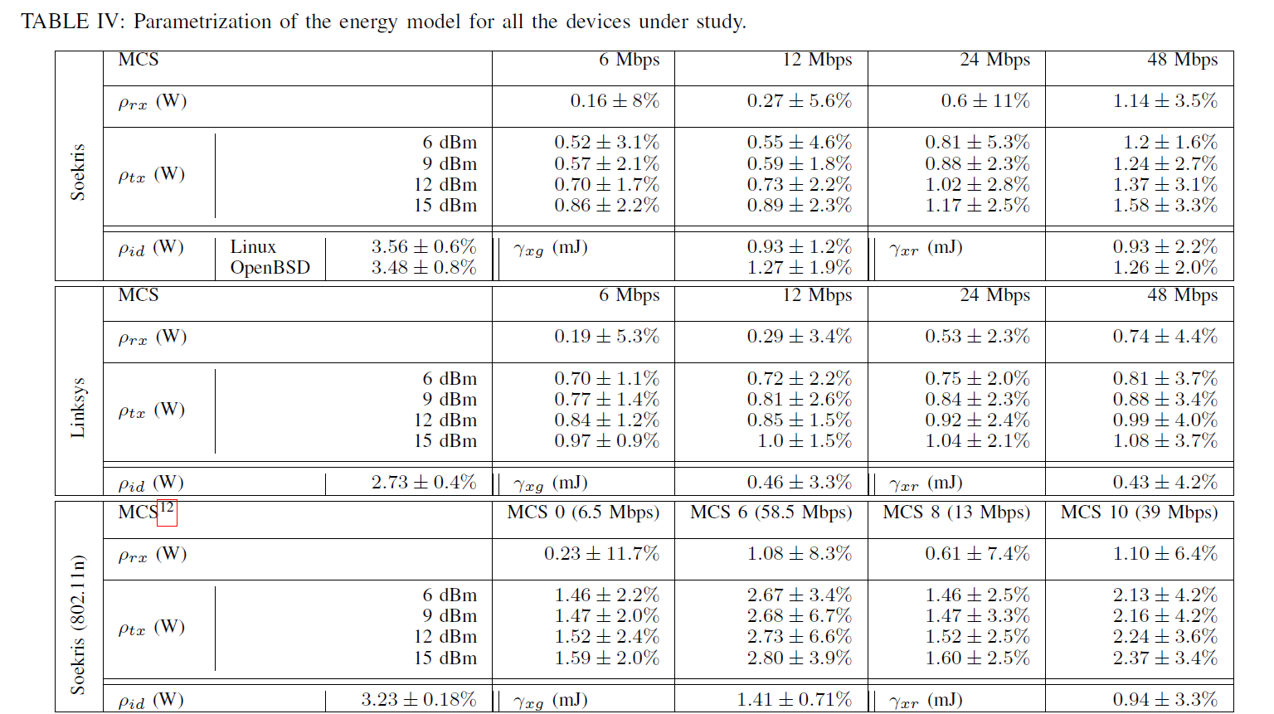
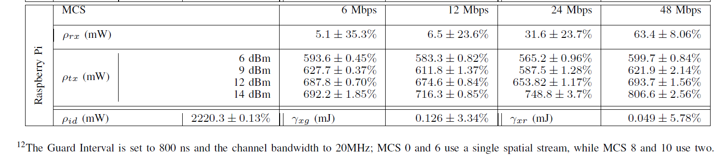
Power values for different states of Wireless Routers and AP

Slide 28
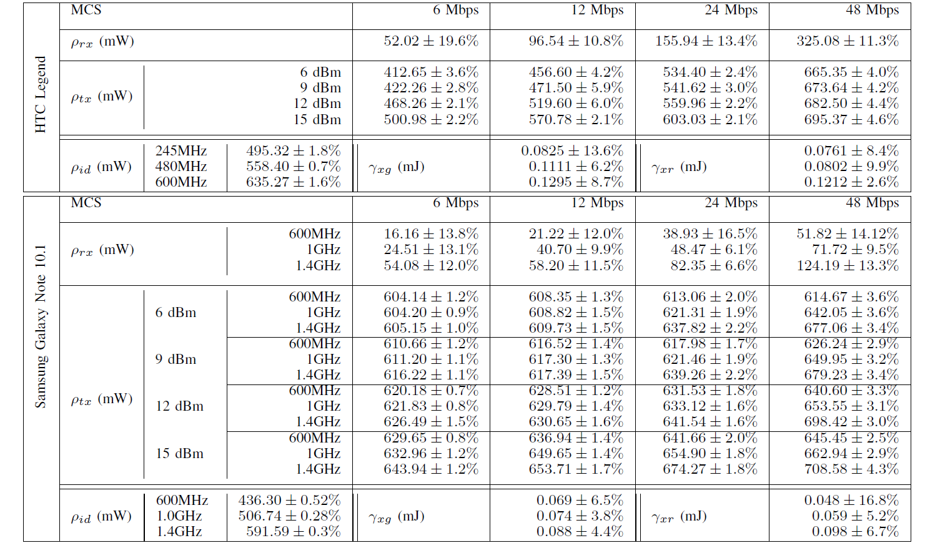
Power values for different states of Smartphone and Tablet

Slide 29
Power values for different states of an Embedded device

