Slide 1
Network Energy Modeling

Slide 2

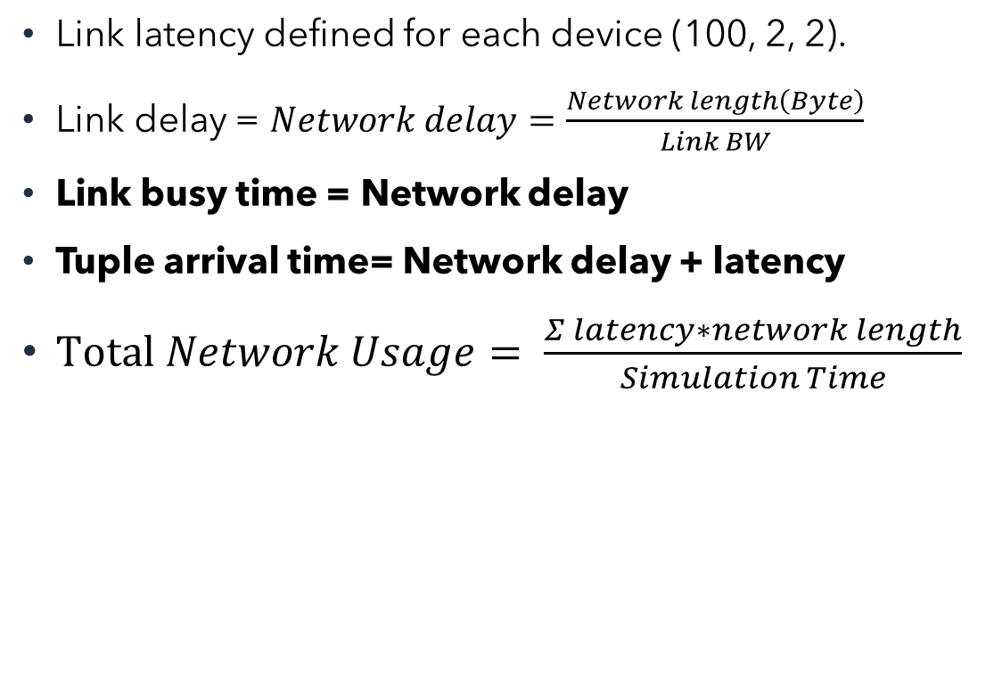
Background
Cloud
Link latency defined for each device (100, 2, 2).
Link delay = $Network delay=\frac{Network length\left(Byte\right)}{Link BW}$
Link busy time = Network delay
Tuple arrival time= Network delay + latency
$Total Network Usage= \frac{Σ latency∗network length}{Simulation Time}$
Default BW=10000
Latency=100
Modified BW=100000
Proxy server
Latency=2
Default BW=10000
Router
Modified BW=100000
Latency=2
Delay = Network length(byte)/ link BW
Delay = 2000/10000 = 0.2
Default BW=10000
Smart camera
Link busy time= Network delay
Tuple arrives to north module after network delay + latency
Latency=1msec
Default BW=10000

Slide 3
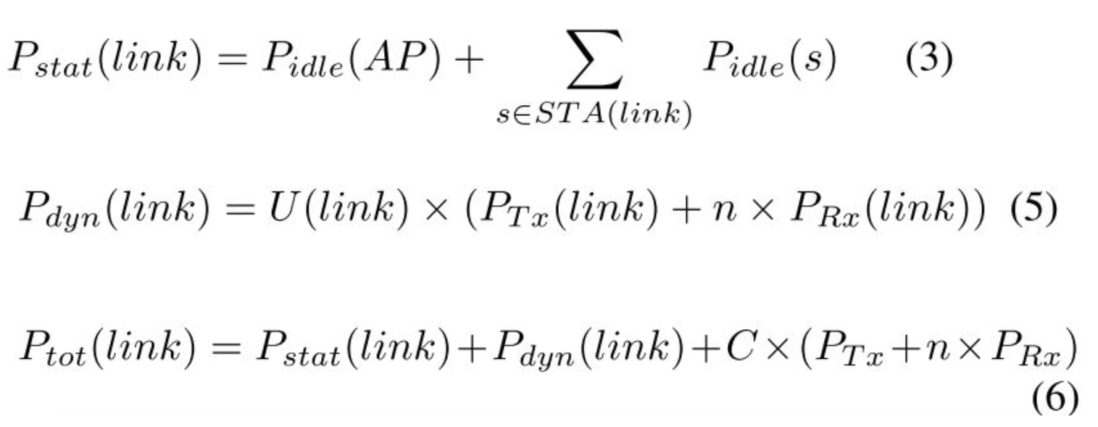
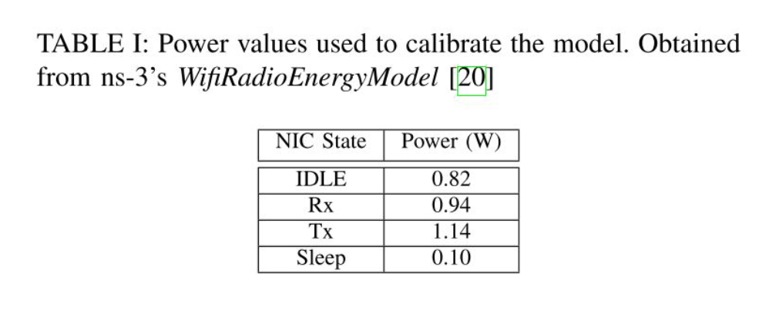
Wi-Fi Energy Model
Control packets

Slide 4
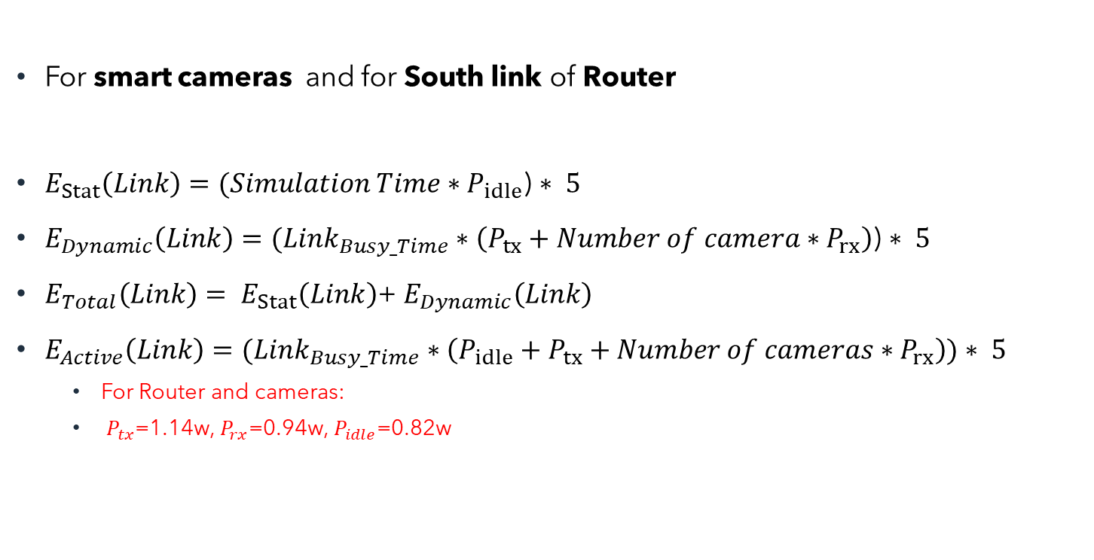
Wi-fi Network Energy^{[1]}
cloud
For smart cameras and for South link of Router
$E_{Stat}\left(Link\right)=(Simulation Time∗P_{idle}$) $∗ 5$
$E_{Dynamic}\left(Link\right)=(Link_{Busy_Time}∗\left(P_{tx}+Number of camera∗P_{rx}\right)$) $∗ 5$
$E_{Total}\left(Link\right)= E_{Stat}\left(Link\right)$+ $E_{Dynamic}\left(Link\right)$
$E_{Active}\left(Link\right)=(Link_{Busy_Time}∗\left(P_{idle}+P_{tx}+Number of cameras∗P_{rx}\right))$ $∗ 5$
For Router and cameras:
$P_{tx}$=1.14w, $P_{rx}$=0.94w, $P_{idle}$=0.82w
Proxy
server
Wi-Fi network
router
Smart camera
Smart camera
Smart camera
Smart camera

Slide 5
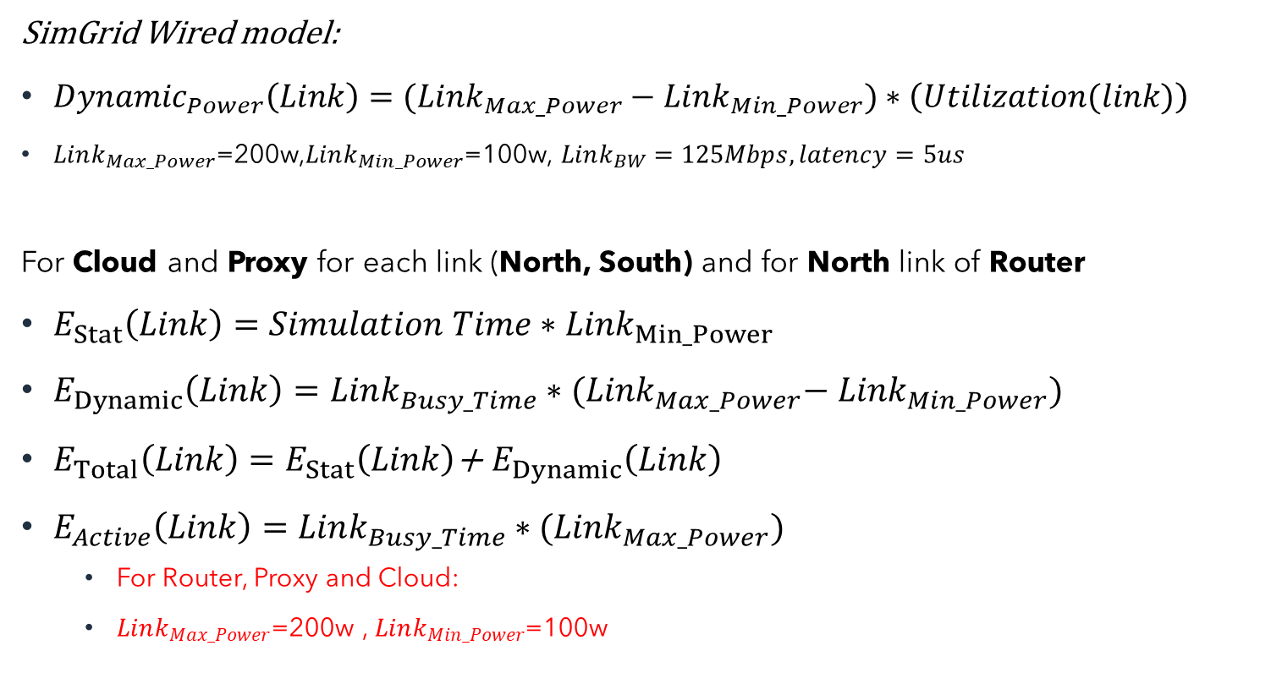
Wired Model^{[2]}
SimGrid Wired model:
${Dynamic}_{Power}\left(Link\right)=(Link_{Max_Power}−Link_{Min_Power})∗\left(Utilization(link)\right)$
$Link_{Max_Power}$=200w,$Link_{Min_Power}$=100w, $Link_{BW}=125Mbps, latency=5us$
For Cloud and Proxy for each link (North, South) and for North link of Router
$E_{Stat}\left(Link\right)=Simulation Time∗{Link}_{Min_Power}$
$E_{Dynamic}\left(Link\right)=Link_{Busy_Time}∗{(Link}_{Max_Power}−$ ${Link}_{Min_Power})$
$E_{Total}\left(Link\right)=E_{Stat}\left(Link\right)$+ $E_{Dynamic}\left(Link\right)$
$E_{Active}\left(Link\right)=Link_{Busy_Time}∗{(Link}_{Max_Power})$
For Router, Proxy and Cloud:
$Link_{Max_Power}$=200w , $Link_{Min_Power}$=100w
cloud
Wired network
Proxy
server
Wired network
router
Smart camera
Smart camera
Smart camera
Smart camera
^{[2].} Casanova, Henri. "Simgrid: A toolkit for the simulation of application scheduling." Proceedings First IEEE/ACM International Symposium on Cluster Computing and the Grid. IEEE, 2001.

Slide 6
WiFi-Wired Model Energy Results

Slide 7
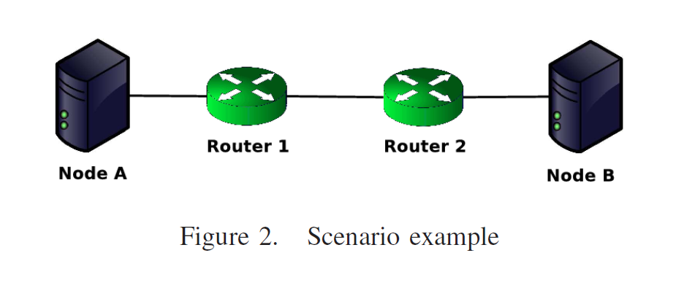
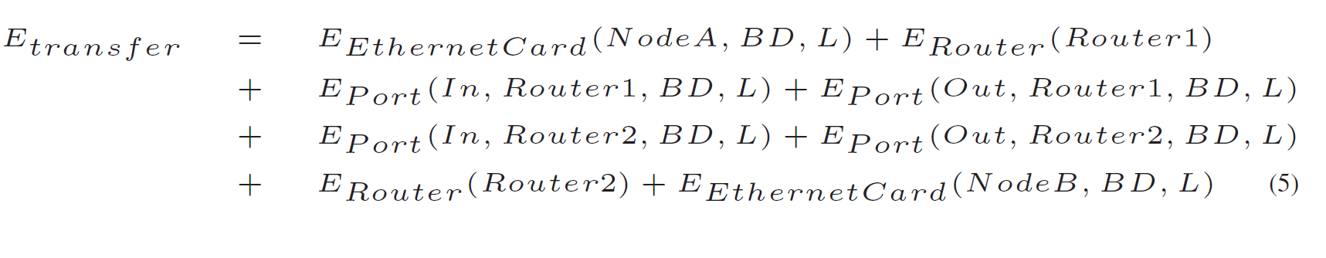
ECOFEN Energy Model

Slide 8
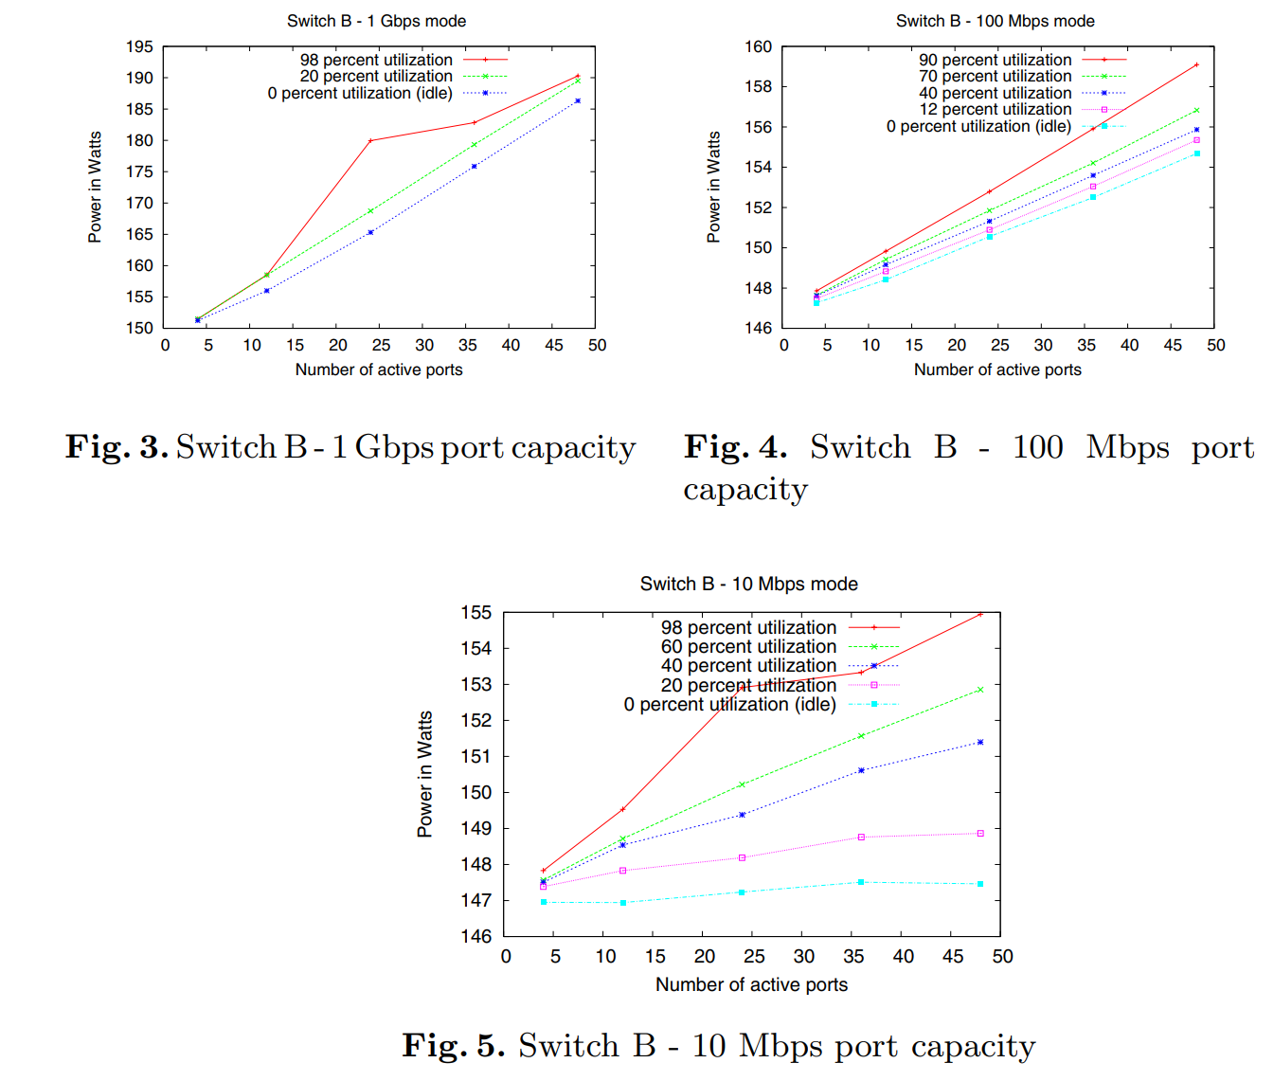
Effect of Port Capacity on Power Consumption

Slide 9
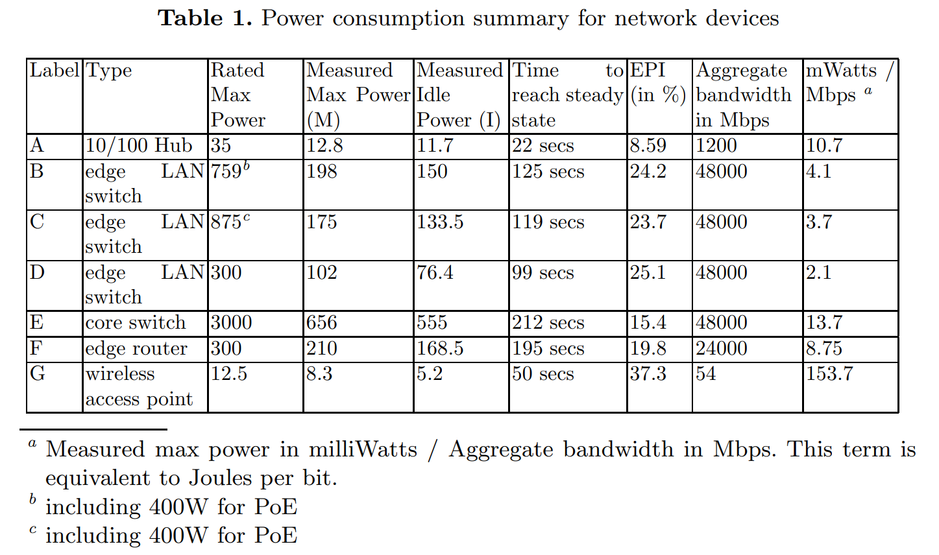
A Power Benchmarking Framework for Network Devices
Mahadevan, Priya, et al. "A power benchmarking framework for network devices." NETWORKING 2009: 8th International IFIP-TC 6 Networking Conference,, Aachen Germany, May 11-15, 2009. Proceedings 8. Springer Berlin Heidelberg, 2009.

Slide 10
Flow-Based Networking Energy model
For shared equipment: Flow-based model
For equipment in end user premises (which are not shared): Time-based model
Jalali, Fatemeh, et al. "Fog computing may help to save energy in cloud computing." IEEE Journal on Selected Areas in Communications 34.5 (2016): 1728-1739.

Slide 11
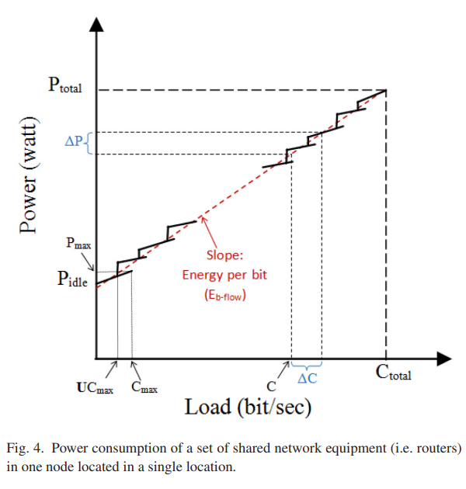
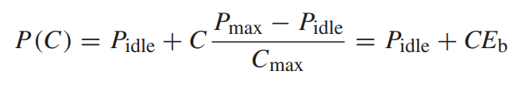
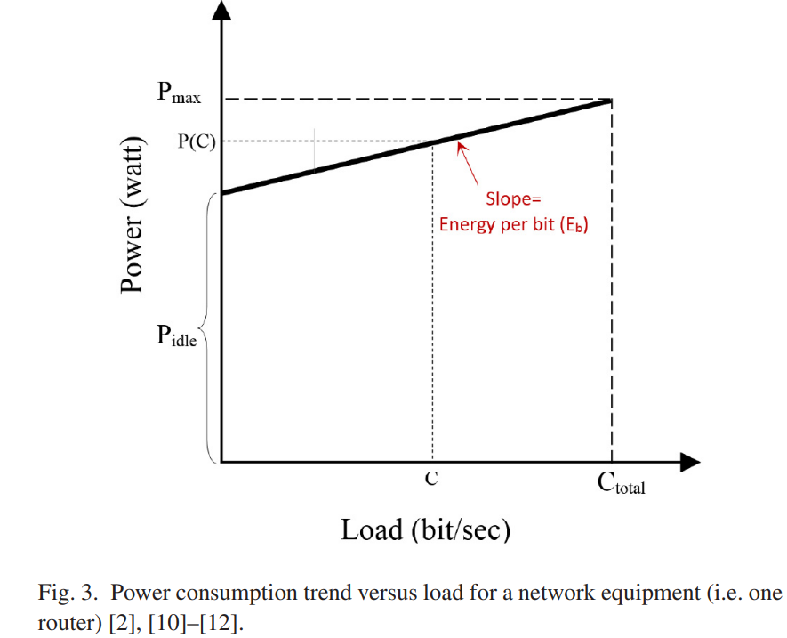


Flow-based for Shared equipment energy model

Slide 12
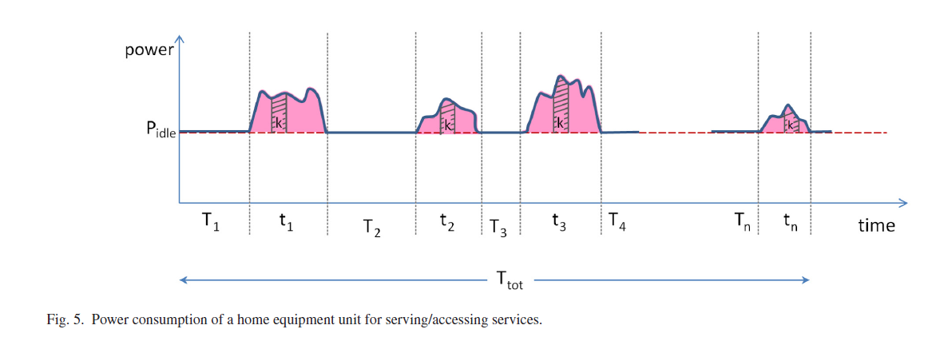

Flow-based for End users equipment energy model

Slide 13

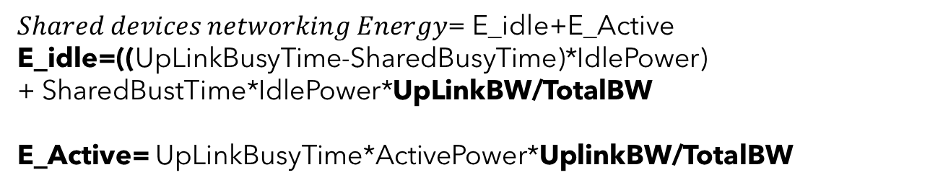
Flow-Based Energy model
cloud
Shared devices(Flow-based model)
$Shared devices networking Energy$= E_idle+E_Active
E_idle=((UpLinkBusyTime-SharedBusyTime)*IdlePower)
+ SharedBustTime*IdlePower*UpLinkBW/TotalBW
E_Active= UpLinkBusyTime*ActivePower*UplinkBW/TotalBW
Proxy
server
router
$CPE−Devices:E−Time−based (service k)$=
E_Active(Service k)+ TotalTime*IdlePower*(Active time of service k/Total active time)
End user devices (Time based model)
Smart camera
Smart camera
Smart camera
Smart camera

Slide 14
Comparison results

Slide 15
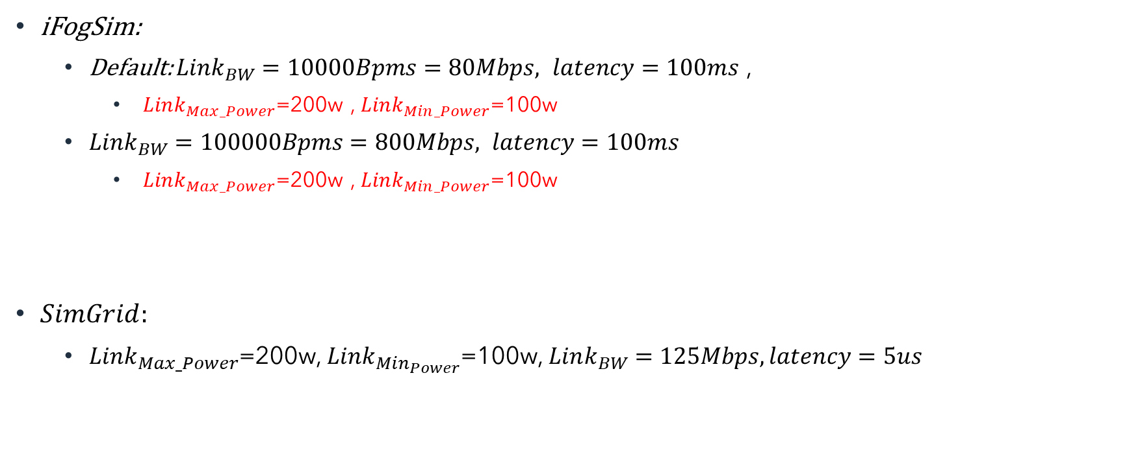
Links power
iFogSim:
Default: $Link_{BW}=10000Bpms=80Mbps, latency=100ms$ ,
$Link_{Max_Power}$=200w , $Link_{Min_Power}$=100w
$Link_{BW}=100000Bpms=800Mbps, latency=100ms$
$Link_{Max_Power}$=200w , $Link_{Min_Power}$=100w
$SimGrid:$
$Link_{Max_Power}$=200w, $Link_{Min_{Power}}$=100w, $Link_{BW}=125Mbps, latency=5us$

Slide 16
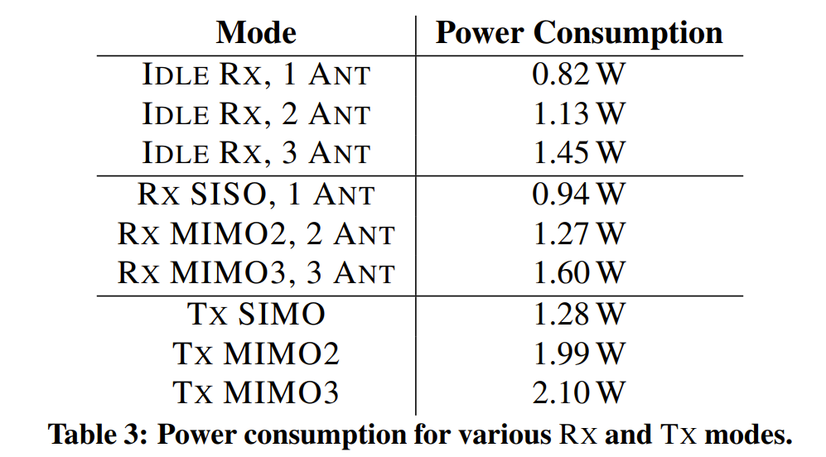
Power values for different states of laptops and desktop computers ^{[2]}
Network adapter is Intel 5300 (Which is common for laptops and desktop computers, and it is based on IEEE 802.11n wireless networking standard)
^{[2].} Halperin, Daniel, et al. "Demystifying 802.11 n power consumption." Proceedings of the 2010 international conference on Power aware computing and systems. USENIX Association, 2010.

Slide 17

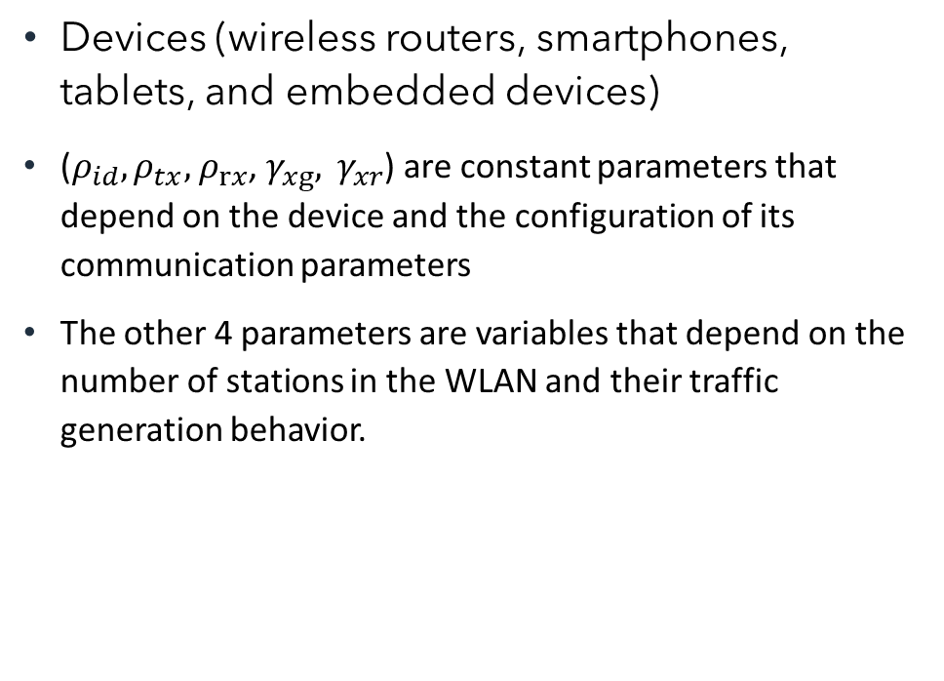
Per frame energy model
Devices (wireless routers, smartphones, tablets, and embedded devices)
($ρ_{id}, ρ_{tx},$ $ρ_{rx}$, $γ_{xg}, γ_{xr}$) are constant parameters that depend on the device and the configuration of its communication parameters
The other 4 parameters are variables that depend on the number of stations in the WLAN and their traffic generation behavior.

Slide 18
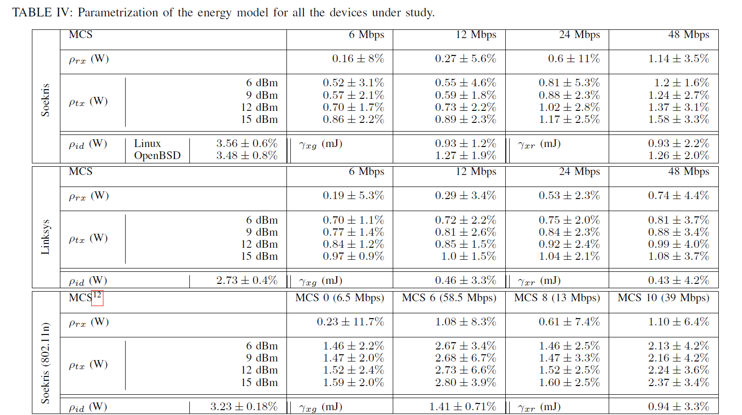
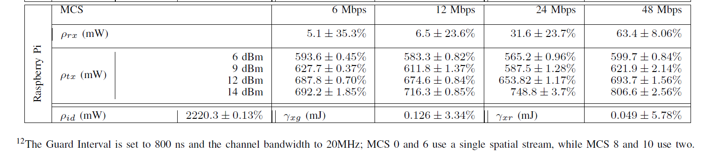
Power values for different states of Wireless Routers and AP

Slide 19
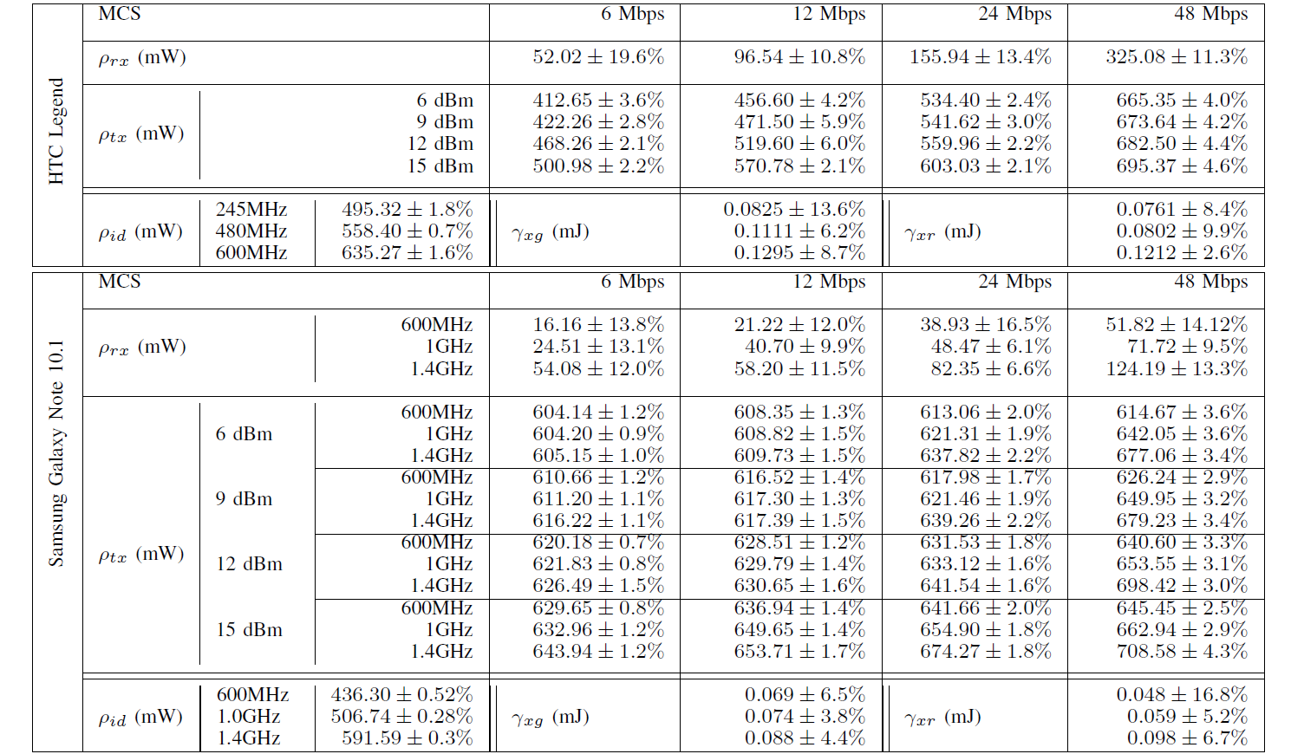
Power values for different states of Smartphone and Tablet

Slide 20
Power values for different states of an Embedded device

