Slide 1
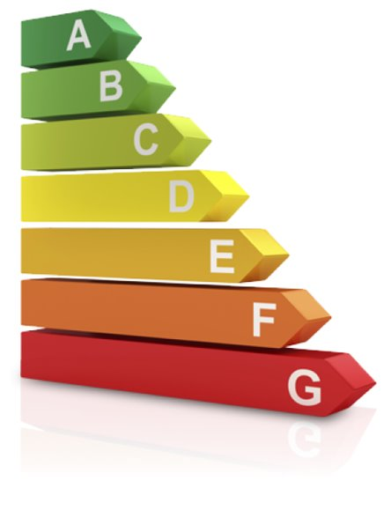

Towards Zero-Waste Computing:​ Energy Labels for Digital Services​
Saeedeh Baneshi
February. 2024
Ana-Lucia Varbanescu, Anuj Pathania, Benny Akesson, Andy Pimentel

Slide 2






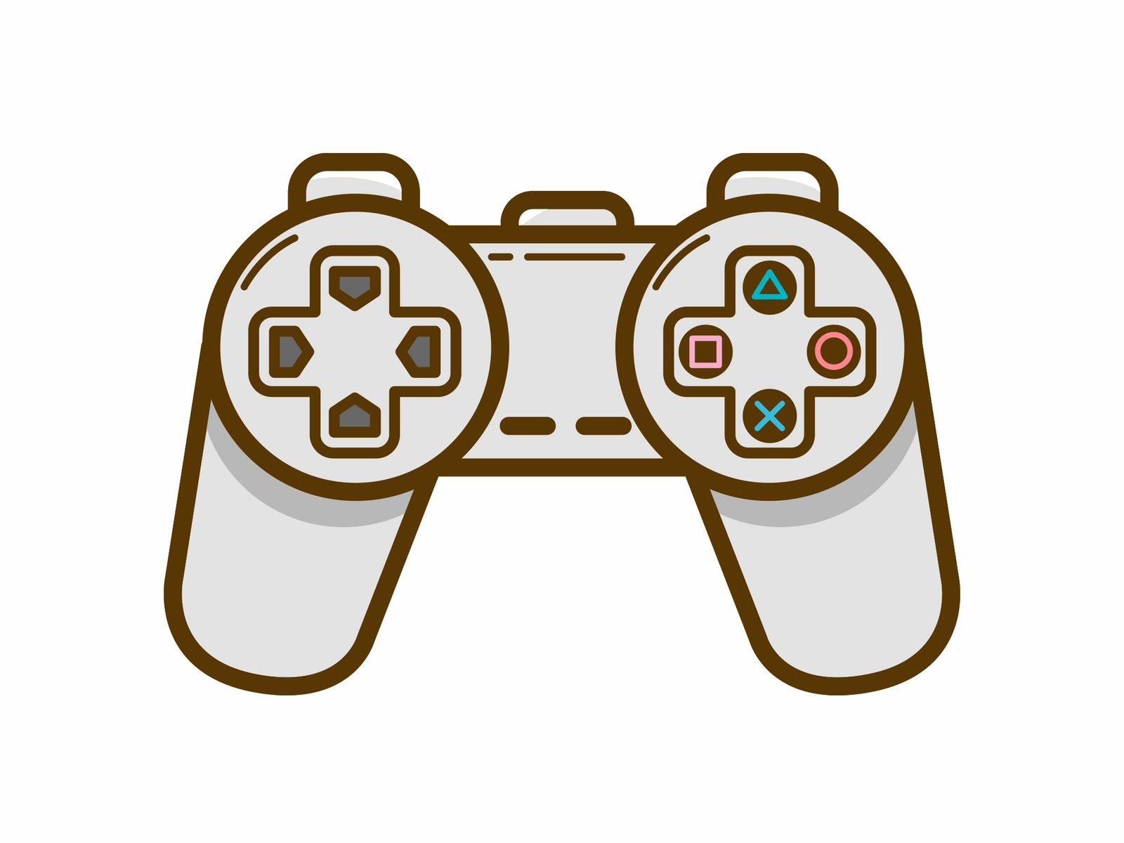
Digital Services
Scientific Discovery
Online Shopping
Digital services become essential part of our lives.
Significant energy cost
A mid-size datacenter = Small town.
ICT sector → 21% of the global energy consumption by 2030.
Data
Science
Digital
Services
Artificial Intelligence
Product Development
Entertainment
We need to study and analyze end-to-end energy consumption of applications.
Introduction
Simulation
Framework
Application
Case-Study
Continuum
Architecture
Experimental
Scenarios
Simulation
Results
Network
Energy Modeling
Multi
Application
Simulation
Results
Conclusion and Future Work
Notes:
Today activities like scientific discovery, data science , online shopping and entertainment rely increasingly on digital service. They come with significant energy cost and raising sustainability concerns. A mid size data center consume as much energy as a small town and projections show that ICT sector will reach 21% of the global energy consumption by 2030. However, data centers are only the final link in massive computing continuum and by emerging edge and fog computing paradigms we need to study and analyze the energy consumption of applications in such environment.

Slide 3

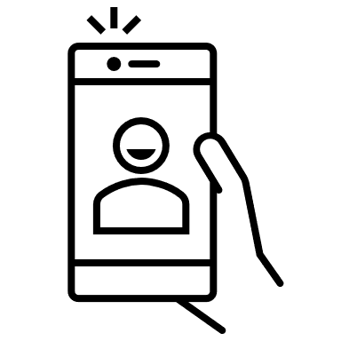
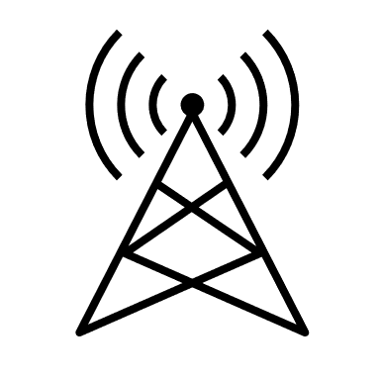






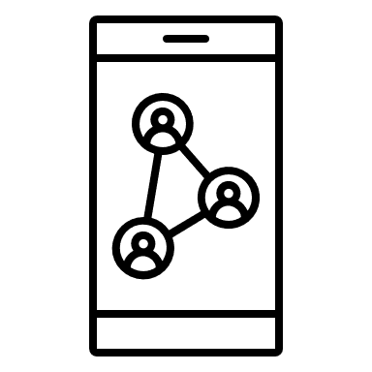
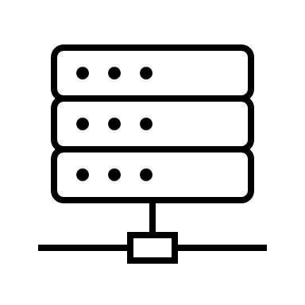
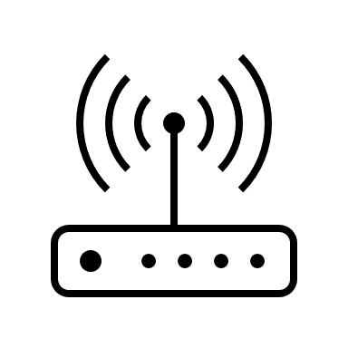

Computational Continuum
Multiple layers, with specific computing infrastructures.
Scheduling decisions impact QoS and energy consumption.
Energy measurement is challenging.
Users and Devices
(Data collection, aggregation)
Fog nodes
(Initial processing)
Data Center/ Cloud
(Heavy processing)
Simulation techniques are promising solutions to estimate energy consumption
Introduction
Simulation
Framework
Application
Case-Study
Continuum
Architecture
Experimental
Scenarios
Simulation
Results
Network
Energy Modeling
Multi
Application
Simulation
Results
Conclusion and Future Work
Notes:
Computational continuums compose of multiple layers from the device through the fog nodes to the data centers. these layers have specific computing infrastructure and scheduling decisions at each layer have impact on QoS and energy consumption.
Measuring the energy consumption of apps spanning entire the chain is challenging due to the distributed nature of apps and systems, so simulation techniques are promising solutions for estimating energy consumption.

Slide 4
Simulation Framework
Simulator​ | Language​ | Goal of simulator​ | GitHub link​
EdgeCloudSim​ | Java​ | An environment for performance evaluation of edge computing systems​ | https://github.com/CagataySonmez/EdgeCloudSim​
iFogSim2​ | Java​ | Modeling Mobility, Clustering, and Microservice Management in Edge and Fog Computing​ | https://github.com/Cloudslab/iFogSim​
YAFS​ | Python​ | Analyze the design and deployment of applications ​ | https://github.com/acsicuib/YAFS/tree/YAFS3​
Open-source simulation framework
Based on CloudSim framework
Simulates the interaction between fog devices and application
Discrete-event simulation approach
Introduction
Simulation
Framework
Application
Case-Study
Continuum
Architecture
Experimental
Scenarios
Simulation
Results
Network
Energy Modeling
Multi
Application
Simulation
Results
Conclusion and Future Work
Notes:
Among all available simulator we chose IfogSim. Ifogsim is an open-source framework written in java and it is based on CloudSim a popular framework for modelling cloud computing. There is an extension for modelling mobility, clustering and microservice management in edge and fog computing environment. It is based on discrete-event approach and simulates the interaction between fog devices and applications.

Slide 5
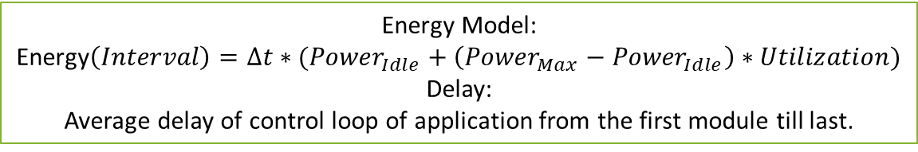
iFogSim
Physical components​
Fog devices
Specify computational capacity
Power characteristics​
iFogSim
Performance Metrics
(Energy consumption, Delay, Network usage, etc.)
Logical components​ ​
AppModules
AppEdges ​
Management component​
Identify available resources
Launch AppModules
Gather data results
Energy Model:
Energy$\left(Interval\right)=Δt∗({Power}_{Idle}+\left({Power}_{Max}−{Power}_{Idle}\right)∗Utilization)$
Delay:
Average delay of control loop of application from the first module till last.
It only reflects certain point of view (“Device perspective”) in reports
Introduction
Simulation
Framework
Application
Case-Study
Continuum
Architecture
Experimental
Scenarios
Simulation
Results
Network
Energy Modeling
Multi
Application
Simulation
Results
Conclusion and Future Work
Notes:
IfogSim has three main components, physical, logical and management component which we should define before starting the simulation. For modelling fog devices, we should specify computational capacity and power characteristics of each device. We should define application by splitting it to independence modules called AppModules and define dependency of AppModules by AppEdges.
Logical components of ifogsim are module mapping and controller which are responsible for identifying available resources based on the app requirement and launching modules on target devices and gathering data results at the end of simulation. It reports metrics like network usage, cost delay, and energy consumption, and for estimating the energy consumption it considers utilization and max and Idle power and uses a linear model. It reports is the average delay of app from start of processing by the first module till the end of last one.
However, It only consider device perspective in its reports.

Slide 6
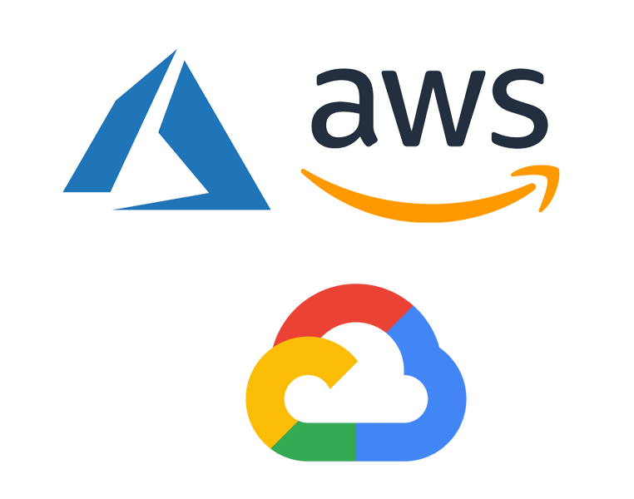


Who cares about what?
Cloud Providers
Application providers
Users
Want to know energy consumption of devices to:
Optimize resource allocation
Improve energy efficiency
Make informed decisions
Want to know energy consumption of applications to:
Identify energy-intensive components
Optimize code and algorithms
Design energy-efficient solutions
Want to know energy consumption of applications to:
Make informed choices
Support eco-friendly services
Introduction
Simulation
Framework
Application
Case-Study
Continuum
Architecture
Experimental
Scenarios
Simulation
Results
Network
Energy Modeling
Multi
Application
Simulation
Results
Conclusion and Future Work
Notes:
Reporting energy consumption from the device perspective could be interesting for cloud providers and by understanding it they can optimize resource allocation, Improve energy efficiency, and make informed decisions regarding infrastructure expansion and utilization. Reducing energy consumption can leads to cost saving, Increasing profitability and minimizing carbon footprint.
However, App providers wants to know energy consumption of apps to identify energy intensive components, optimize code and algorithms and design energy efficient solutions to reduce cost, enhance user experience and contribute to environmental sustainability.
Users also want to know the energy consumption of apps to make informed choices and support eco-friendly services.
In the rest I will show you how we consider these perspectives in our experiments for two case study.

Slide 7
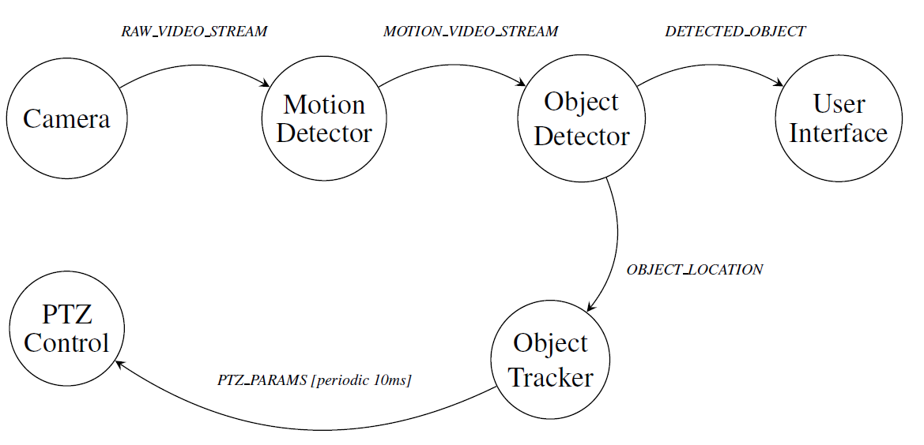
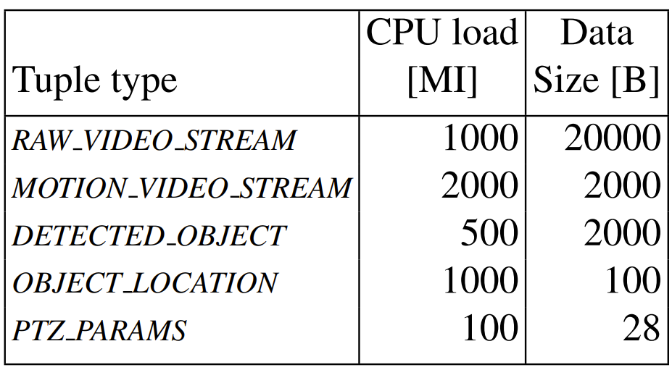
Surveillance Application Model ^{[1]}
Motion Detector:
Reads raw captured video to detect motion.
Object Detector:
Extracts moving objects and theirs coordinates.
Object Tracker:
Calculates optimal PTZ configuration.
PTZ Control:
Adjusts physical camera based on parameters.
User Interface:
Sends the detected object to the user.
[1]. Gupta, Harshit, et al. "iFogSim: A toolkit for modeling and simulation of resource management techniques in the Internet of Things, Edge and Fog computing environments." Software: Practice and Experience 47.9 (2017): 1275-1296.
Introduction
Simulation
Framework
Application
Case-Study
Continuum
Architecture
Experimental
Scenarios
Simulation
Results
Network
Energy Modeling
Multi
Application
Simulation
Results
Conclusion and Future Work
Notes:
Sends video fraction of streams containing the detected object to the user.

Slide 8
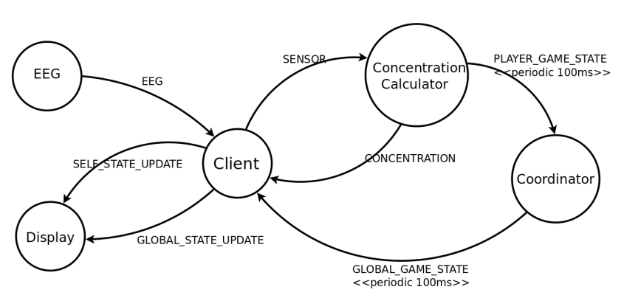
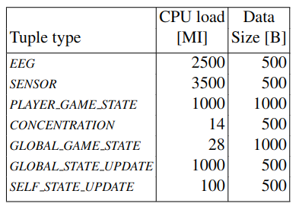
VR Game Application Model ^{[1]}
Client Module:
Filters raw EEG signals
Concentration Calculator Module:
Detects brain state, calculates concentration level, and updates the player's game state.
Coordinator Module:
Manages the game and updates all clients.
[1]. Gupta, Harshit, et al. "iFogSim: A toolkit for modeling and simulation of resource management techniques in the Internet of Things, Edge and Fog computing environments." Software: Practice and Experience 47.9 (2017): 1275-1296.
Introduction
Simulation
Framework
Application
Case-Study
Continuum
Architecture
Experimental
Scenarios
Simulation
Results
Network
Energy Modeling
Multi
Application
Simulation
Results
Conclusion and Future Work

Slide 9
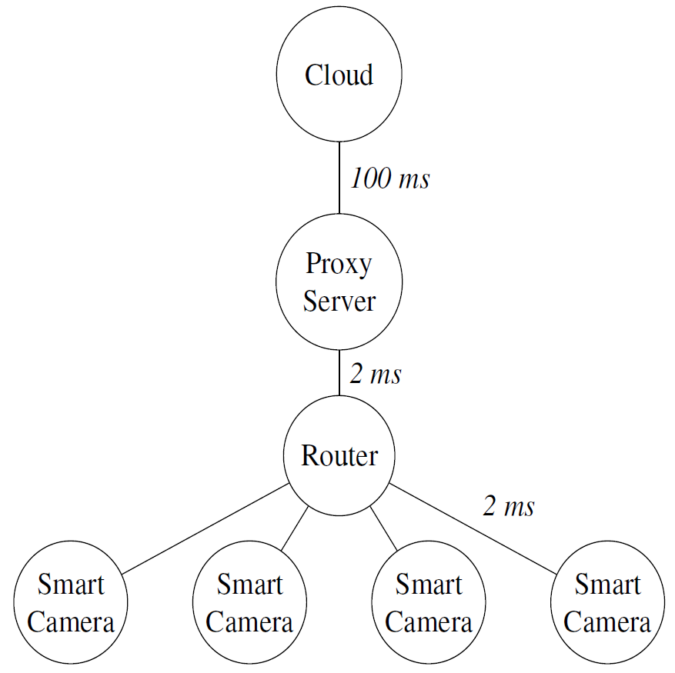

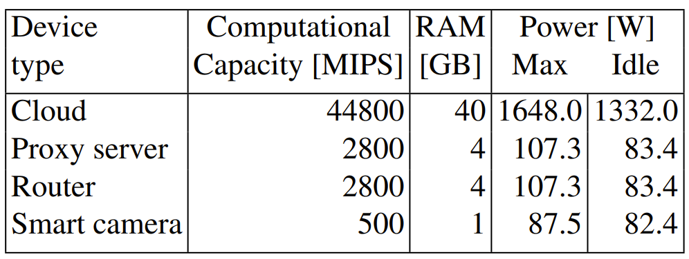
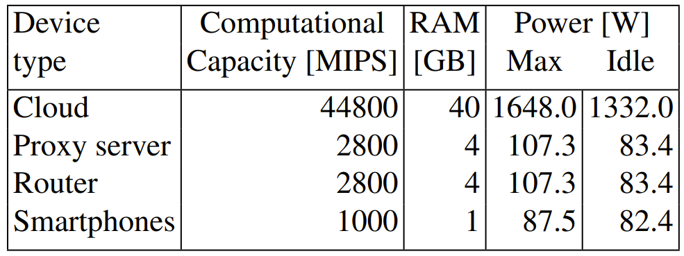
Continuum Architectures
Surveillance Application
VR Game
Application
Introduction
Simulation
Framework
Application
Case-Study
Continuum
Architecture
Experimental
Scenarios
Simulation
Results
Network
Energy Modeling
Multi
Application
Simulation
Results
Conclusion and Future Work

Slide 10
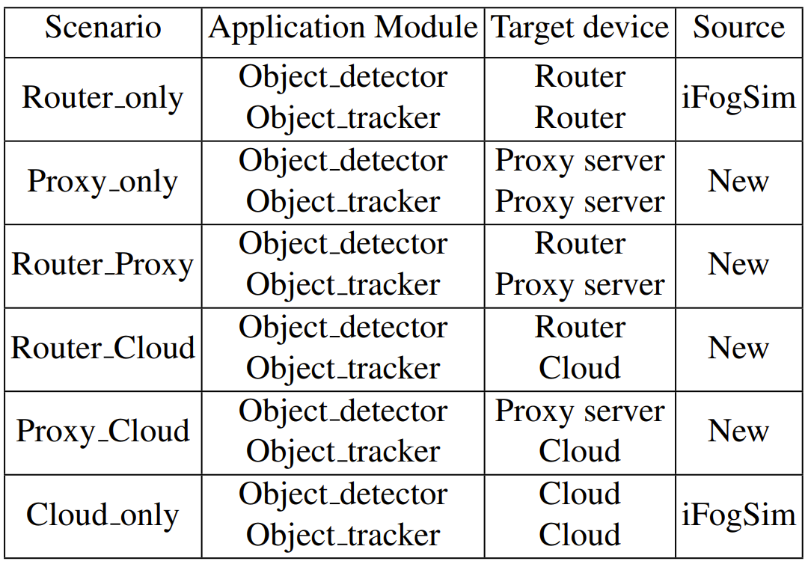
Mapping Scenarios for the Surveillance Application
Application requirements:
User interface module → cloud
Motion detector → Smart camera.
Six mapping scenarios
Gain insight on application energy consumption across different layers.
Introduction
Simulation
Framework
Application
Case-Study
Continuum
Architecture
Experimental
Scenarios
Simulation
Results
Network
Energy Modeling
Multi
Application
Simulation
Results
Conclusion and Future Work
Notes:
For running app in system, we considered different scenarios of mapping AppModules to the Devices.

Slide 11
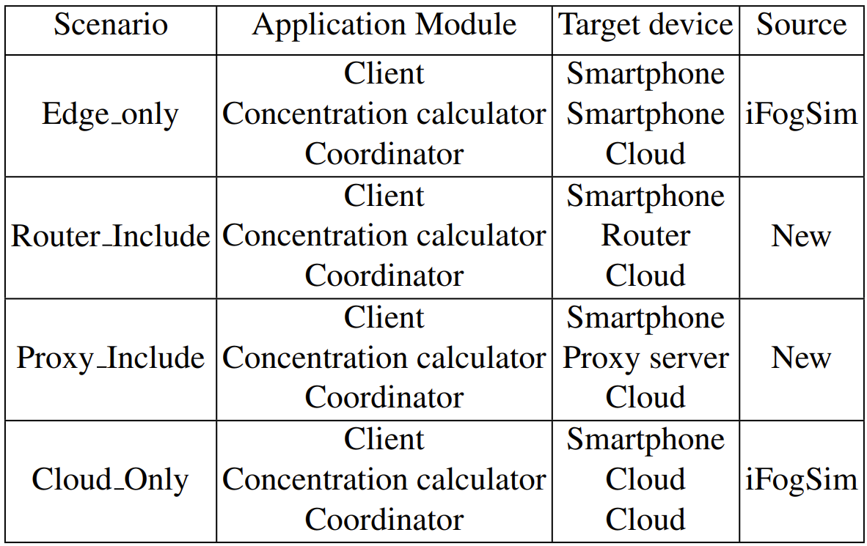
Mapping Scenarios for the VR Game Application
Application requirements :
Coordinator module → cloud
Client module → Smart phone.
Four mapping scenarios
Gain insight on application energy consumption across different layers.
Introduction
Simulation
Framework
Application
Case-Study
Continuum
Architecture
Experimental
Scenarios
Simulation
Results
Network
Energy Modeling
Multi
Application
Simulation
Results
Conclusion and Future Work
Notes:
Four mapping scenarios to gain insight on energy consumption of the application at different layers of the continuum.

Slide 12
Simulation Results for Surveillance Application
Delay of surveillance application in different scenarios
Digital Chain Energy consumption (KJ)
Application Energy consumption (KJ)
Introduction
Simulation
Framework
Application
Case-Study
Continuum
Architecture
Experimental
Scenarios
Simulation
Results
Network
Energy Modeling
Multi
Application
Simulation
Results
Conclusion and Future Work
Notes:
This figure shows the energy consumption of devices in different scenarios for surveillance application. As you can see there is no significant difference in total energy of chain among all scenarios. Also, we observed that the energy consumption of each device doesn't change significantly for different scenarios. The reason is that for each device the idle energy consumption is dominant.
In application perspective, we just consider energy consumption of devices when they are processing the application and remove energy consumption of inactive intervals. By doing this, in app perspective you can see the difference in total energy of chain and devises energy consumption.

Slide 13
Simulation Results for VR Game Application
Digital Chain Energy consumption (KJ)
Application Energy consumption (KJ)
Delay of VR Game application in different scenarios
Introduction
Simulation
Framework
Application
Case-Study
Continuum
Architecture
Experimental
Scenarios
Simulation
Results
Network
Energy Modeling
Multi
Application
Simulation
Results
Conclusion and Future Work
Notes:
In second application, same as first one we observed that there is no significant difference in both device and total chain energy consumption. But in Application perspective, these differences in device and total chain energy consumption is obvious.
And delay chart shows that by offloading process to the cloud the delay will increase.

Slide 14
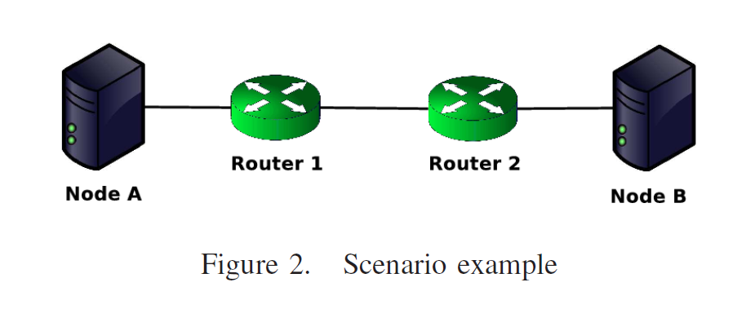
Network Energy Modeling
Networking energy models
Wired- Wi-Fi model
Wi-Fi model: connection of cameras and Router
Wired model: connection of Router, Proxy and Cloud
ECOFEN Model
NIC of nodes and all ports of intermediate devices
Flow-Based model
Shared and end-user devices
Calibration
Doesn’t support of multitenancy
Calibration
Lack of information about hops
Doesn’t support of multitenancy
Calibration
Lack of considering space shared scenarios (e.g., dedicated BW)
Support of multitenancy
Fits with available information of iFogSim
Introduction
Simulation
Framework
Application
Case-Study
Continuum
Architecture
Experimental
Scenarios
Simulation
Results
Network
Energy Modeling
Multi
Application
Simulation
Results
Conclusion and Future Work
Notes:
Our experimental results highlight the lack of networking energy modeling in iFogSim, So to have a more realistic estimation of applications energy we investigate network energy models.
We explored 3 different models.
In first model we consider a combination of wired wi-fi model. We use wi-fi model for cameras and router in our architecture and wired for other connections. The problem of this model is that it doesn’t support of multitenancy and has calibration problem.
Second model considers energy of NIC of nodes and ports of intermediate devices. But as our goal is to provide a high-level framework and we don’t have information about the intermediate hops, such detailed model is not a good fit.
we chose flow-based model because it supports multitenancy, and it fits with available information of iFogSim, but it still has calibration problem.

Slide 15
Flow-Base Energy Model ^{[4]}
Type of devices:
Shared
End user equipment (CPE)
For shared equipment → Flow-based model
Active energy based on size of transferred data
Idle energy during their active time based on their BWs ratio
For equipment in end user premises (which are not shared) → Time-based model
Active energy during their active time with their BWs ratio
Total Idle power of device based on their BWs ratio
Introduction
Simulation
Framework
Application
Case-Study
Continuum
Architecture
Experimental
Scenarios
Simulation
Results
Network
Energy Modeling
Multi
Application
Simulation
Results
Conclusion and Future Work
Notes:
In this model, they classify devices in two types, shared and end user devices.
For shared devices they considered a flow-based model and based on this model applications should pay for active energy base on their transferred data size
And pay for idle energy proportional to their BW utilization.
For end-user devices as it is dedicated to user they consider a time –base model, and applications should pay for active energy proportional to their BW usage. And pay for Total idle energy of device proportional to their BW

Slide 16
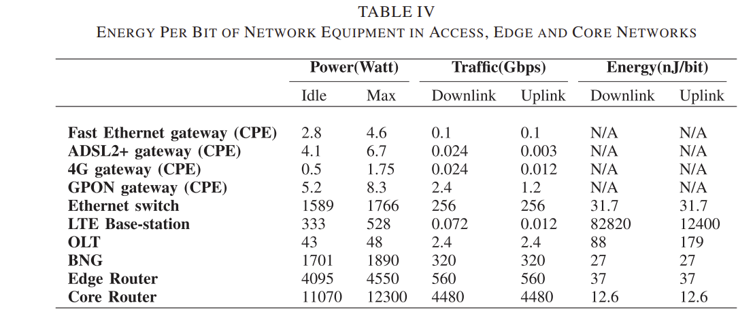
Flow-Based Energy model
cloud
$Application Networking Energy=E_{Cloud}$+$E_{Proxy}$+$E_{Router}$+ $E_{Camera}$
Shared devices(Flow-based model)
Proxy
server
router
Smart camera
Smart camera
Smart camera
Smart camera
End user devices (Time based model)
Introduction
Simulation
Framework
Application
Case-Study
Continuum
Architecture
Experimental
Scenarios
Simulation
Results
Network
Energy Modeling
Multi
Application
Simulation
Results
Conclusion and Future Work
Notes:
In our architecture we consider cameras as end user devices and other as shared devices. We used same power parameters for our devices as original model which need to calibrate for our architecture.
Now simulator can report the communication energy consumption of device which is the energy consumed by it’s NIC during data transfer.

Slide 17
Application Perspective
Improve iFogSim to support multiple application
Considering Networking energy consumption model with fine granularity
Flow-base model for networking energy of NICs
Implement flow-based model to have energy result per task
Considering Computation energy consumption with granularity of VMs:
Energy consumption per VMs of devices → Tracking the energy of application modules
Introduction
Simulation
Framework
Application
Case-Study
Continuum
Architecture
Experimental
Scenarios
Simulation
Results
Network
Energy Modeling
Multi
Application
Simulation
Results
Conclusion and Future Work
Notes:
Additionally, we improved it to report networking energy consumption of applications and support multi application scenarios. Now simulator not only report networking energy consumption of application but also report it with granularity of tasks.
Also, we improved it to report Computation energy consumption per application module as well as networking.

Slide 18
Multi Applications Mapping Scenarios
App_0
We consider Two instances of surveillance app
Scenario | Application | Target device
Router_Only | App_0 App_1 | Router Router
Router_Proxy | App_0 App_1 | Router Proxy
Router_Cloud | App_0 App_1 | Router Cloud
Proxy_Only | App_0 App_1 | Proxy Proxy
Proxy_Cloud | App_0 App_1 | Proxy Cloud
App_1
Introduction
Simulation
Framework
Application
Case-Study
Continuum
Architecture
Experimental
Scenarios
Simulation
Results
Network
Energy Modeling
Multi
Application
Simulation
Results
Conclusion and Future Work
Notes:
To characterize energy consumption of applications in multi applications scenarios, we consider two instances of surveillance application and by considering limitation of app assigned MD to camera and UI to cloud and for the rest.

Slide 19
Multi Applications experimental results
Introduction
Simulation
Framework
Application
Case-Study
Continuum
Architecture
Experimental
Scenarios
Simulation
Results
Network
Energy Modeling
Multi
Application
Simulation
Results
Conclusion and Future Work
Notes:
And this is the applications energy characterization results. Left chart shows the networking energy of application and right one shows the computation energy in different scenarios. The difference between energy of two apps on same device is because that we consider a submission delay for second app. And as you can see by offloading application to cloud its energy consumption will increase.

Slide 20
Multi Applications experimental results
Delay of surveillance application in different scenarios
Introduction
Simulation
Framework
Application
Case-Study
Continuum
Architecture
Experimental
Scenarios
Simulation
Results
Network
Energy Modeling
Multi
Application
Simulation
Results
Conclusion and Future Work
20
Notes:
Here left chart shows the total energy consumption of application including computation and communication, its like computation energy chart because the computation energy part is dominant.
The right chart shows the delay of applications and unlike the single app scenarios here you can see benefit of offloading to the cloud. For example, in scenarios that both apps are on same device as router only, the delay significantly increase duo to the queueing off apps.

Slide 21
Conclusion and discussion
Both computation and networking energy
We designed experiments to study the energy consumption of applications
Effect of multi application
Future directions
Considering other possible mapping scenarios of multi application
Exploring attribution policies of energy consumption
Calibration
Introduction
Simulation
Framework
Application
Case-Study
Continuum
Architecture
Experimental
Scenarios
Simulation
Results
Network
Energy Modeling
Multi
Application
Simulation
Results
Conclusion and Future Work
Notes:
To wrap up, we improved iFogSim to report both computation and communication energy with fine granularity. We designed experiment to study and analyze energy of application in multitenant environment.
As future work, we aim to design different experiments and scenarios of multi application Also consider exploring the attribution policies
And consider the calibration of power model for our architecture.

Slide 22
References
[1]. H. Gupta, A. Vahid Dastjerdi, S. K. Ghosh, and R. Buyya. ifogsim: A toolkit for modeling and simulation of resource management techniques in the internet of things, edge and fog computing environments. Software: Practice and Experience, 47(9):1275–1296, 2017.
[2]. R. N. Calheiros, R. Ranjan, A. Beloglazov, C. A. De Rose, and R. Buyya. Cloudsim: a toolkit for modeling and simulation of cloud computing environments and evaluation of resource provisioning algorithms. Software: Practice and experience, 41 (1):23–50, 2011.
[3]. E. Ahvar, A.-C. Orgerie, and A. Lebre. Estimating energy consumption of cloud, fog, and edge computing infrastructures. IEEE Transactions on Sustainable Computing, 7(2):277–288, 2019.
[4].Jalali, Fatemeh, et al. "Fog computing may help to save energy in cloud computing." IEEE Journal on Selected Areas in Communications 34.5 (2016): 1728-1739.

Slide 23

Energy Calculation (Backup)
State of device do not change between events
Device(Cloud)
event₁
event₂
event₃
event₄
event₅
Host
VM1
VM2
Task1
Task₁
Task₂
Idle
Task₃
…...
Δt₁
P₁
Δt₂
P₂
Δt₃
P₃
Δt₄
P₄
Time
E₁
E₂
E₃
E₄
E_{Task1} E₂ / 2 | E_{Task2} E₂ / 2 | E_{Task3} 0
Device Energy = E₁+E₂+E₃+ E₄...
Task₁ Energy = E₁+E₂/2
Application Energy = E₁+E₂+E₄+ ...
Task₂ Energy = E₂/2
Task₃ Energy = E₄
VM1 Energy = E₁+E₄+ ...
VM2 Energy = E₂+ ...

Slide 24
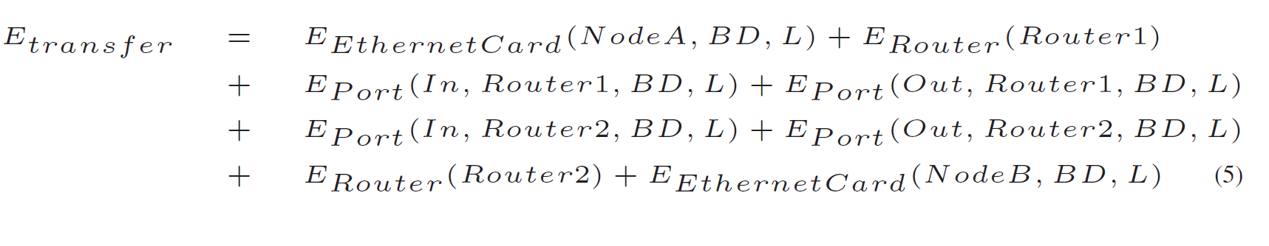
First Model: ECOFEN Energy Model (Backup)
We don’t have information about the hops between two nodes!
First assumption: Only considering NICs of fog nodes and use the power parameters

Slide 25
Flow-based model for Shared equipment (Backup)
Applications pay for active energy based on size of transferred data
Applications pay for idle energy during their active time with their BWs ratio
$$Active energy part=DataSize∗Energy per bit=BW∗t_{interval}∗\frac{{Power}_{max}−{Power}_{idle}}{Aggregate BW}$$
$$Idle energy part=DataSize∗\frac{{Power}_{idle}}{Active BW}=BW∗t_{interval}∗\frac{{Power}_{idle}}{Active BW}$$
$Aggregate BW=Uplink BW+$ $Downlink BW$
$Active BW=Uplink BW Or$ $Downlink BW$

Slide 26
Time-based model for user equipment (Backup)
Applications pay for active energy during their active time with their BWs ratio
And pay for the Total Idle power of device with their BWs ratio
$$Active energy part=\sum_{Intervals}{\left({Power}_{max}−{Power}_{idle}\right)∗t_{interval}}∗\frac{BW}{Aggregate BW}$$
$$Idle energy part={Power}_{idle}∗\frac{Total simulation time}{Total NIC active time}∗\sum_{Intervals}{\frac{t_{interval}∗BW}{Active BW}}$$

Slide 27
Networking models result (Backup)

