Slide 1
Network Energy Modeling

Slide 2

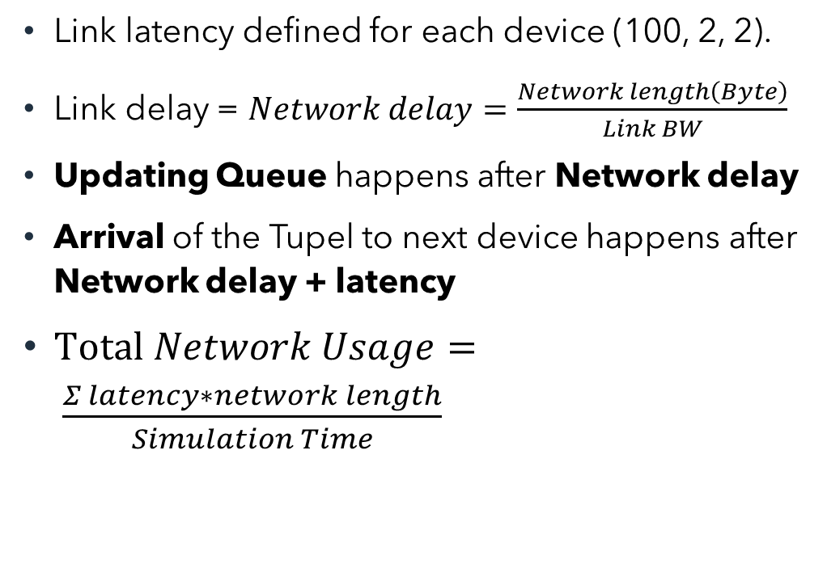
Continuum Architecture
Cloud
Default BW=10000
Link latency defined for each device (100, 2, 2).
Link delay = $Network delay=\frac{Network length\left(Byte\right)}{Link BW}$
Updating Queue happens after Network delay
Arrival of the Tupel to next device happens after Network delay + latency
$Total Network Usage= \frac{Σ latency∗network length}{Simulation Time}$
Latency=100
Modified BW=100000
Proxy server
Latency=2
Default BW=10000
Router
Modified BW=100000
Latency=2
Delay = Network length(byte)/ link BW
Delay = 2000/10000 = 0.2
Default BW=10000
Smart camera
Latency=1msec
Default BW=10000

Slide 3
A Wi-Fi Energy Model for Scalable Simulation
A flow-based simulation model
For large scale and heterogeneous network infrastructure
Similar accuracy compared to the energy model of the packet-based simulator ns-3

Slide 4
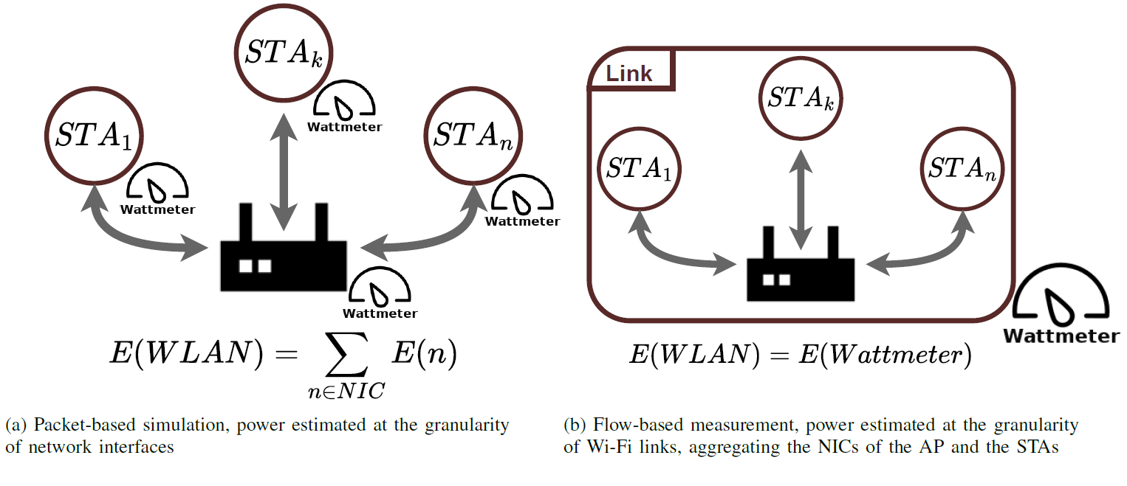
A Wi-Fi Energy Model for Scalable Simulation
Focus on the energy of the network card, excluding the consumption of the other devices’ components.
Wi-Fi link describes the aggregation of an Access Point (AP), the communication channel, and the Stations (STA) attached to the AP.
Power Saving Mechanisms, MIMO configurations, control and management frames are not considered in the current energy model.
This model is homogeneous.

Slide 5
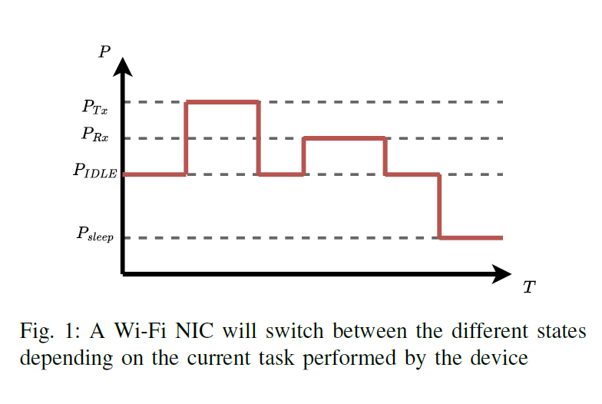
Energy modeling
PIDLE: The NIC does not perform any operation, the power used only consists of the idle power consumption.
Tx: The NIC actively sends data, requiring to power the antennas of the device.
Rx: The NIC actively receives data, which requires listening to the wireless channel.
Sleep: Deactivates parts of the circuitry to reduce the power usage, but also deactivates some functionalities.
^{[1].} Courageux-Sudan, Clément, Anne-Cécile Orgerie, and Martin Quinson. "A Wi-Fi Energy Model for Scalable Simulation." 24th IEEE International Symposium on a World of Wireless, Mobile and Multimedia Networks (WoWMoM). 2023.

Slide 6
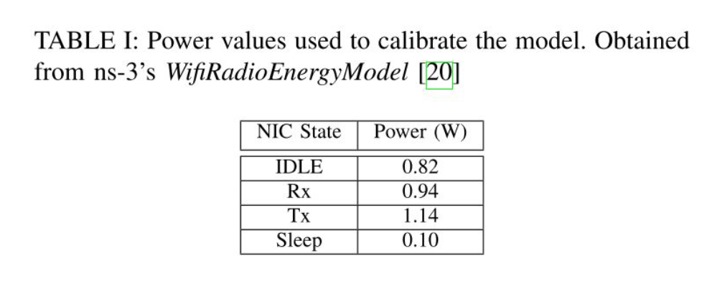
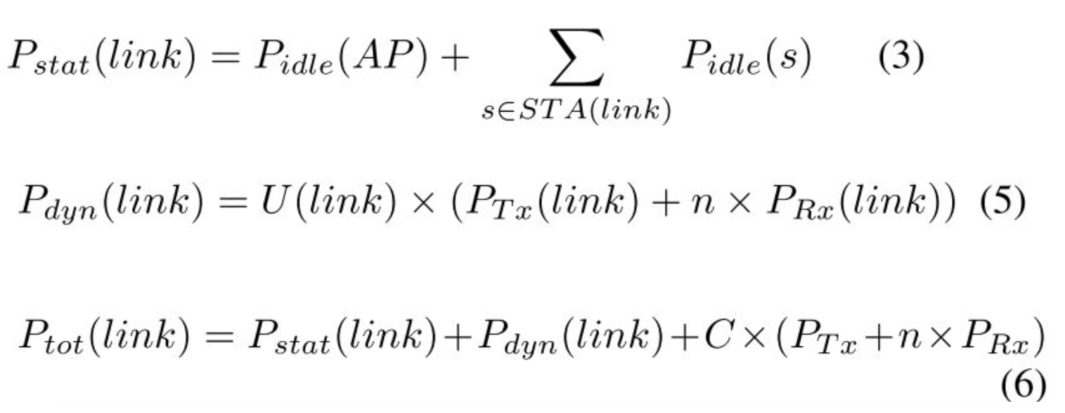
Flow-based calculation for scalable simulations for Wi-Fi

Slide 7

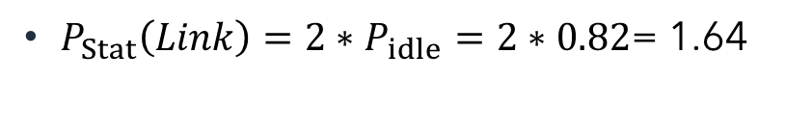
Using Model in our case
cloud
$P_{Stat}\left(Link\right)=2∗P_{idle}=2∗0.82$= 1.64
$P_{dyn}\left(Link\right)=P_{tx}+P_{rx}$= 0.94+1.14= 2.08
$P_{tot}\left(Link\right)=P_{stat}(Link)+P_{dyn}(Link)$= 1.64 + 2.08= 3.72
Proxy
server
router
Link
Smart camera
Smart camera
Smart camera
Smart camera

Slide 8
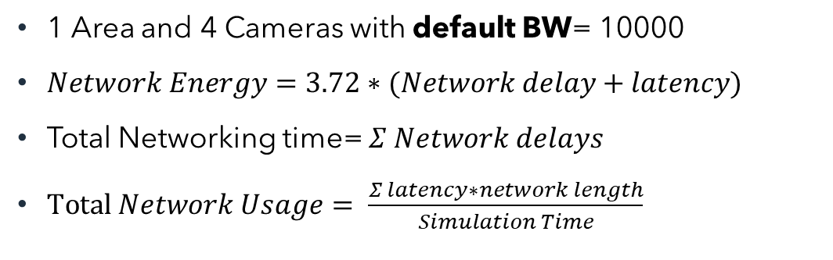
Network Energy Estimation
1 Area and 4 Cameras with default BW= 10000
$Network Energy=3.72∗(Network delay+latency)$
Total Networking time= $Σ Network delays$
$Total Network Usage= \frac{Σ latency∗network length}{Simulation Time}$

Slide 9

Network Energy Estimation
1 Area and 4 Cameras with modified BW=100000
$Network Energy=3.72∗(Network delay+latency)$
Total Networking time= $Σ Network delays$
$Total Network Usage= \frac{Σ latency∗network length}{Simulation Time}$

Slide 10
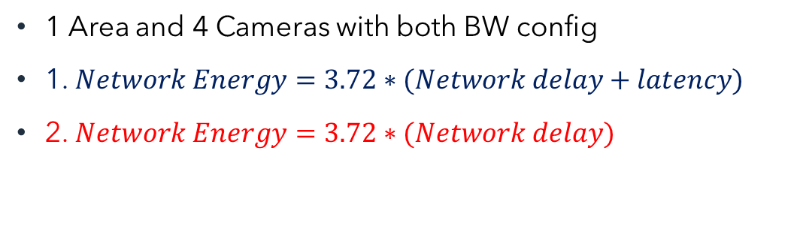
Network Energy Estimation in both approach(2)
1 Area and 4 Cameras with both BW config
1. $Network Energy=3.72∗(Network delay+latency)$
2. $Network Energy=3.72∗(Network delay)$

Slide 11
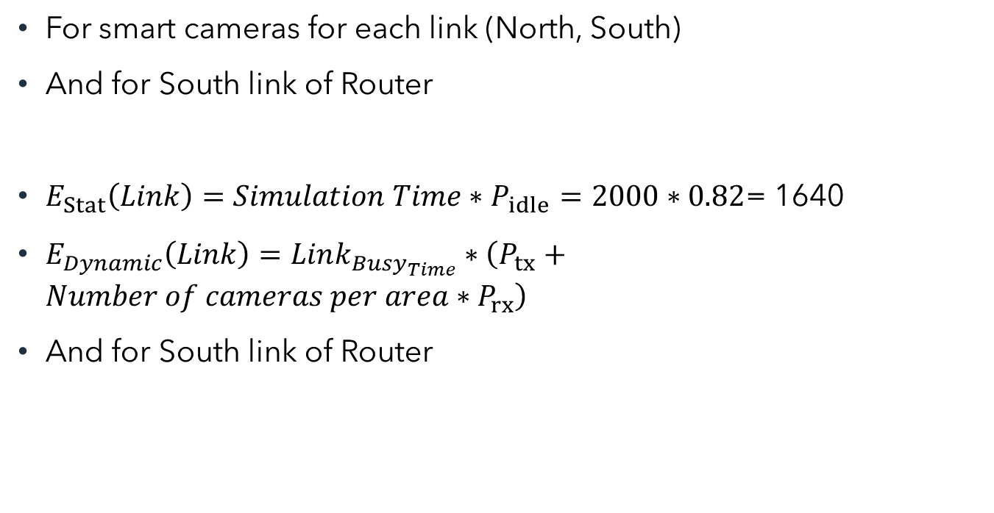
Wi-fi Network Energy
cloud
For smart cameras for each link (North, South)
And for South link of Router
$E_{Stat}\left(Link\right)=Simulation Time∗P_{idle}=2000∗0.82$= 1640
$E_{Dynamic}\left(Link\right)=Link_{Busy_{Time}}∗\left(P_{tx}+Number of cameras per area∗P_{rx}\right)$
And for South link of Router
Proxy
server
Wi-Fi network
router
Smart camera
Smart camera
Smart camera
Smart camera

Slide 12
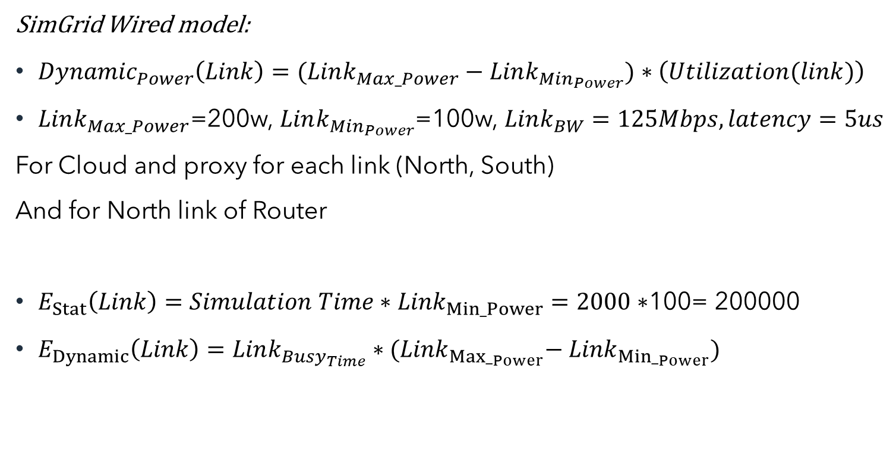
Wired Model
SimGrid Wired model:
${Dynamic}_{Power}\left(Link\right)=(Link_{Max_Power}−Link_{Min_{Power}})∗\left(Utilization(link)\right)$
$Link_{Max_Power}$=200w, $Link_{Min_{Power}}$=100w, $Link_{BW}=125Mbps, latency=5us$
For Cloud and proxy for each link (North, South)
And for North link of Router
$E_{Stat}\left(Link\right)=Simulation Time∗{Link}_{Min_Power}=2000∗$100= 200000
$E_{Dynamic}\left(Link\right)=Link_{Busy_{Time}}∗{(Link}_{{Max_}_{Power}}−$ ${Link}_{{Min_}_{Power}})$
cloud
Wired network
Proxy
server
Wired network
router
Smart camera
Smart camera
Smart camera
Smart camera

Slide 13
Results

Slide 14

Links power
iFogSim:
Default: $Link_{BW}=10000Bpms=80Mbps, latency=100ms$ ,
$Link_{Max_Power}$=128w , $Link_{Min_Power}$=64w
$Link_{BW}=100000Bpms=800Mbps, latency=100ms$
$SimGrid:$
$Link_{Max_Power}$=200w, $Link_{Min_{Power}}$=100w, $Link_{BW}=125Mbps, latency=5us$

Slide 15
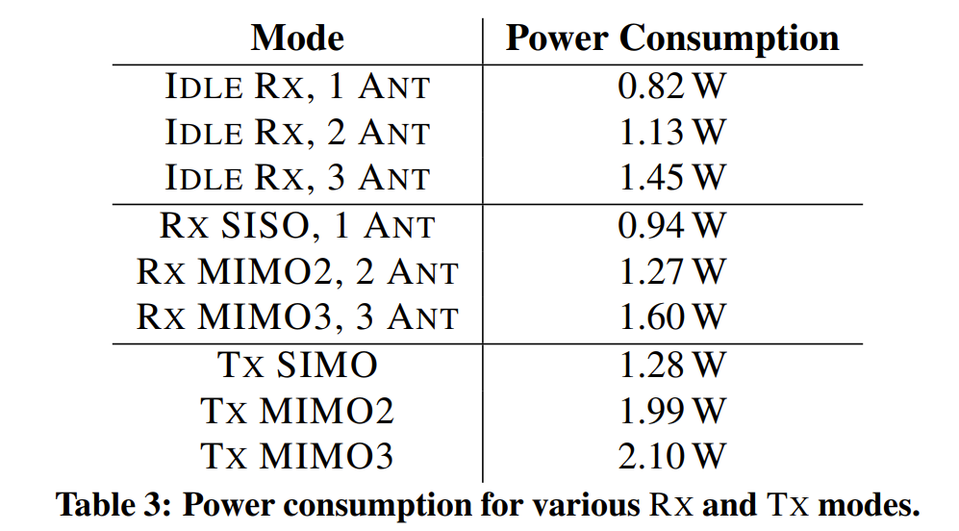
Power values for different states of laptops and desktop computers ^{[2]}
Network adapter is Intel 5300 (Which is common for laptops and desktop computers, and it is based on IEEE 802.11n wireless networking standard)
^{[2].} Halperin, Daniel, et al. "Demystifying 802.11 n power consumption." Proceedings of the 2010 international conference on Power aware computing and systems. USENIX Association, 2010.

Slide 16

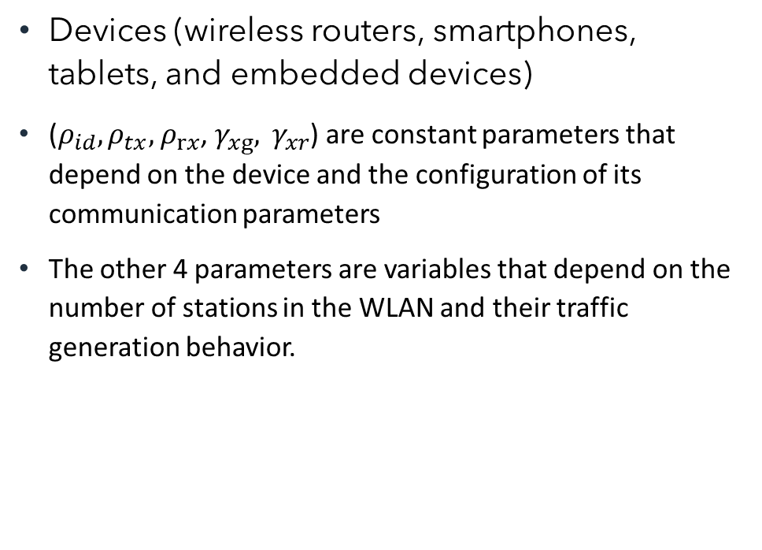
Per frame energy model
Devices (wireless routers, smartphones, tablets, and embedded devices)
($ρ_{id}, ρ_{tx},$ $ρ_{rx}$, $γ_{xg}, γ_{xr}$) are constant parameters that depend on the device and the configuration of its communication parameters
The other 4 parameters are variables that depend on the number of stations in the WLAN and their traffic generation behavior.

Slide 17
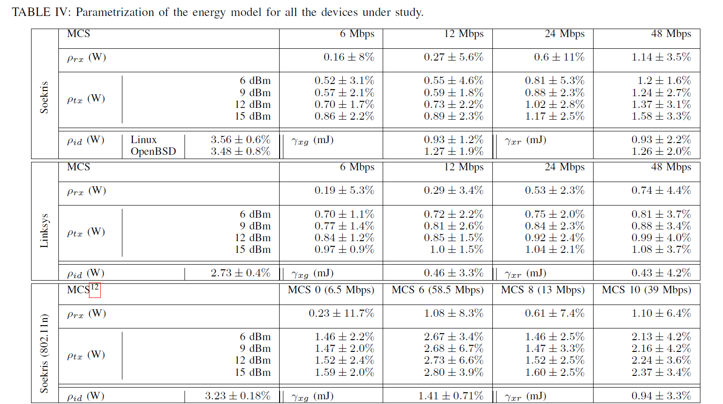
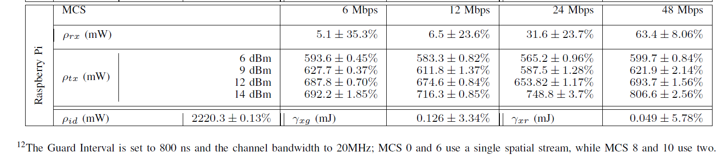
Power values for different states of Wireless Routers and AP

Slide 18
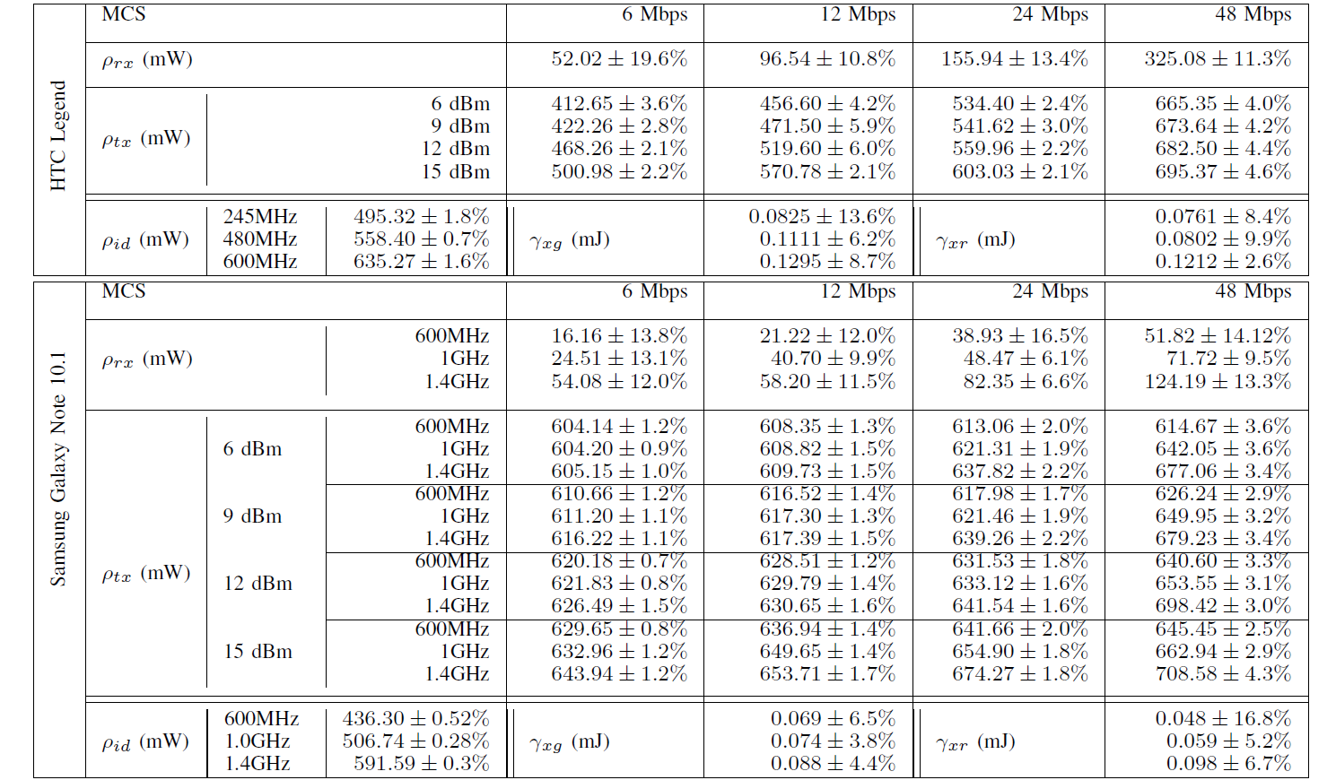
Power values for different states of Smartphone and Tablet

Slide 19
Power values for different states of an Embedded device

