Slide 1
A Planar Subdivision Method,
Beyond Straight Lines
IS-LAB seminar
Saeed, September 2016
[with special thanks to Adam Duracz]

Slide 2
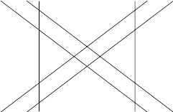

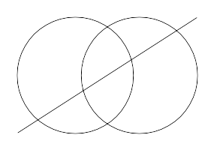
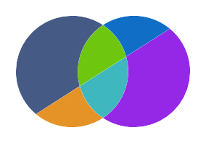
Objective
Input
Output

Slide 3
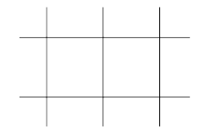
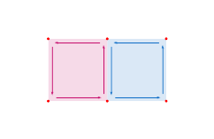
Problem Statement - Assumptions
Input: a set of curves
Output: partitioning of space
Space: a 2D plane.
Classes of Curves:
  straight lines; as an example of an unbounded class,
  circles; as an example of a bounded class.
No Redundancy: if two curves were identical, their intersection would be the same curve which is beyond a finite set of points.

Slide 4


Problem Statement - Terminology
Curves: A curve set contains the level-curves of some multivariable functions.
Faces: A face is the “interior” region of a “Jodan Curve”, i.e. a closed and simple compilation of curves.
Unbounded Faces
Functions
member: a function of points which returns the face that encompass a given point.
neighbor: is a function of faces and returns all other faces that are neighboring the input face by the mean of [at least] one shared edge in their boundaries.

Slide 5
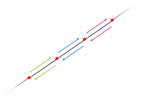
State of The Art - DCEL
Doubly Connected Edge List
Half-Edge
  twin
  directed
  start-node, end-node
Membership

Slide 6
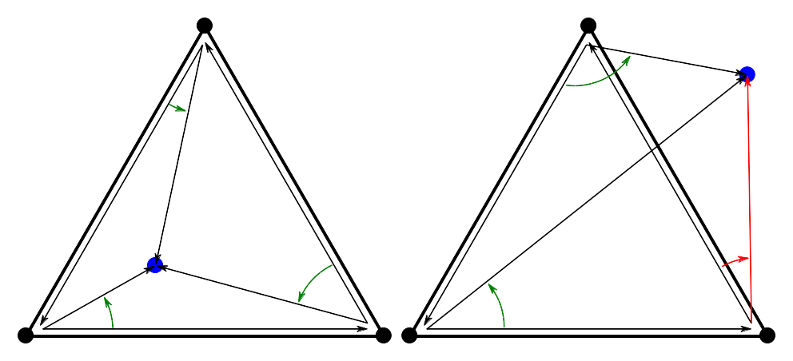
State of The Art - DCEL
Doubly Connected Edge List
Half-Edge
Membership
  cross-product
  convexity assumed

Slide 7
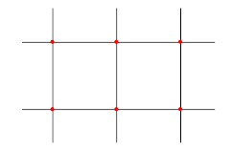
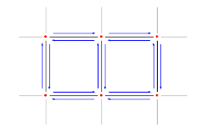
State of The Art - DCEL
Partitioning Procedure

Slide 8
State of The Art - DCEL
Partitioning Procedure – intersection & half-edge identification

Slide 9
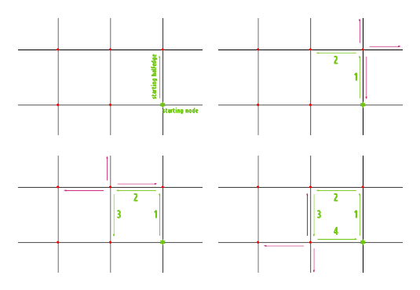
State of The Art - DCEL
Partitioning Procedure - Face Identification via path following

Slide 10
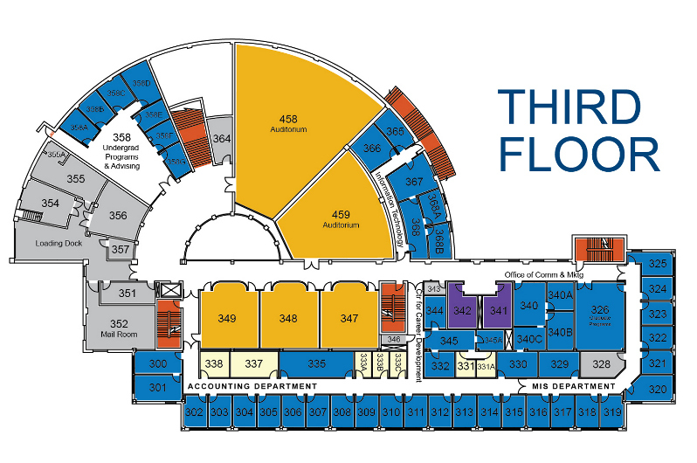
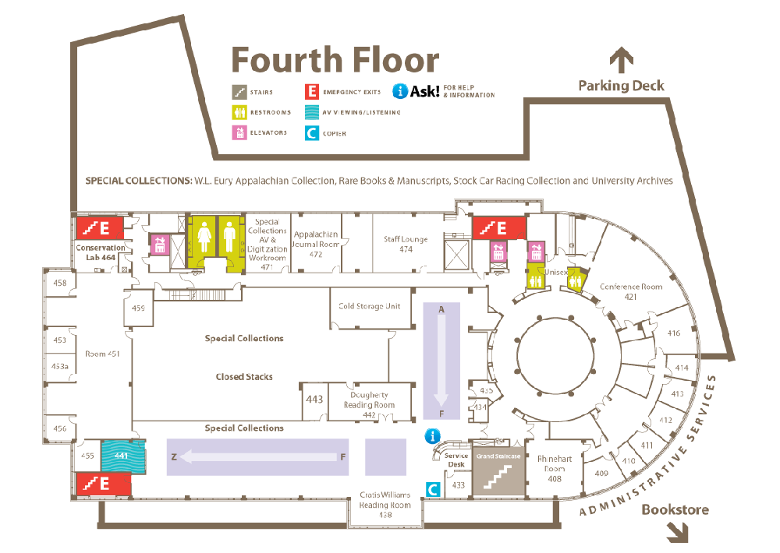
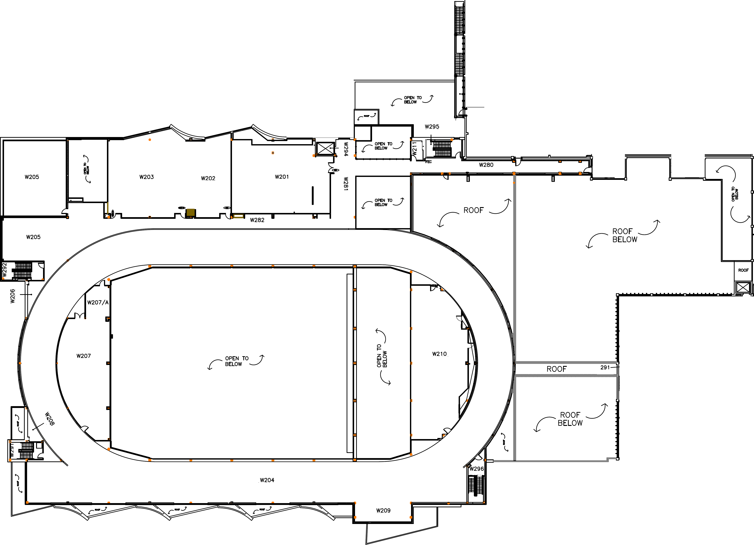
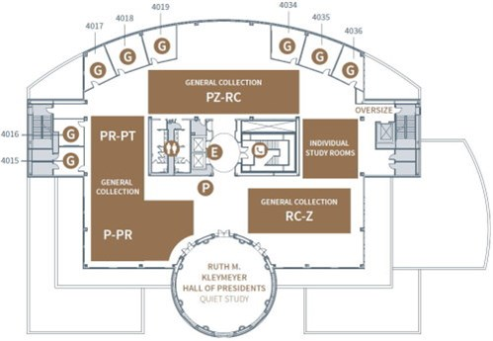
Why circles?
West Virginia University
Belk Library
McMaster University
Southern Indiana University
* all maps are from the web, links under titles.

Slide 11
So, what's the deal with circles?

Slide 12
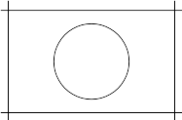
Circles - Challenges
Challenges:
None intersecting circles
Sorting nodes over curves
Edges are no longer vectors
Holes
Membership function

Slide 13
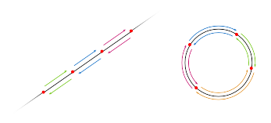
Circles - Challenges
Challenges:
None intersecting circles
Sorting nodes over curves
Edges are no longer vectors
Holes
Membership function

Slide 14
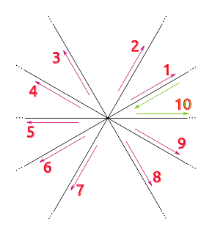
Circles - Challenges
Challenges:
None intersecting circles
Sorting nodes over curves
Edges are no longer vectors
  finding the correct successor via departure angle of the edge
Holes
Membership function

Slide 15
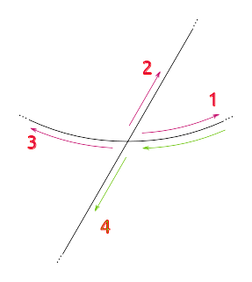
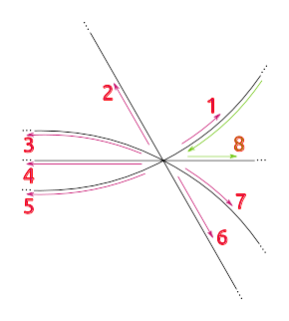
Circles - Challenges
Challenges:
None intersecting circles
Sorting nodes over curves
Edges are no longer vectors
  finding the correct successor via departure angle of the edge – first derivative
Holes
Membership function

Slide 16
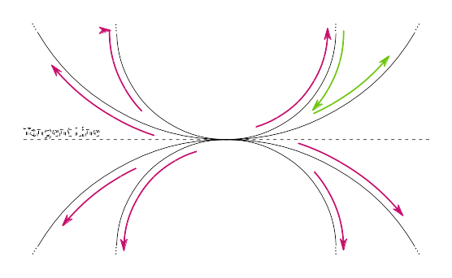
Circles - Challenges
Challenges:
None intersecting circles
Sorting nodes over curves
Edges are no longer vectors
  Tangency
Holes
Membership function

Slide 17
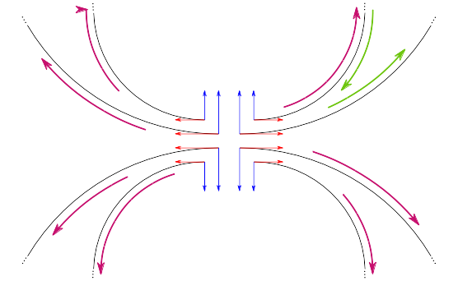
Circles - Challenges
Challenges:
None intersecting circles
Sorting nodes over curves
Edges are no longer vectors
  Tangency – second derivative
Holes
Membership function

Slide 18
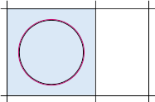
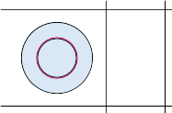
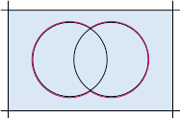
Circles - Challenges
Challenges:
None intersecting circles
Sorting nodes over curves
Edges are no longer vectors
Holes
Membership function

Slide 19

Circles - Challenges
Challenges:
None intersecting circles
Sorting nodes over curves
Edges are no longer vectors
Holes
  Subgraphs and super-face
Membership function
example#1
curves
example#2
faces
super-face
example#3

Slide 20
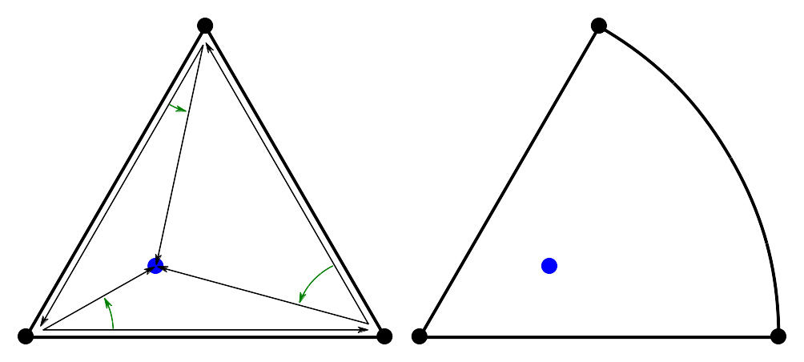
Circles - Challenges
Challenges:
None intersecting circles
Sorting nodes over curves
Edges are no longer vectors
Holes
Membership function

Slide 21
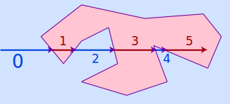
Circles - Challenges
Challenges:
None intersecting circles
Sorting nodes over curves
Edges are no longer vectors
Holes
Membership function
  Point-In-Polygone, ...
Point-In-Polygone: “The number of intersections for a ray passing from the exterior of the polygon to any point; if odd, it shows that the point lies inside the polygon. If it is even, the point lies outside the polygon; this test also works in three dimensions”*.
* “Point-In-Polygone”, the description and image from wikipedia.

Slide 22
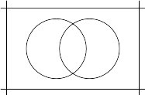
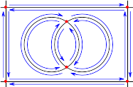
Subdivision
Intersection: finding nodes and half-edges
curves
nodes and half-edges

Slide 23
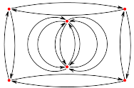
Subdivision
Constructing a Multi-Directional Graph (MDG)
curves
nodes and half-edges
Multi-Directional Graph

Slide 24
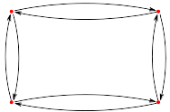
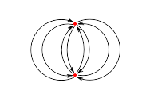
Subdivision
Connected components
curves
nodes and half-edges
Multi-Directional Graph
connected components

Slide 25
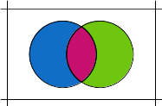
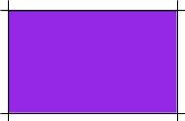
Subdivision
Decomposing sub-graphs (i.e. connected components)
sub-graph#2
subdivision
sub-graph#1
subdivision

Slide 26
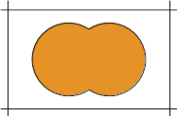
Subdivision
Detecting overlay (and super-face)
sub-graph#2
subdivision
super-face
sub-graph#1
subdivision

Slide 27
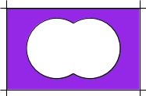
Subdivision
Updating faces according to overlay and super-faces.
sub-graph#2
subdivision
subdivision#2
super-face
sub-graph#1
subdivision
subdivision#1

Slide 28
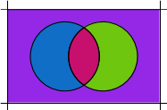
Subdivision
Merging sub-graphs
subdivision#1
subdivision
subdivision#2

Slide 29
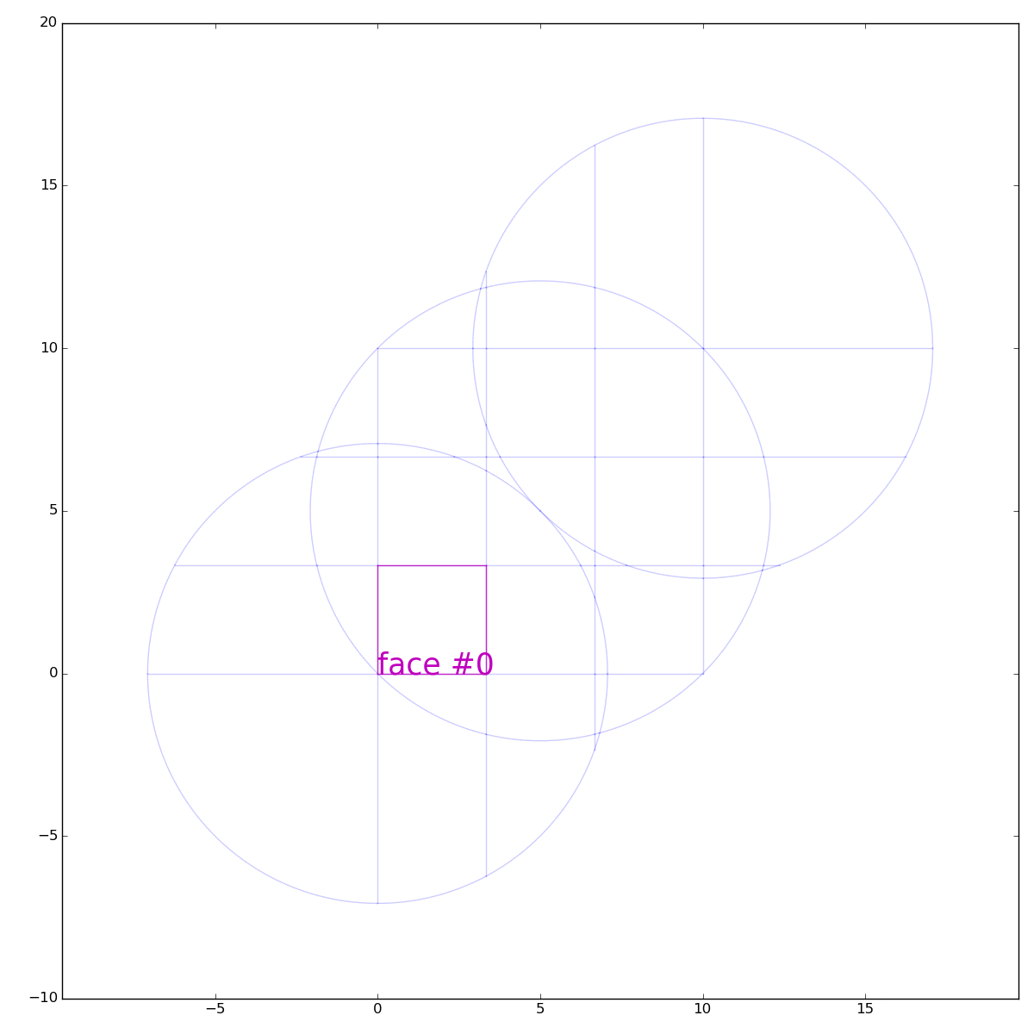

Implementation
Private repo available at:
https://github.com/saeedghsh/subdivision/
Dependencies:
Python >=2.6
numpy >= 1.10.2
sympy >= 1.0
networkx >= 1.10
matplotlib >= 1.4.3

Slide 30
Summary
Contributions:
Extending the subdivision algorithm beyond straight-line
A prototype of the implementation
TODO:
implementation efficiency – speed
degenerate cases
subdivision overlay (i.e. intersection)

Slide 31
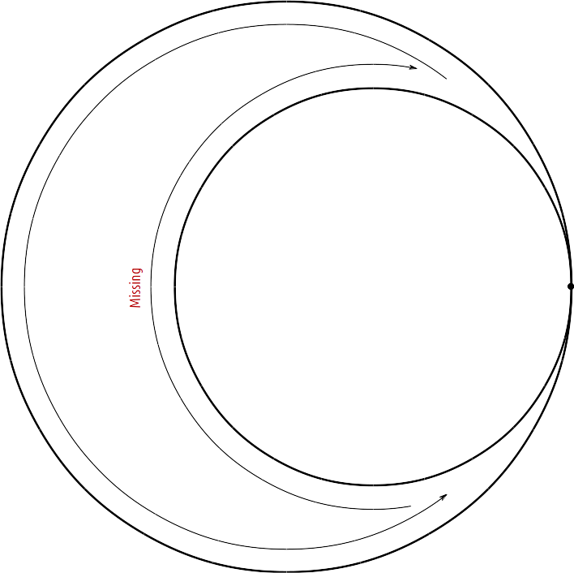
Summary
Contributions:
Extending the subdivision algorithm beyond straight-line
A prototype of the implementation
TODO:
implementation efficiency – speed
degenerate cases
subdivision overlay (i.e. intersection)

Slide 32
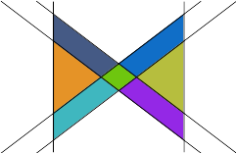
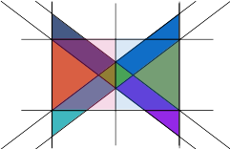
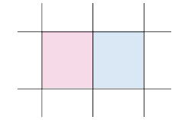
Summary
Contributions:
Extending the subdivision algorithm beyond straight-line
A prototype of the implementation
TODO:
implementation efficiency – speed
degenerate cases
subdivision overlay

Slide 33
Future work
Challenges
Identifying degenerate cases
Dynamic subdivision
Subdivision overlay – intersection, ...

Slide 34

Future work
Challenges
Identifying degenerate cases
Dynamic subdivision
Subdivision overlay – intersection, ...
Implementation
Handling degenerate cases,
Including more practical curves
  rays (half-line) and line segments
  arcs, ellipses, …
Extending the implementation to include “subdivision overlay”,

Slide 35
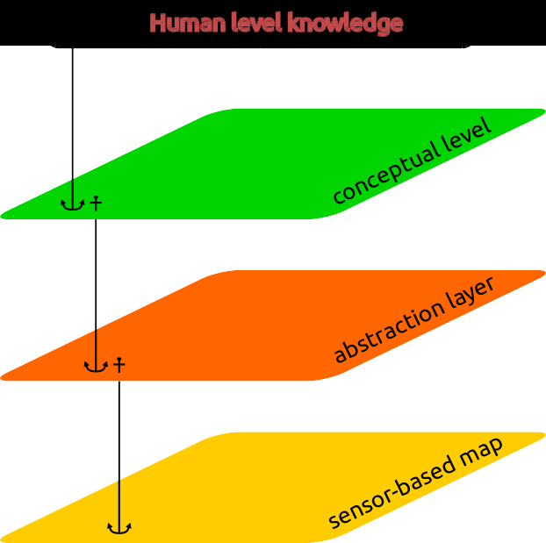
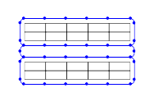
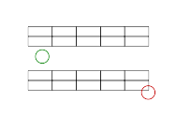
Future work
Challenges
Identifying degenerate cases
Dynamic subdivision
Subdivision overlay – intersection, ...
Implementation
Handling degenerate cases,
Including more practical curves
  rays (half-line) and line segments
  arcs, ellipses, …
Extending the implementation to include “subdivision overlay”,
In Application
Deploying in a multi-layer semantic map, (also documenting a proper API)
Integrating robotics related feature,
  collision detection,
  path planning libraries,...

Slide 36
Thank you

