Slide 1
Final Project Presentation
PROG8620-22S-Sec2-Data Warehouse Implementation
Saeed Moghadam
Akash Sharma
Delmi Alarcon
Varinder Singh
Professor: prof. Osam Ali
Notes:
Hello every one. I am glad to present our group work on final project. Group members are me, akash, delmi and verinder.

Slide 2

OUTLINES
OLTP database
Creating dimensional model
ETL Process
Extract
Transform
Load
Execute
OLAP
Notes:
Our work contains:
The execution part are procedures that execute whole extract process, transform and loading process. And finally we have an anonymous block which execute whole ETL process for all dates for which an order is recorded in oltp database.

Slide 3
OLTP Database
Oracle Database Sample Schemas, 12c Release 2 (12.2) in May 2017.
The Oracle Database sample schemas are based on a fictitious sample company that sells goods through various channels. The company operates worldwide to fill orders for products. It has several divisions, each of which is represented by a sample database schema.
Schema HR – Division Human Resources tracks information about the company employees and facilities.
Schema OE – Division Order Entry tracks product inventories and sales of company products through various channels.
Schema PM – Division Product Media maintains descriptions and detailed
information about each product sold by the company.
Schema IX – Division Information Exchange manages shipping through B2B applications.
Notes:
The dataset we selected for this work is

Slide 4
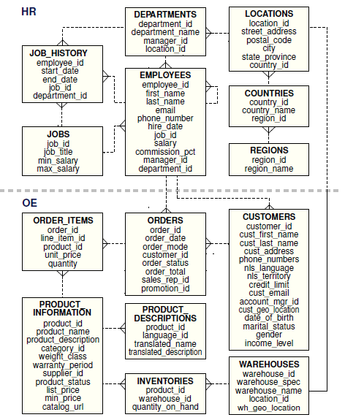
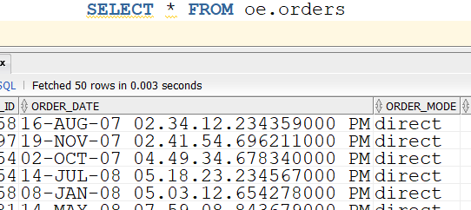
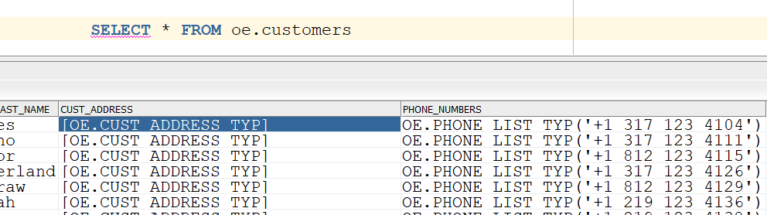
OLTP Database- Schema
the latest version of the sample schema scripts are available on GitHub at:
https://github.com/oracle/db-sample-schemas/releases/latest.
We enjoyed HR schema and OE for our purpose.
We had to manipulate data in some tables to reach our purpose. For example insert values to table promotions.
The difficulties we encountered:
Data in some columns was not in usual types. For example:
Column cust_address in table Customers was in object type
Date in table orders is an timestamp.
Notes:
You can see HR and OE entity diagram here. the table oe. Orders and hr. employees make a connection between two schema. In fact employeeId is the foreging key in table orders to track sale reprentive people.
We transformed these types in the ETL process.

Slide 5
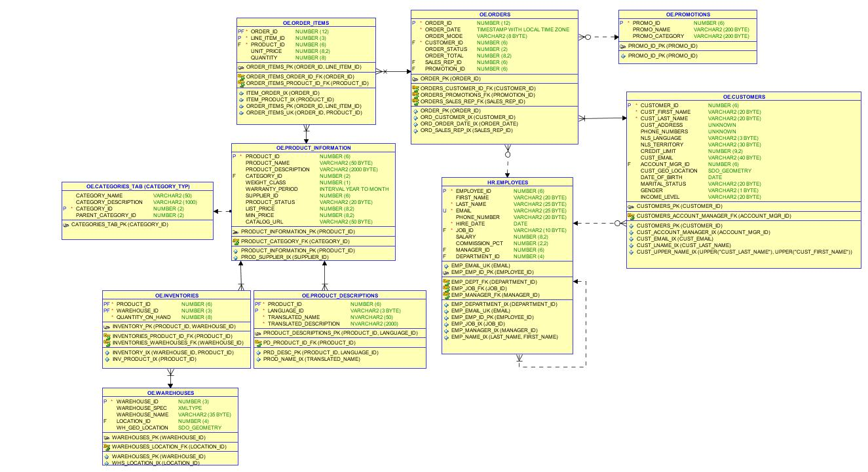
OLTP Database- Schema
Notes:
I provided an data model of OLTP schemas . there is an possibility in sql developer to create data model in script fromat (means sql file) that I have included in submission files or such diagram.

Slide 6
Creating dimensional model
Follow the course material instruction:
Identify the process to be tracked:
We would like to track sales information for oracle sample database.
Identify the granularity:
maximum granularity as “An online or direct sale that may include promotions, for one or more of a stock item purchased by a customer in a city and soled by a salesperson in an specific time”
Define Dimensions
Define Facts and Measures
Notes:
After selecting our OLTP database and reviewing the available tables and information inside the each table. We started working on dimensional model. Here we tried to follow useful guidelines we learned from this course.

Slide 7




Define Dimensions and Fact Table
Following granularity:
DimCustomer
DimProduct
DimLocation
DimSalespeople
DimPromotion
DimSaleCahnnel
DimDate
FactOrder
Notes:
So by following the granularity we reached these these dimensions and fact table.

Slide 8
Star Schema
DimPromotion
DimSaleChannel
DimCustomers
FactOrder
Quantity
Unit Price
Total Price
DimDate
DimSalesPeople
DimLocation
DimProducts
Notes:
Finally we reached these star schema.
Measures are quantity and product unit price and the total price which is calculated from unit price and quantity. These are information we could derive from oltp database.

Slide 9
SCD and Business keys
DimCustomer:CustomerName, SCD2 (If any non attribute keys changes)
DimProduct: ProductName, SCD2 (if only CategoryName changes)
DimLocation: combination of Country, State and City-SCD 1
DimSalespeople: SalePersonName, SCD1
DimPromotion: PrmotionId, SCD1
DimSaleCahnnel: SaleChannelName, SCD1
DimDate:DateValue,SCD0
FactOrder
Notes:
In the first step of deploying star schema, we specified the business key and SCD level for each dimension .
I should mention that the dimproduct have three non key attributes, product description, category and category description. If only category name changes we keep the history and add new record.

Slide 10
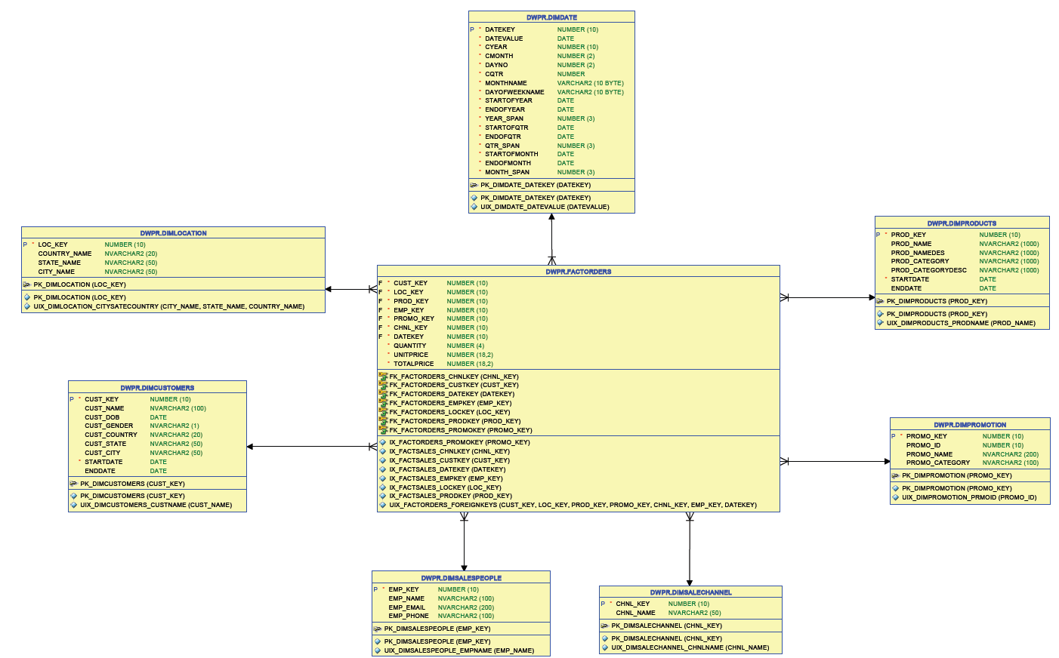
Data Model
SCD and Business keys
DimCustomer: CustomerName, SCD2 (If any non attribute keys changes)
DimProduct: ProductName, SCD2 (if only CategoryName changes)
DimLocation: combination of Country, State and City-SCD 1
DimSalespeople: SalePersonName, SCD1
DimPromotion: PrmotionId, SCD1
DimSaleCahnnel: SaleChannelName, SCD1
DimDate: DateValue,SCD0
Notes:
Here you can see the data model we exported from sql developer. The relationship between fact table and dimensions are stablished by define foreign keys in fact order. We also created indexes on foreign keys in fact order for optimizing the queries. Unique indexes are laso created on business keys in dimenstion tables

Slide 11
ETL Process
INITIALIZE
INITIALIZE
CUS_
TRANS
CUS_
PRLOAD
CUS_
TRANS
CUS_
PRLOAD
CUS_
PRLOAD
CUS_
TRANS
DIM
CUSTOMER
CUS_
TRANS
Customers
Customers
CUS_EXT
CUS_EXT
CUS_STG
CUS_STG
LOC_
TRANS
LOC_
PRLOAD
LOC_
TRANS
LOC_
PRLOAD
LOC_
PRLOAD
LOC_
TRANS
DIM
LOCATION
LOC_
TRANS
Employees
Employees
EMP_
TRANS
EMP_
TRANS
EMP_
PRLOAD
EMP_
TRANS
DIM
SALESPEOPLE
EMP_EXT
EMP_
TRANS
EMP_
PRLOAD
EMP_EXT
EMP_STG
EMP_STG
Orders
Orders
ORD_
TRANS
ORD_
TRANS
CHNL_
PRLOAD
CHNL_
PRLOAD
FACT
ORDERS
ORD_
TRANS
ORD_
PRLOAD
ORD_
TRANS
Order_
Items
Order_
Items
ORD_EXT
ORD_EXT
ORD_STG
ORD_STG
CHNL_
TRANS
CHNL_
TRANS
PROD_
PRLOAD
PROD_
PRLOAD
DIM
SALECHANNEL
CHNL_
TRANS
CHNL_
PRLOAD
CHNL_
TRANS
Product_
Information
Product_
Information
PROD_EXT
PROD_EXT
PROD_STG
PROD_STG
PROD_
EXT
PROD_
PRLOAD
PROD_
EXT
DIM
PRODUCTS
PROD_
EXT
PROD_
PRLOAD
PROD_
PRLOAD
Product_
Category
Product_
Category
PROM_
EXT
PROM_EXT
PROM_
EXT
PROM_EXT
PROM_
PRLOAD
PROM_
PRLOAD
DIM
PROMOTION
PROM_
EXT
PROM_
PRLOAD
PROM_STG
PROM_
EXT
Promotions
PROM_STG
Promotions
Notes:
Now, we enters the etl process by describing the etl process diagram. We derived data from tables

Slide 12
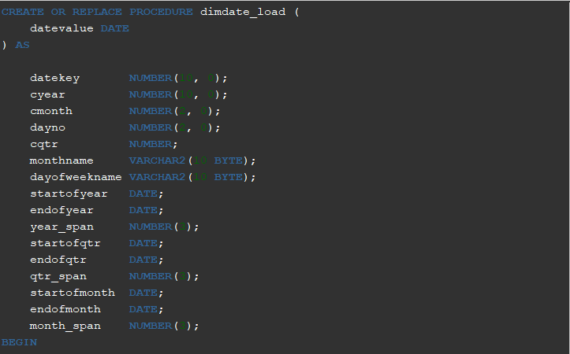
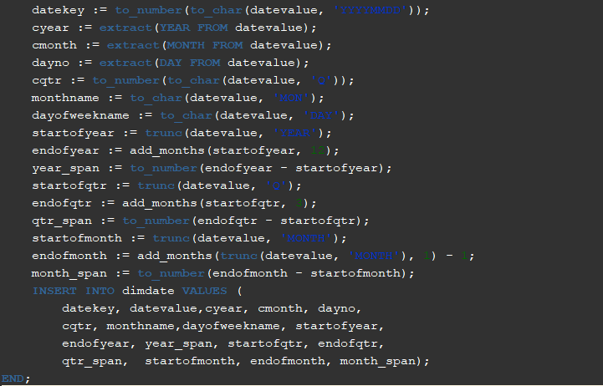
Initial Process
Notes:
The initial process include the dimdate procedure. We calculated some attributes from data value. Like extracting year, year span, start year and end year same attributes for qurter and month.

Slide 13
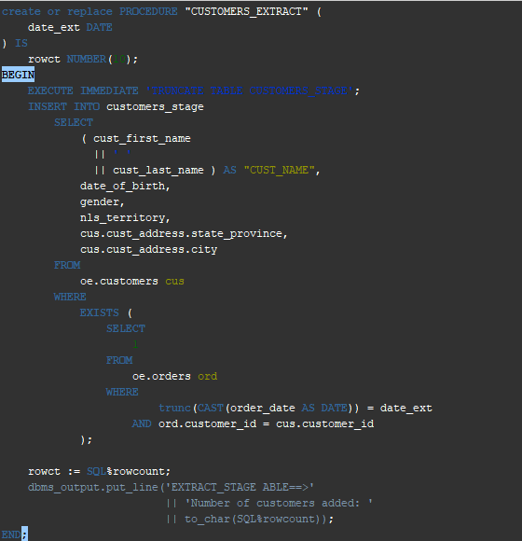
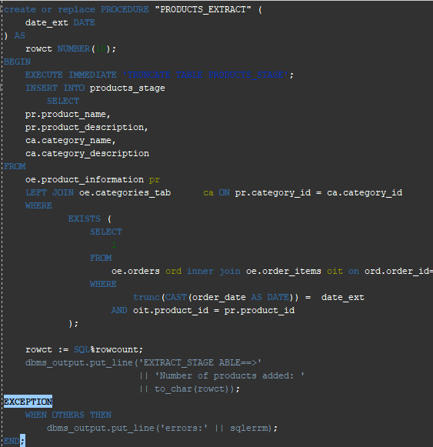
Extract Procedure
Notes:
In comparison to course guidelines , we followed another approach. We extract data for a specific date order in each etl process execution instead of importing all dimensional information from oltp tables. As you can see, our extract procedures get date input unlike course materials.
I should note that this statement changes timestamp to the date

Slide 14
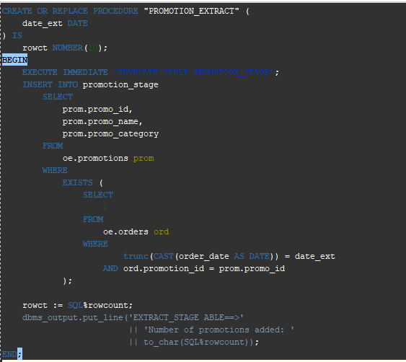
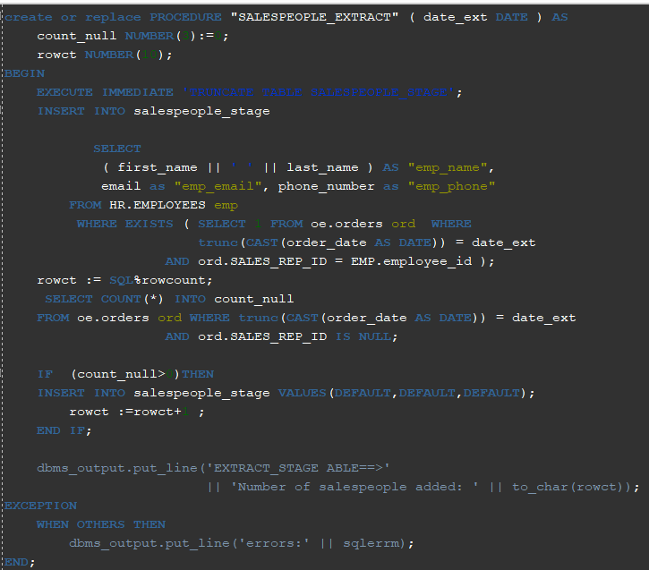
Extract Procedure

Slide 15
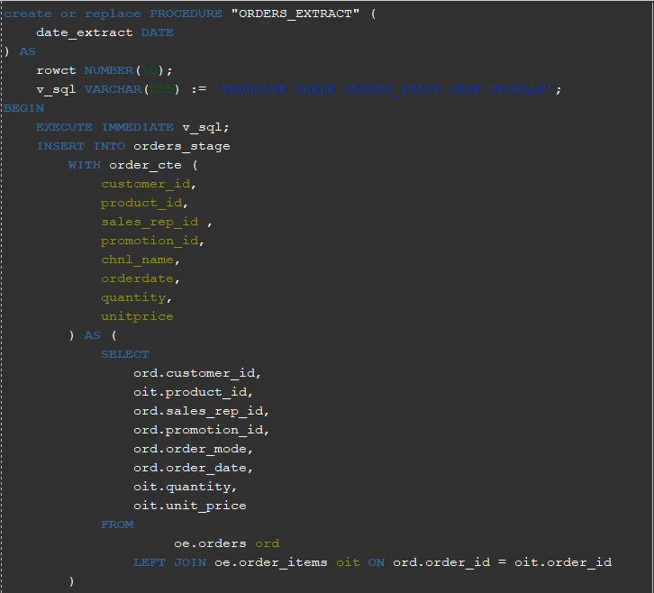
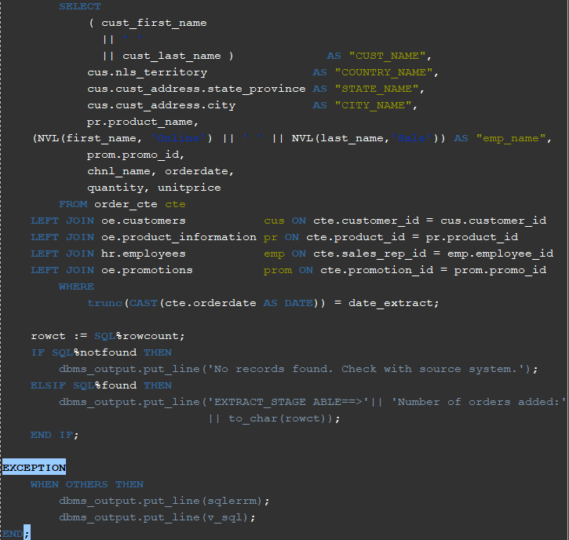
Extract Procedure

Slide 16
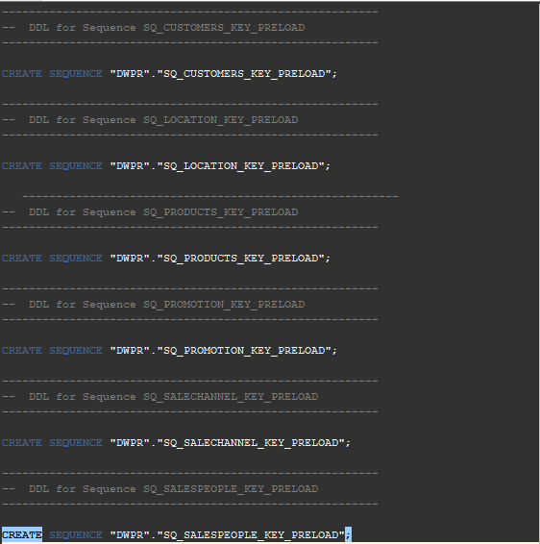
Transform
Notes:
In the transformation part, we create some necessary sequence in the first place. Except for dim date, we created one sequence for each dimtables. The sequences provides surrogate keys.

Slide 17
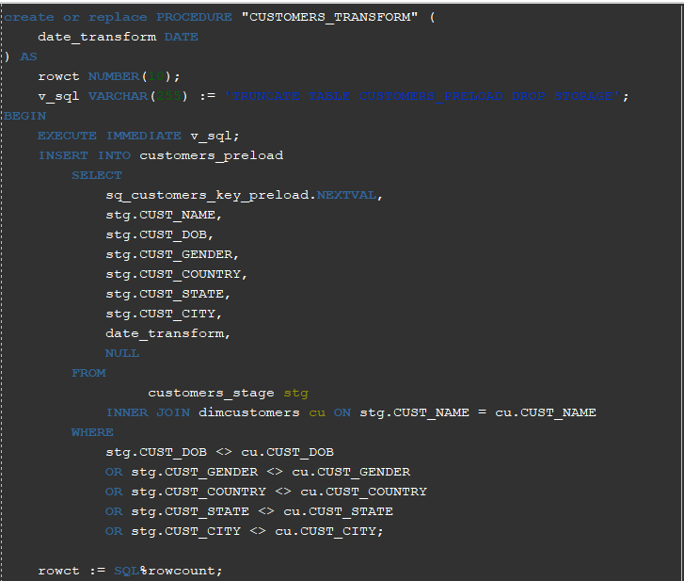
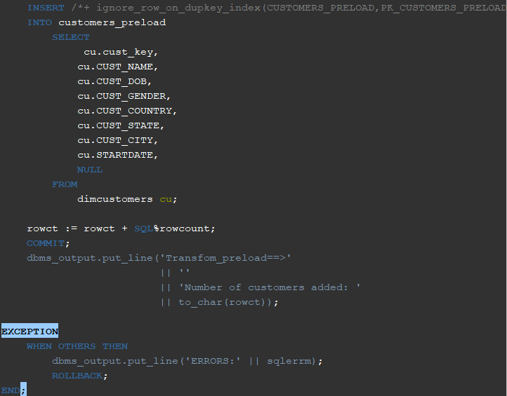
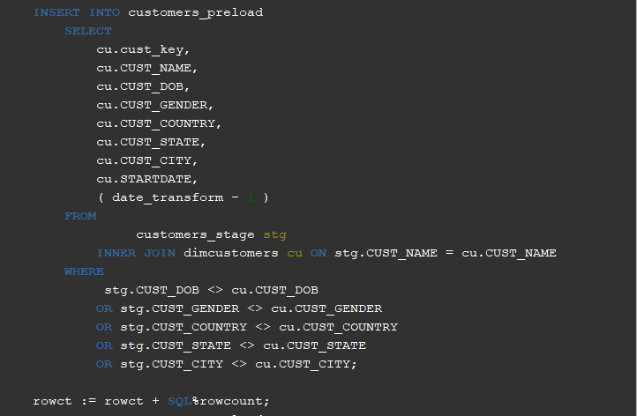
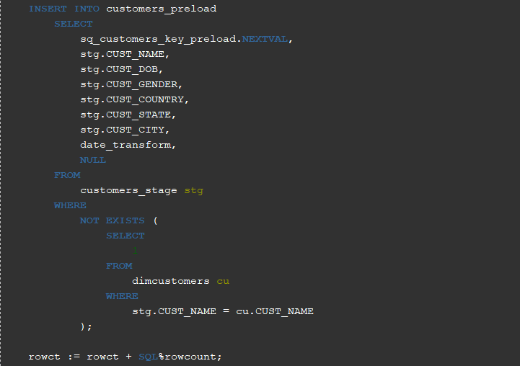
Transform Process
Notes:
For scd2 tables that are customer and products we consider the following conditions:
If matched then update : update includes adding new record and closing the existing record
If not matched by target: add new record
If not matched by source: closing the existing new record
In the next slides we see provided transformation procedures for other tables

Slide 18
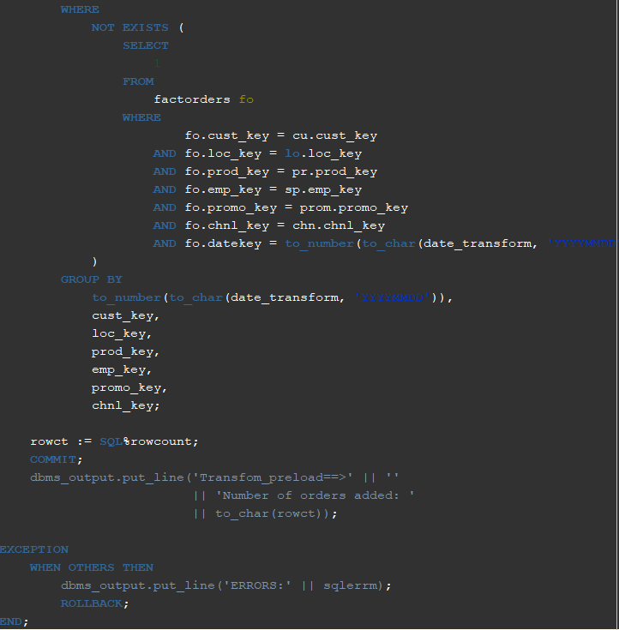
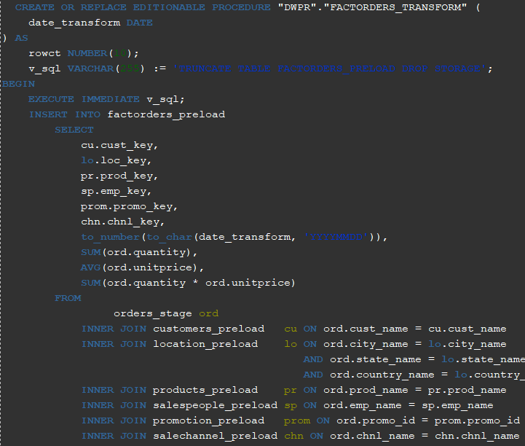
Transform Process

Slide 19
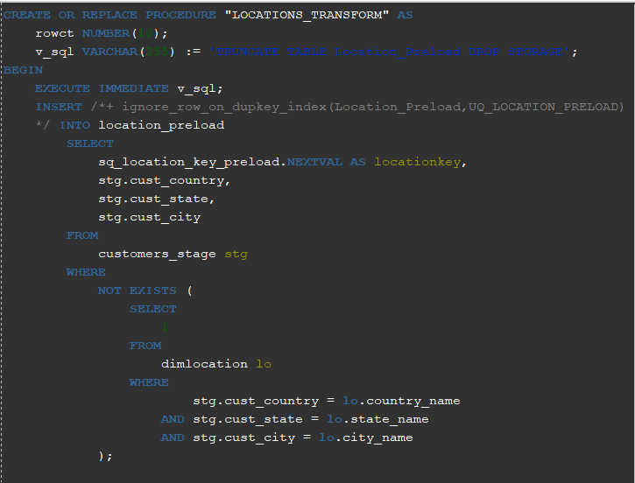
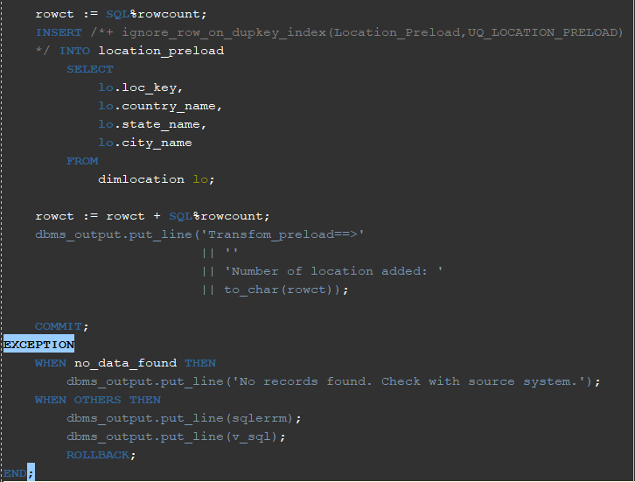
Transform Process

Slide 20
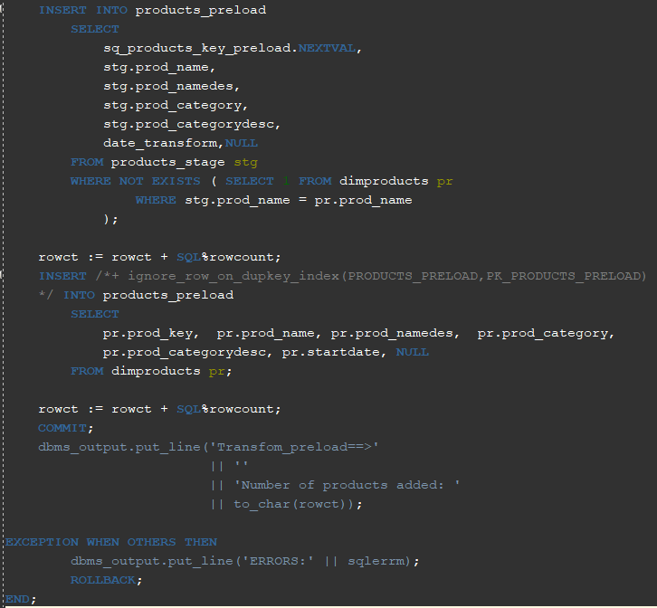
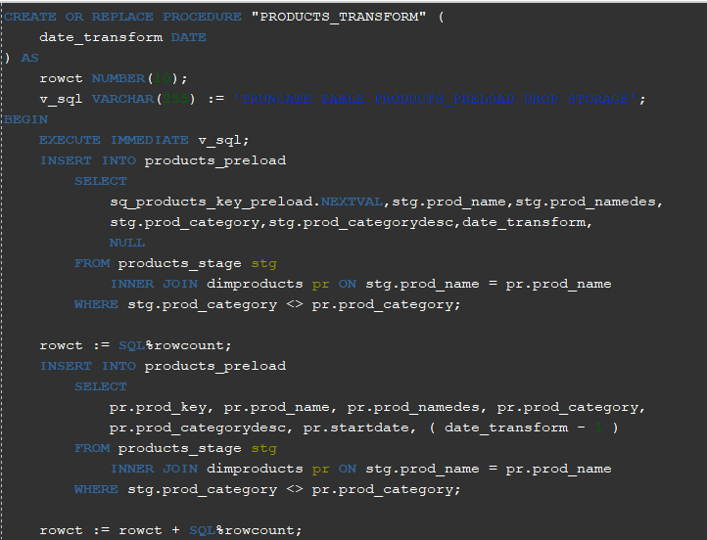
Transform Process

Slide 21
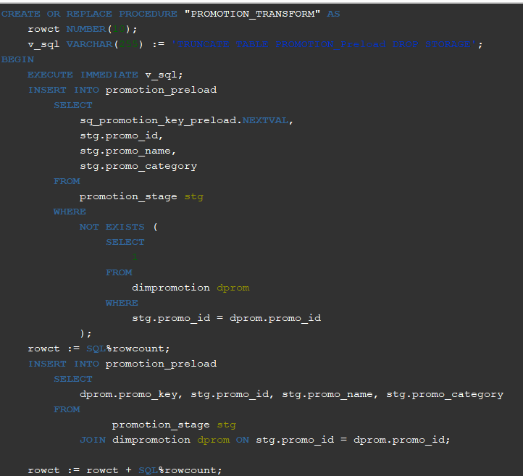
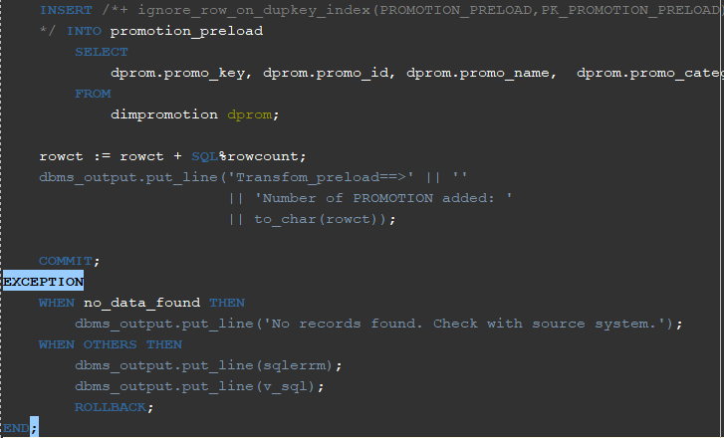
Transform Process

Slide 22
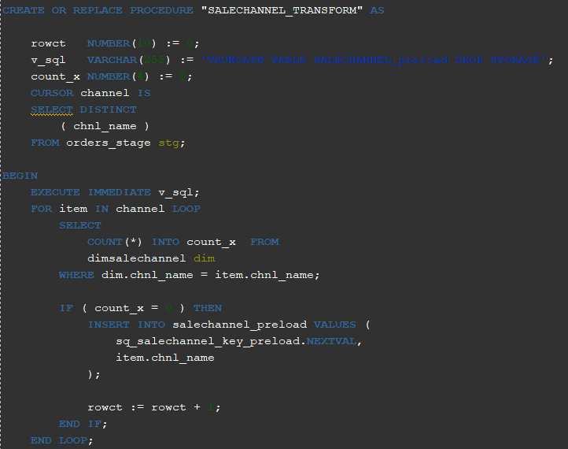
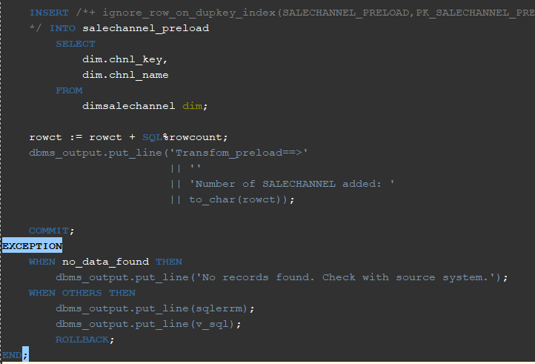
Transform Process

Slide 23
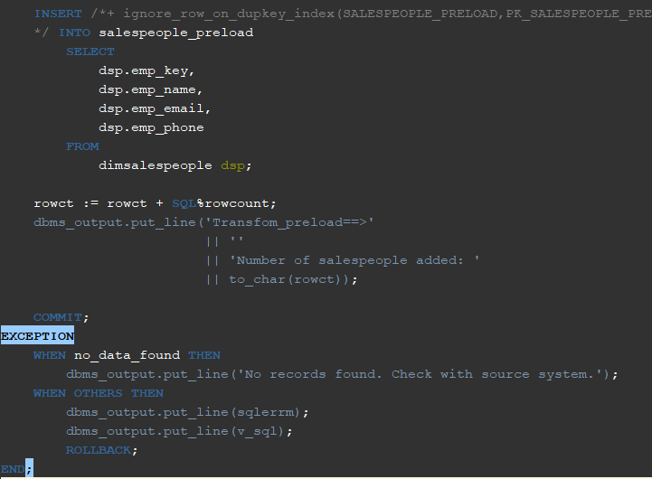
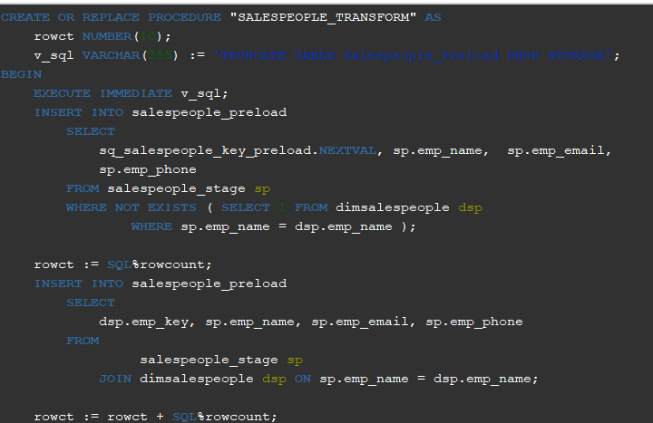
Transform Process

Slide 24
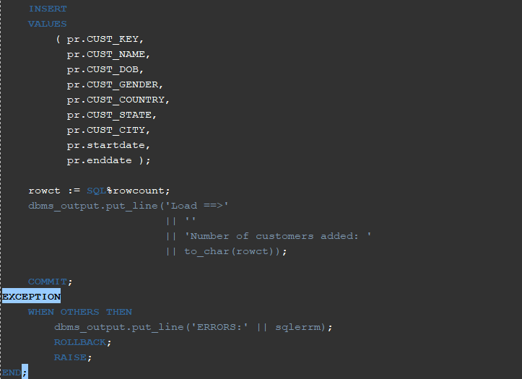
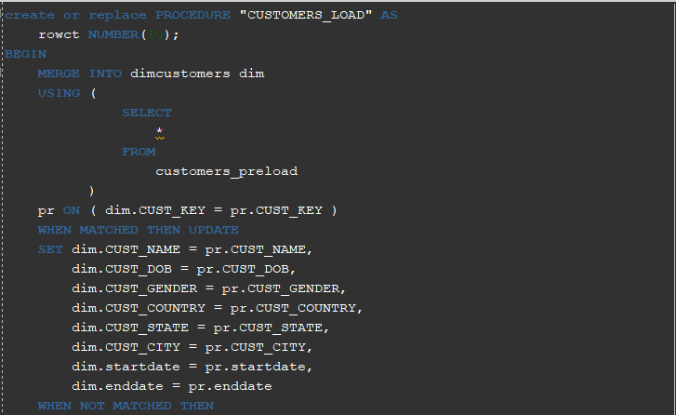
Load Process
Notes:
The loading process include simple procedures for importing data into final tables. I should note that unlike course material procedures, we could not enjoy delete statement because of integrity errors. We decided to use merge statement to update or insert records.

Slide 25
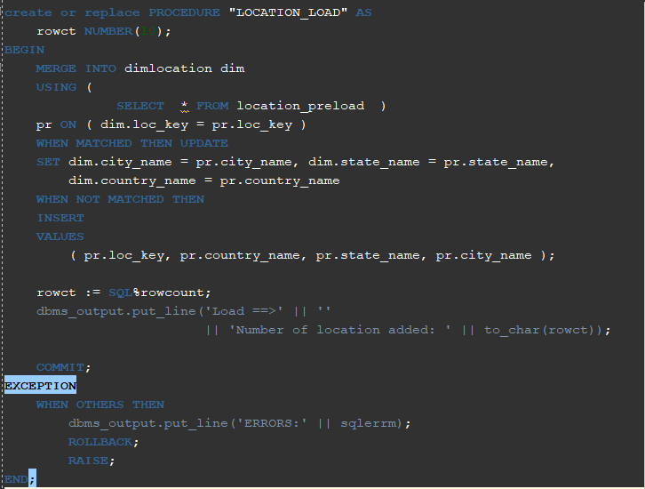
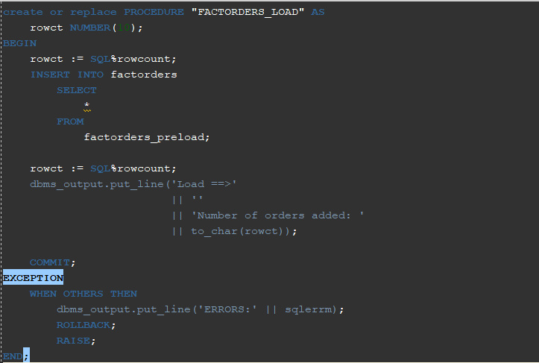
Load Process

Slide 26
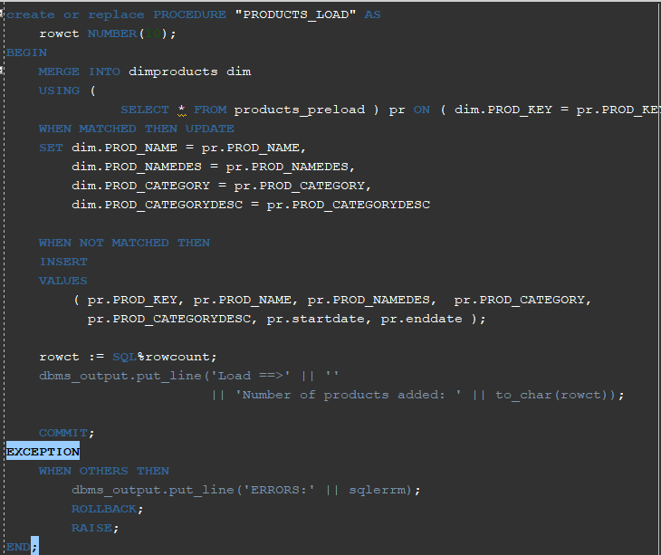
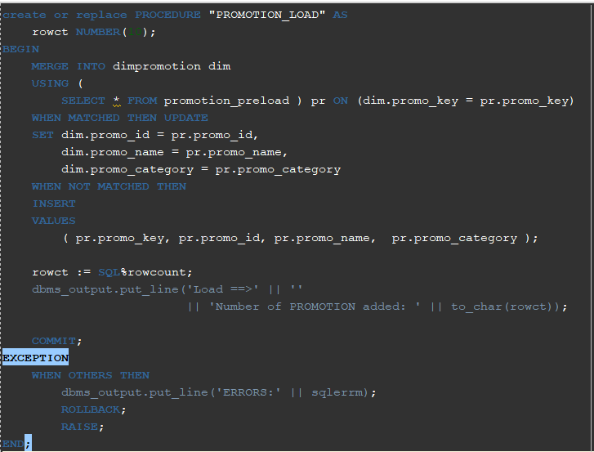
Load Process

Slide 27
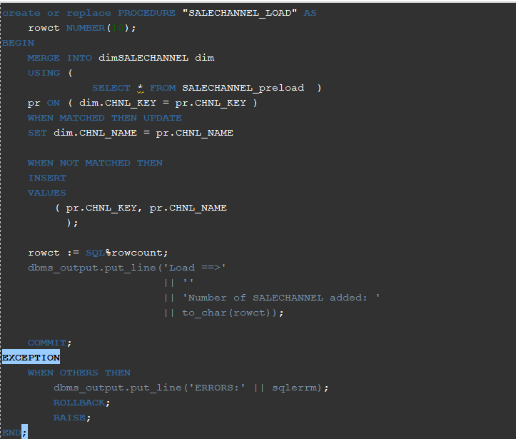
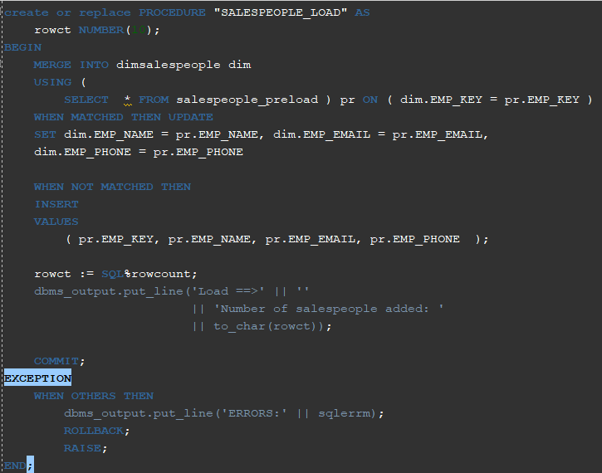
Load Process

Slide 28
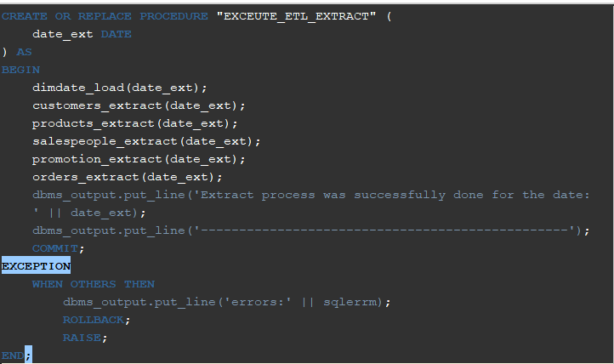
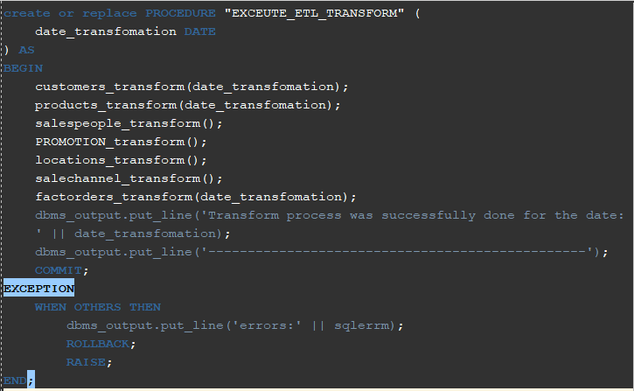
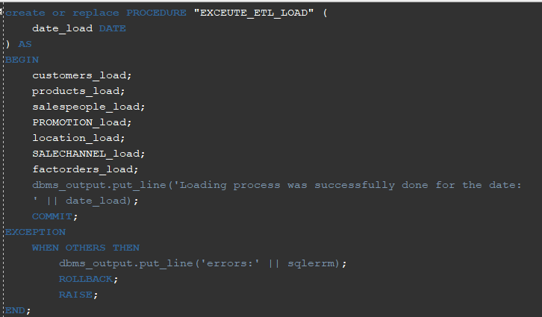
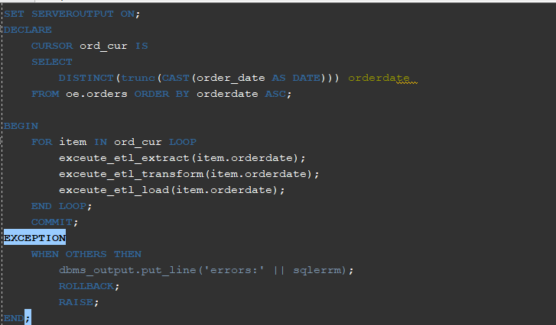
Execute
Notes:
In the execution part, I created some execution procedures. Procedures for executing the extract, transform and loading process, finally I executed these three procedures in an anonemous block in a for loop to load data for all dates in which we have an order

Slide 29
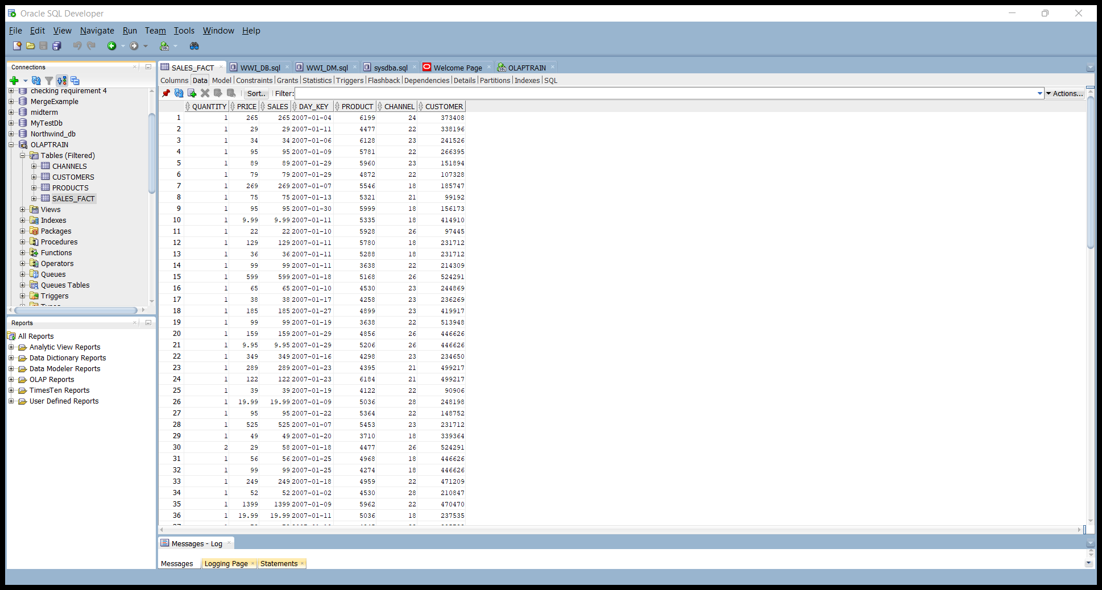
OLAP
OLAP SALES_FACT - Stores purchases in dollars, quantity, and price, by channel of distribution, product item, day, and customer.

Slide 30
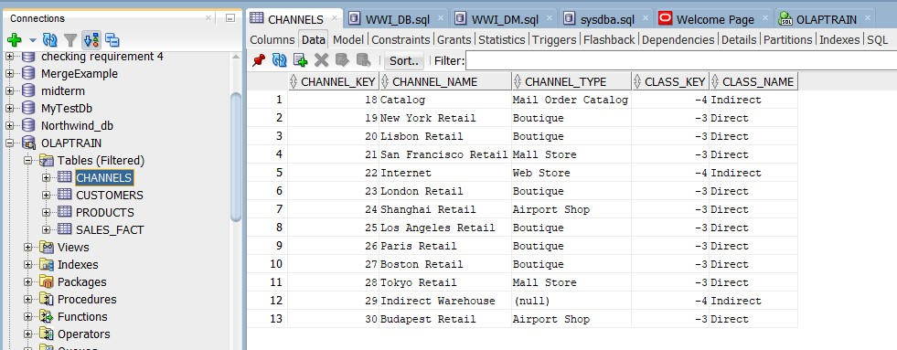
OLAP
OLAP – CHANNELS - Table containing distribution channels for customers purchases.

Slide 31
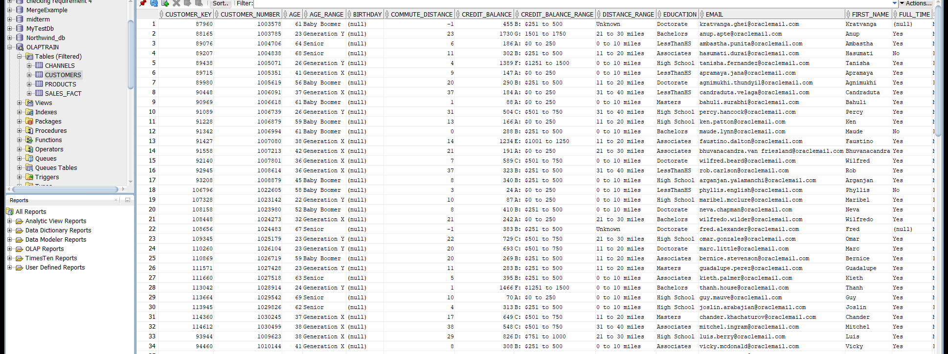
OLAP
OLAP -CUSTOMERS - Table that show who purchased products, and where products are sold for the Geography dimension

Slide 32
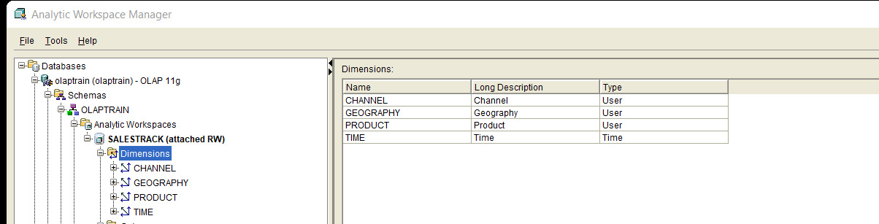
OLAP
DEFINING DIMENSIONS AND THEIR TYPE
Dimensions are lists of unique members that identify and categorize data. They form the edges of a cube, and thus the measures within the cube. Dimensions may contain levels, hierarchies, and attributes.
In the picture below we have created four DIMENSIONS and three(GEOGRAPHY,PRODUCT and TIME) out of them are taken from Template.

Slide 33
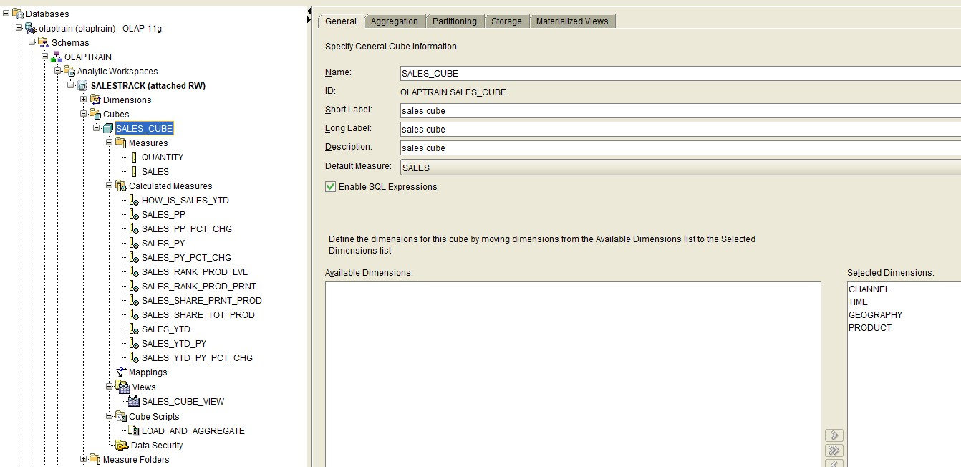
OLAP
Sales Cube - Measures, Calculated Measures and Views

Slide 34
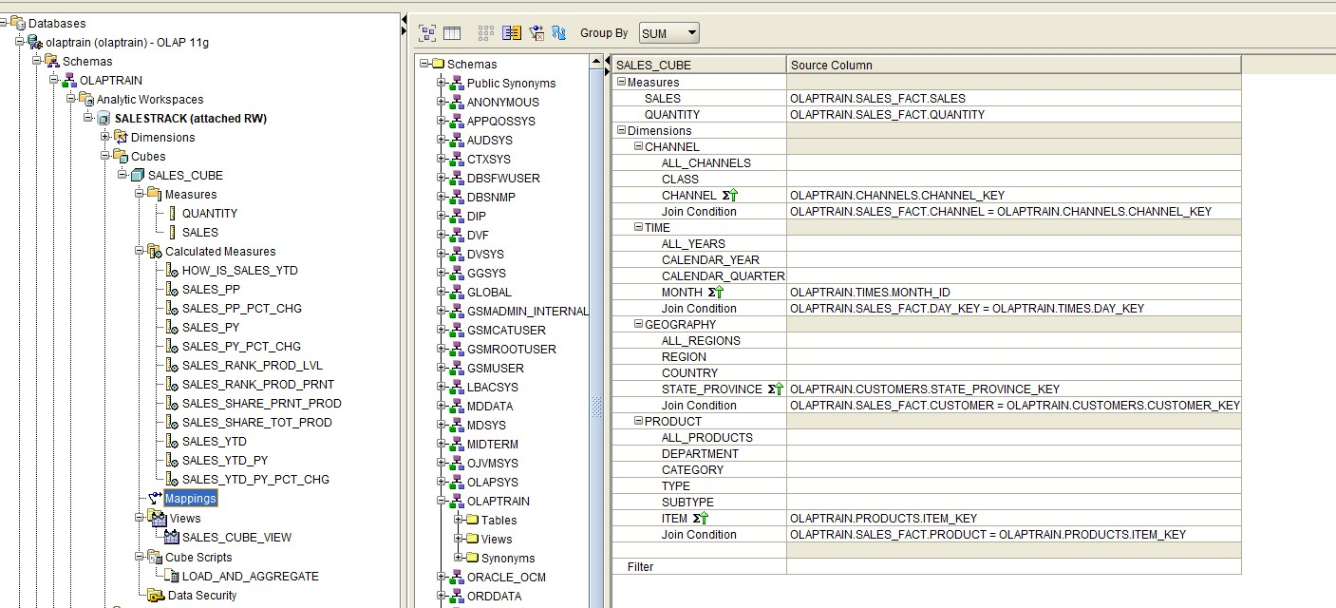
OLAP: Sales Cube - Mapping

Slide 35
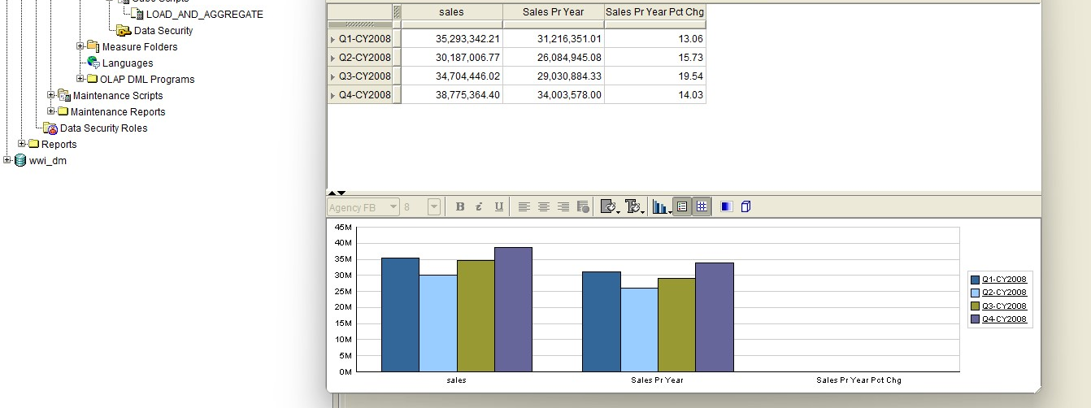
OLAP
Sales Measures Data Viewer of Year 2008 (All Quarters) in comparison to previous year

Slide 36
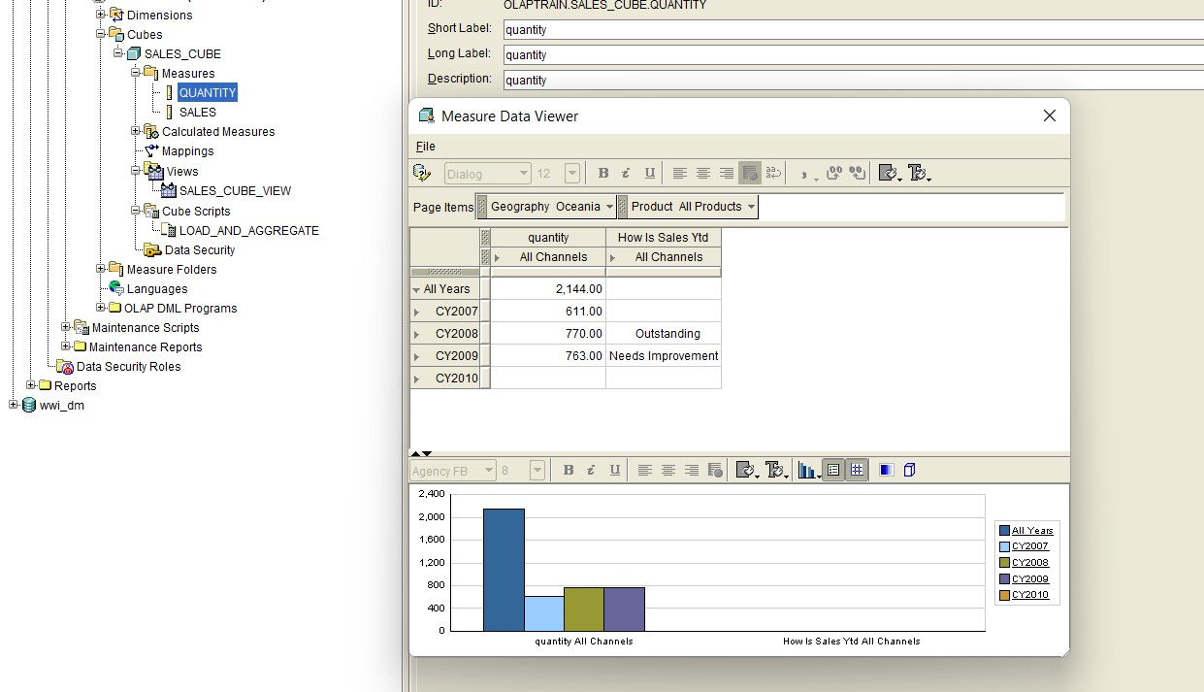
OLAP
Quantity Measures Data Viewer of All Years and their performance status

Slide 37

OLAP:Sales Cube View – Dimension and Measures

Slide 38

Thank you for your attention

