Slide 1
Algebraic Fault Attack on SHA Hash Functions
using Programmatic SAT Solvers
Saeed Nejati¹, Jan Horáček², Catherine Gebotys¹, and Vijay Ganesh¹
¹University of Waterloo
²University of Passau
CP, August 30, 2018

Slide 2
Motivation
SAT solvers has recently increasingly been used in Cryptographic tasks (testing weaknesses of function design/implementation, few verifications)
Mostly used as a black-box solver for a reduced equation system
Can we tailor internals of a SAT solver for a specific cryptographic problem to improve the solving time?
Specific problem: Algebraic Fault Attack

Slide 3
Background
Hash functions (SHA-1)
[Algebraic] Fault Attack

Slide 4

SHA-1
All operations are on 32-bit words
W_{i}
K_{i}
E
E
Message expansion
D
D
F
W₀ … W₁₅
W₁₆ … W₇₉
C
C
B
B
0
79
2
IV
80 rounds
$$H$$
A
A
5
One round of SHA-1
Notes:
Remember to mention that hash should be preimage resistant

Slide 5



Fault Injection
Hardware device
Inducing fault in a target register
Using heat, EM, laser, …
W₀ … W₆₃
W₆₄ … W₇₉
0
63
64
79
IV
64 rounds
16 rounds
$$H$$
IV
64 rounds
16 rounds
$$H_{1}^{′}$$
IV
64 rounds
16 rounds
$$H_{2}^{′}$$

Slide 6


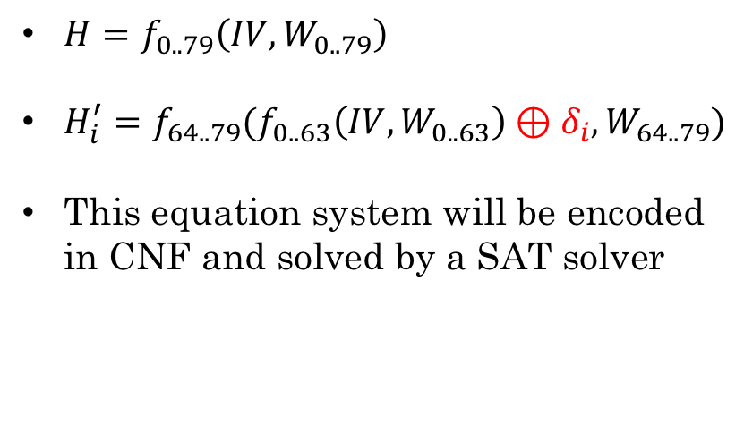
Algebraic Fault Analysis
$H=f_{0..79}\left(IV, W_{0..79}\right)$
$H_{i}^{′}=f_{64..79}(f_{0..63}\left(IV,W_{0..63}\right)⊕δ_{i}, W_{64..79})$
This equation system will be encoded in CNF and solved by a SAT solver
W₀ … W₆₃
W₆₄ … W₇₉
0
63
64
79
IV
64 rounds
16 rounds
$$H$$
$$δ_{1}$$
IV
64 rounds
16 rounds
$$H_{1}^{′}$$
$$δ_{2}$$
IV
64 rounds
16 rounds
$$H_{2}^{′}$$
Notes:
Why fault works in general?

Slide 7
Algebraic Fault Analysis
Message recovery
$H=f_{0..79}\left(IV, W_{0..79}\right)$
$H_{i}^{′}=f_{64..79}(f_{0..63}\left(IV,W_{0..63}\right)⊕δ_{i}, W_{64..79})$
This equation system will be encoded in CNF and solved by a SAT solver
W₀ … W₆₃
W₆₄ … W₇₉
0
63
64
79
IV
64 rounds
16 rounds
$$H$$
$$δ_{1}$$
16 rounds
$$H_{1}^{′}$$
$$δ_{2}$$
The solution should be verified
16 rounds
$$H_{2}^{′}$$

Slide 8
Improvement Opportunities
The verification loop
As soon as the message word variables are set, they are ready to be verified
Early check vs Check after solving completely
Encoding and propagation
Non-Arc consistency of the usual encoding of addition (w.r.t. BCP)
Multi-operand addition in each round of SHA-1 and SHA-256 ( blocks)
Popular encoding of multi-operand addition [Nossum2012] is not Arc-consistent
“Better” encoding vs “Better” propagation

Slide 9
Programmatic SAT

Slide 10
CDCL SAT Solver
Input Formula
Decision
Unit Propagation
Backjump
No
Done?
Conflict?
SAT
Yes
No
No
Yes
Top level?
Conflict Analysis
Yes
UNSAT

Slide 11
Programmatic extension
Input Formula
Decision
Programmatic Propagation
Unit Propagation
Backjump
No
Done?
Conflict?
Yes
No new
reason clauses
No
SAT
No
Yes
Top level?
No conflict clauses
Programmatic Conflict Analysis
Conflict Analysis
Yes
UNSAT

Slide 12
Programmatic SAT
Inspired by and similar to DPLL(T)
but without implementing a complete theory solver
Conflict analysis callback
Similar to theory conflict clause
When BCP does not detect a conflict: Analyzes the partial assignment and determines if it cannot be extended to a solution
Propagation callback
Similar to theory propagation
When BCP is done deriving literals: Analyzes the partial assignment and may derive additional literals

Slide 13






Programmatic Callbacks
Conflict analysis
As soon as the variables corresponding to message words are set:
Recovers the words $W_{0},…,W_{15}$ from $W_{64},…,W_{79}$
Runs the hash function in forward direction and match with the correct output
No match: block the spurious solution
Message recovery
W₀ … W₇₉
W₆₄ … W₇₉
IV
80 rounds
16 rounds
$$H$$
$$δ_{1}$$
h
16 rounds
$$H_{1}^{′}$$
$$δ_{2}$$
16 rounds
$$H_{2}^{′}$$

Slide 14









Programmatic Callbacks
Propagation
At the input of each multi-operand addition, if input bits in each column are set:
Derive the output bit
If it is not set: return a reason clause for setting it
If it is set and conflicting: return a conflict clause
$$c_{1}^{′}$$
$$c_{1}$$
$$a_{31}$$
$$b_{31}$$
$$c_{31}$$
$$d_{31}$$
$$e_{31}$$
$$a_{3}$$
$$b_{3}$$
$$c_{3}$$
$$d_{3}$$
$$e_{3}$$
$$a_{2}$$
$$b_{2}$$
$$c_{2}$$
$$d_{2}$$
$$e_{2}$$
$$a_{1}$$
$$b_{1}$$
$$c_{1}$$
$$d_{1}$$
$$e_{1}$$
$$a_{0}$$
$$b_{0}$$
$$c_{0}$$
$$d_{0}$$
$$e_{0}$$
…
$$s_{1}$$
$$s_{0}$$

Slide 15
Experiments

Slide 16
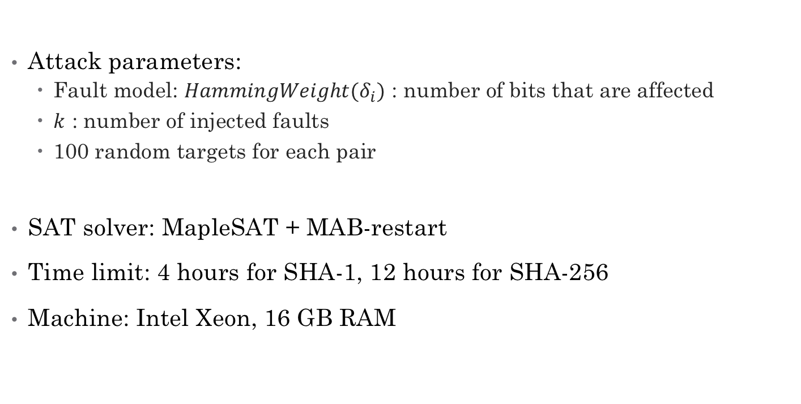
Setup
Attack parameters:
Fault model: $HammingWeight(δ_{i})$ : number of bits that are affected
$k$ : number of injected faults
100 random targets for each pair
SAT solver: MapleSAT + MAB-restart
Time limit: 4 hours for SHA-1, 12 hours for SHA-256
Machine: Intel Xeon, 16 GB RAM

Slide 17
Results – Fault Model
Number of Faults
SHA-256
Number of solved instances out of 100
Previous best result: 65 faults in the 32-bit fault model [Hao14]
 | 32 | 40 | 48 | 56
8 | 28 | 20 | 8 | 0
12 | 32 | 21 | 8 | 2
16 | 69 | 60 | 28 | 9
20 | 90 | 75 | 31 | 10
24 | 100 | 95 | 72 | 20
28 | 95 | 71 | 70 | 34
32 | 71 | 82 | 100 | 48
Max weight of fault

Slide 18
Results – Effect of each callback
SHA-1
3.6x speedup on average

Slide 19
Results – Effect of each callback
SHA-256
14.3x speed up on average

Slide 20
Conclusion
Enhanced propagation and conflict analysis of a SAT solver to improve solving of AFA equation set
Evaluated the solver on a range of fault models and number of injected faults
For both SHA-1 and SHA-256, we find the message words with fewer injected faults compared to previous works in the same fault model
SHA-1: 11 faults
SHA-256: 48 faults

