Slide 1


Slide 2
Design and Simulation of Routing and Wavelength Assignment in Optical Networks based on Graph Theory
By: Saeed Odak
Supervisor: Dr. Lotfollah Beygi

Slide 3
Motivation
Internet traffic demand roaring
Limited network resources
Efficient network utilization
Wavelength Assignment
Routing
Network resources

Slide 4

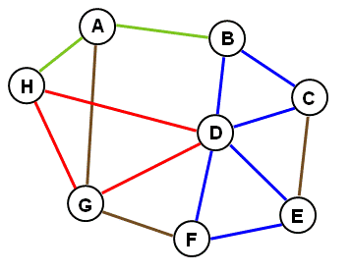
Mathematical Problem Statement

Slide 5
Routing and Wavelength Assignment (RWA)
Integral part of the network planning
Statement of RWA
Wavelength continuity property

Slide 6
Approaches
Multistep RWA
One-Step RWA

Slide 7
Multistep RWA
A route is selected for a connection
Break into sub connections
Assign a wavelength
No feasible wavelength assignment

Slide 8
One-Step RWA
Topology Pruning
Reachability Graph Transformation
Flow-Based Methods
ILP-Based RWA

Slide 9
What we’ve done!!!

Slide 10
Preliminary Concepts / Techniques
Binary Search
Maximum Flow
Minimum Cost Flow

Slide 11
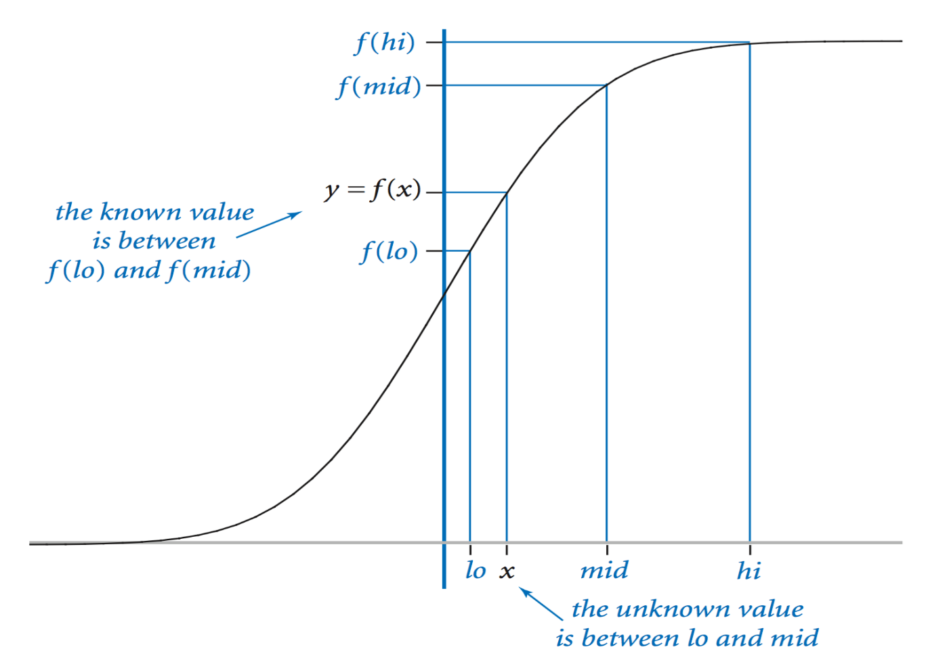
Binary Search

Slide 12
Maximum Flow
Maximum Flow Problem
Ford-Fulkerson method

Slide 13
Maximum Flow Problem
12
16
20
s
10
9
7
t
4
13
4
14

Slide 14
Ford-Fulkerson Method
FORD-FULKERSON-METHOD (G, s, t) :
initialize flow f to 0
while there exists an augmenting path p
do augment flow f along p
return f

Slide 15
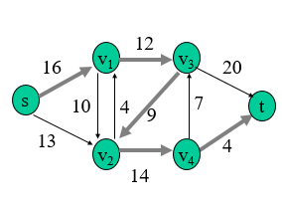
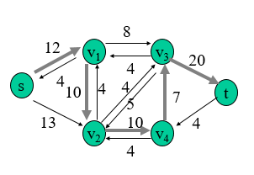
Ford-Fulkerson Method

Slide 16
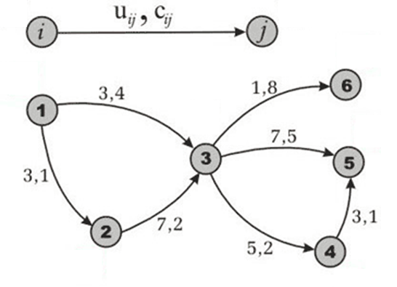
Minimum Cost Flow

Slide 17
How to tackle the problem?
Binary search on answer
Choose a wavelength
Get as much as you can
Go to the next wavelength

Slide 18


Complexity
$$O(\left(k!\left({n \atop k}\right)[n∗m∗T\left(n, m\right)+q]\right)\log_{2}\left(MAX\right))$$

Slide 19
Utilized networks for Numerical Results
US Network
German Network
European Network

Slide 20
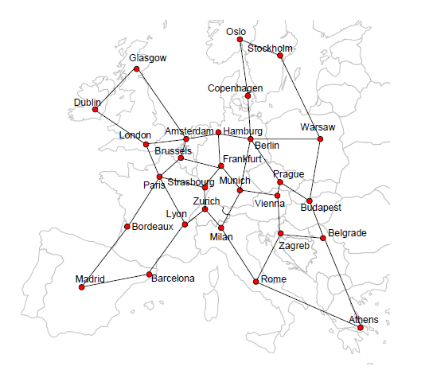
European Network Graph

Slide 21
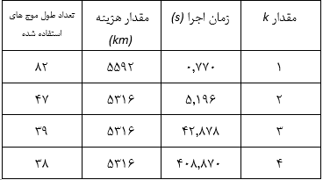
US Network

Slide 22
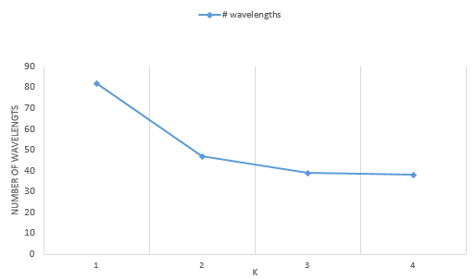
US Network

Slide 23
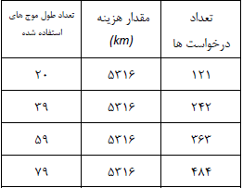
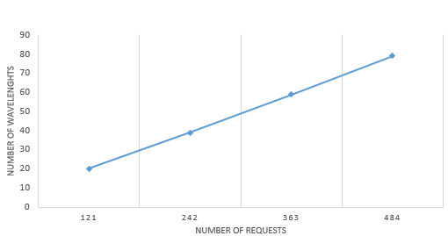
US Network – Different Number of Requests

Slide 24
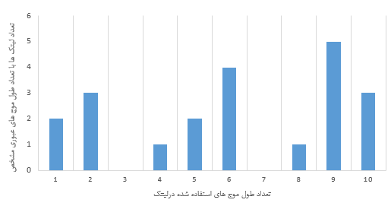
US Network – Alternate Characteristic

Slide 25
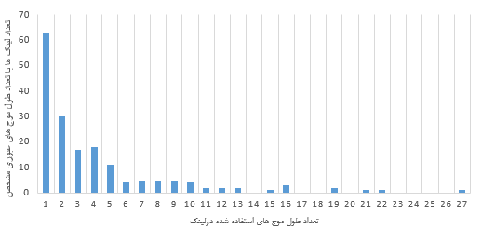
European Network – Alternate Characteristic

Slide 26

ILP Solution
$$\min{\max_{h}{δ^{h}}}$$
$$δ^{h}= \sum_{e}{w_{e}P_{e}^{h}} ∀h$$
$$\sum_{\begin{aligned}e \\ d\left(e\right)=n\end{aligned}}{P_{e}^{h}}= \sum_{\begin{aligned}e \\ s\left(e\right)=n\end{aligned}}{P_{e}^{h}} ∀h, n=1,…,N:n≠s\left(h\right),d(h)$$

Slide 27

ILP Solution
$$\sum_{\begin{aligned}e \\ s\left(e\right)=s(h)\end{aligned}}{P_{e}^{h}}=1; \sum_{\begin{aligned}e \\ d\left(e\right)=d(h)\end{aligned}}{P_{e}^{h}=1} ∀h$$
$$\sum_{\begin{aligned}e \\ d\left(e\right)=s(h)\end{aligned}}{P_{e}^{h}}=0; \sum_{\begin{aligned}e \\ s\left(e\right)=d(h)\end{aligned}}{P_{e}^{h}=0} ∀h$$
$$\sum_{h}{P_{e}^{h}}≤M ∀e$$

Slide 28
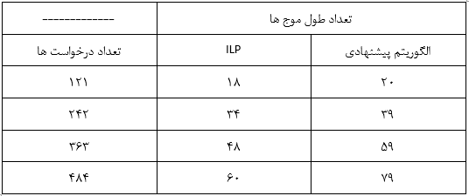
Compare Two Methods in US Network

Slide 29
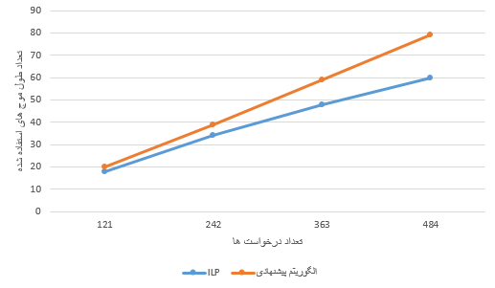
Compare Two Methods in US Network

Slide 30
Conclusions / Future Works
Number of used wavelengths
Accuracy
Running time

Slide 31
Thanks!

Slide 32

Questions?

