Slide 1
BCL
Bigwig format
5’ to 3’ reads coverage
Plot Heatmap/profile
De-multiplex by Cellranger
Coverage Visualization
Expression matrix
Dimension reduction
K-means
Filtering for
cells /genes
Data preparation
Plotting expressions
Cell population/state inference
Phenograph method
D. Ahemar et al. Cell 2016
Differential expression analysis
Quality control
Dimension reduction
Filtering for
cells /genes
Plotting expressions
Cell population/state inference
Differential expression analysis
Seurat method
E. Macosko et al. Cell 2015
Pathway enrichment analysis

Slide 2
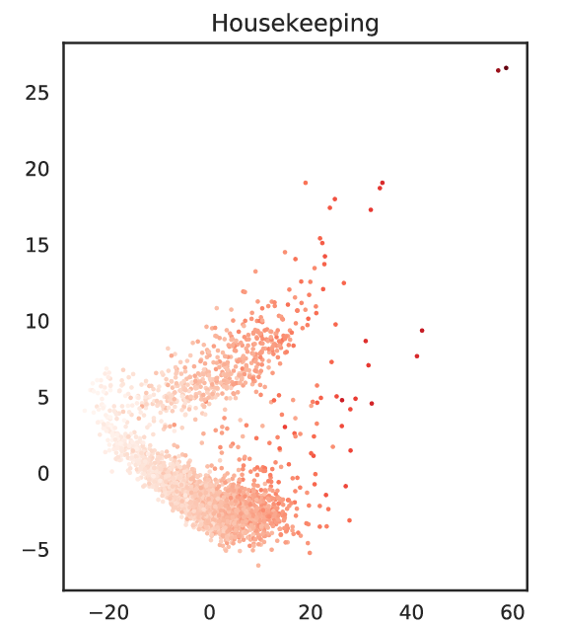
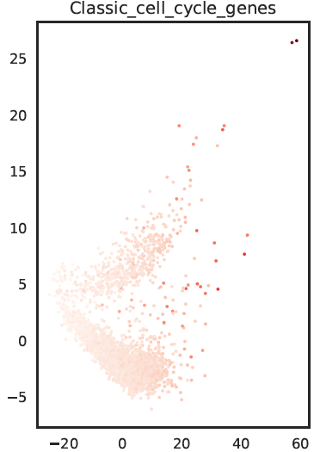
PCA/Clustering analysis analysis Phenograph
Clusters

