Slide 1
Glucose Forecasting for Type 1 Diabetes Using Machine Learning
Sahar Saeed(23095056) MSc Data Science, University of Hertfordshire

Slide 2
Background & Motivation
Glucose spikes are unpredictable and risky.
Traditional models lack personalization.
CGM + EHR = opportunity for smarter forecasting.
Goal: Predict glucose accurately to enable timely intervention.

Slide 3
Research Question & Objectives
Research Question
Can ML models like LSTM, GRU, and Random Forest accurately predict glucose levels using biometric and clinical data?
Objectives
Preprocess and engineer features from CGM & EHR data
Train and compare LSTM, GRU, and Random Forest models
Evaluate performance and clinical relevance of predictions

Slide 4
Literature Review & References
Literature Review
Traditional Models: Rule-based systems, linear regression — limited adaptability
ML Progress: LSTM, GRU, and Random Forest improve glucose forecasting by capturing temporal and nonlinear patterns
Challenges Identified: Data sparsity, lack of interpretability, and low clinical trust
References
Zhu, T. et al. (2018). Blood glucose prediction using deep learning.
Li, K. et al. (2020). Time-series models for diabetes management.
Shashaj, B. et al. (2022). Machine learning for personalized insulin and glucose forecasting.

Slide 5
Dataset Overview
Records: ~5,000 rows of patient time-series data
Features: 30+ columns including:
Biometrics: Glucose (GL), Weight, Height
Clinical Data: Insulin dosage, Complications, Diagnoses
Lifestyle: Alcohol, Exercise, Diet
Demographics: Age, Gender, Ethnicity
Temporal Feature: Timestamped every 5–15 minutes
Challenges: Sparse insulin entries, patient-wise variability, missing values in some fields

Slide 6
Feature Engineering & Preprocessing
Time-Series Structuring: Sorted data by patient ID and timestamp
Lag Features: Created glucose lags (e.g., gl_lag1, gl_lag2) to capture trends
Rolling Stats: Added rolling mean and glucose difference for short-term dynamics
Demographic Encoding: One-hot encoded gender, marital status, etc.
Scaling: Applied MinMaxScaler to normalize numeric features
Handling Missing Data: Dropped or imputed missing values where necessary

Slide 7
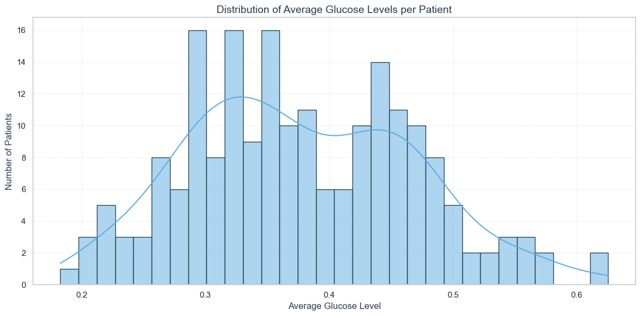
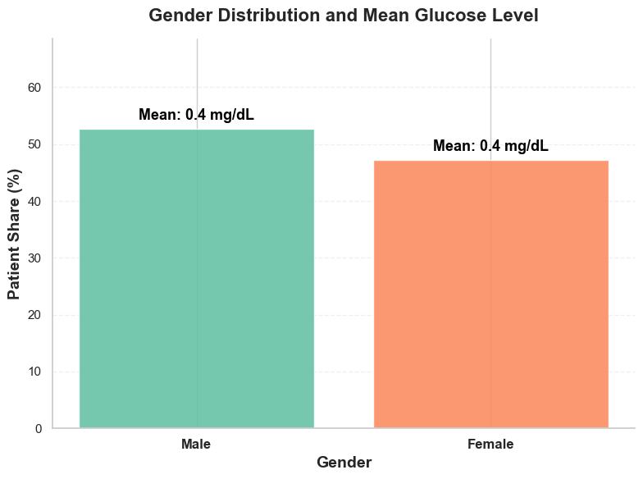
Exploratory Data Analysis (EDA)
🔹 1. Glucose Distribution
Shows overall spread and skewness of glucose values
Right-tailed with high variability in upper ranges
🔹 2. Glucose by Gender
Highlights gender-based variation and outliers in glucose readings

Slide 8
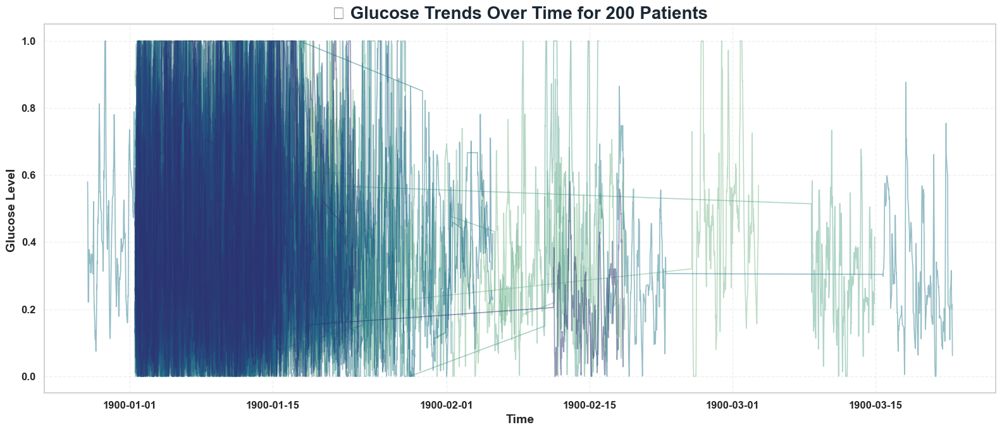
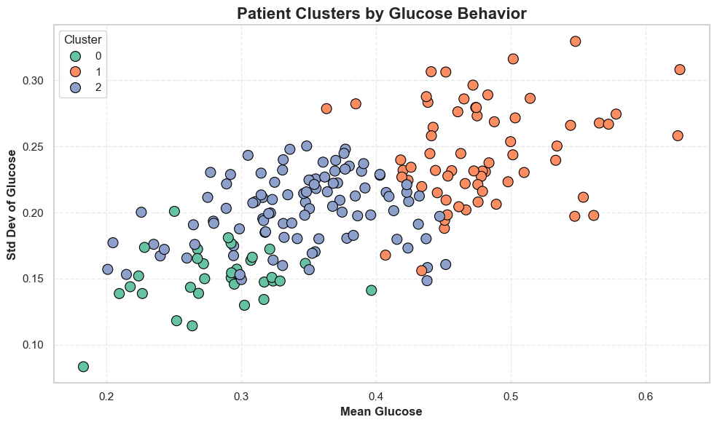
🔹 3. Glucose Over Time
Time series view showing spikes, dips, and patterns over time for 200 patients
🔹 4. Patient Clusters by Glucose Behavior
K-means clustering using mean & variability of glucose across 200 patients

Slide 9
Methodology – Model Selection
LSTM (Long Short-Term Memory) Captures sequential patterns and long-range dependencies in glucose data
GRU (Gated Recurrent Unit) Lightweight alternative to LSTM with faster training and competitive performance
Random Forest Robust, non-linear ensemble model—great for handling mixed feature types and baseline comparison

Slide 10
Model Architecture & Hyperparameters
🔁 LSTM & GRU (Deep Learning Models)
Input: Sequences of past glucose and related features
Architecture:
1 layer of LSTM/GRU with 64 units
Dropout (0.4) to prevent overfitting
Dense(1) for single-value output (glucose prediction)
Training Settings:
Optimizer: Adam
Loss: Mean Squared Error (MSE)
Batch Size: 32
Epochs: 20
EarlyStopping: Patience = 3 (to stop when val loss stops improving)
🌲 Random Forest (Baseline Model)
Reshaped input into 2D feature vectors
Trained using scikit-learn’s RandomForestRegressor with default settings
Used for performance comparison against sequential models

Slide 11
Training & Evaluation
Setup:
Patient-specific training for personalized glucose prediction
80/20 train-test split
Models: Random Forest, LSTM, GRU
Evaluated using MAE, RMSE, and R²

Slide 12
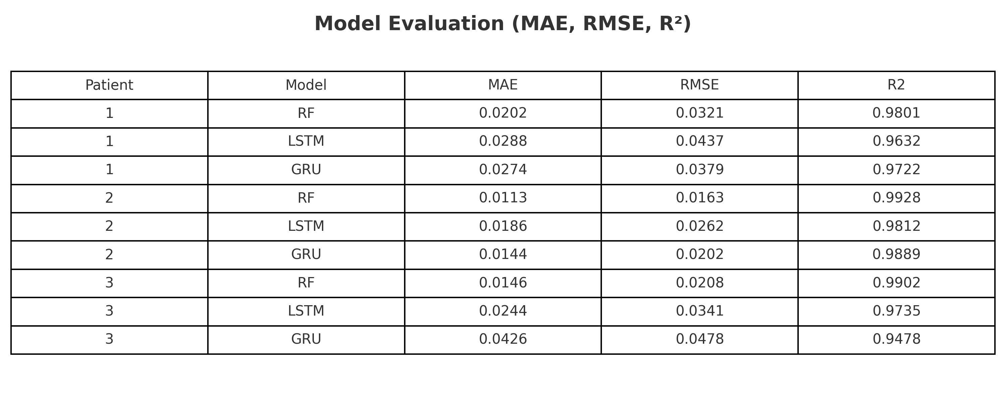
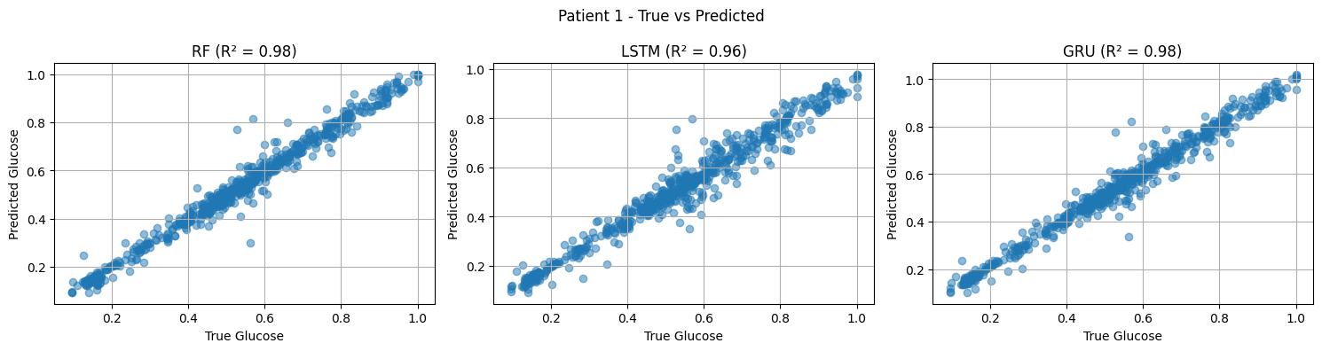
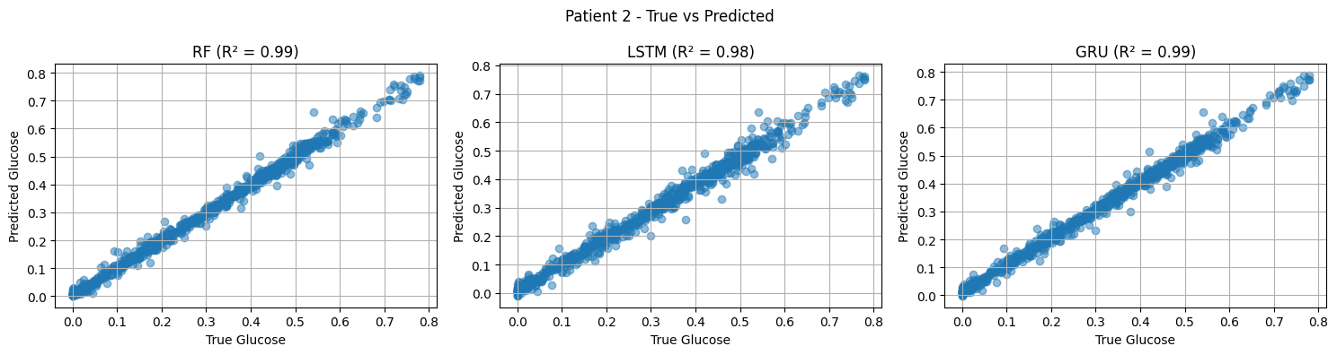
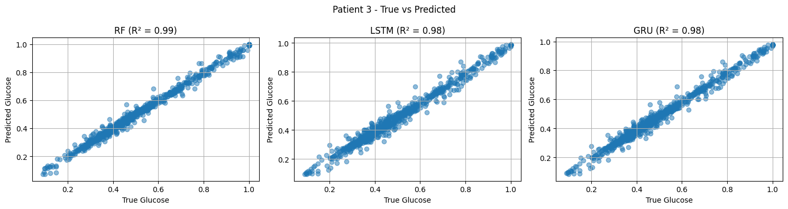
Results
📈 All models performed well, with R² scores above 0.94
🌲 Random Forest:
Best performer across all 3 patients
Lowest MAE and RMSE, highest R² (up to 0.99)
⚡ GRU:
Competitive performance, nearly matches RF
Faster training, good for real-time applications
🔁 LSTM:
Stable predictions but slightly higher error
Still viable for capturing long-term glucose trends

Slide 13
Critical Discussion & Limitations
🔄 Patient Variability
Model performance differs across individuals — personalization is key
📉 LSTM Underperformance
Slightly higher error rates; may require deeper tuning or more data
📦 Limited Dataset Size
Small number of patients reduces generalizability
🧩 Feature Gaps & Missing Data
Some biometric/lifestyle fields are incomplete or noisy
🕒 Temporal Granularity
Irregular time gaps can affect time-series modeling precision

Slide 14
Implications
📈 Accurate glucose prediction enables proactive care
💉 Supports personalized insulin management
📱 Powers real-time CGM apps
🏥 Enhances clinical decision-making
🔄 Scalable to wider patient populations

Slide 15
Conclusion & Future Work
Train on larger & more diverse datasets
Integrate real-time prediction with CGM devices
Explore hybrid models and attention mechanisms

Slide 16
References & GitHub
[1] Hochreiter & Schmidhuber (1997), [2] Lim et al. (2021), [3] Chen & Guestrin (2016).
GitHub: https://github.com/saeedsahar/GlucoseForecastingML.git

Slide 17
Q&A / Thank you
Questions? Thank you for your attention!

