Slide 1
Root Insurance Challenge
Team 26 (Attitude):
Abolfazl Setayesh
Saeed Shaker
https://github.com/saeedshaker/RootIC
The Erdős Institute

Slide 2
The Goal and Our Approach
Problem
Insurance company placing bids to gain Ad space on vertical search websites.
Goal
to maximize the likelihood of policy sale for each $ spent on advertisement
Work break-down structure:
Understanding Data
Designing a tailored approach
Factual analysis
Counter-factual analysis
The Erdős Institute

Slide 3
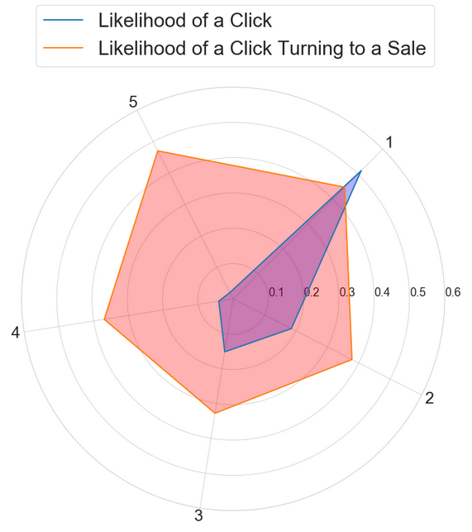
A big picture of Data
Data limitations:
Small dataset
All important variables are Boolean
No variation in bid values
No information on competitors’ bid values
What we observe (stylized facts)
P(Click) heavily depends on rank
P(Sale | Click) does not depend on rank
…
The Erdős Institute

Slide 4
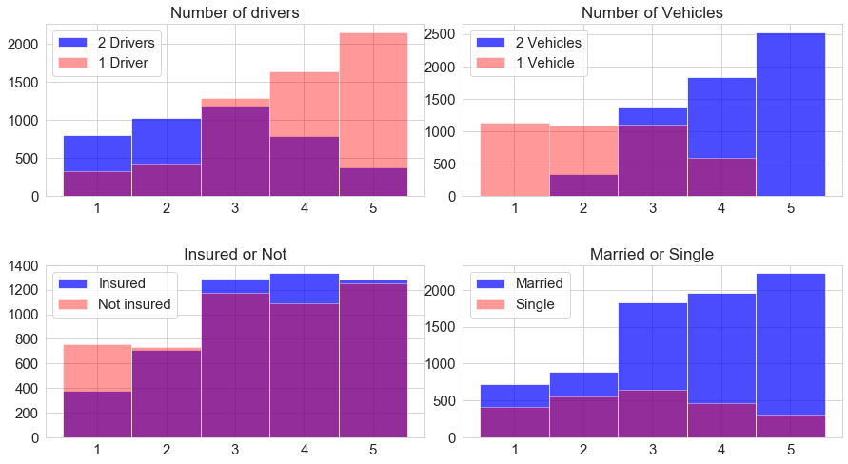
A big picture of Data…
More stylized facts
Market exhibits imperfections
Opponents under-bid uninsured customers !
Costumers do not generate equal profits
Owners of two vehicles
Under current bidding strategy we lose a large segment of the market (>60%)
The Erdős Institute

Slide 5
Understanding Data
Observed System Dynamics
Characteristics = (Insured , Married, 2Vehicles, 2Drivers) (all dummy variables)
We collapse all characteristics into one categorical variable (IMVD)
Our bid
Characteristics
Rank
Click
Sale
Competitors’
Bids-distribution
The Erdős Institute

Slide 6
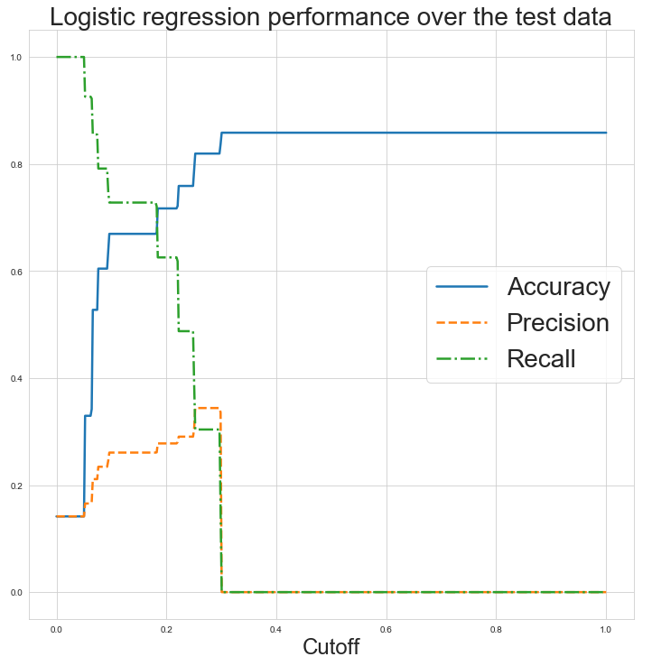
Methods/Challenges
To predict higher likelihood of policy sales
We use off-the-shelf machine learning algorithms
(But maybe not the best approach!)
Only 16 distinct groups (limited variation)
No variation at all in bidding values
They cannot predict rank for alternative bid values
We analyze the dataset using:
Logistic regression
Decision trees
Random forest
Neural network
Performance measures used for each ML method:
Accuracy, recall, and precision
The Erdős Institute

Slide 7
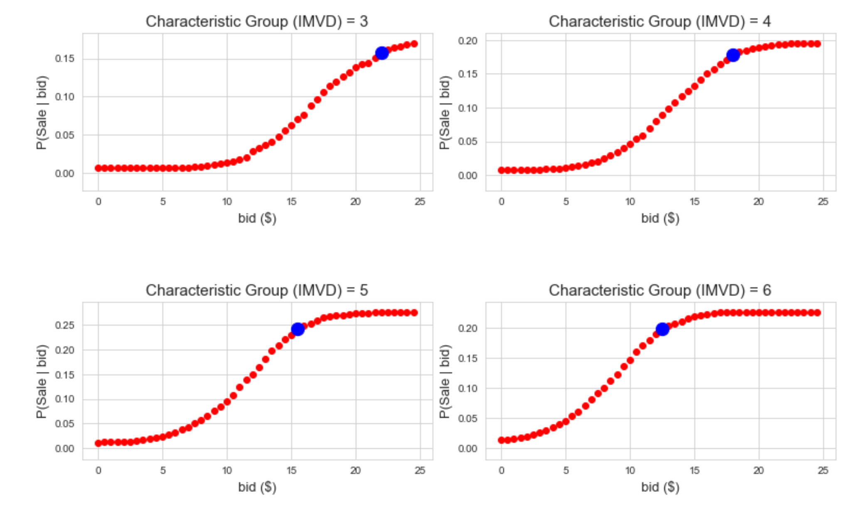
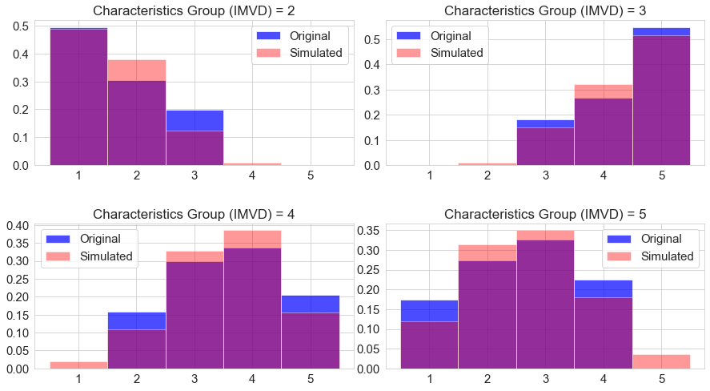
Our Tailored Approach to the Question
Estimate competitors’ bidding value distribution according to each characteristic group (IMVD)
Calibrating distribution moments to match rank histograms for bid=$10
Generating opponents’ bidding values using Monte-Carlo method
Estimate histogram of rank for different bidding values
Estimate the revenue generated for alternative bidding values
Optimize bidding values for each characteristic group (IMVD)
The Erdős Institute

Slide 8
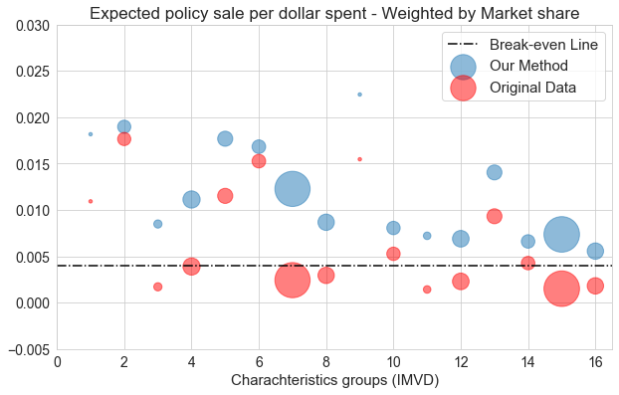
Optimal Results vs. status quo
 | Break even | Status quo | Optimal strategy | Improvement
Ad cost | $10,000 | $10,000 | $10,000 | -
# policies sold | 400 | 493 | 1475 | 200%
Cost per policy | $25 | $20.28 | $6.77 | 200%
Profits | $0 | $2,325 | $26,875 | 1055%
The Erdős Institute

Slide 9
Future Directions
Some variation on bidding values can significantly increase our estimation accuracy
Some information on competitors’ bidding distributions can serve the same purpose
Information on type-dependent profitability would also improve the results
The Erdős Institute

Slide 10
Thank You!
TEAM 26: Attitude
https://github.com/saeedshaker/RootIC
Abolfazl Setayesh
Setayesh.1@osu.edu
Saeed Shaker
Shaker.34@osu.edu
The Erdős Institute

