Slide 2
Workflow
Slice the .vol data: Extract time
*Image registration (py code) → initialisation → batch correction(loadsolver.py) to get a bspline fourier txt
*Segmentation(lazy snap 3 time points) → 3D reconstruction (using vmtk to generate stl) → check stl shape (check_stl_fit.m)
**→ txt+stl to generate stl video using generate_fourier_stl for all time points
Strain information + …

Slide 3

Get images from .vol
Ultrasound images from the raw .vol file are converted into png images at different time points and different slice.

Slide 4
Make avi from .vol using 4D view
.avi file for each time point is genereated

Slide 5
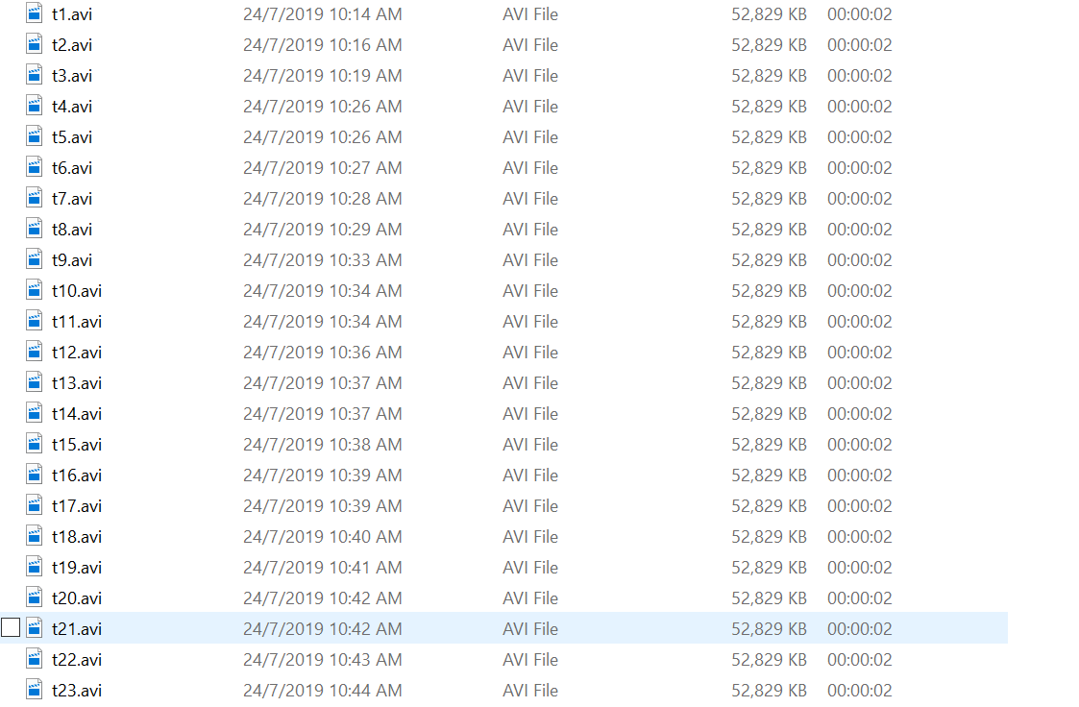
Generate video VOL → AVI

Slide 6
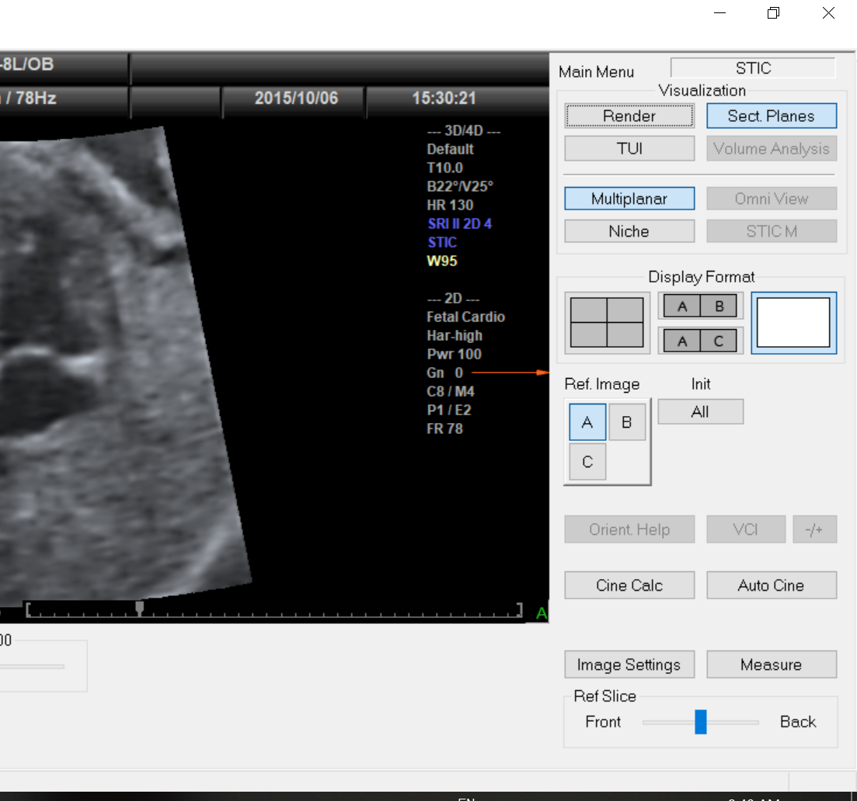

Open .vol
1
2
4D View

Slide 7
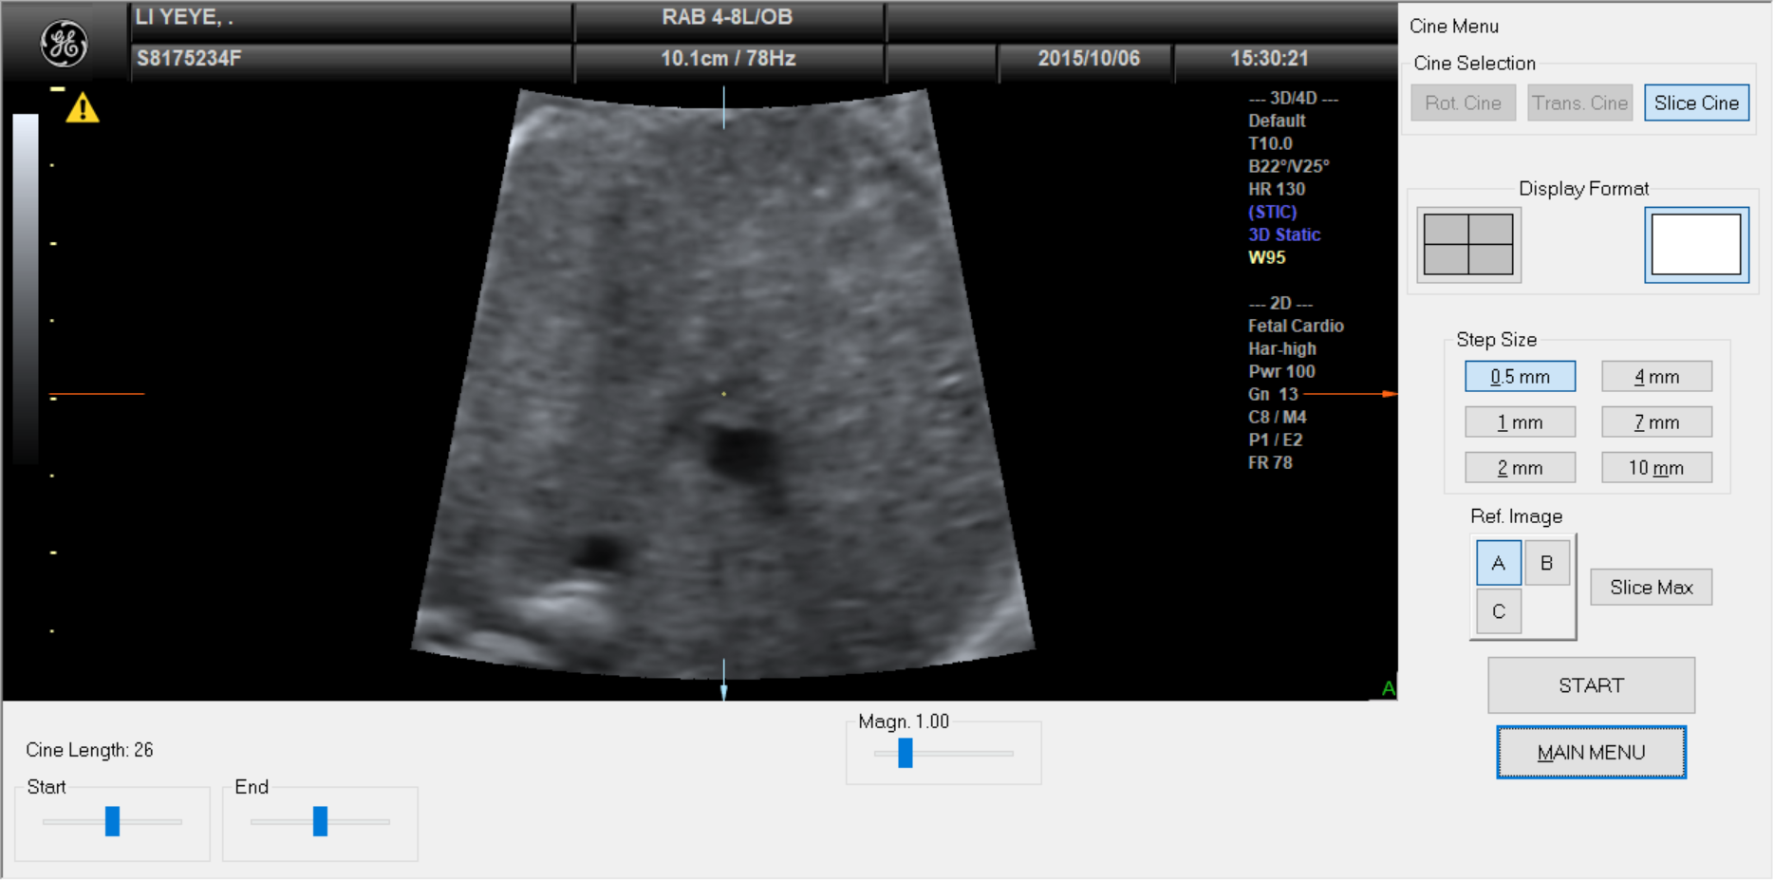
Cine Calc
Calculate cine at each time point 1. With same cine length (adjust start and end slice until cannot see ventricle)
2. Step size: 0.5mm
3. Press Start
2
3
1

Slide 8
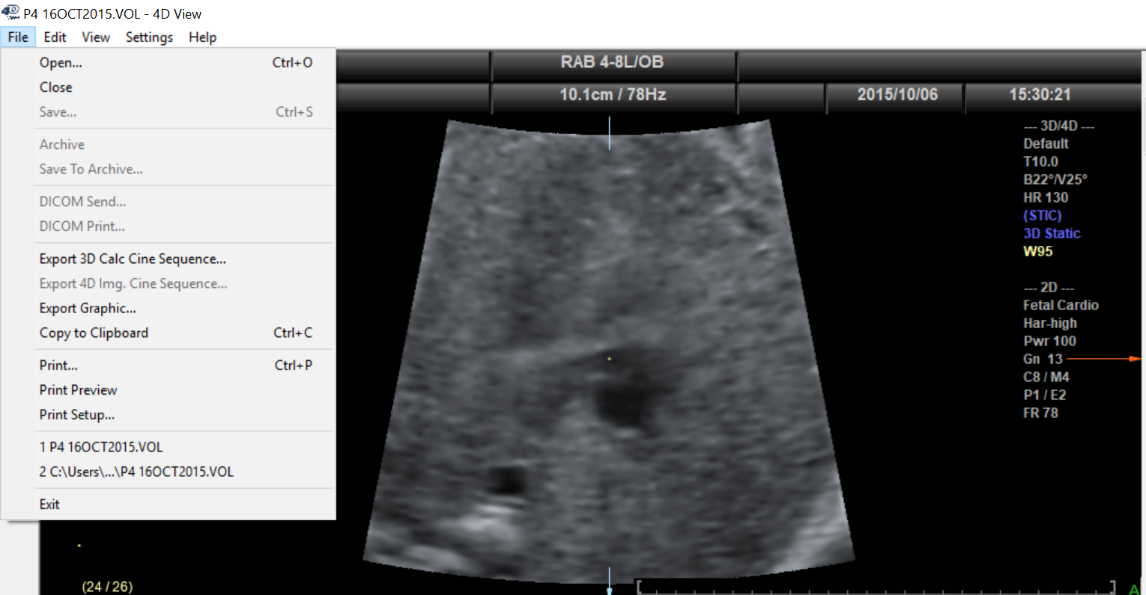
Save as .avi

Slide 9
Make png from .avi for each slice

Slide 10
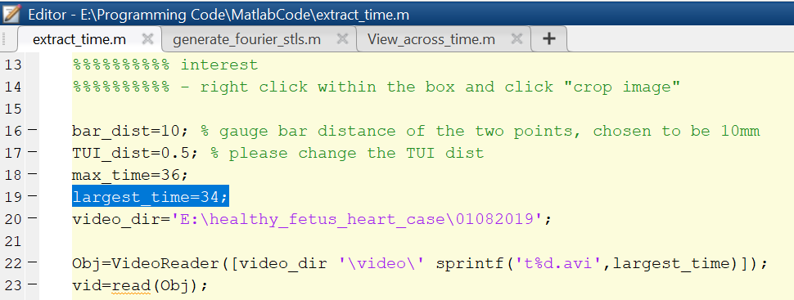
Extract time
Change directory
largest_time: the time point of end diastolic
start slice: enter; end slice: enter
choose 2 big grid
crop and right click to crop image

Slide 11
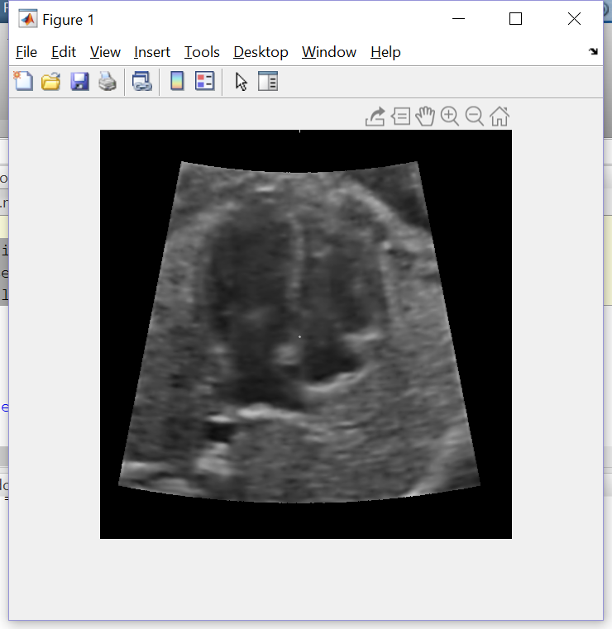
View_across_time
Change the following
numTimes=36;
sliceNum=6; (the slice of interest)
maxSlice=16;
Left and right arrow: change time
Top and bottom arrow: change slice
Aim:
to check if images are sliced correctly
To find end systolic and end diastolic

Slide 12

Image registration
Register one slice at different time
2D_registration.py

Slide 13
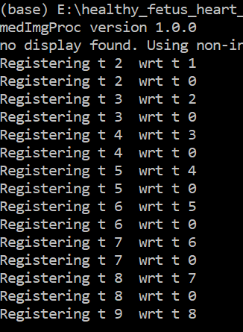
Image registration change file directory and run
1. Load image
2. Register image with respect to t0 and the previous image

Slide 14
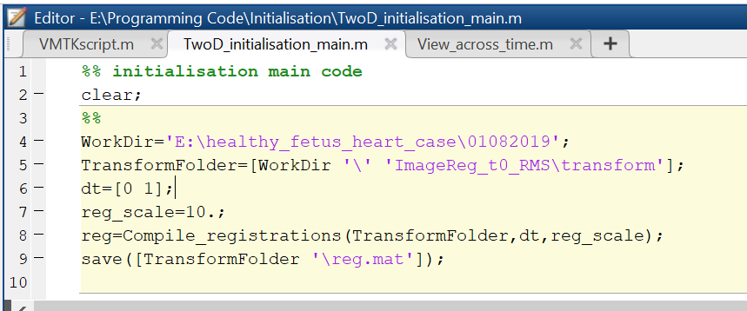
Initialisation
This step is done after registration

Slide 15
Batch correction
Packages needed: https://pypi.org/user/choonhwai/

Slide 16
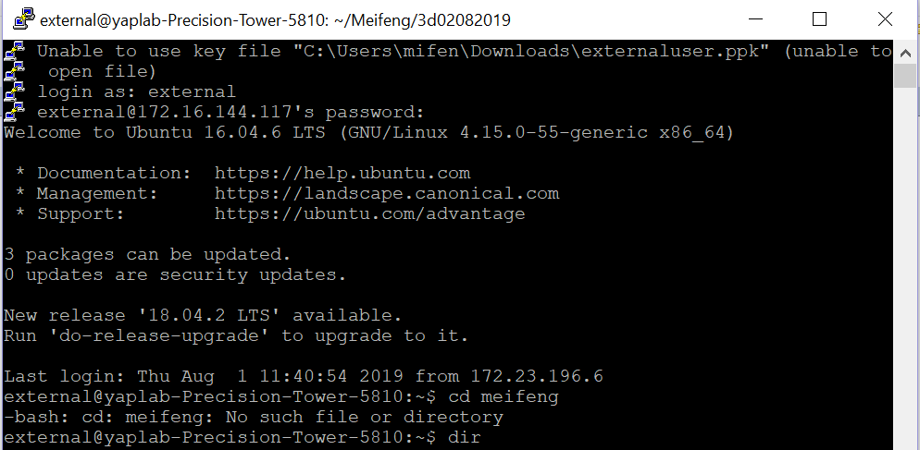
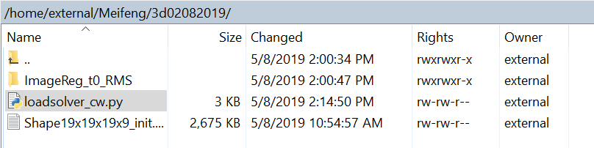
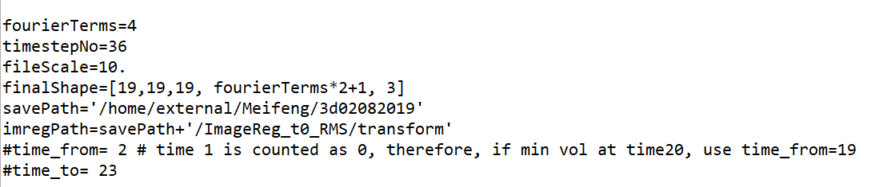
Batch correction (Loadsolver.py)
Upload ImageReg_t0_RMS and _init.txt to WinSCP
Open Putty with name of external (yaplab)
Run loadsolver.py
Change file location and timestepNo
*the pc runs on Linux, format a bit different from that in windows.(no need \\)

Slide 17
Segmentation
Segment myocardium from the images for one particular slice at different time

Slide 18
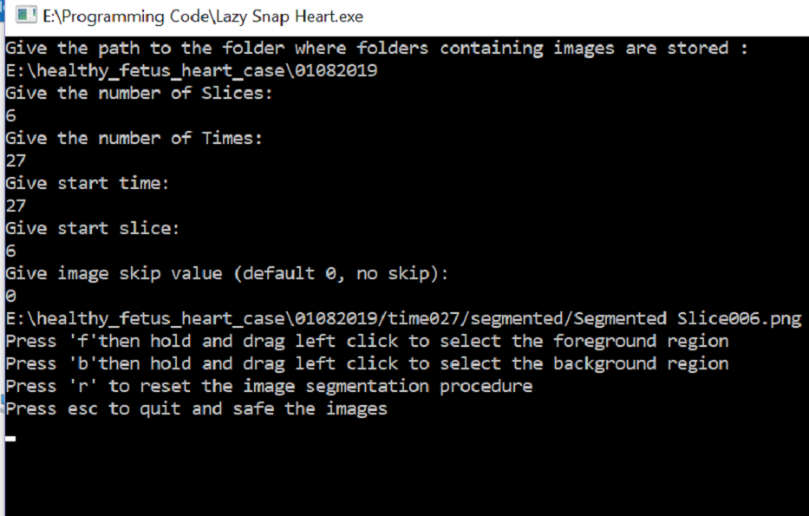
Image segmentation (lazysnap)
1. Three time points to segment
End-systolic
End-diastolic
The first time point
2. Input
Give the number of slice/time:
The slice/time of interest
Start slice/time:
The slice/time of interest

Slide 19
Only 3D

Slide 20
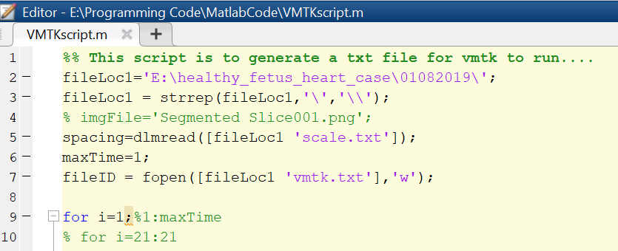
VMTK
Change file location and run VMTP
It will generate a vmtk.txt

Slide 21
Geomagic
To repair the stl file from segmentation.

Slide 22
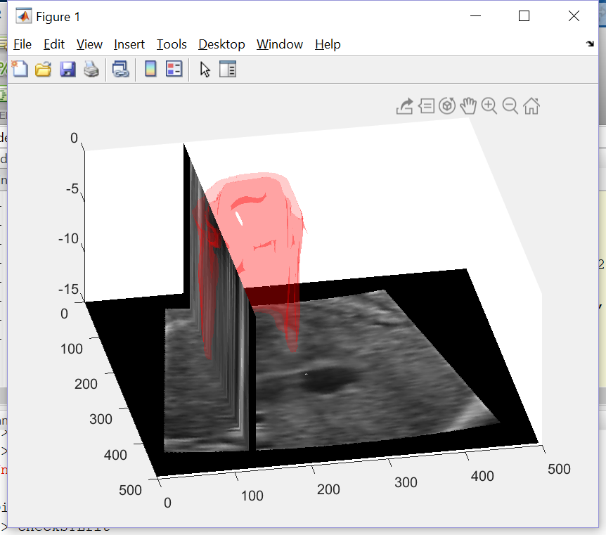
Check_stl_fit
After generating stl file
To compare segmented with original images.
Change file location and scale and slice number and run the code.

Slide 23
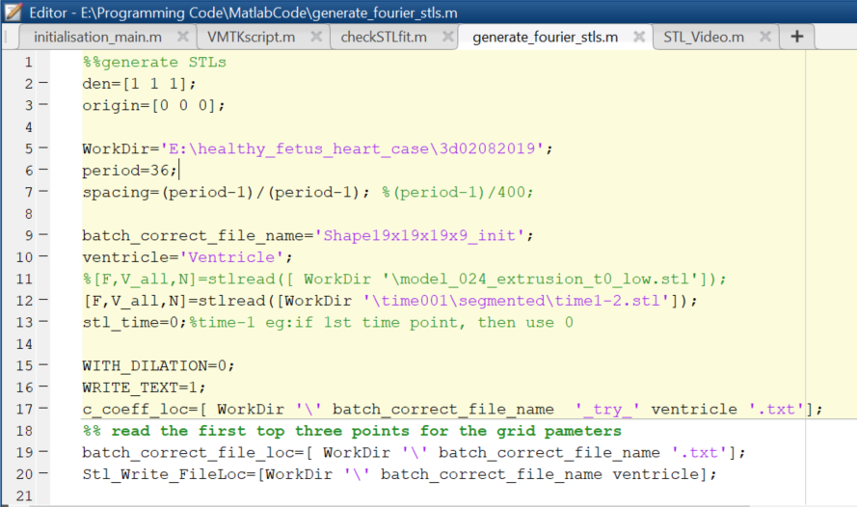
Generate_fourier_stls
Change directory and run
To generate stls for all time points

Slide 24
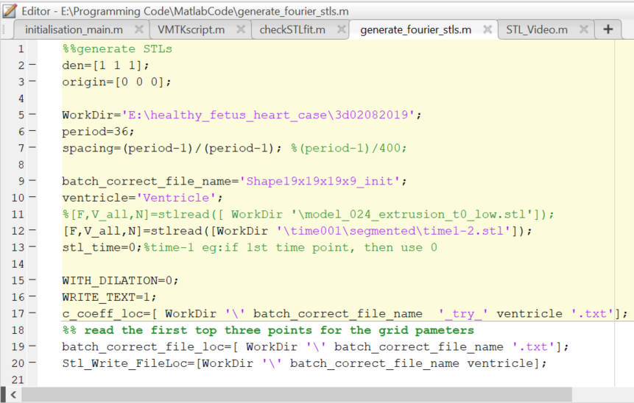
STL_Video
Change the directory, slice number and time points and run
To check whether the stl fit into the motion based on the image

Slide 25
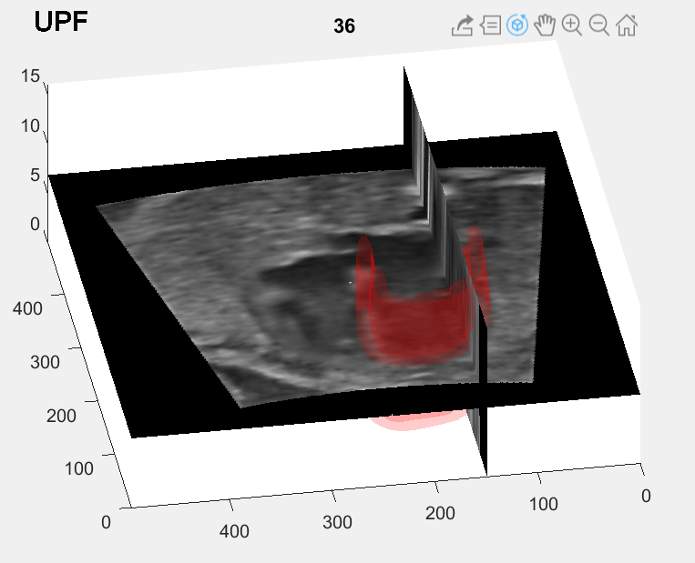
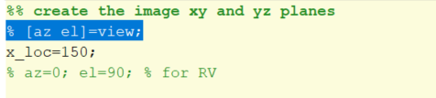
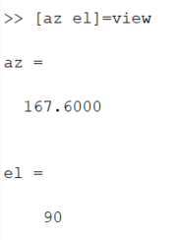
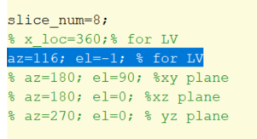
Find the right plane to view
Find the targeted plane (figure on top left)
Run the code highlighted in blue (figure on the right)
Change the number in blue (figure on the bottom left) and run section to view stl with the specified orientation.

Slide 26
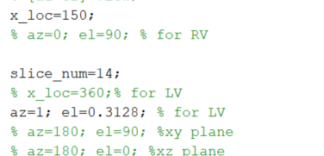
To change the reference slice
Change x_loc and slice_num

