Slide 1
Installing and running of motion tracking

Slide 2
Content
Installation
Getting Image ready
Workflow (Running script)
Debug

Slide 3
Installation
Content
Install python3
Install “Simple Elastix”
Install module “motionSegmentation”

Slide 4
Installing python 3

Slide 5
Python 3 installation
Windows:
Install anaconda https://problemsolvingwithpython.com/01-Orientation/01.03-Installing-Anaconda-on-Windows/
Install Spyder on anaconda http://docs.spyder-ide.org/current/installation.html
Linux
sudo apt-get install idle3

Slide 6
Install Simple Elastix
Windows

Slide 7

Softwares Requirements
Python
Anaconda
Spyder and all related packages
*Visual Studio 2019
*Cmake
*Git
Github
*SimpleElastix https://simpleelastix.readthedocs.io/GettingStarted.html
!VMTK https://blog.csdn.net/jinghongluexia/article/details/81560436
http://www.vmtk.org/download/
4D view
!Geomajic
!Lazy snap
*to install simpleitk

Slide 8
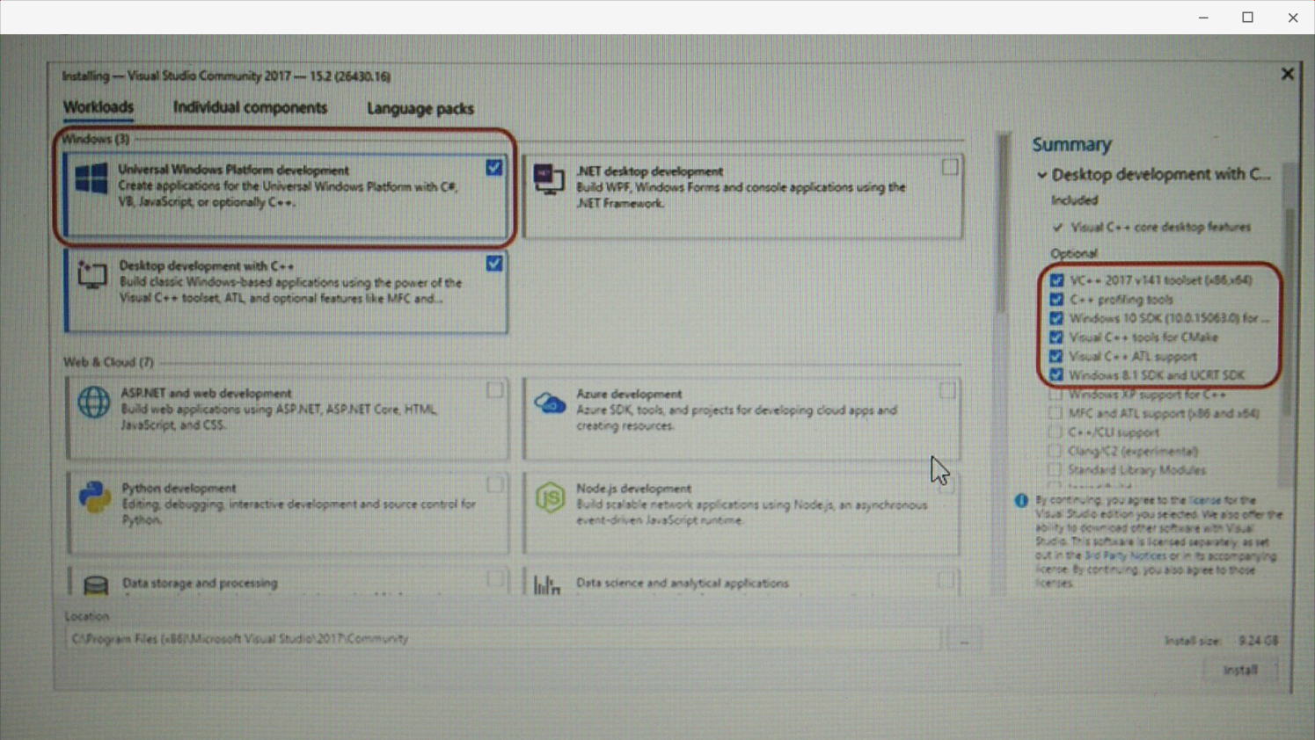
Visual studio 2019

Slide 9
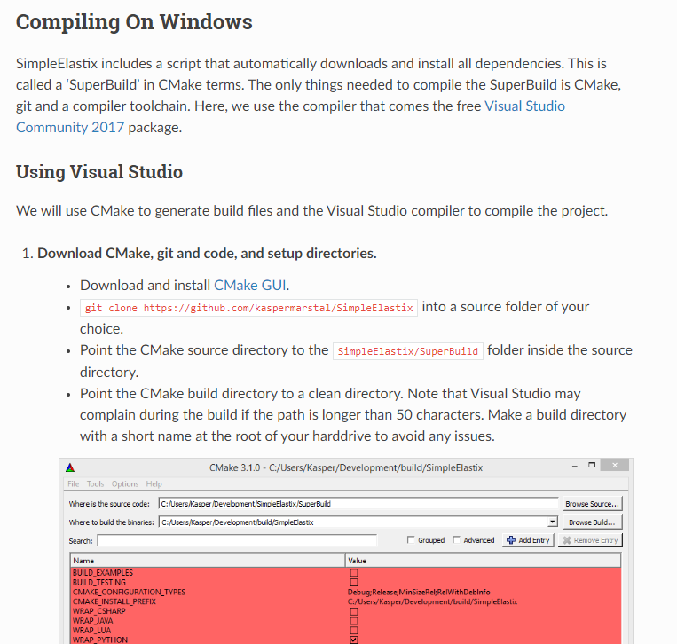
simpleITK

Slide 10
Install Simple Elastix
Linux

Slide 11
Installing Simple Elastix on Linux
Follow: https://simpleelastix.readthedocs.io/GettingStarted.html

Slide 12
Installing “motionSegmentation”module

Slide 13
Installing “motionSegmentation”module
Install pip (or pip3 if you default python is v2.X)
Run in terminal or anaconda command prompt (using admin access):
pip install medImgProc
if you need administrative access (linux):
sudo pip install medImgProc
if you using pip3:
sudo pip3 install medImgProc

Slide 14
Debug

Slide 15
Debug
Image in RGB
Use: img.changeGreyscaleFormat()
Image problem
Check Image anywhere within the code with img.show()
Check image data shape and dimension to see if they match print(img.data.shape) print(img.dim)
Image registration output files all 0s
Check and adjust fileScale
Batch correction taking too long
Adjust bgrid to higher value

Slide 16
Debug (advance) - if the tracking does not match image
Check all units ( img.dimlen , fileScale , stl dimension)
Check manual points
Adjust stlFile to list of points with column = x y z
Register other time point (and add it to the solver to act as anchor)
t1=0 #timestep 0
t2=10 #timestep 10
image1=img.clone()
image1.removeDim(‘t’,t1)
image2=img.clone()
image2.removeDim(‘t’,t2)
pf.TmapRegister_img2img(image1,image2,savePath= imregPath,fileName= regfile_general[1:].format(t1,t2)scaleImg=fileScale,rms=True,bgrid=NEED_TO_BE_DETERMINED) #register image 1 to 2

Slide 17
Debug (advance) - if the tracking does not match image
add other bspline file to the solver (to act as anchor)
solver.addBsplineFile(imregPath+regfile_general.format(t1,t2),timeMapList=[timeList[t1],timeList[t2]],weightList=10.,fileScale=fileScale)
Check any bspline file (trfFile)
pf.transform_img2img(STL_FILE,BSPLINE_FILE,savePath=savePath, fileName='trf',scale=1./fileScale,delimiter=' ')

