Slide 1
Free Energy

Slide 2
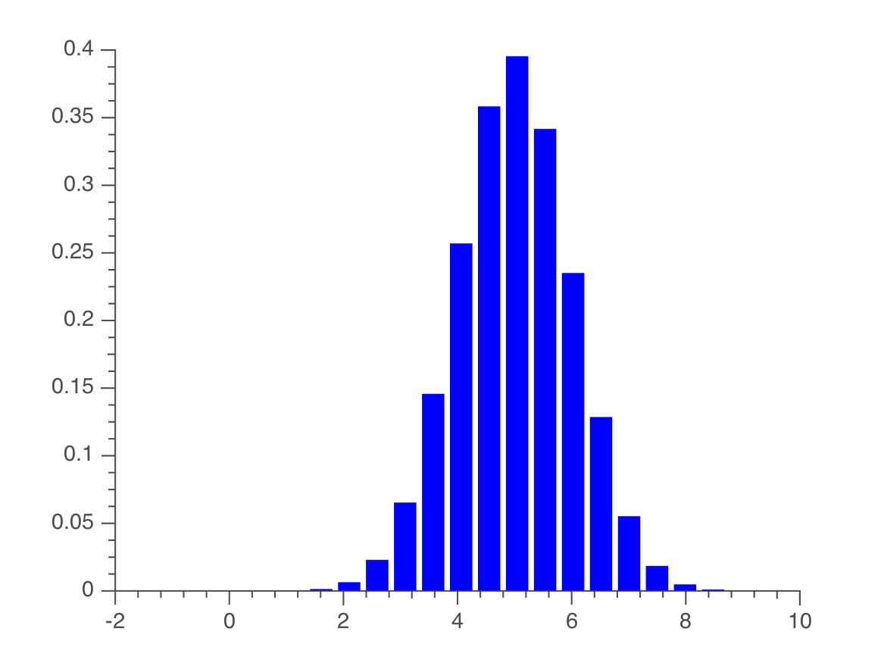
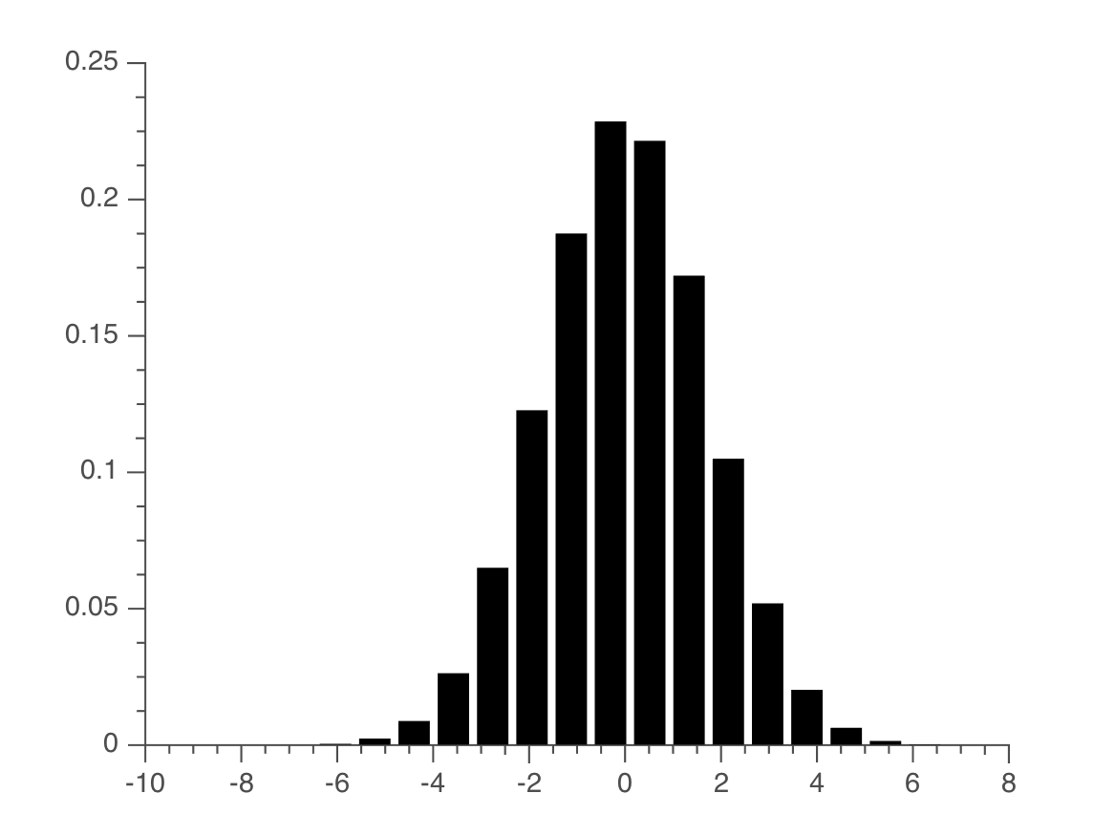
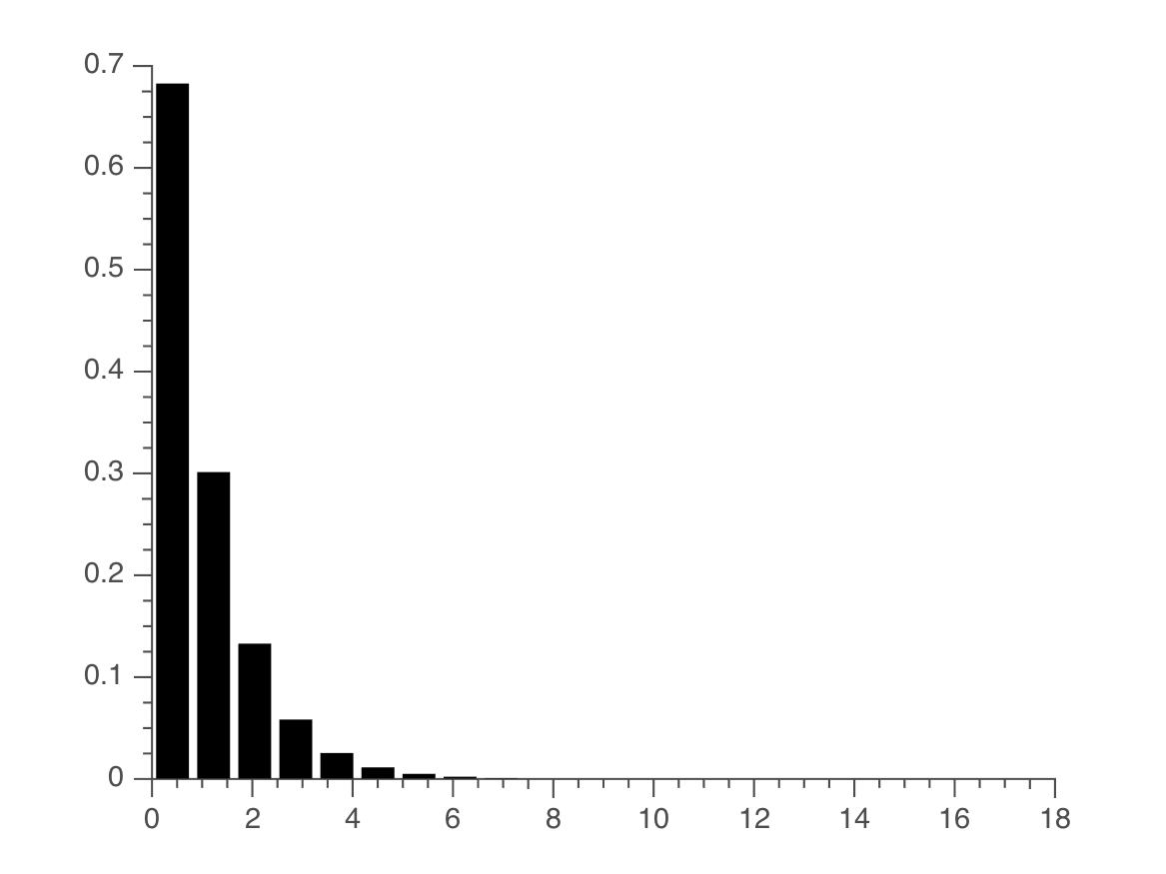

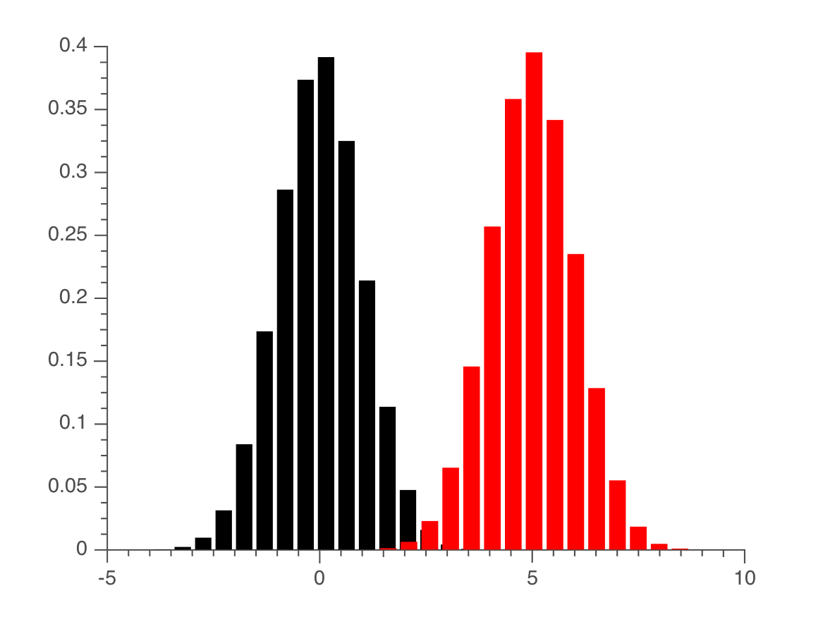
Toy model
Likelihood
Prior
P(D|μ, τ) ~ N(μ,τ)
p(μ) ~ N(μ₀,λ₀τ)
p(τ) ~ Γ(a₀,b₀)
Prior vs likelihood
We choose these distributions, since they are conjugate distributions and insure that our posterior will also be Gaussian.
Notes:
You have this model with the priors, and now you want to estimate the posterior and now we want to approximate it

Slide 3
Functional form
a₀
Define a simple model with a Gaussian likelihood:
τ
b₀
D = data
μ = mean of Gaussian
τ = precision of Gaussian (1/σ²)
D
μ
μ₀
The corresponding priors are:
N
τ₀
Notes:
You have this model with the priors, and now you want to estimate the posterior and now we want to approximate it

Slide 4
Approximate posterior
We now have a full generative model, and want to evaluate the posterior. We use a technique called Variational Bayes, in which we find an approximate posterior that maximizes (negative) free energy, which is the lower bound on the log of model evidence.

Slide 5
Free energy functional

Slide 6

Free energy functional cont’d

Slide 7
Free energy functional cont’d

Slide 8
Varying β
prior distribution
true posterior
low β
high β
approximate
posterior

Slide 9

Free energy and Control
Notes:
Brief discussion of control as optimality, of boundedness as a representation of perceived control in a cognitive task.

Slide 10
?

Slide 11
Thank you!

Slide 12
Control as Optimality
Optimality and control are often linked (Todorov, optimal policy model).
β is the dial between optimality and constraint, or control and limitation.
For cognitive tasks, β can be thought of as the index of perceived control (also interpreted as the index of rationality (Wolpert)), Lagrangian multiplier, resource parameter (Ortega, Braun), QRE (McKelvey)).

