Slide 1
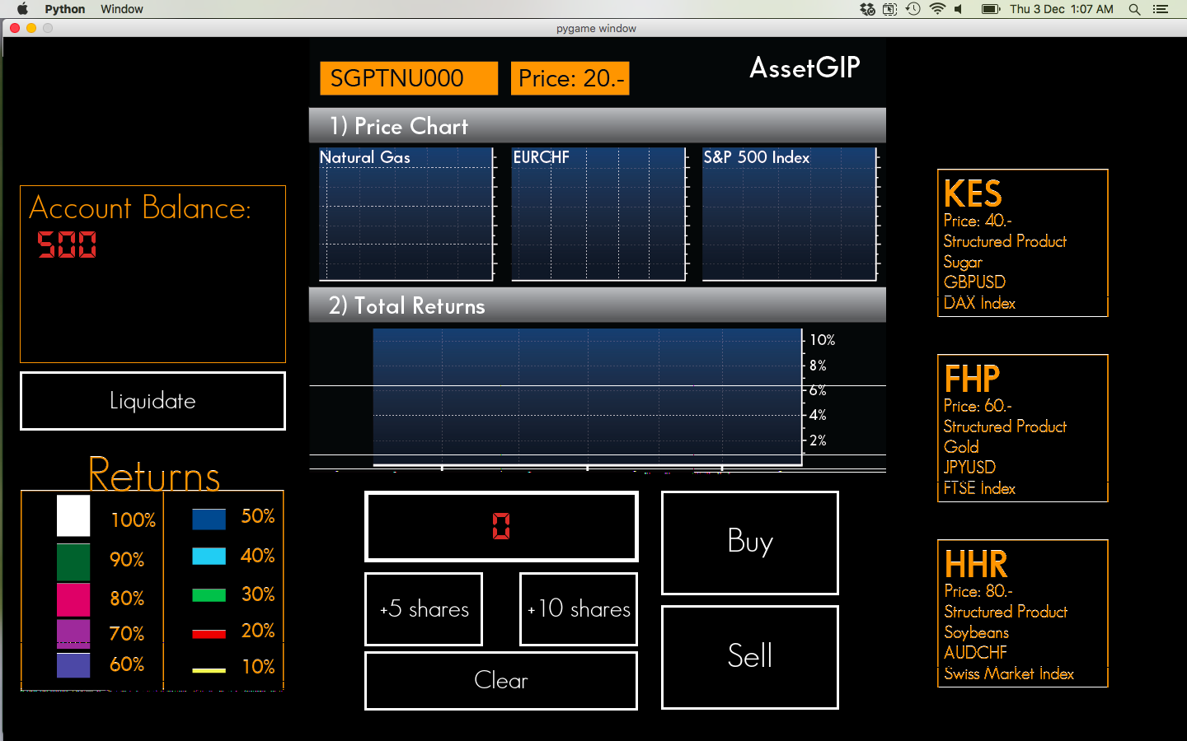
Instructions
Welcome to the TNU Trading System! This task is a simulation of a financial market setting. In this task, you will have the opportunity to trade four possible structured products, buying and selling them over the course of a market session.

Slide 2
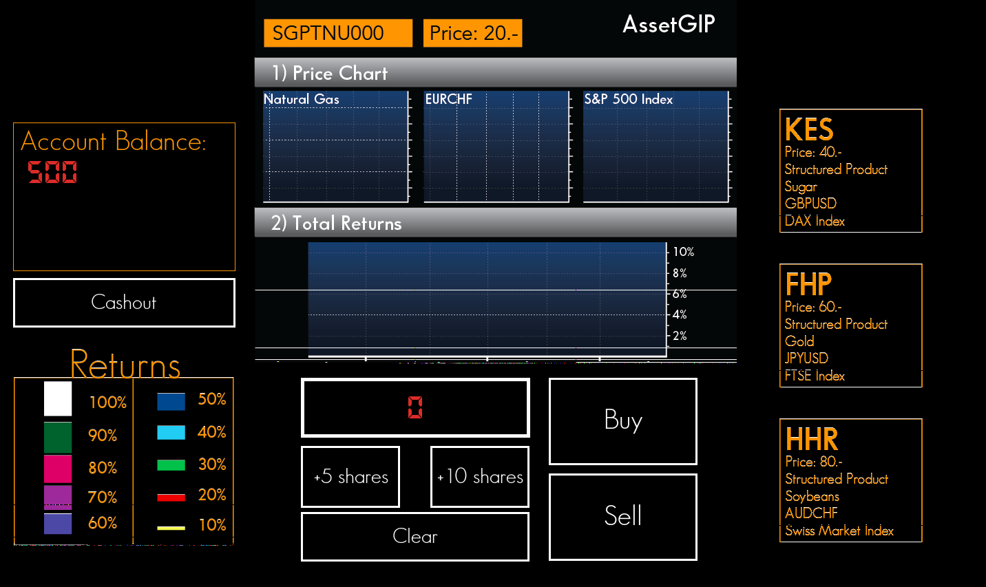
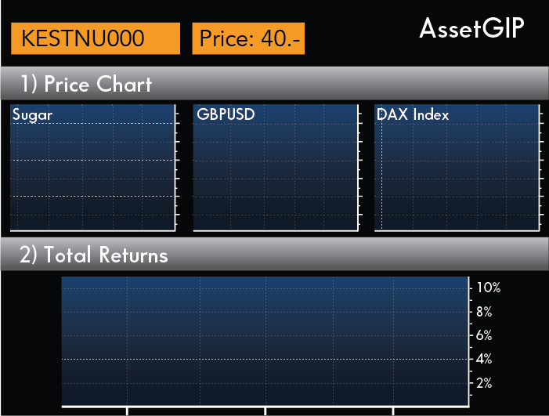
What is a structured product?
A structured product is a financial asset (like a stock) whose price depends on several different financial components.
The price of this product at any given moment, for instance, depends on the price of sugar, the exchange rate between the British pound and the US Dollar (GBPUSD) and the index value of Germany’s DAX index.
Trading a structured product works just like a normal stock. You can buy and sell shares, and the price of each share is indicated in the description of the product. For example, each share of KES is 40.--.
IMPORTANT: In these particular products, your investment is only profitable if each of the underlying components achieve the same percentage return.

Slide 3
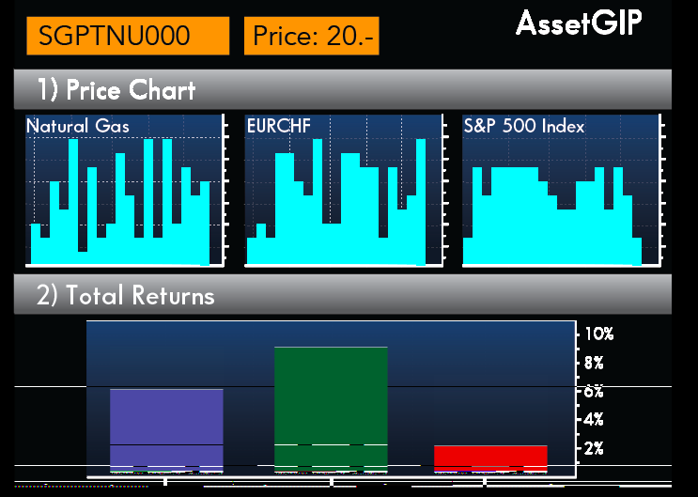
The market session
In each market session, you will be asked to buy a certain number of shares of a given product. You can change the product you are trading by clicking on these descriptions of the product on the right panel:
You will then place your order buy clicking ‘buy’ and sell your order by clicking ‘sell’ (panel above). After placing your order (pressing Buy) you will see the prices of the three underlying assets change as the market session progresses. You can sell your shares at any point in the market session.

Slide 4
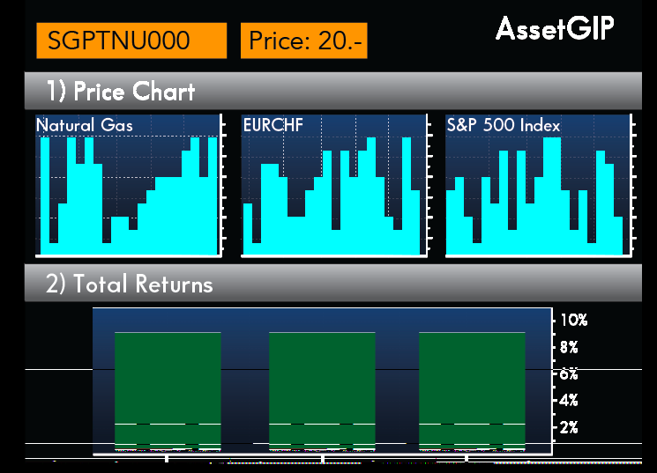
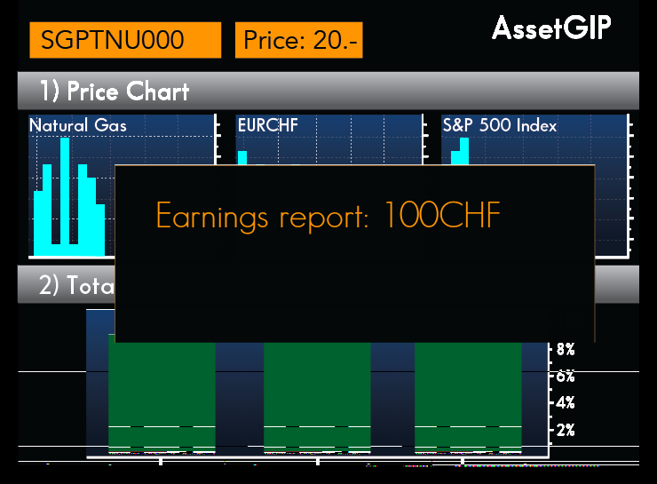
Return on investment
This combination would result in no return on investment.
This combination would result in a return on investment proportional to the level of increase of each asset
After each win, an earnings report comes up to inform you of your wins.

Slide 5
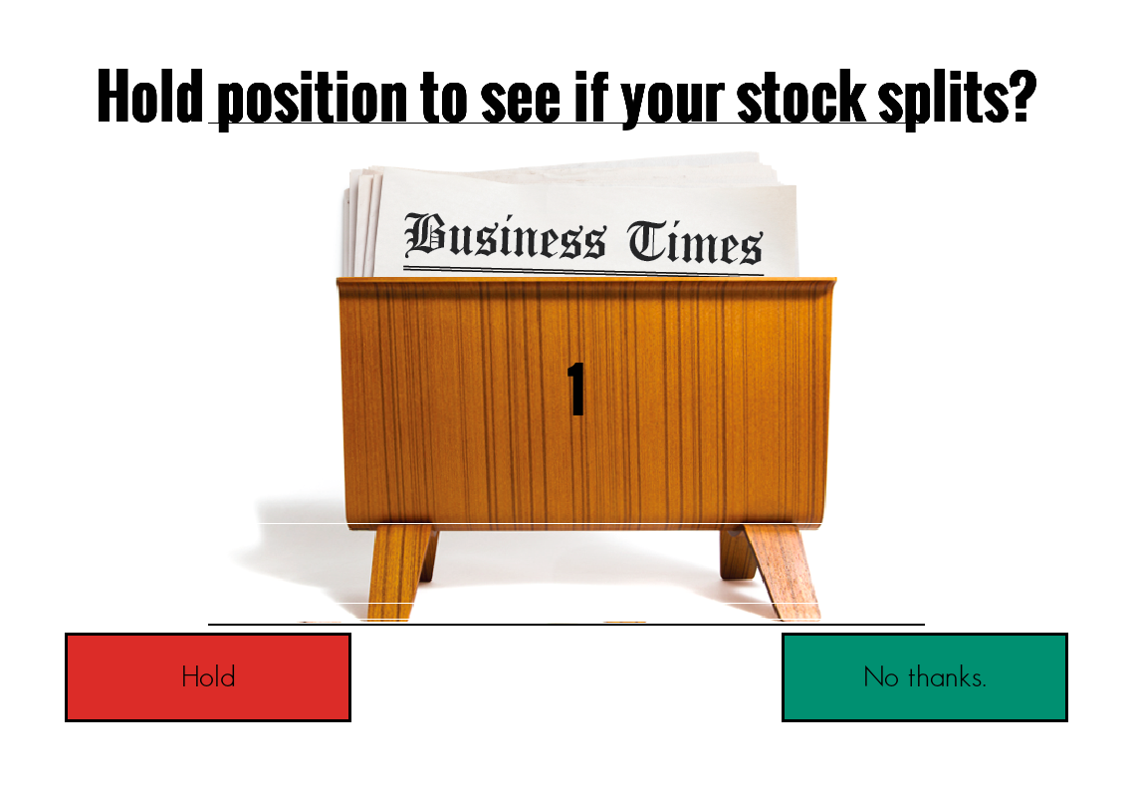
Stock split
After certain profitable market sessions, you will be given the option to hold your porfolio to see if there is a stock split. A stock split is essentially a double-or-nothing option. If your shares split, you receive double the returns on your investment. If your stock does not split, you lose your gains.

Slide 6
Liquidate
At any point in the market session, you can choose to ‘liquidate’ your assets. This clears your portfolio and brings you back to the trading system on a new market day.

Slide 7
Training trials
The next 5 trials will be training trials to acquaint you with the game. They will not count towards your final score. Please alert the experimenter, should you have any additional questions.

