Slide 1
Transformers
Physical Commonsense Reasoning on PIQA
NLP – Sacha Vogel

Slide 2
Preprocessing
DATA
ybisk/piqa into
FEATURE SELECTION
COL_GOAL = 'goal’ COL_SOL1 = 'sol1’ COL_SOL2 = 'sol2’ COL_LABEL = 'label'
FILTER HTML ELEMENTS
training split | 15'113
validation split | 1’000
test split | 1’838

Slide 3
Input / Output Format Transformers
TOKENIZATION
bert-base-uncased
truncate at 126 (99th percentile)
(OOM with max input length - 512)
TEXT EXAMPLE
['[CLS]', 'when', 'boiling', 'butter', ',', 'when', 'it', "'", 's', 'ready', ',', 'you', 'can', '[SEP]', 'pour', 'it', 'onto', 'a', 'plate', '[SEP]']

Slide 4
Input / Output Format Transformers
TOKENIZATION
label 0 or 1
input1_attention_mask always 1
input1_input_ids token ids
input1_token_type_ids goal 0 / sol 1
input2_attention_mask always 1
input2_input_ids token ids
input2_token_type_ids goal 0 / sol 1

Slide 5
Input / Output Format Transformers
DATA LOADER
BATCH_SIZE = 32
pad to longest input sequence in batch
create tensor for each input
FINAL INPUT FORMAT
encode inputs into [CLS] vector (768 dim)
concatenate CLS1 & CLS2 into (1536 dim)

Slide 6
Input / Output Format Transformers
OUTPUT
2 logits
argmax of those logits predicted label 0 / 1
SOL1 is correct if predicted label = 0
SOL2 is correct if predicted label = 1

Slide 7
Input / Output Format LLM
PROMPTS
system prompt – assign role
user prompt – including goal, sol1 and sol2
TOKENIZATION
Qwen2.5-3B-Instruct
apply_chat_template
input_ids
attention_mask
<|system|> system prompt <|user|> user prompt – including goal, sol1 and sol2 <|assistant|>

Slide 8
Input / Output Format LLM
OUTPUT
answer is concatenated with input [... input tokens ..., 32, 198]
split answer to output [32, 198]
decode tokenizer.decode([32, 198]) → "A"
parse into predicted label A = 0 / B = 1 / default = -1

Slide 9
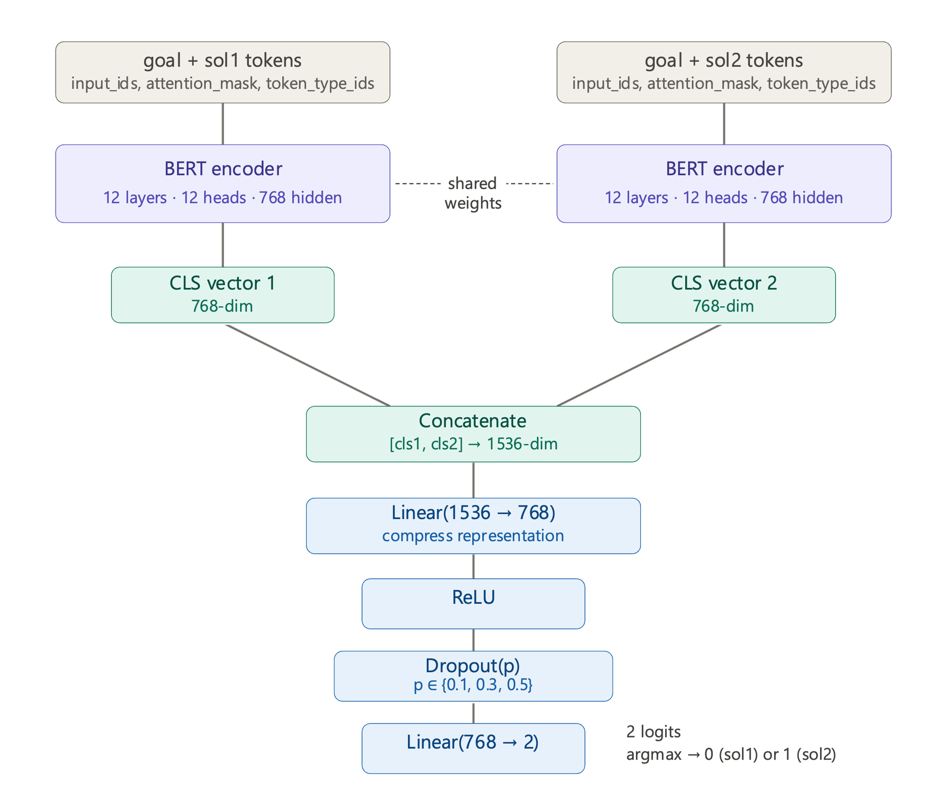
Network Architecture Transformers
Visualisation generated by Claude

Slide 10
Network Architecture LLM
“ARCHITECTURE”
Qwen2.5-3B-Instruct
3B parameters

Slide 11
Experiments
PRETRAINED TRANSFORMER
add OneCycleLR scheduler after low regularization
LLM
switched from Qwen2.5-1.5B-Instruct to Qwen2.5-3B-Instruct
try second prompt with specific role assignment
answer with «A» and «B» instead of «0» and «1» improved performance

Slide 12
Results
MODEL | TRAINING SET ACCURACY | VALIDATION SET ACCURACY | TEST SET ACCURACY
Random Initialized BERT | 0.504 | 0.517 | 0.496
Pretrained BERT (bert-base-uncased) | 0.956 | 0.668 | 0.656
LLM (Qwen2.5-3B-Instruct) | - | - | 0.753

Slide 13
Interpretation
RANDOM INITIALIZED TRANSFORMER
always predicts sol1
never learned anything
are 110B params too much to learn anything for about 15’000 data records?
PRETRAINED TRANSFORMER
meaningful predictions
bad regularization
OneCycleLR scheduler improved test set acc. by 0.056
(pretrained weights are not destroyed)

Slide 14
Interpretation
LLM
solid predictions
Qwen2.5-3B-Instruct outperformed Qwen2.5-1.5B-Instruct
(by 0.143 on the same prompt)
KEY TAKEAWAY
models fail on near identical solutions
physical commonsense world knowledge in training data of LLM outperforms task specific fine tuning

Slide 15
Thank You For Your Attention!

Slide 16
Are There Any Questions?

