Slide 1
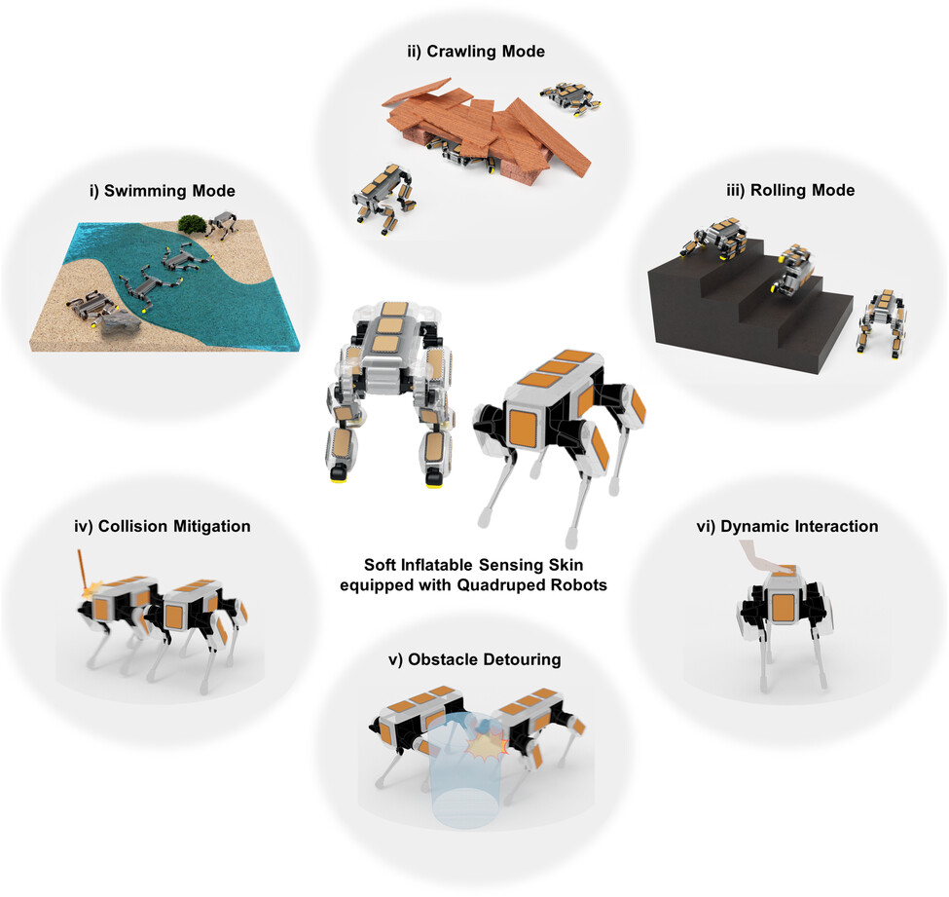
Environmental Adaptability of Legged Robots with Cutaneous Inflation and Sensation
Advanced Intelligent Systems, First published: 18 August 2023, DOI: (10.1002/aisy.202300172)
Notes:
Multimode locomotion and environmentally adaptive responses enabled by cutaneous inflation and tactile sensation. i) Floating and swimming with buoyancy and propulsion, ii) crawling with stable ground contact and friction, iii) rolling down from height with air cushions, iv) impact detection and mitigation, v) obstacle recognition and detouring, and vi) dynamic whole‐body interaction with surrounding.
IF THIS IMAGE HAS BEEN PROVIDED BY OR IS OWNED BY A THIRD PARTY, AS INDICATED IN THE CAPTION LINE, THEN FURTHER PERMISSION MAY BE NEEDED BEFORE ANY FURTHER USE. PLEASE CONTACT WILEY'S PERMISSIONS DEPARTMENT ON PERMISSIONS@WILEY.COM OR USE THE RIGHTSLINK SERVICE BY CLICKING ON THE 'REQUEST PERMISSIONS' LINK ACCOMPANYING THIS ARTICLE. WILEY OR AUTHOR OWNED IMAGES MAY BE USED FOR NON-COMMERCIAL PURPOSES, SUBJECT TO PROPER CITATION OF THE ARTICLE, AUTHOR, AND PUBLISHER.

