Slide 1
7.5 Deadlock Avoidance
The algorithm is simply to ensure that the system will always remain in safe state.
Therefore, if a process requests a resource that is currently available, it may still have to wait.
Thus, resource utilization may be lower

Slide 2
Avoidance algorithms
Single instance of a resource type. Use a resource allocation graph
Multiple instances of a resource type. Use the banker’s algorithm

Slide 3
Resource-Allocation Graph Scheme
Claim edge Pi → Rj indicated that process Pj may request resource Rj in the future; represented by a dashed line.
Claim edge converts to request edge when a process requests a resource.
Request edge converted to an assignment edge when the resource is allocated to the process.
When a resource is released by a process, assignment edge reconverts to a claim edge.

Slide 4
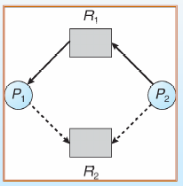
Resource-Allocation Graph

Slide 5
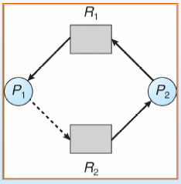
Unsafe State In Resource-Allocation Graph

Slide 6
Resource-Allocation Graph Algorithm
Suppose that process Pi requests a resource Rj
The request can be granted only if converting the request edge to an assignment edge does not result in the formation of a cycle in the resource allocation graph

Slide 7
Banker’s Algorithm
Multiple instances.
Each process must a claim maximum use in advance.
When a process requests a resource it may have to wait.
When a process gets all its resources it must return them in a finite amount of time.

Slide 8
Banker’s Algorithm
Two algorithms need to be discussed:
1. Safety state check algorithm
2. Resource request algorithm

Slide 9
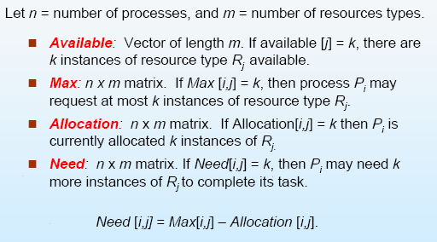
Data Structures for the Banker’s Algorithm

Slide 10
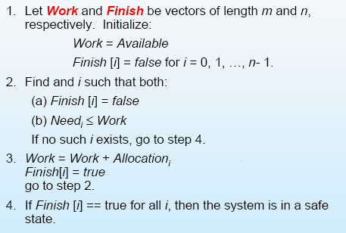
Safety Algorithm

Slide 11
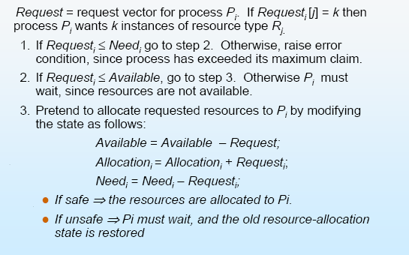
Resource-Request Algorithm for Process Pi

Slide 12
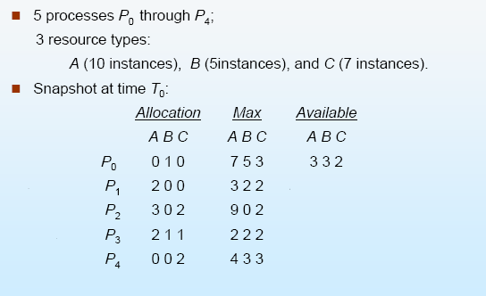
Example of Banker’s Algorithm

Slide 13
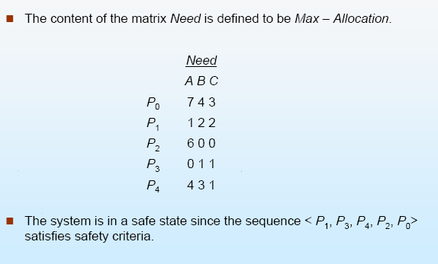
Example of Banker’s Algorithm

Slide 14
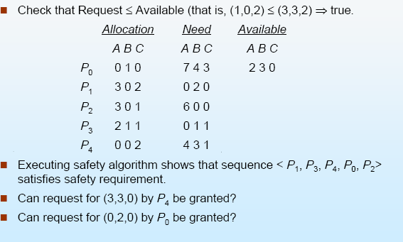
Example of Banker’s Algorithm

Slide 15
7.6 Deadlock Detection
Under the environment of a system employs neither a deadlock prevention nor a deadlock avoidance, it should provide:
Find: An algorithm that examines the state of the system to determine whether a deadlock has occurred
Recover: an algorithm to recover from the deadlock

Slide 16
7.6 Deadlock Detection
The overhead of the detection includes not only the run-time cost of maintaining the necessary information and execute the detection algorithm but also the recovery part

Slide 17
Detection Algorithms
Single instance of a resource type. Use a wait-for graph
Multiple instances of a resource type. Use the algorithm similar to banker’s algorithm

Slide 18
Wait-for Graph
Maintain wait-for graph
Nodes are processes.
Pi→Pj if Pi is waiting for Pj.
Periodically invoke an algorithm that searches for a cycle in the graph. If there is a cycle, there exists a deadlock.

Slide 19
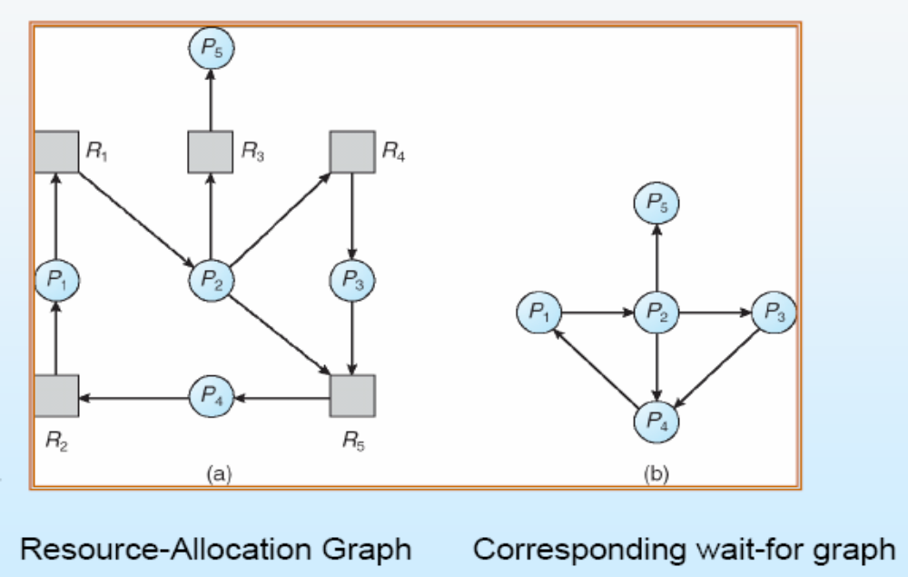
Wait-for Graph

Slide 20
Several Instances of a resource type
Available: A vector of length m indicates the number of available resources of each type.
Allocation: An n x m matrix defines the number of resources of each type currently allocated to each process.
Request: An n x m matrix indicates the current request of each process. If Request [ij] = k, then process Pi is requesting k more instances of resource type Rj.

Slide 21
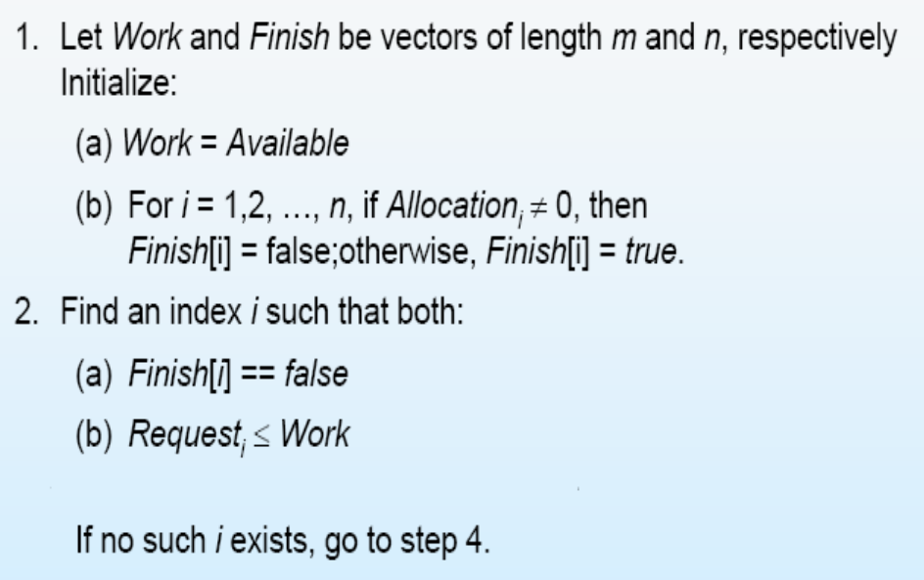
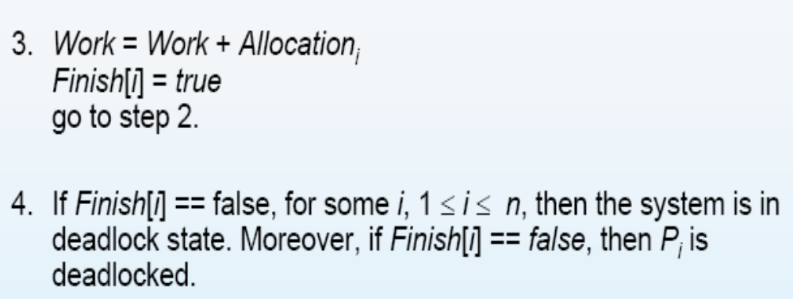
Detection Algorithm

Slide 22
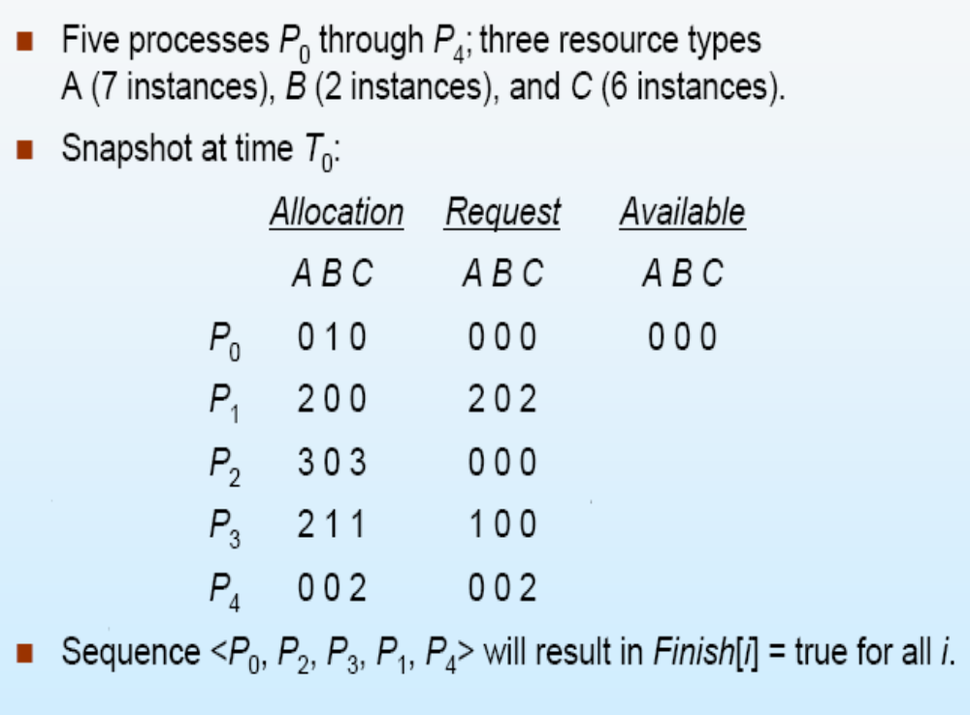
Detection Example

Slide 23
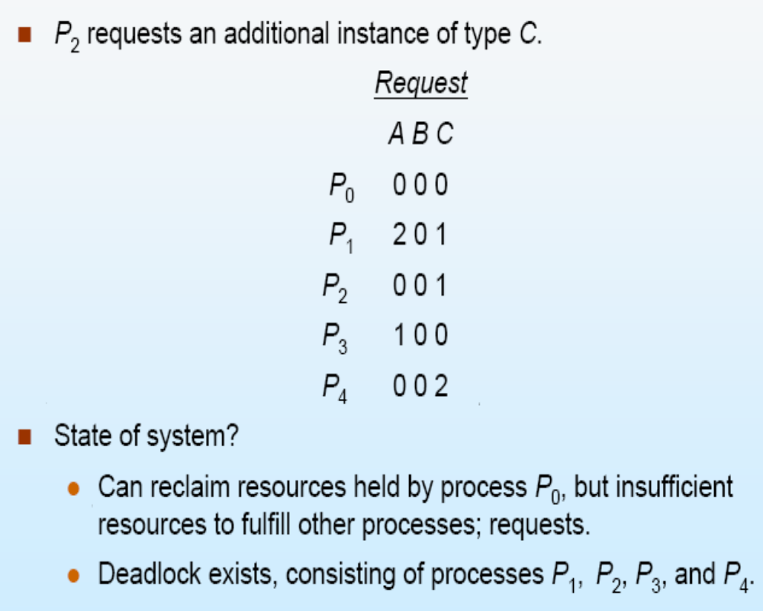
Detection Example

Slide 24
Detection Algorithm Usage
When, and how often, to invoke depends on:
How often a deadlock is likely to occur?
How many processes will need to be rolled back?

Slide 25
Recovery from Deadlock: Process Termination
Abort all deadlocked processes.
Abort one process at a time until the deadlock cycle is eliminated. (Based on which process is the min cost)

Slide 26
Recovery from Deadlock: Process Termination
However, the cost of process may be computed by:
Priority of the process.
How long process has computed, and how much longer to completion.
Resources the process has used.
Resources process needs to complete.
How many processes will need to be terminated.
Is process interactive or batch?

Slide 27
Recovery from Deadlock: Resource Preemption
Selecting a victim –minimize cost.
Rollback –return to some safe state, restart process for that state.
(Starvation may occur)

