Slide 1
Insights for making decisions/improvements
By Saeid Iranmanesh

Slide 2
Outline
Section 1: initial exploration
Section 2: Insights
Promoters’ expenditure
The value of promoters with negative comments
The value of age groups
Chadstone Store, the busiest store in Australia

Slide 3
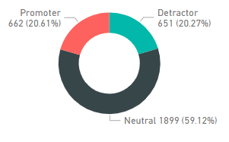
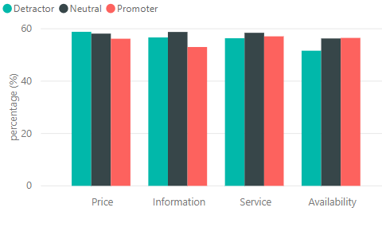
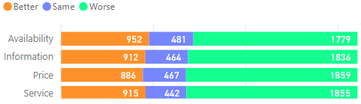
Initial exploration
More than 50% of respondents in all NPS labels say that all the metrics are worse.
About 60% of customers are neutrals.
More than 50% of customers say that all the metrics mentioned are worse.

Slide 4
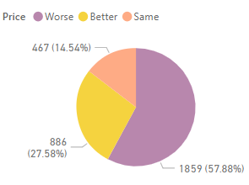
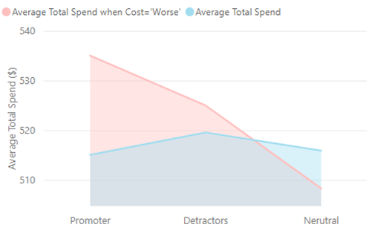
Promoters’ expenditure
Amongst the customers who say price is worse, on average, promoters spend more than detractors and neutrals .
More than half of the customers say price is worse.

Slide 5
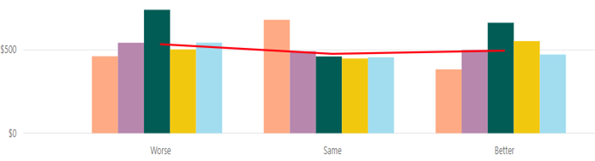
The value of promoters with negative comments
Average spend of Promoters based on their comment categories
Promoters who:
believe that the price is either Worse or Better than competitors &
express that they are not satisfied with the quality
spend significantly more than those who made other types of comments.

Slide 6
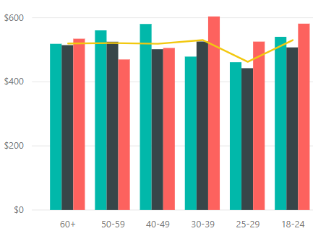
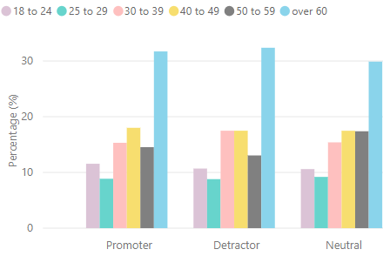
The value of age groups
Amongst the customers who say price is worse:
on average, Young promoters up to age 39 spend more than other age groups.
Detractors beyond the age groups of 25-29 and 30-39 spend more than the total average.
The average of total spend within the age group of 25-29 is 12% less than other age groups.
Over 30% of the customers of each NPS label that say price is worse are
over 60 years old.

Slide 7
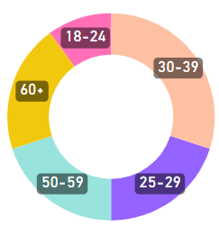
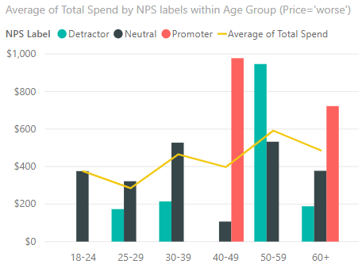
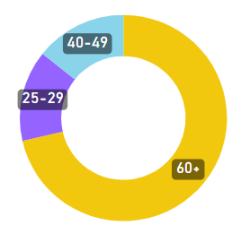
Chadstone Store
Amongst who say price is worse, promoters spend up to two times more than the average of total spend especially when they are
within groups age of 40-49 and 60+
Majority of Detractors are middle-aged
Detractors
Promoters
Majority of the promoters are over 60 year old
Detractors of age 50-59 who say price is worse spend more than average

Slide 8
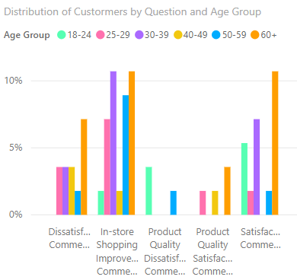

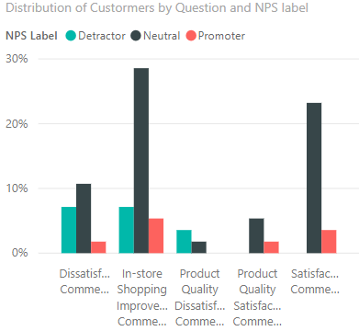
Chadstone Store (Cont.)
In-store Shopping Improvement Comment
Product Quality Satisfaction Comment
Dissatisfaction comments
Product Quality Dissatisfaction Comment
Satisfaction Comment
Maximum number of comments is for in-store shopping improvement.
Minimum concern about “product quality comments” as just 5% of the total customer are not happy with the quality.
In-store Shopping Improvement Comment
Product Quality Dissatisfaction Comment
Dissatisfaction comments
Product Quality Satisfaction Comment
Satisfaction Comment
Neutrals focus mainly on in-store shopping improvement comments.
Over 20% of Neutrals provided satisfied comments

Slide 9
Conclusion
Neutrals will play important role in the future success of this business.
This is because they are 60% of the customers who may easily change mind to be promoter or detractor.
Neutrals’ comments are mainly to improve the in-store shopping.
Majority of customers of any NPS label are over 60 years old.
Customers over 60 years old are almost have positive comments and suggestions (in general)
Promoters spend higher that the average of total spend even if they say price is worse.
Over 55% of each MPS label say cost, service, information, and availability are worse.

