Slide 1
Election prediction with Twitter
Saeed keshavarz
Prof.Boguila
Fall 2019

Slide 2

How to prevail?

Slide 3

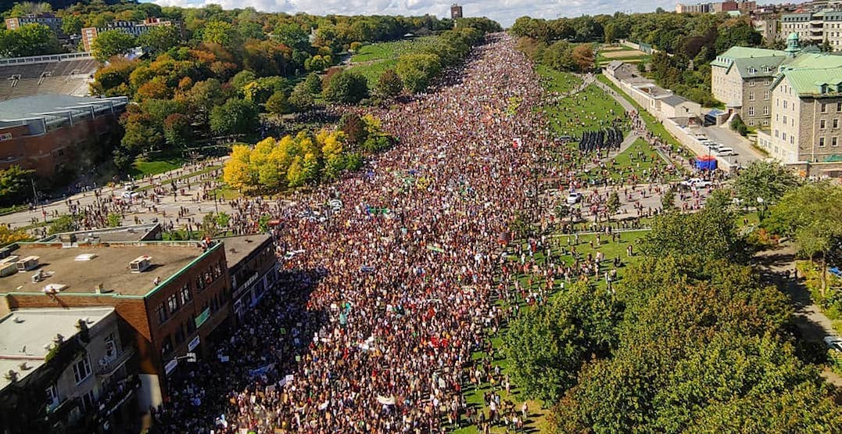
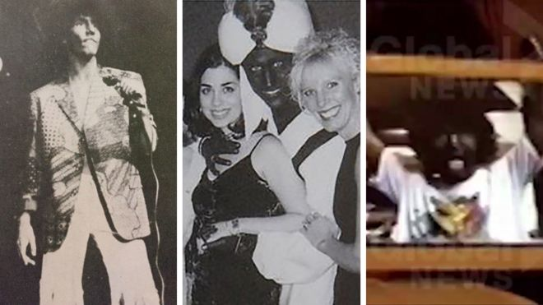
Why tweets?

Slide 4
Collecting Tweets
Used Tweepy API as a python library to collect tweets in real time
Filtered based on most popular key words for the election #cdnpoli, #elxn43
Collected tweets from Sept 27 till sept 29 (100k)
Tweets been stored in Csv format
Less than 1% of tweets came with geo-location

Slide 5
Politcal Tweets
Scheer Rally Choices: Pride March? Nope Climate Strike? White Nationalist Rally? Now we’re talking baby! #cdnpoli #elxn43
This is the best sign of the day #climatestrike #cdnpoli
While Canadians marched to save the planet, Scheer hosted a pizza party #cdnpoli
RESIST JUSTYN ALERT 🚨 Hey ho.. 🚩 "" Truudeau has to go ""Truudeau belongs in jail "" 🚩 "" No excuse for his blackface racism"" #elxn43
The more people see and hear @theJagmeetSingh the more they like him. Yikes! #cdnpoli

Slide 6
sentiment of Tweets

Slide 7
Tweets word frequency

Slide 8
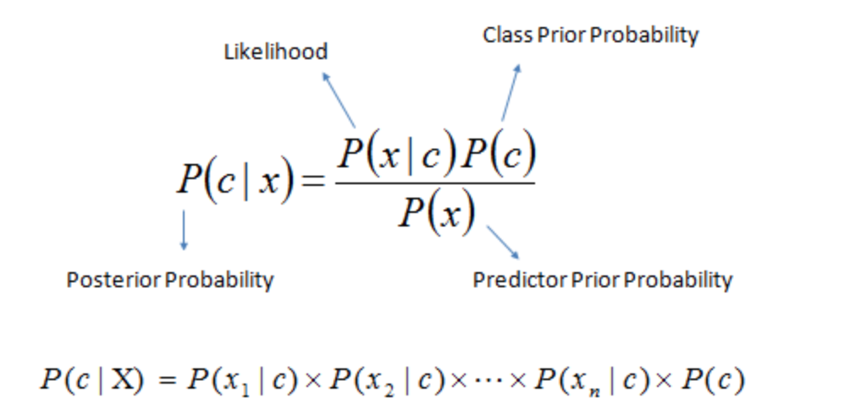
Naïve bayes classifier
Used Naïve Byes assumption for label the sentiment
We had two sentiment to apply on each tweet, positive or negative
used 3k labeled data as sample set
Probability of each word in training data
Probability of given label
Data cleaning: stop wors, tokenize, stemming
Used an algorithm by bag of words to find each tweets for Parties
P(c|x) is the posterior probability of class (target) given predictor (attribute).
P(c) is the prior probability of class.
P(x|c) is the likelihood which is the probability of predictor given class.
P(x) is the prior probability of predictor.

Slide 9
class MultinomialB(object):
def __init__(self, alpha=1.0):
self.alpha = alpha
def fit(self, X, y):
count_sample = X.shape[0]
separated = [[x for x, t in zip(X, y) if t == c] for c in np.unique(y)]
self.class_log_prior_ = [np.log(len(i) / count_sample) for i in separated]
count = np.array([np.array(i).sum(axis=0) for i in separated]) + self.alpha
self.feature_log_prob_ = np.log(count / count.sum(axis=1)[np.newaxis].T)
return self
def predict_log_proba(self, X):
return [(self.feature_log_prob_ * x).sum(axis=1) + self.class_log_prior_
for x in X]
def predict(self, X):
return np.argmax(self.predict_log_proba(X), axis=1)
def score(self, X, y):
return sum(self.predict(X) == y) / len(y)

Slide 10
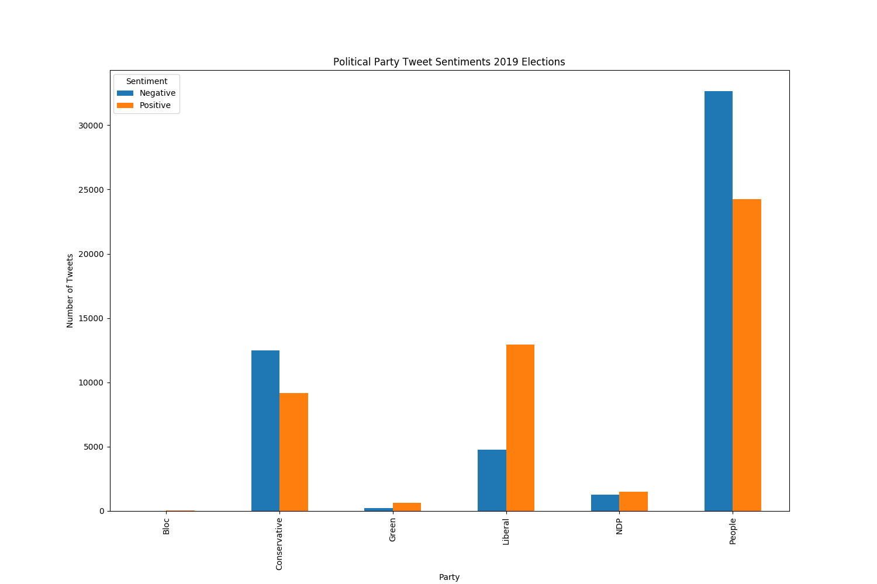
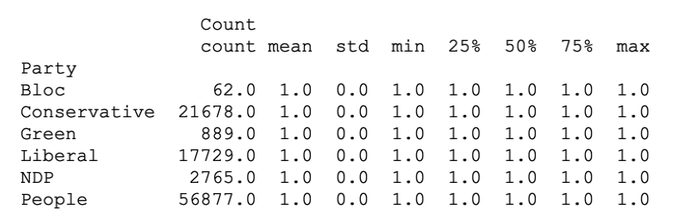
Tweets sentiment by Number

Slide 11
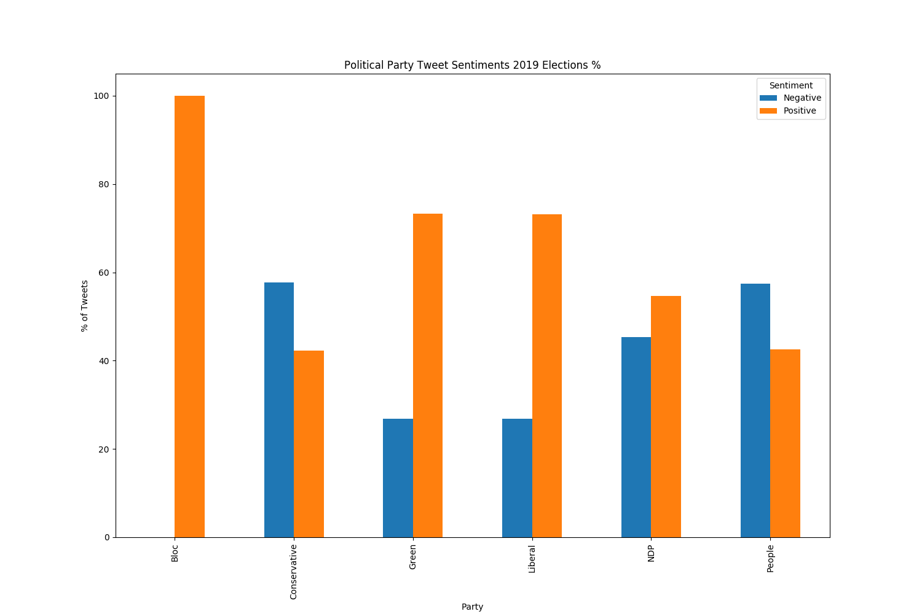
Tweets sentiment by percentage

Slide 12
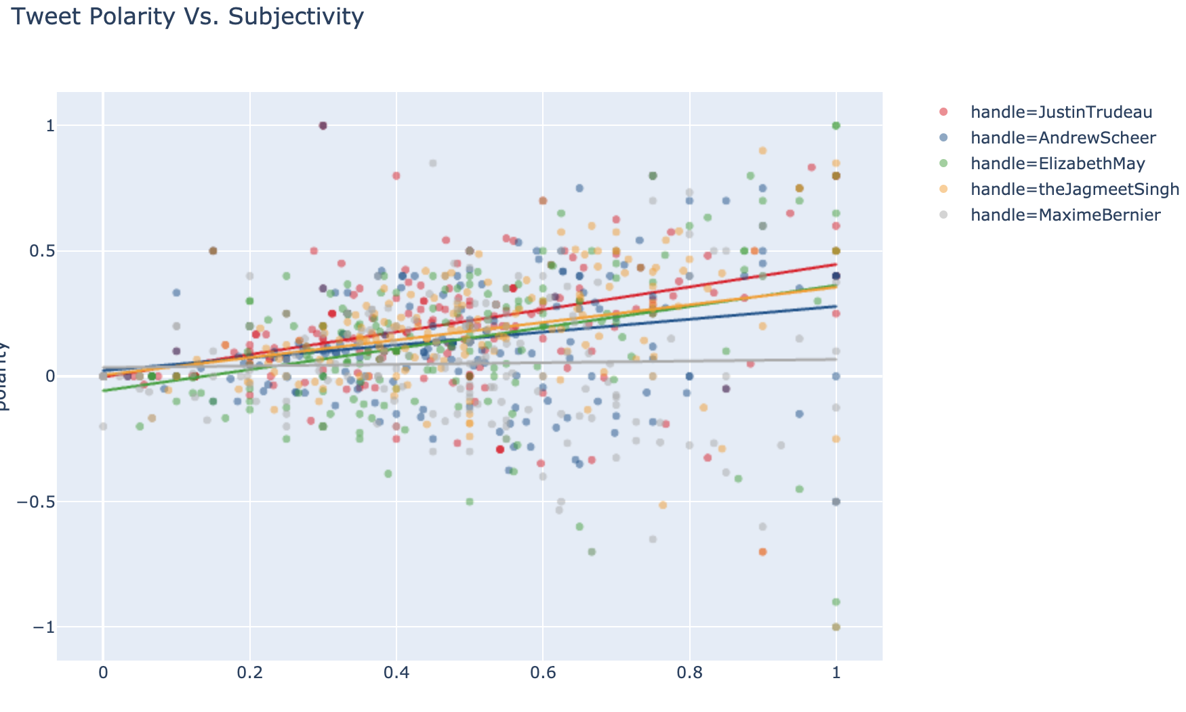
Textblob analysis
Used Textblob to for polarity and subjectivity
We can see the trend for Trudeau or neutral of Bernier

Slide 13
Limitaion
Predicting the futures with Twitter is CHALLENGING !
Labeling by hand is much better than pre made ones like IMDB
Topic modeling is very good advancement for finding topics with LDA
Geo location can unravel the popularity for specific district when we have electoral college vote
The horizon for these type of modeling with younger generation and new technology i.e 5g a

Slide 14
Thank you
Thank you
Question ?

