Slide 1
Frameworks, Node and Design Patterns
By Adam Saenzpardo

Slide 2
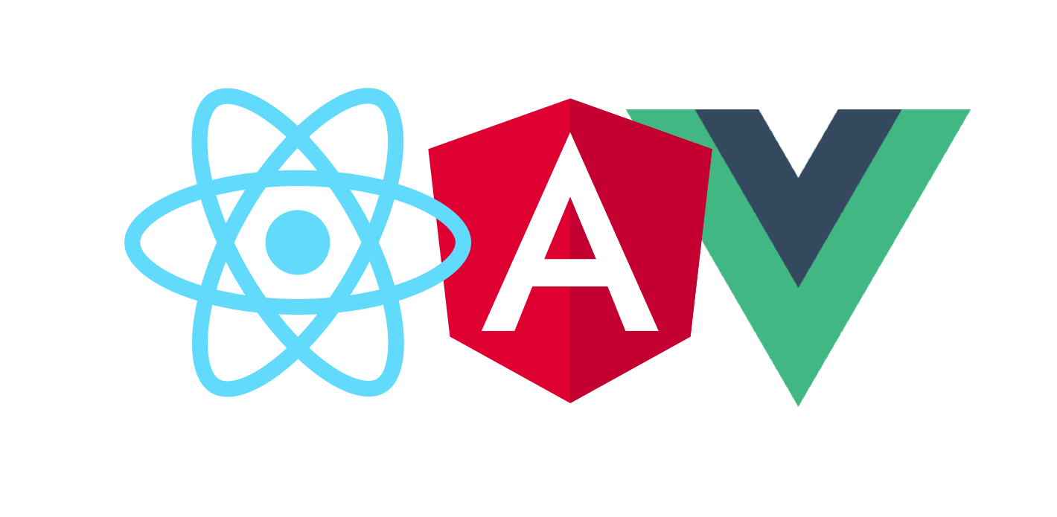
React, Angular and Vue.JS frameworks
React
Fast
JS Library
Virtual DOM
Shareable Components
Angular
Complex
Structural Framework
Model View Controller
Flexible when understood
Vue.JS
Simple
Fast
Versatile
Not as Flexible

Slide 3
React
React is actually a JavaScript library! It’s not a framework.
It’s incredibly flexible.
It’s counterpart, React Native is a framework for developing mobile applications

Slide 4
React
Uses
Resources
Facebook
Allows data on a web page to be changed without reloading the page.
Like a new Facebook notification, or instant message.
Create re-usable components and easily implement.
https://reactjs.org/
https://reactjs.org/docs/getting-started.html
Not to be confused with React Native: https://reactnative.dev/

Slide 5
Angular
Framework for developing dynamic websites and applications
Developed by Google in 2012
Model View Controller architecture
Binds JavaScript and HTML reducing code
AngularJS has been replaced by Angular

Slide 6
Angular
Use and examples
Resources
Dynamic Web Applications – One Framework for Mobile and Desktop
Jimmy Johns
Forbes
Google Marketing Platform
Safeway Shop
Adobe Fonts
https://angular.io/
https://angular.io/docs
https://angular.io/resources?category=education

Slide 7
Vue.js
The framework that acts like a library
Released in 2014
Model-View-Viewmodel front-end framework
Incredibly lightweight spinoff of Angular framework

Slide 8
Vue.JS
Uses
Resources
Web applications
Useful for smaller projects, but also scalable for larger projects
Can be adopted incrementally install of whole application adoption
https://vuejs.org/
https://vuejs.org/v2/guide/
https://www.vuemastery.com/courses/

Slide 9

Node.js
Released in 2009
Ryan Dahl’s answer to solve drawbacks of Apache HTTP Server
Full cross platform support
Inclusive package manager environment to share and publish software

Slide 10
Where is Node.JS used?
A means of unifying server and client-side languages
No DOM –
npm helps keep Node awesome – Node package manager for JavaScript runtime environment
If you’re building a web application, using Node is recommended.

Slide 11
Usage Example
const http = require('http');
const hostname = '127.0.0.1';
const port = 3000;
const server = http.createServer((req, res) => {
res.statusCode = 200;
res.setHeader('Content-Type', 'text/plain');
res.end('Hello, World!\n');
});
server.listen(port, hostname, () => {
console.log(`Server running at http://${hostname}:${port}/`);
});
// type node hello-world.js in the production folder
Assuming Node is installed…
The adjacent code creates a simple local development server running at http://127.0.0.1:3000
Going to this address in your browser will open a web page and display the text “Hello, World!”

Slide 12
Model View Controller - MVC
It’s a design pattern
Model – Manages the data
View – Renders model to the view
Controller – User dependent – interactions here will be sent to the controller, then to the model and rendered to the view.
Model
View
Controller

Slide 13
Model View Controller (MVC)
MVC solves backend scalability issues without manually mapping out every controller path
Solves a programming problem, not a business issue problem
Simplifies and standardizes code through reflection (code that can inspect other code) and expression trees
Creates a convention that is easy to understand while minimizing needed code and maximizing code re-use
All popular languages have MVC frameworks that are constantly updated
Model will store the data
UI Components make up the view
The controller will be made up of code

Slide 14
Model-View-ViewModel
Model – again stores the data
View – Visual module (what the user sees)
View-Model – interfacing system between Model and View
Using this design patter, we can store user input into the Model and we can update the ViewModel and render this information to the View.
Vue and React utilize this design pattern along with a Virtual DOM dramatically increasing the speed and efficiency of DOM updates.
Uses a binder instead of a controller
Removes user interface code from view layer

Slide 15
Wrap Up
Research what framework or library is the most effective for your application.
You can implement in steps.
Keep scalability in mind.
Use a framework that can be built around your strengths.

