Slide 1
JavaScript Presentation
By: J. Adam Saenzpardo

Slide 2

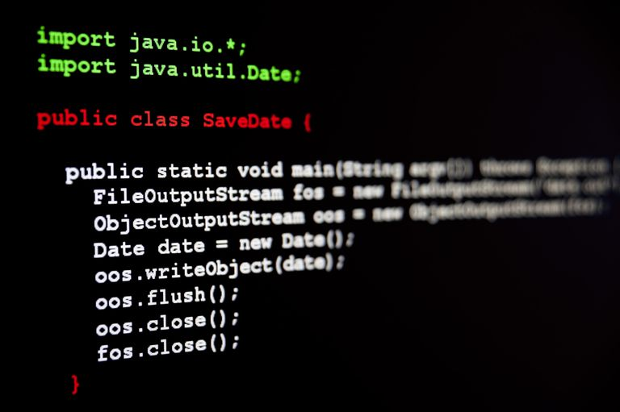
Java: an overview
In simple terms, java was created to create computer programs.
That’s right. Before everything was an application, we had dedicated computer programs that you had to buy and install.
These were written in high level languages such as c, c++, java and many, many others.

Slide 3
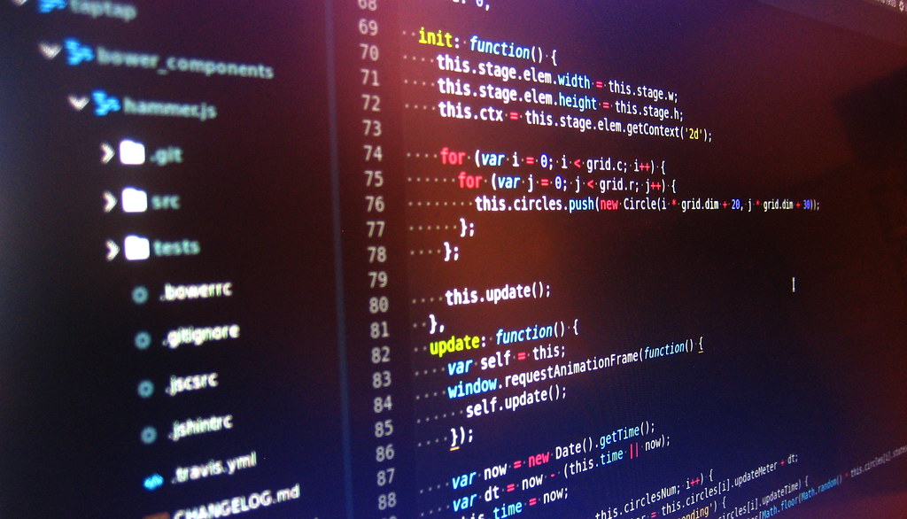
Javascript: an overview
It was created to be used with Netscape’s Navigator browser when it launched in 1993.
The creation of NODE.JS, open source libraries and the explosion of the web has made JavaScript very popular.

Slide 4
Brief Side by side comparison
java
javascript
Statically typed
Compiled to bytecode and then interpreted through jvm
Pure object oriented Language
The language that runs everything else
Difficult to deploy, but easy to maintain
Dynamically typed
Interpreted through browser
Prototype Object Oriented Language
The language that runs the web
Easy to deploy, but the larger it gets the more difficult it is to maintain

Slide 5
Breaking down java
Java’s statically typed syntax is very rigid. A variable must be declared with the data type, i.e. String name = “adam”. Also, the variable can’t be simply changed to another data type. An error would occur if I later wrote - int name = 10.
Class – function – code block. Everything in java must be in a class. This is true by design. To add a feature or update an entire program you just need to change the class instead of every instance the class is called.
Java was never designed to do what JavaScript does and JavaScript was never meant to run a cable box.
JAVA originally had applet support with early browsers, but now it finds more use on the server side.
There are many other differences, but we can settle with these.

Slide 6
Breaking down JavaScript
JavaScript is Dynamically typed – this means if you’re a traditional programmer, you might get a little frustrated in the beginning. A variable can be declared without a datatype and changed to another datatype without casting:
Let myVar = “var”;
myVar = 3;
myVar = ‘variable’;
These are all Legal statements in JavaScript that can all be in the same code block.
JavaScript can be implemented in a web page, imported from a separate JavaScript file or imported from a third party library. I sometimes think of it as the Wild West of languages. Anything goes, results may be unexpected and there are as many ways to get the wrong answer as there might be to get the right answer.

Slide 7
Resources
Both JavaScript and JAVA are highly documented with numerous examples. These two languages are so popular and in such high demand that numerous free resources are available to help teach the concepts and syntax with real world examples.

Slide 8
CSS Responsive Frameworks
A Brief Overview

Slide 9
Bootstrap
Created by Twitter for consistency between tools
This consistent “Blueprint” decreased maintenance while increasing production
Bootstrap is open source and there are numerous plug-ins and templates available. Searching for Bootstrap templates will generate thousands of paid and free templates available for private and commercial use.

Slide 10
Material Design
Developed internally by Google’s research teams and available for public use
Known for its animations, shadow effects and interesting transition effects. These rendering effects can consume excessive resources, though.
Also open source with numerous plug-ins and best practice recommendation for site design.

Slide 11
Foundation
Developed as a project to create faster and better front-end code and is currently maintained by volunteers.
Designed with a reusable component ideology
Open source with excellent documentation and tutorials.

Slide 12
jquery
jQuery was first released in 2014 and was created with simplicity in mind.
Using CSS selectors, you can directly modify the DOM. Animations are simplified and require much less code.
This JavaScript library is used in one form or another in almost ¾ of the top 10 million most popular websites!

