Slide 1
Java vs javascript explained
By: J. Adam Saenzpardo
(…Think of car vs carwash)

Slide 2
Programming languages
Throughout modern history, many computer languages have been created. Here’s a rundown of how it sometimes plays out with popular languages:
1) A software language is created by a research team to solve a common problem (The predecessor to JavaScript was created in 9 days)
2) A company creates a spinoff of that language to incorporate their own proprietary hardware, integration with current software or several other reasons. Examples:
Java – C#
C – Objective-C
JavaScript – TypeScript

Slide 3

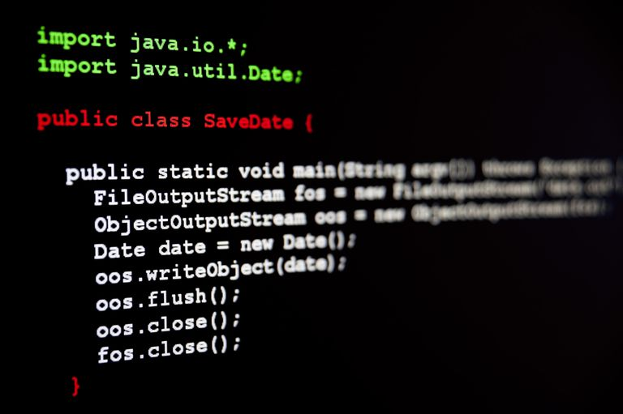
Java: an overview
In simple terms, java was created to create computer programs. It is a compiled language.
That’s right. Before everything was an application, we had dedicated computer programs that you had to buy and install.
These were written in high level languages such as c, c++, java and many, many others.

Slide 4
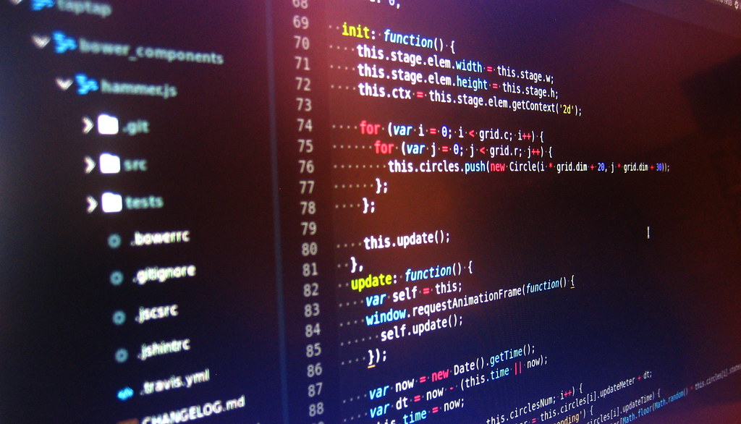
Javascript: an overview
Javascript is an interpreted language. Meaning the web browser uses a special tool to make the JavaScript code work.
It was created to be used with Netscape’s Navigator browser when it launched in 1993.
The creation of NODE.JS, open source libraries and the explosion of the web has made JavaScript very popular.

Slide 5
Brief Side by side comparison
java
javascript
Statically typed
Compiled to bytecode and then interpreted through jvm
Pure object oriented Language
The language that runs everything else
Difficult to deploy, but easy to maintain
Dynamically typed
Interpreted through browser
Prototype Object Oriented Language
The language that runs the web
Easy to deploy, but the larger it gets the more difficult it is to maintain

Slide 6
Breaking down java
Java’s statically typed syntax is very rigid. A variable must be declared with the data type, i.e. String name = “adam”. Also, the variable can’t be simply changed to another data type. An error would occur if I later wrote - int name = 10.
Class – function – code block. Everything in java must be in a class. This is true by design. To add a feature or update an entire program you just need to change the class instead of every instance the class is called.
Java was never designed to do what JavaScript does and JavaScript was never meant to run a cable box.
JAVA originally had applet support with early browsers, but now it finds more use on the server side.
There are many other differences, but we can settle with these.

Slide 7
Breaking down JavaScript
JavaScript is Dynamically typed – this means if you’re a traditional programmer, you might get a little frustrated in the beginning. A variable can be declared without a datatype and changed to another datatype without casting:
Let myVar = “var”;
myVar = 3;
myVar = ‘variable’;
These are all Legal statements in JavaScript that can all be in the same code block.
JavaScript can be implemented in a web page, imported from a separate JavaScript file or imported from a third party library. I sometimes think of it as the Wild West of languages. Anything goes, results may be unexpected and there are as many ways to get the wrong answer as there might be to get the wrong answer.

Slide 8
How was Java Named?
JAVA was named by it’s creator James Gosling.
Originally named “oak” for an oak tree that stood outside James Gosling’s office.
Later changed to JAVA after if was revealed there was a trademark already in place for “oak” by Oak Technologies.
It is rumored the name was derived while members of the team were enjoying a coffee with James in a local coffee shop.

Slide 9
How was JavaScript named?
JavaScript was originally name Mocha and then LiveScript.
When Microsoft launched Internet Explorer, market share quickly shifted away from Netscape’s Navigator.
Netscape teamed up with Sun Microsystems to rename LiveScript to JavaScript in exchange for increased

Slide 10
conclusion
Both are computer programming languages but should not be compared.
Comparing the two is like comparing my dell xps and a MacBook.
Both are high end computers that are loved by many throughout the tech world.
Their respective owners will argue to the death why theirs is superior and ignore the shortcomings of the model they possess.
Also, I should have bought the MacBook

