Slide 1
Web Browsers
Technology allowing users to interact with the web

Slide 2


Konqueror
General Information
Konqueror was created as an open source competitor to Netscape and Internet Explorer. It is considered a “light weight” browser that does not consume resources like many other popular browsers today. It is highly configurable and can also be used as a file manager.

Slide 3
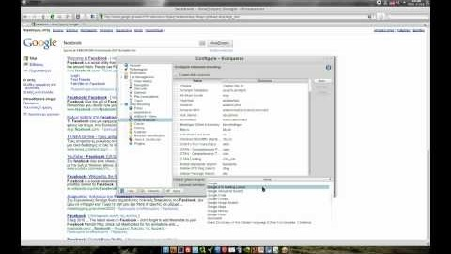
Life Cycle
It was created in 1996 and supports many popular protocols. It is still maintained and actively developed by the open source community, making one of the oldest browsers still in use to date. The community encourages involvement with a beginner projects and projects needing maintenance and development. The interface is crisp, easy to use and can be configured to your needs. Comprised of the KDE desktop environment, it is only available on most Unix-like operating systems utilizing a Linux kernel.
Improvement
Konqueror has adapted well to modernization and currently supports HTML 5 and CSS 3.

Slide 4
Features
Considered the swiss army knife of file management, it contains a full featured ftp client, ability to preview files, numerous plugins and web browsing. Its almost as if the creators wanted to design a web browser and created all of it’s other uses first. Key features include the support of popular protocols such as BitTorrent, HTTP, IMAP, Samba, VNC viewer and, my personal favorite, an ISO viewer.
Evolution
Konqueror is no longer the default KDE file manager and has since been replaced with the Dolphin file manager. Konqueror is still the KDE default web browser and it’s engine supports HTML 5 and CSS 3. While no major improvements have been made in the last few years, it is still popular and supported.

Slide 5

Mozilla firefox
General Information
Firefox was developed by the Mozilla foundation, a non-profit organization that encourages open source free software. Their mission statement insists the internet is a resource that should be available to everyone without censorship and considered a basic human right enriching the lives of human beings and contributing to the greater good. Firefox was designed with privacy and security in mind and that you have the right to create your own experience without worrying about privacy concerns. Believing the only true internet experience involves an unregulated balance between commercial profit and public benefit.

Slide 6
Life Cycle
Created in 2002 by the Mozilla Foundation it is truly cross platform available for use on all operating systems including mobile devices.
Improvement
There are many browsers that have been created using the Firefox source code. One of the more controversial is the “Tor” browser. A browser focused on anonymity which is used exclusively to visit the dark web. Created for truly private and untraceable web browsing, criminals flocked to the dark web and created pages posting/selling illegal weapons, drugs, sex/slave trade, child pornography, assassination lists and hit men for hire, extreme violence and hate groups along with the worst humanity can offer.

Slide 7

Features
Firefox is a very popular web browser among developers. It has numerous extensions and plugins front-end developers rely on for efficient web development. It was the first browser to advertise it’s developer tool bar allowing you to view and modify web page HTML/CSS code, view the page layout and give access to a Javascript console which I frequently use as a calculator! The video to the right discusses some popular browser extensions from one of my favorite open source enthusiasts, Nixie Pixel.
Evolution
Improvements are continuous and well documented. I expect Firefox to maintain it’s popularity among developers for a long time.

Slide 8

SWRare iron
General Information
Iron is a browser based on the Chromium open source browser project from Google and launched in 2008 shortly after Google’s Chrome browser release. It was created by a German company called SRWare. The company specializes in data harvesting for advertising supported services. I found this very interesting and I do believe the browser was designed with privacy in mind. Their pitch includes a fast, private, simple and secure web browser. Although not much different from Google’s chrome browser, Iron encourages users not to use Chrome due to privacy concerns.

Slide 9
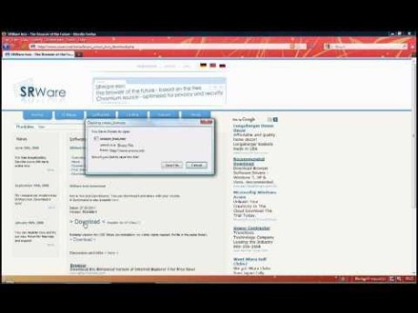
Life Cycle
While currently still in development and technically open source software, critics argue the source code has not been released for years, along with version history, update documentation and bug fixes. It is considered a “Chrome clone” and the creators do not deny that it is. Faithful users have posted frustration for the blocking for Chrome extensions in Iron and continually warn others of the personal data harvested from using Chrome browsers.
Improvement
It’s difficult to know what improvements have been made. There is no active documentation on their website with version history. The only update is a twitter feed stating the version and a generic description of the fix.

Slide 10
Wrap up
Evolution
While Iron isn’t a popular browser, dynamics can change quickly and you never know what the next big thing will be. Without current open source support and documentation to communicate updates and fixes, it’s difficult to say how much longer Iron will continue.
There are many more browsers available and most are directed to suit a certain audience. I encourage you to research and try several. Perhaps you would like a lightweight linux machine and you need a good browser that doesn’t take up a lot of space or consume a lot of resources. There are many out there. Good luck!

