Slide 1


Input
Output

Slide 2



Input 1
Input 2
Output

Slide 3
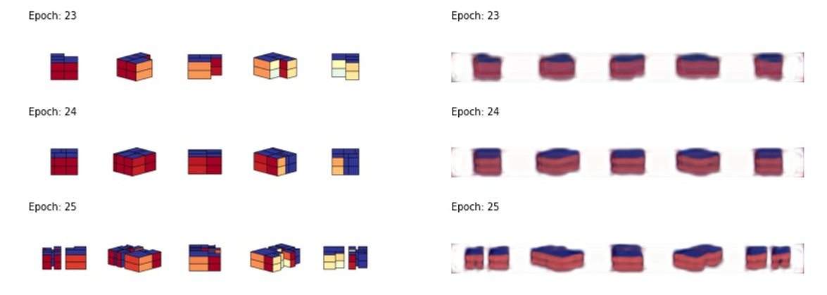

Slide 4
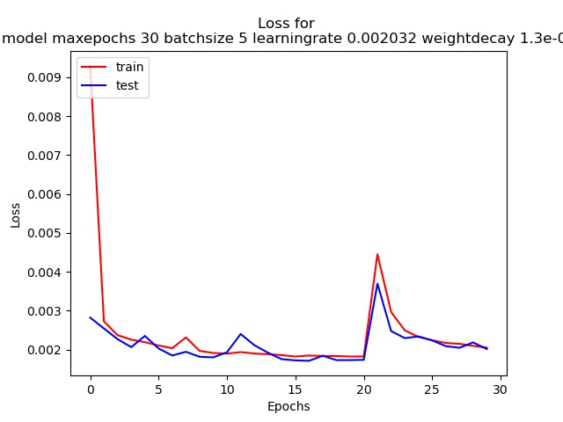
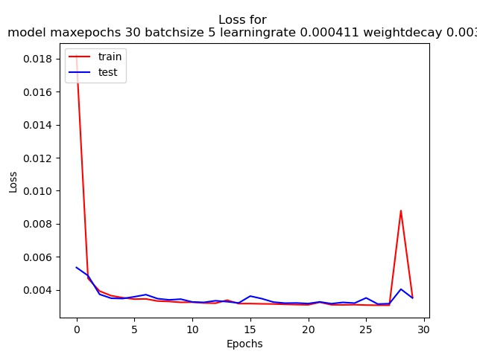
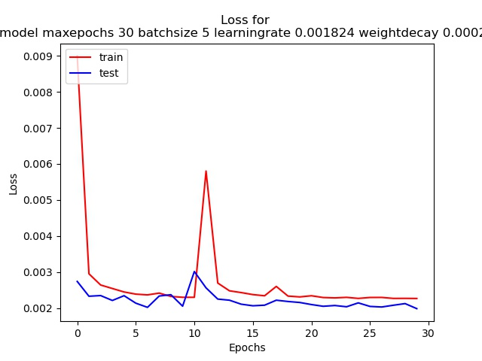
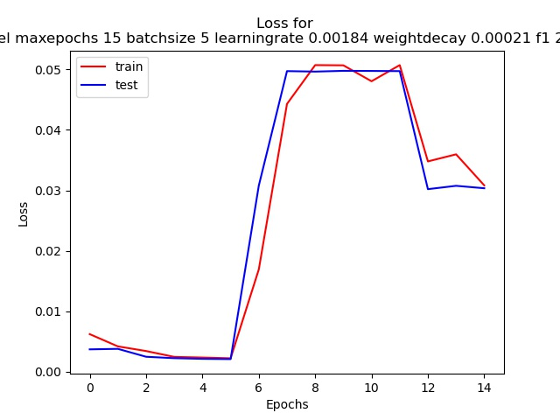

Slide 5
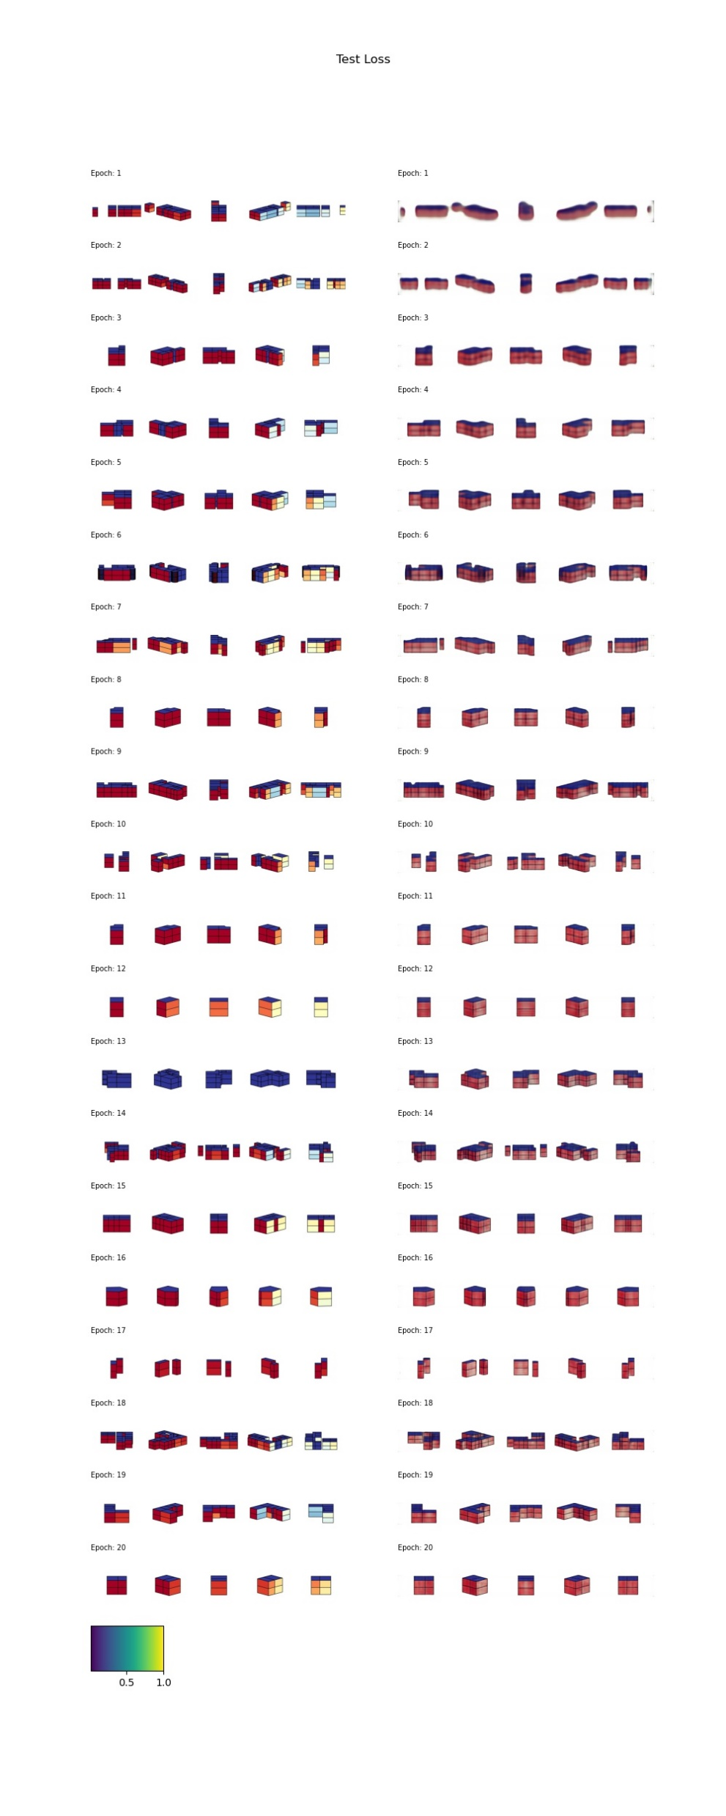
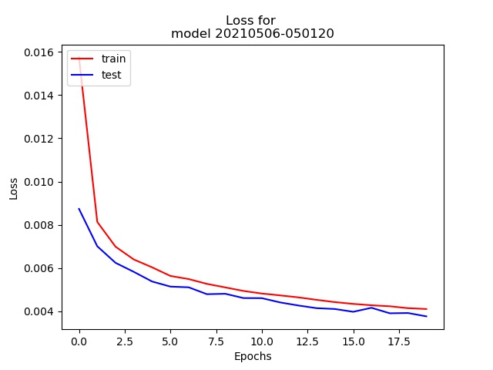
Epochs 1 – 3 (out of 20)
last test_loss: [0.00376571]
Epochs 18 – 20 (out of 20)

Slide 6
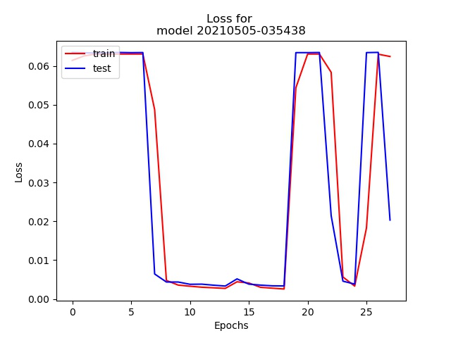
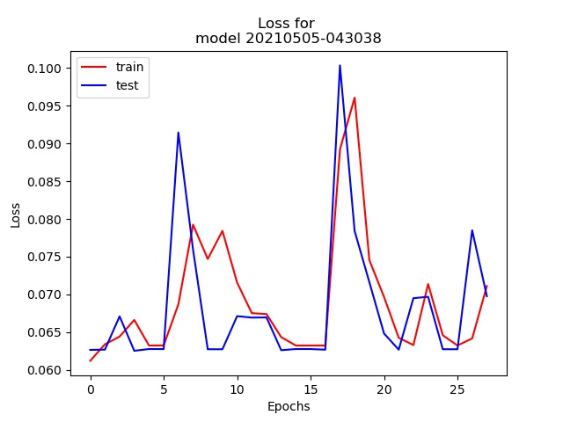

Slide 7
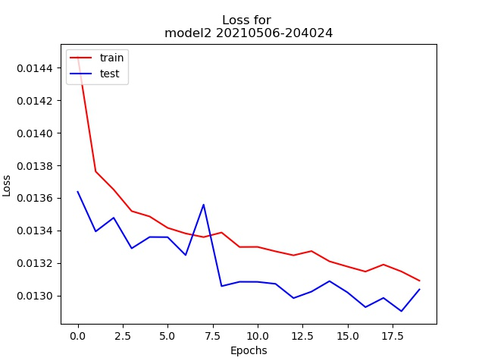
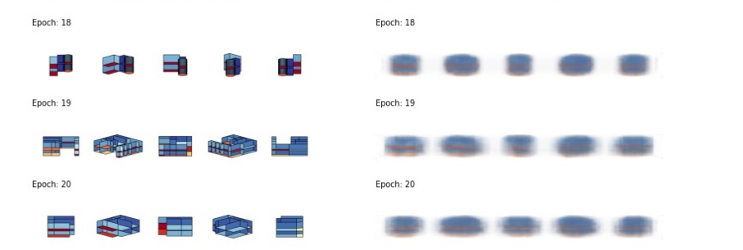

Slide 8
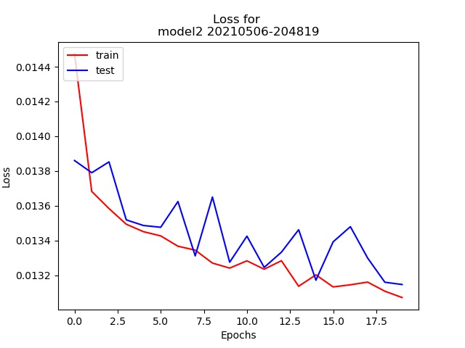
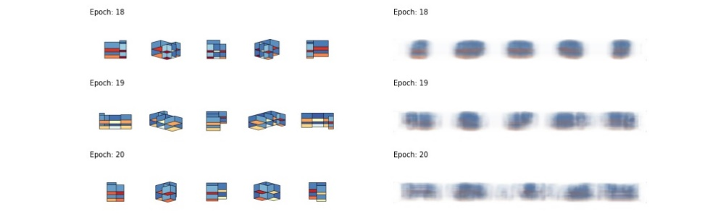

Slide 9

Source Model
Input
Output
Prediction
. . .

Slide 10

Target Model w/o Transfer
Input
Output
Prediction
. . .

Slide 11
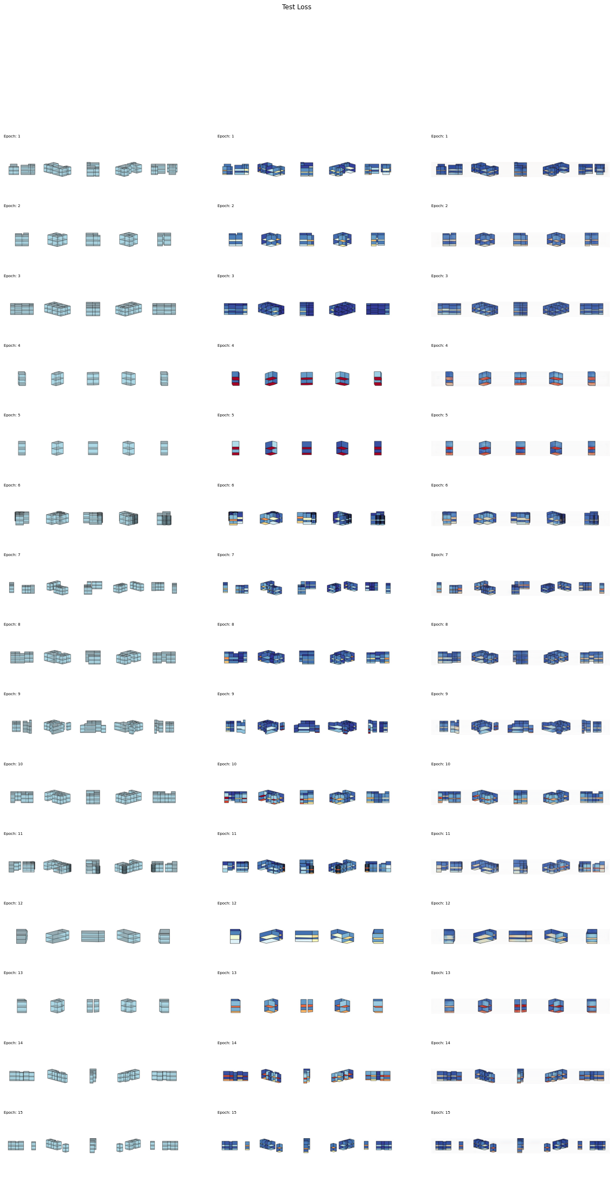
Target Model w/ Transfer
Input
Output
Prediction
. . .

Slide 12
Target Model w/ Transfer
Input
Label
Prediction

Slide 13
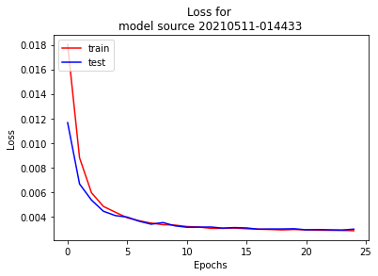
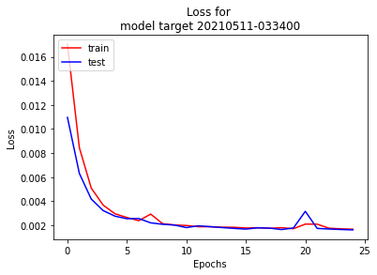
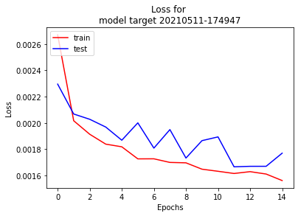
Source Model
Target Model (w/o transfer)
Target Model (w/ transfer)

