Slide 1


Input
Output

Slide 2



Input 1
Input 2
Output

Slide 3
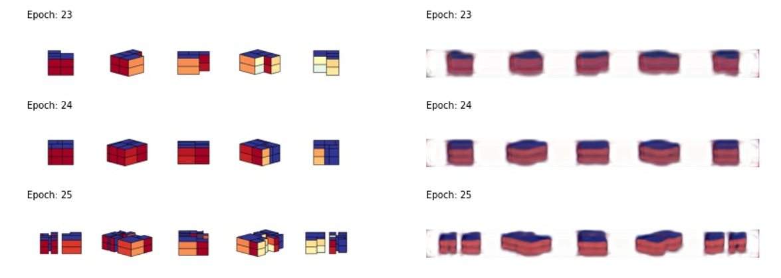

Slide 4
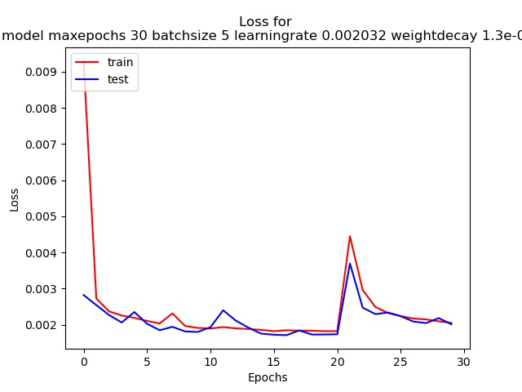
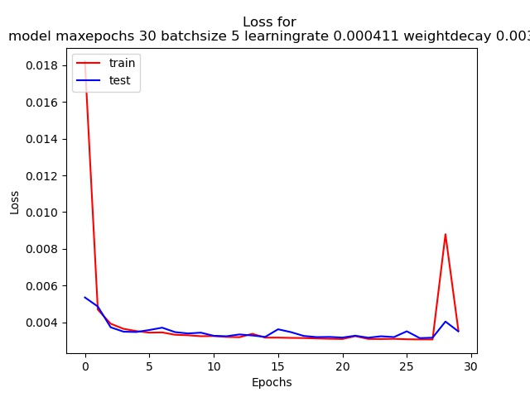
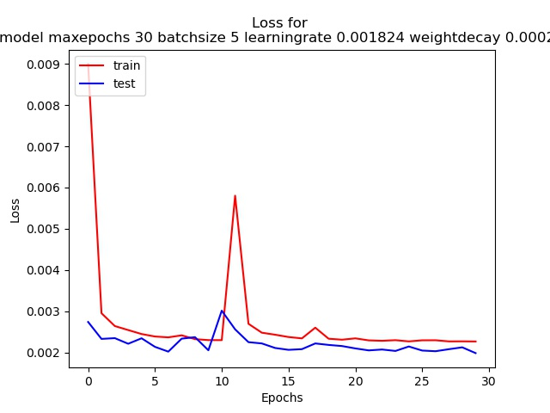
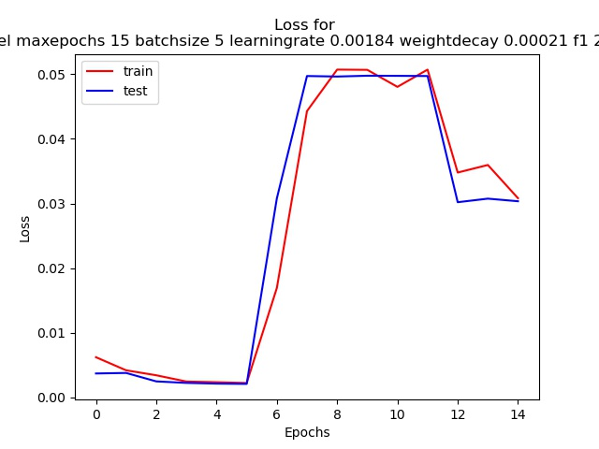

Slide 5
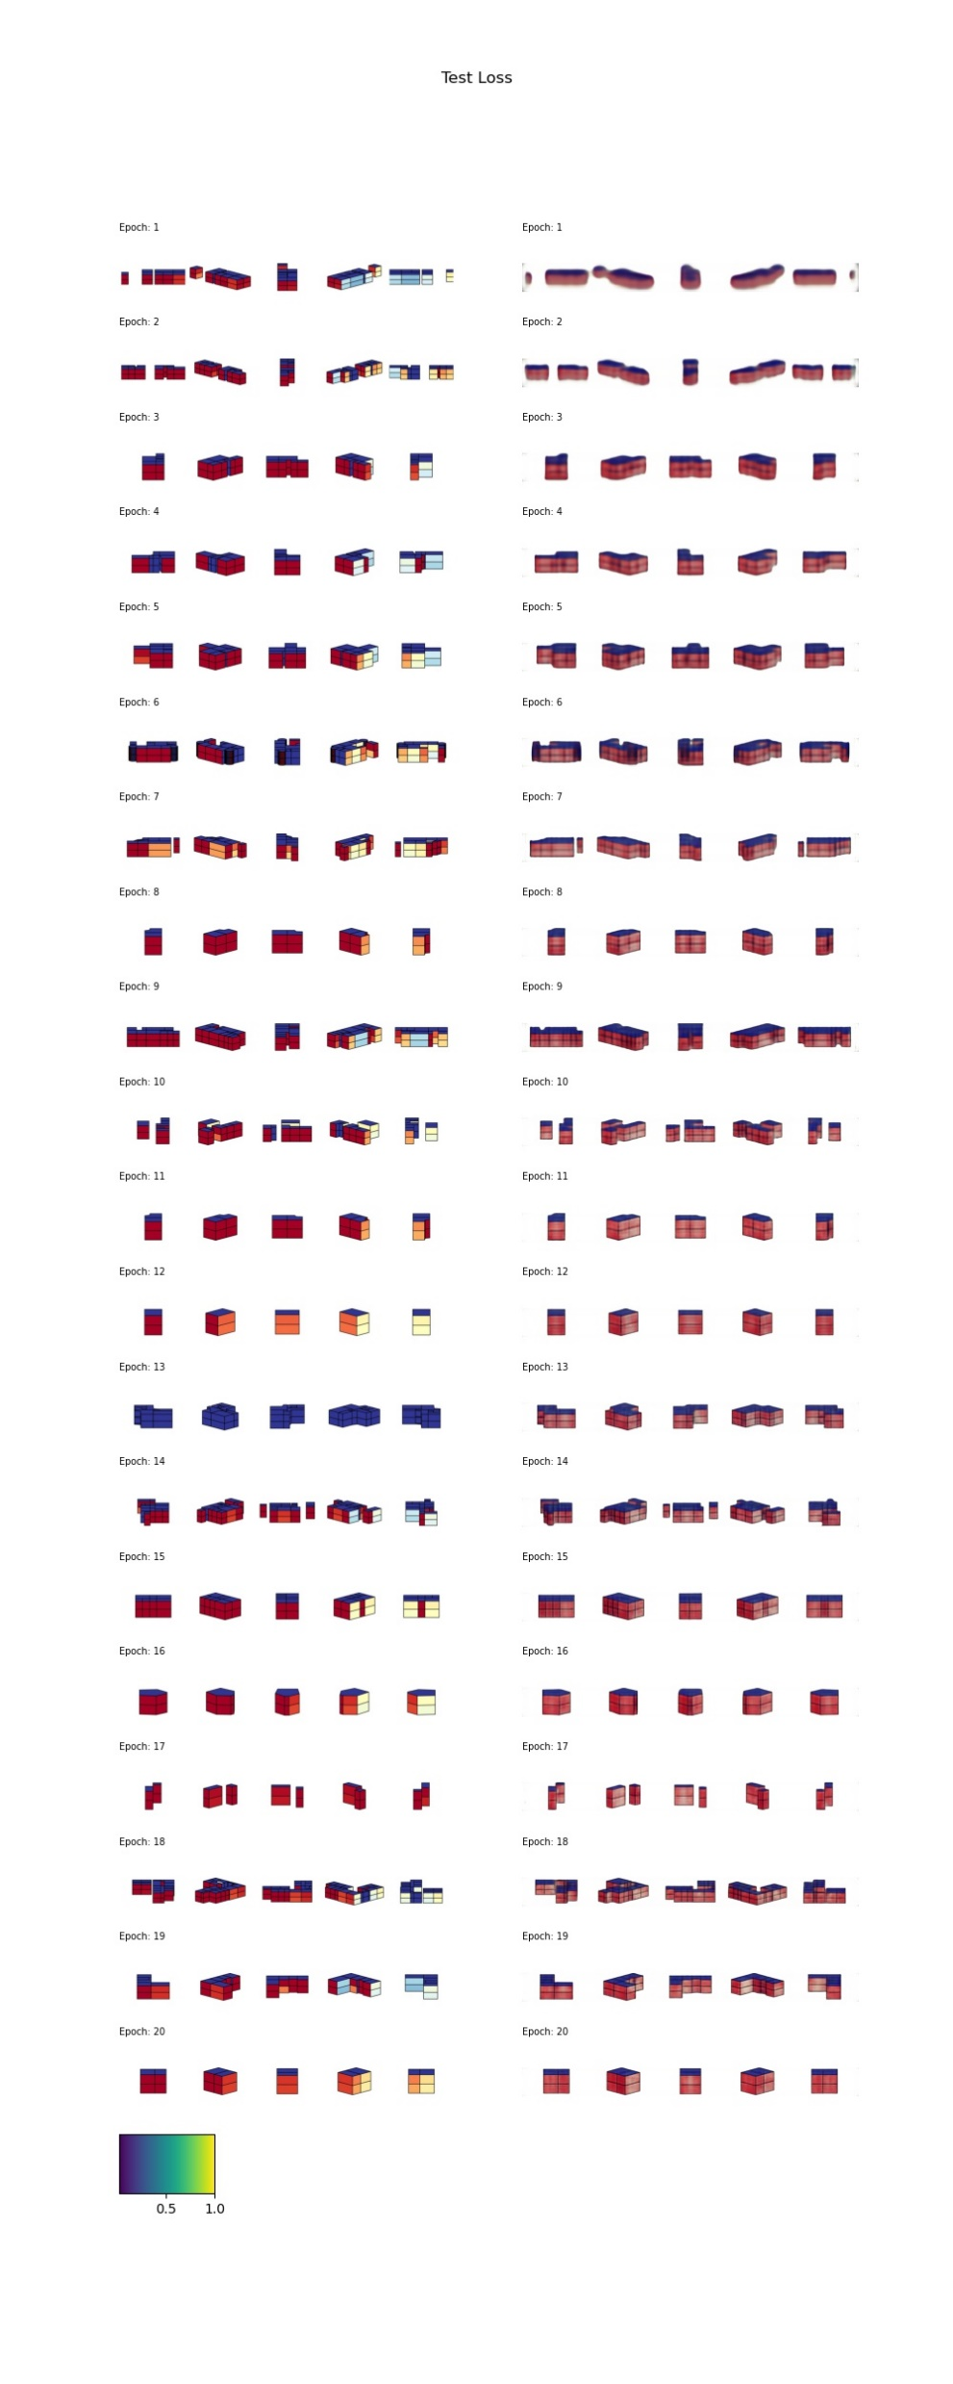
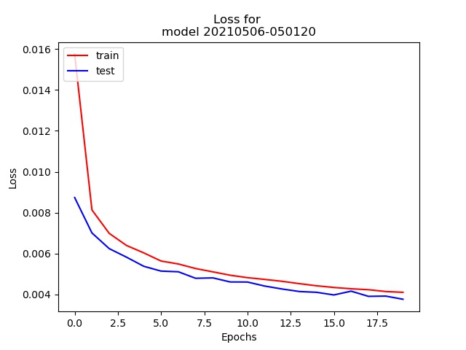
Epochs 1 – 3 (out of 20)
last test_loss: [0.00376571]
Epochs 18 – 20 (out of 20)

Slide 6
