Slide 1
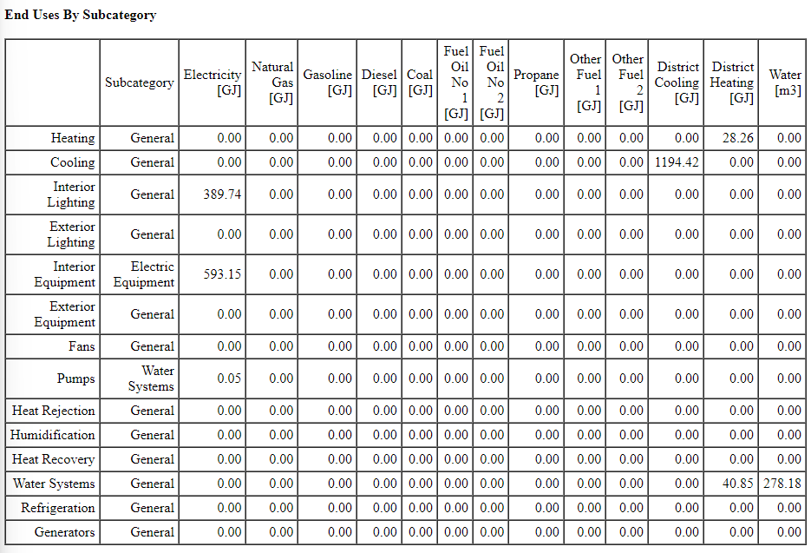
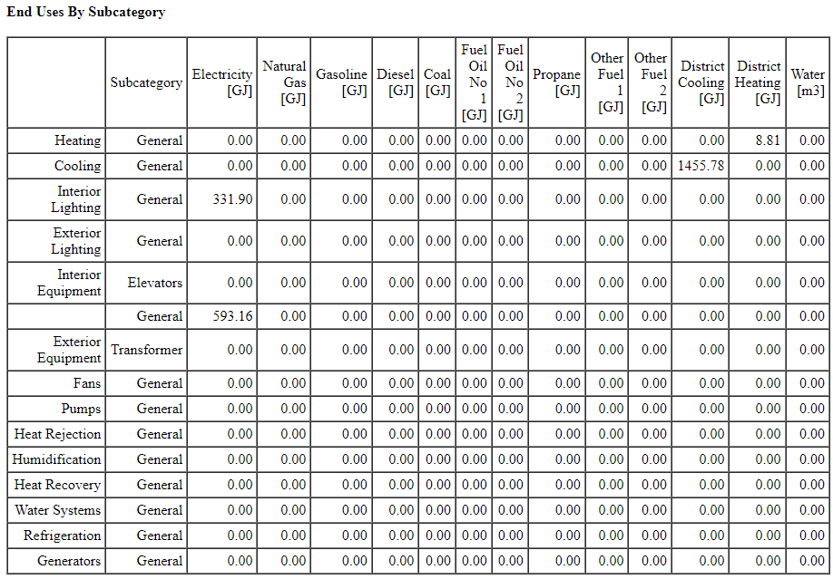
GH
REF

Slide 2
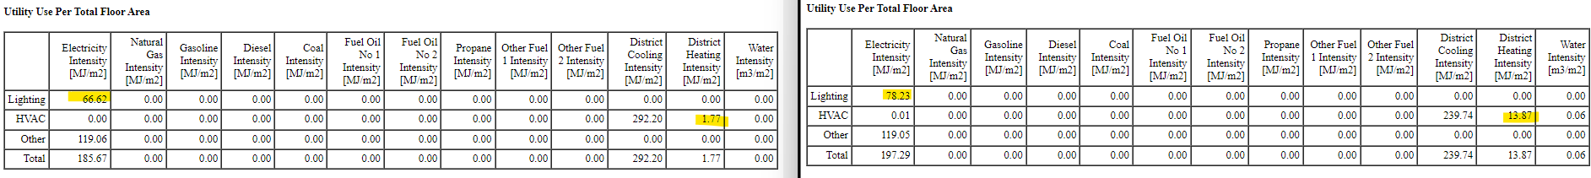
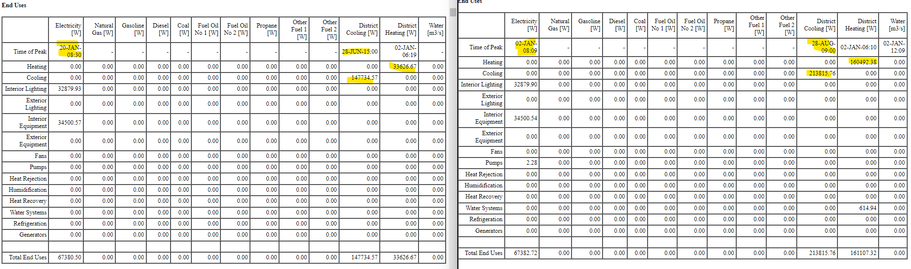
REF
ACT
ACT district heating peak = 160k W
REF district heating peak = 34k W
~ 5 times higher
- actual energy s 12 times higher

Slide 3
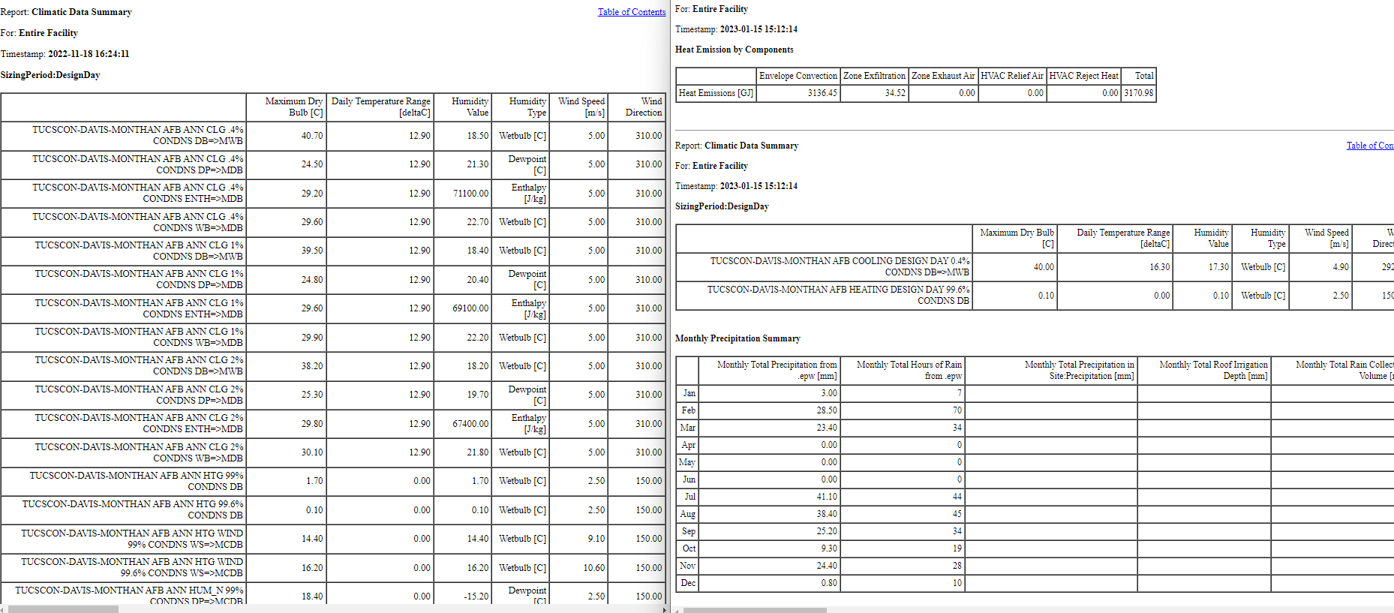
REF
ACT
cause of mismatch! DDY

Slide 4
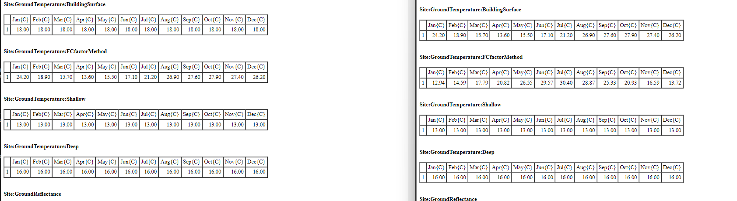
REF
ACT
site-ground + Fcfactor both are defined in ref.

Slide 5
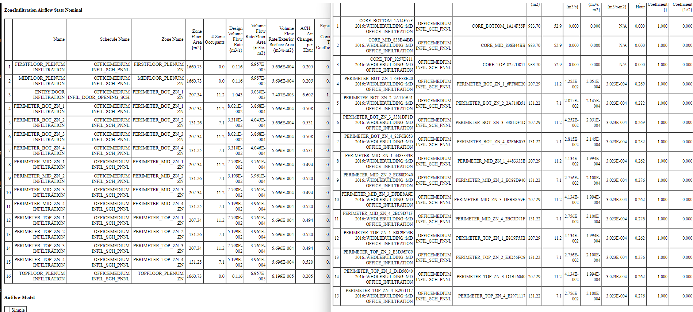
REF
ACT
Changed solar
Infiltration in ref:
no cores
includes plenums
Infiltration in act
- incl cores, but infil=0
omits plenums
Some infil through plenum in ours need to add

Slide 6
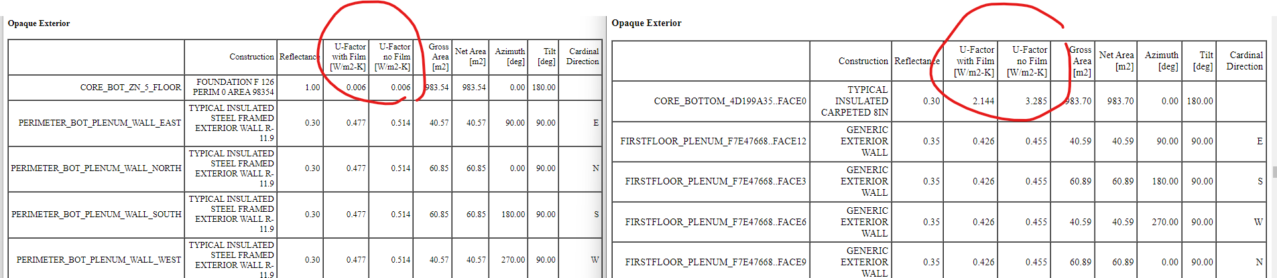
REF
ACT

Slide 7
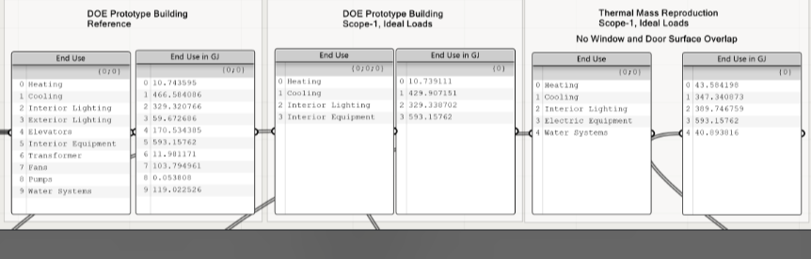
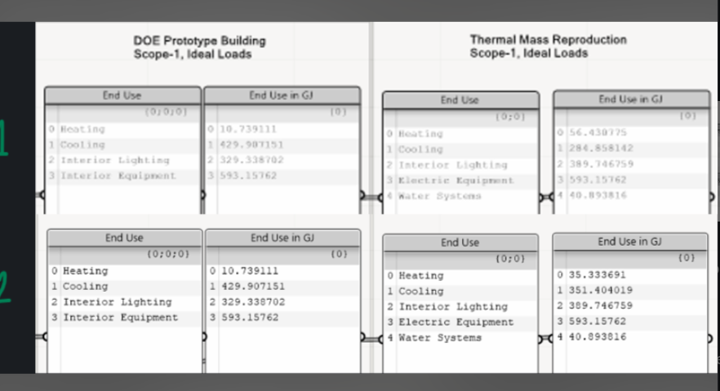

Slide 8
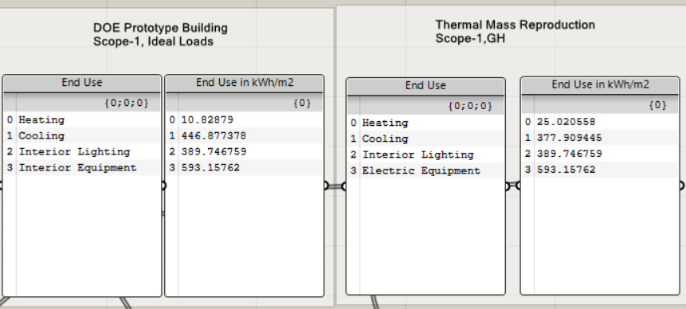
heating sizing factor GH > 1; ACT = 1

