Slide 1
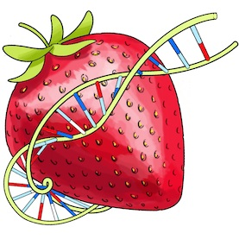
Data Visualization
Final Project – BerryVis

Slide 2
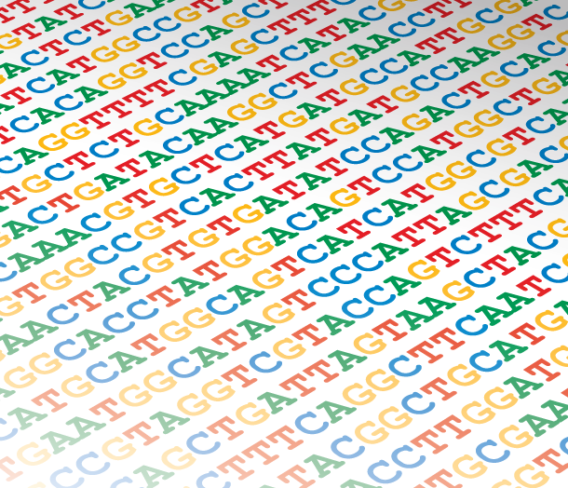
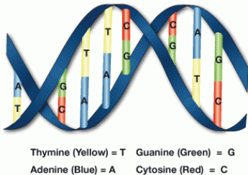
Visualizing similarities in DNA samples

Slide 3
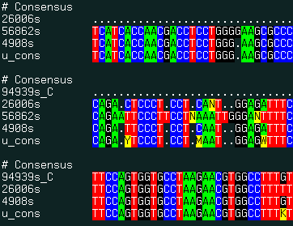
Data
http://www.molsoft.com/man/icm-commands.html
Distance matrix from 7 samples
 | JX118175 | JX118176 | JX118171 | JX118172 | JX118173 | JX118174 | JX118179
JX118175 |  | 0.001382 | 0.000706 | 0.000748 | 0.000677 | 0.000925 | 0.001134
JX118176 | 0.001382 |  | 0.001344 | 0.001386 | 0.001315 | 0.001563 | 0.001772
JX118171 | 0.000706 | 0.001344 |  | 0.000334 | 0.000407 | 0.000655 | 0.000864
JX118172 | 0.000748 | 0.001386 | 0.000334 |  | 0.000449 | 0.000697 | 0.000906
JX118173 | 0.000677 | 0.001315 | 0.000407 | 0.000449 |  | 0.000334 | 0.000697
JX118174 | 0.000925 | 0.001563 | 0.000655 | 0.000697 | 0.000334 |  | 0.000945
JX118179 | 0.001134 | 0.001772 | 0.000864 | 0.000906 | 0.000697 | 0.000945

Slide 4
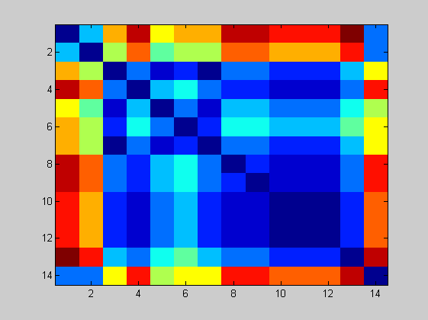
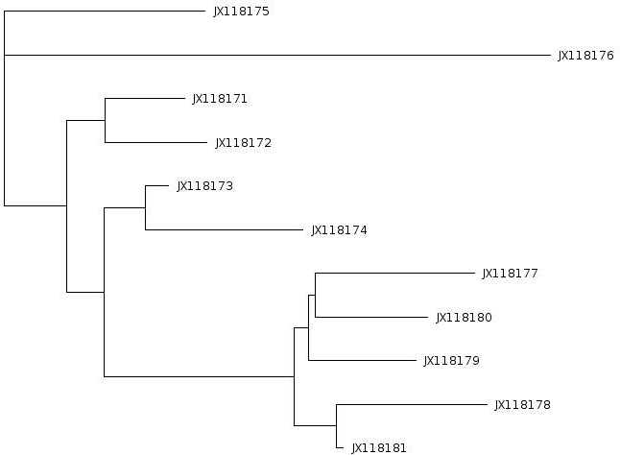
Means of visualizing the data
Distance matrix
Tree view
http://www.computational-genomics.net/case_studies/sars_demo_02.png

Slide 5
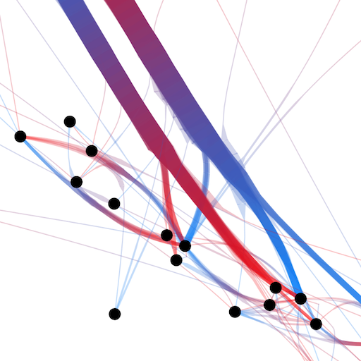
Means of visualizing the data
Node-link view with colored dimension for representing distance
Distance matrix
http://www.computational-genomics.net/case_studies/sars_demo_02.png
http://www.selassid.net/DividedEdgeBundling/bay.png

Slide 6
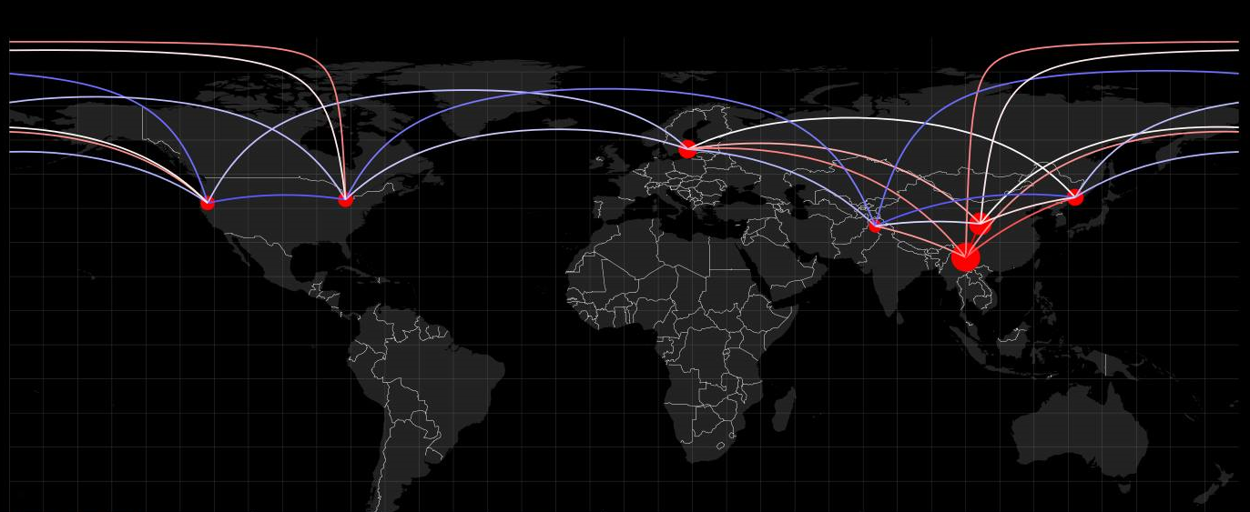


Adding more information – geographical location
Circle radius - hub weight (similarity of a sample to all others)
Blue-white-red color range for representing genetic distance

Slide 7
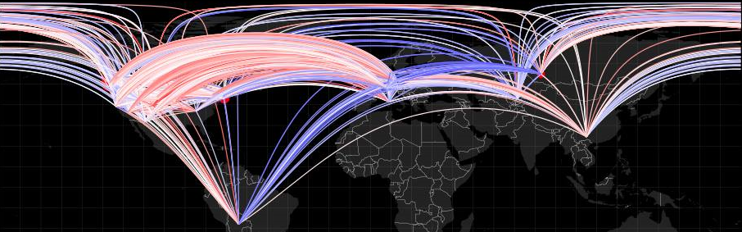
Cluttering problems
7 samples – 21 edges
270 samples – 36585 edges
Hard to distinguish and extract information.

Slide 8
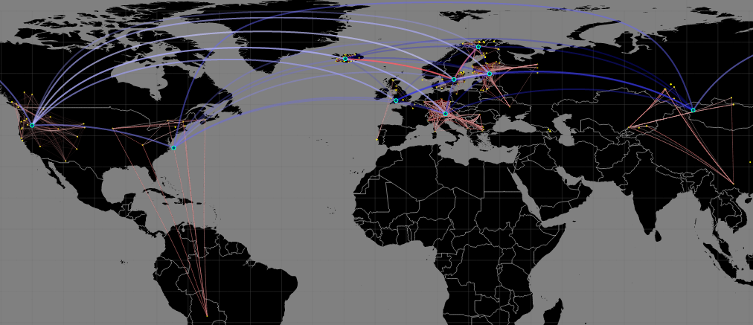
Solution
Hybrid view with clustering for a hierarchical representation

Slide 9
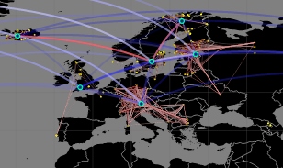
Hybrid clustering technique – hierarchical information
K-means clustering
Automatic clustering and centroid creation.
Recomputed distance matrices.
Results – Easier to perceive information in the data.

Slide 10
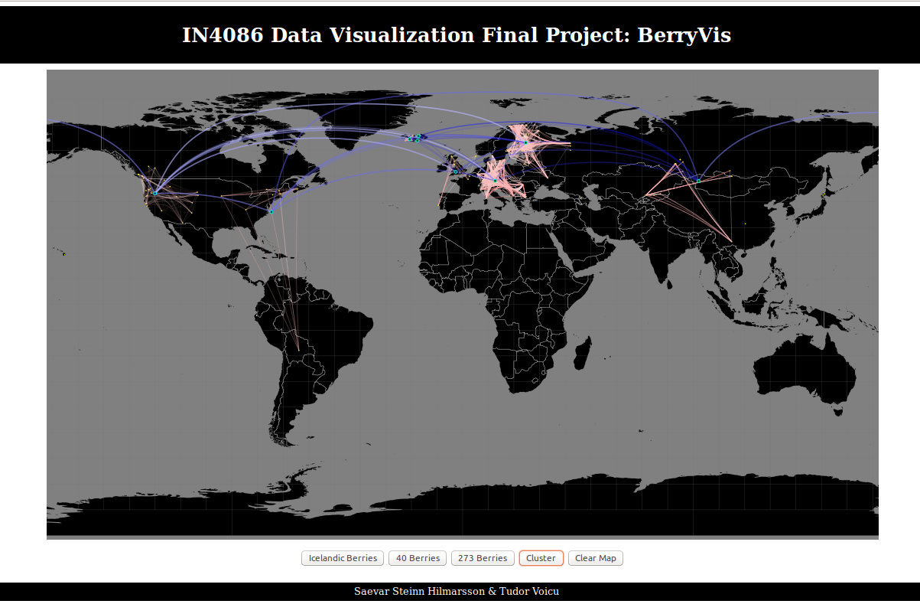

Slide 11
Thank you!
Saevar Steinn & Tudor Voicu

