Slide 1
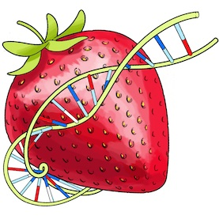
Data Visualization
Final Project – BerryVis
Notes:
Our final project is BerryVis, a geographical visualization of strawberry genetic distance. That is to see how closely related samples of the Fragaria, collected around the globe are.

Slide 2
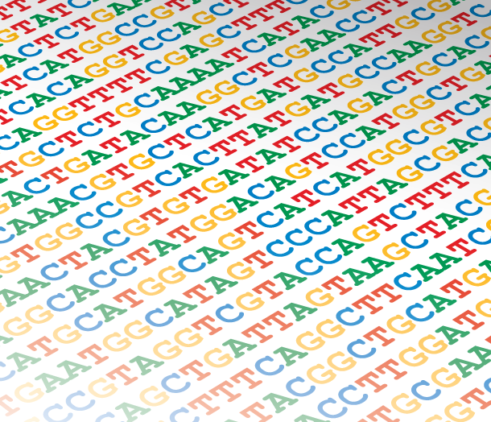
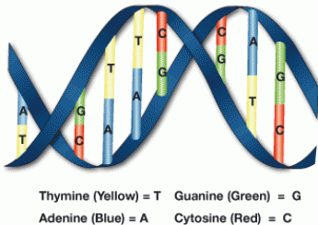
Visualizing similarities in DNA samples
http://dna-footprints.com/wp-content/uploads/2011/12/DNA-Sequencing.png
http://igoscience.com/wp-content/uploads/DNA-sequence-genetic-code-color-150x150.png
Notes:
We did gather some samples from the ncbi gene bank and used geneious, a suite of molecular biology tools, to create a distance matrix using the Tamura-Nei algorithm.

Slide 3
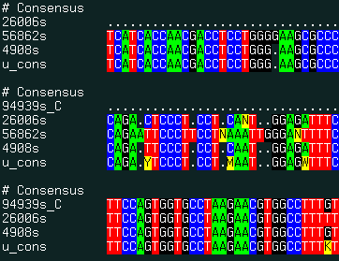
Data
http://www.molsoft.com/man/icm-commands.html
Distance matrix from 7 samples
 | JX118175 | JX118176 | JX118171 | JX118172 | JX118173 | JX118174 | JX118179
JX118175 |  | 0.001382 | 0.000706 | 0.000748 | 0.000677 | 0.000925 | 0.001134
JX118176 | 0.001382 |  | 0.001344 | 0.001386 | 0.001315 | 0.001563 | 0.001772
JX118171 | 0.000706 | 0.001344 |  | 0.000334 | 0.000407 | 0.000655 | 0.000864
JX118172 | 0.000748 | 0.001386 | 0.000334 |  | 0.000449 | 0.000697 | 0.000906
JX118173 | 0.000677 | 0.001315 | 0.000407 | 0.000449 |  | 0.000334 | 0.000697
JX118174 | 0.000925 | 0.001563 | 0.000655 | 0.000697 | 0.000334 |  | 0.000945
JX118179 | 0.001134 | 0.001772 | 0.000864 | 0.000906 | 0.000697 | 0.000945
Notes:
The result is a matrix were each cell represent the distance between two samples in percentages. Not easy to visualize much from that table in your mind as it just raw data.

Slide 4
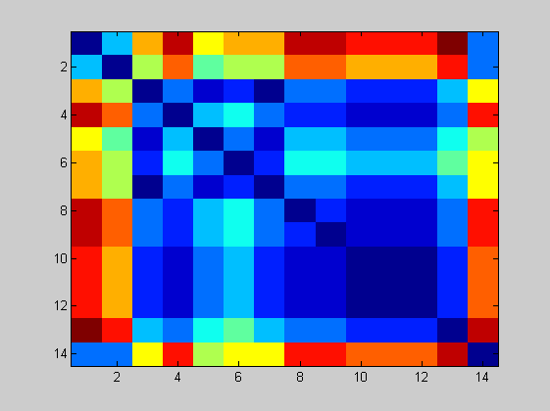
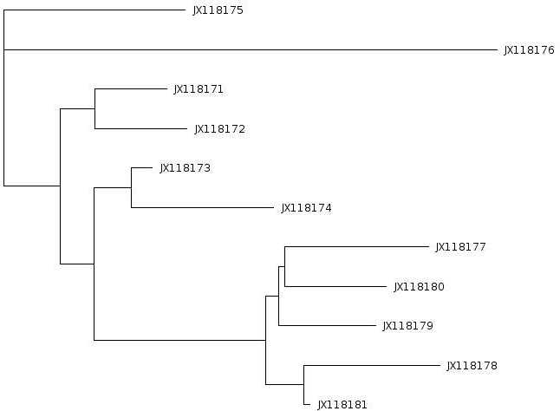
Means of visualizing the data
Distance matrix
Tree view
http://www.computational-genomics.net/case_studies/sars_demo_02.png
Notes:
So there are some ways to visualize these relationships, or distances. One is to just color the matrix and try to get an idea from there. Other well known way is to use the Neighbor-join method to create a rootles tree where distance between the samples are represented with the length of the lines.

Slide 5
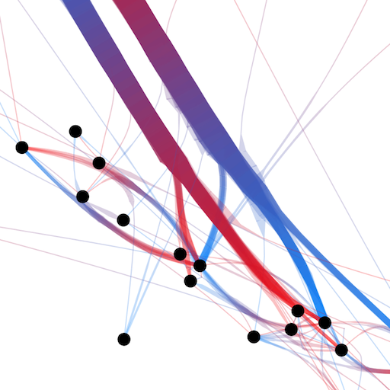
Means of visualizing the data
Node-link view with colored dimension for representing distance
Distance matrix
http://www.computational-genomics.net/case_studies/sars_demo_02.png
http://www.selassid.net/DividedEdgeBundling/bay.png
Notes:
We wanted to represent each sample with a node. Then use each cell from the matrix to create an edge between the nodes and use the values from the Tamura-Nei algorithm to control both width and color of the edges by, for example, representing little related plants with the color blue and closely related with the color red.

Slide 6
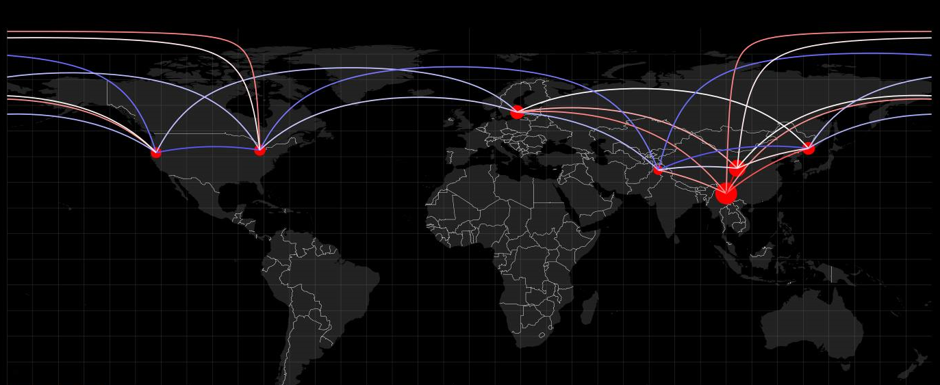

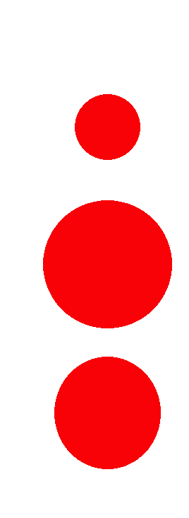
Adding more information – geographical location
Circle radius - hub weight (similarity of a sample to all others)
Blue-white-red color range for representing genetic distance
Notes:
Then to make it interesting we would project the nodes onto a world map, using available GPS locations of where the samples were collected.
In this way we hoped to get a good overview of relations based on geographical positions – to see how the Fragaria migrates over the planet, or, to focus on smaller areas of the world by using zoom.

Slide 7
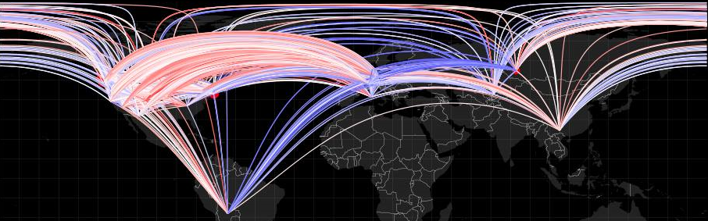
Cluttering problems
7 samples – 21 edges
270 samples – 36585 edges
Hard to distinguish and extract information.
Notes:
The first visualization works nicely and we can distinguish the fact that China is very tied to all samples around the globe. However, when we applied the same algorithm on the entire provided database (270 samples), we had difficulty in seeing any patterns or strong connections. The graph is too cluttered and the computing time considerable (grows quadratically with sample count)

Slide 8
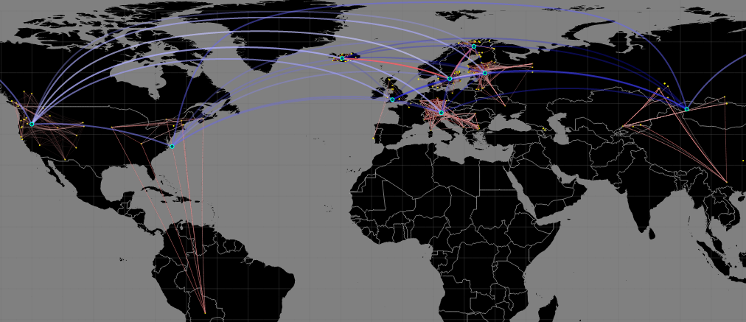
Solution
Hybrid view with clustering for a hierarchical representation
Notes:
So, what we did:
-we separated the data on different regions.
-connected dots within the same region (red-to-white color range).
-created centroids (meaning center for every cluster)
-connected centroids to show inter-cluster distance (e.g. to see whether the West American Coast has similarities with Europe or China etc.)
-added transparency for less relevant connections to further reduce cluttering.

Slide 9
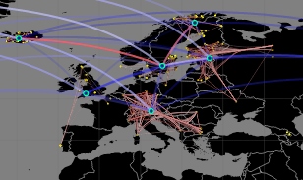
Hybrid clustering technique – hierarchical information
K-means clustering
Automatic clustering and centroid creation.
Recomputed distance matrices.
Results – Easier to perceive information in the data.
Notes:
Our hybrid technique uses:
-K-means clustering automatically grouping the samples.
-Force-edge bundling (curved arcs in the figure) for reducing the cluttering.
Everything is done automatically, the only thing needed is to input the data (the distance matrix and geographical positions) and select the cluster granularity (how many clusters do we want?)
This technique gives us a better view of the information and we can really see the strong connections between species of berries in Iceland and Finland.
We think of it as a nice approach in overviewing this kind of data and a good means for reducing the workload for specialized research.

Slide 10
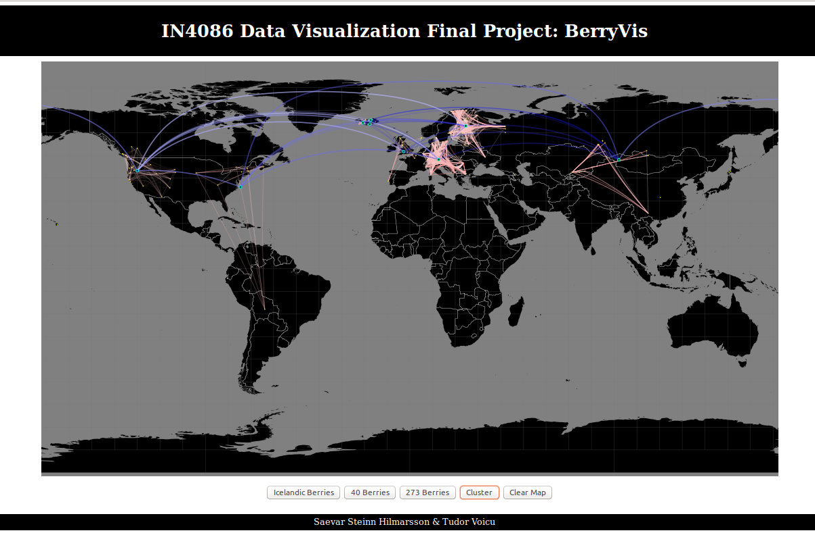
Notes:
Our demo website consists of steps and different views of visualizing our information. It has been designed in D3. For now the color ranges and the visualization settings are fixed, but the script can be extended into a functional online platform if needed for open use (we didn’t publish it anywhere).

Slide 11
Thank you!
Saevar Steinn & Tudor Voicu

