Slide 1
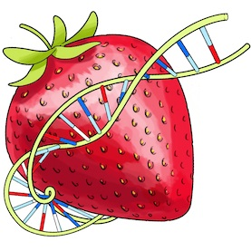
Data Visualization
Final Project – BerryVis
Notes:
Our final project is BerryVis, a geographical visualization of strawberry genetic distance. That is to see how closely related samples of the Fragaria, collected around the glope, are.

Slide 2
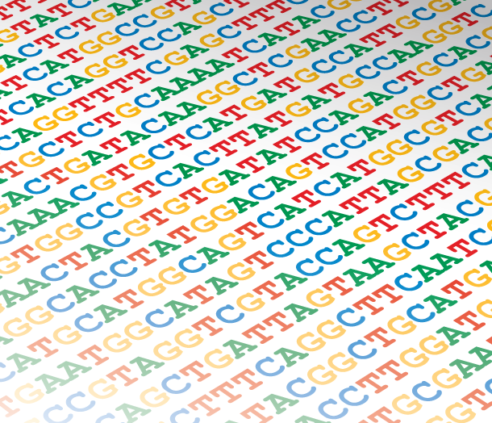
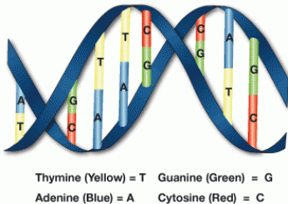
Visualizing similarities in DNA samples
Notes:
We did gather some samples from the ncbi gene bank and used geneious, a suite of molecular biology tools, to create a distance matrix using Tamura-Nei algorithm.

Slide 3
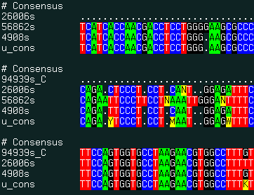
Data
http://www.molsoft.com/man/icm-commands.html
Distance matrix from 7 samples
 | JX118175 | JX118176 | JX118171 | JX118172 | JX118173 | JX118174 | JX118179
JX118175 |  | 0.001382 | 0.000706 | 0.000748 | 0.000677 | 0.000925 | 0.001134
JX118176 | 0.001382 |  | 0.001344 | 0.001386 | 0.001315 | 0.001563 | 0.001772
JX118171 | 0.000706 | 0.001344 |  | 0.000334 | 0.000407 | 0.000655 | 0.000864
JX118172 | 0.000748 | 0.001386 | 0.000334 |  | 0.000449 | 0.000697 | 0.000906
JX118173 | 0.000677 | 0.001315 | 0.000407 | 0.000449 |  | 0.000334 | 0.000697
JX118174 | 0.000925 | 0.001563 | 0.000655 | 0.000697 | 0.000334 |  | 0.000945
JX118179 | 0.001134 | 0.001772 | 0.000864 | 0.000906 | 0.000697 | 0.000945
Notes:
The result is a matrix were each cell represent the distance between to samples in percentages. Not easy to visualize much from that table in your mind as it just raw data.

Slide 4
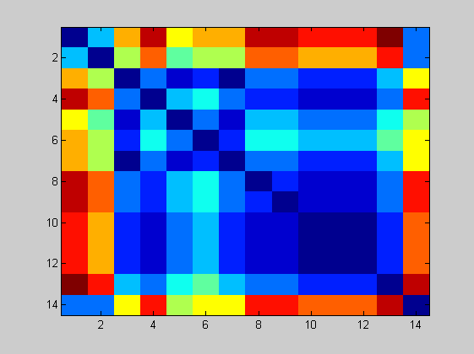
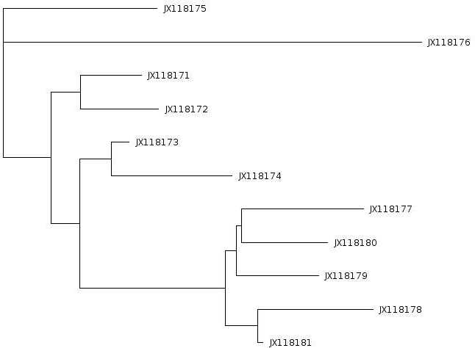
Means of visualizing the data
Distance matrix
Tree view
http://www.computational-genomics.net/case_studies/sars_demo_02.png
Notes:
So there are some ways to visualize these relationships, or distances. One is to just color the matrix and try to get an idea from that. Other well known way is to use the Neighbor-join method to create a rootles tree where distance between the samples are represented with the length of the lines.

Slide 5
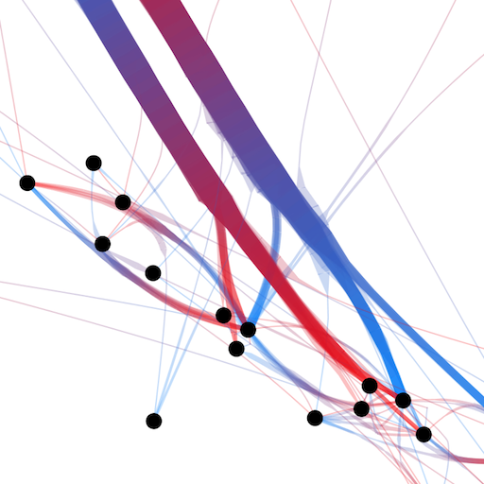
Means of visualizing the data
Node-link view with colored dimension for representing distance
Distance matrix
http://www.computational-genomics.net/case_studies/sars_demo_02.png
http://www.selassid.net/DividedEdgeBundling/bay.png
Notes:
We wanted to represent each sample with a node. Then use each cell from the matrix to create an edge between the nodes and use the values from the Tamura-Nei algorithm to control both width and color of the edeges by, for example, representing little related plants with the color blue and closely related with the color red.

Slide 6
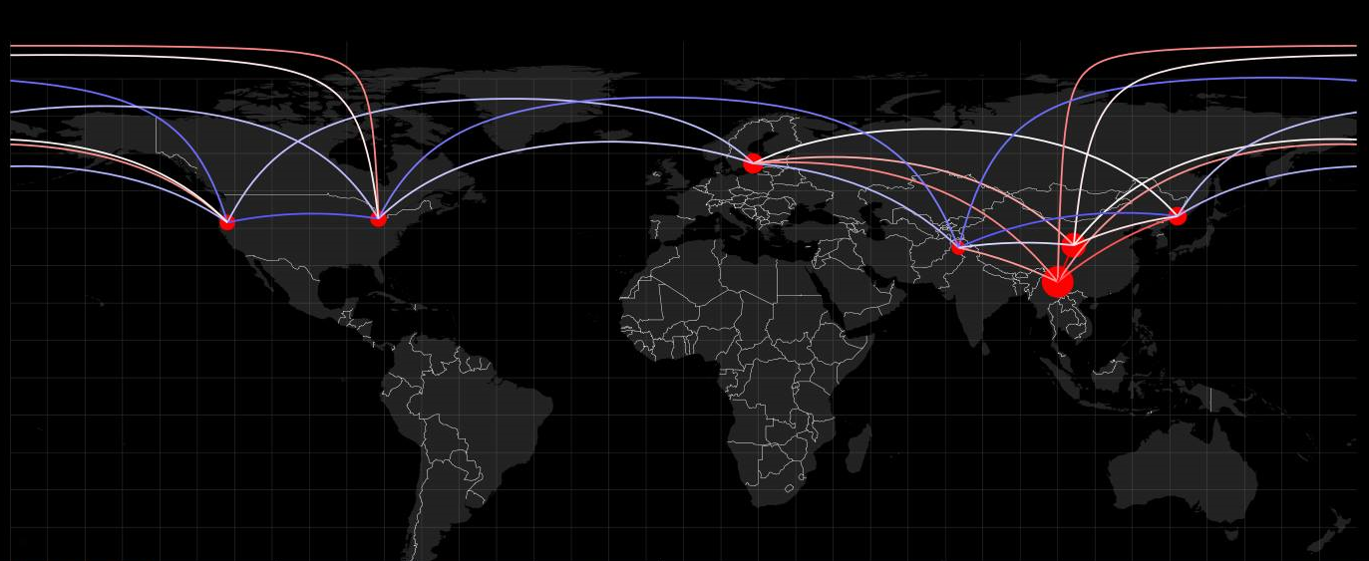

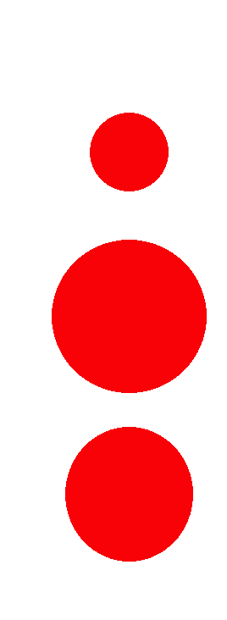
Adding more information – geographical location
Circle radius - hub weight (similarity of a sample to all others)
Blue-white-red color range for representing genetic distance
Notes:
Then to make it interesting we would project the nodes onto a world map, using available GPS locations of where the samples were collected.
In this way we hoped to get a good overview of relations based on geographical positions – to see how the Fragaria migrides over the planet, or, to focus on smaller areas of the world by using zoom.

Slide 7
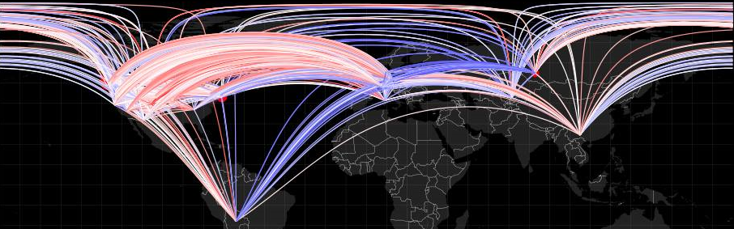
Cluttering problems
7 samples – 21 edges
270 samples – 36585 edges
Hard to distinguish and extract information.

Slide 8
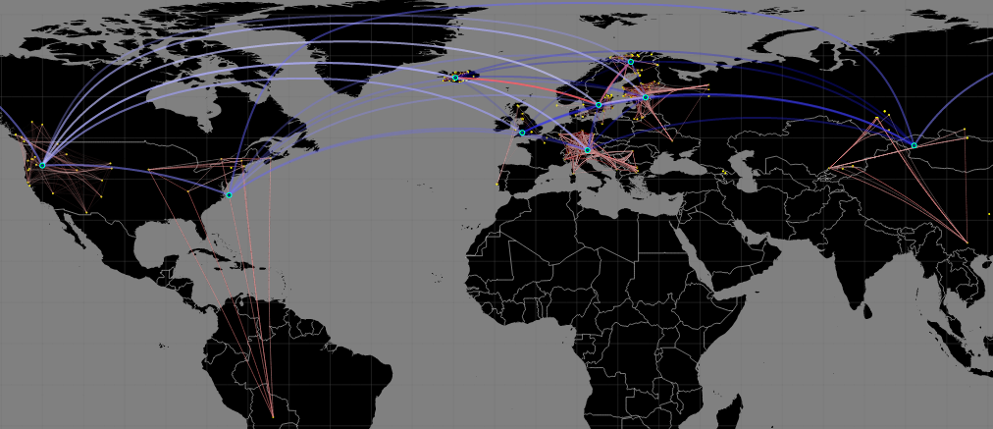
Solution
Hybrid view with clustering for a hierarchical representation

Slide 9
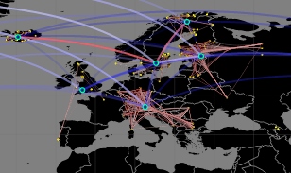
Hybrid clustering technique – hierarchical information
K-means clustering
Automatic clustering and centroid creation.
Recomputed distance matrices.
Results – Easier to perceive information in the data.

Slide 10
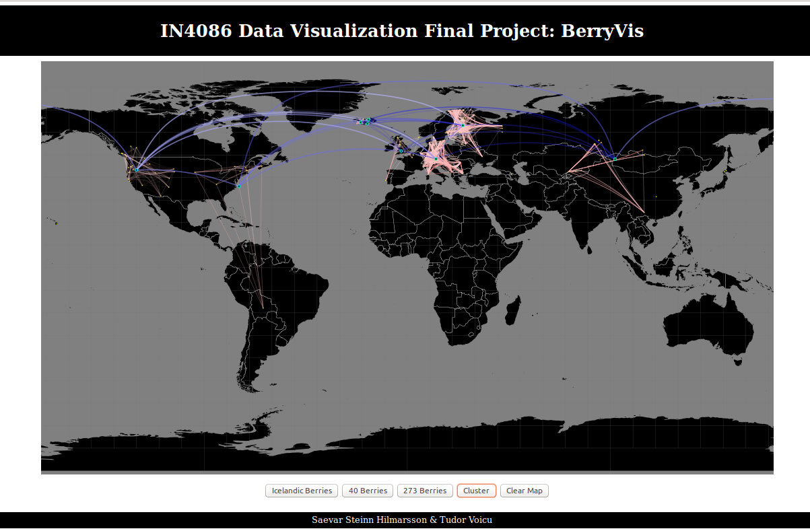

Slide 11
Thank you!
Saevar Steinn & Tudor Voicu

