Slide 1


juin 2026
SDBDIA-2A
Used Car Price
Prediction - Machine
Learning Project
End-to-End Machine Learning Project
Developed by: SAFAA OUSSALEM

Slide 2
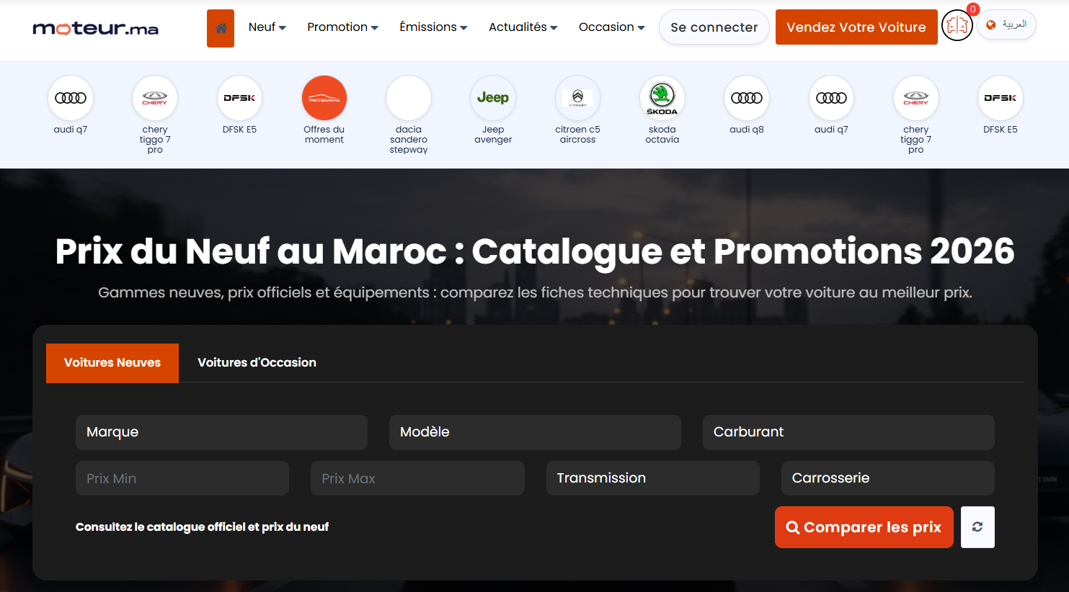
Table of Contents
From Web Scraping to Predictive Modeling: Unlocking the Moroccan Used Car Market.
Introduction & Project Overview
Model Building
Data Collection - Overview
Model Evaluation and Validation
Exploratory Data Analysis (EDA)
Results & Conclusion
Data Cleaning and Preprocessing

Slide 3

Project Context and Objectives
Problem Statement: How to accurately predict the price of a used car in the Moroccan market?
Objectives:
+ Collect real data from moteur.ma
+ Analyze factors influencing prices
+ Develop a performant predictive model
+ Provide insights for buyers/sellers
Methods: Web Scraping, Machine Learning, Statistical Analysis

Slide 4
Data Collection - Overview
Web Scraping from Moteur.ma
Source: https://www.moteur.ma/fr/voiture/achatvoiture-occasion/
Volume: 67 pages scraped (~2000 listings)
Extracted data:
Price, Brand, Model, Year
Mileage, Fuel, Transmission
City, Fiscal Power, Number of doors
Tools: Python, BeautifulSoup, Requests, Pandas
Sequential Version:
- Page-by-page processing
- Estimated time: ~26 minutes for detail pages
- Problem: Too slow
Multi-Threaded Version:
- Using ThreadPoolExecutor
- 10 threads in parallel
- Gain: Time divided by ~10
- Result: ~2-3 minutes
Tools: concurrent.futures.ThreadPoolExecutor

Slide 5
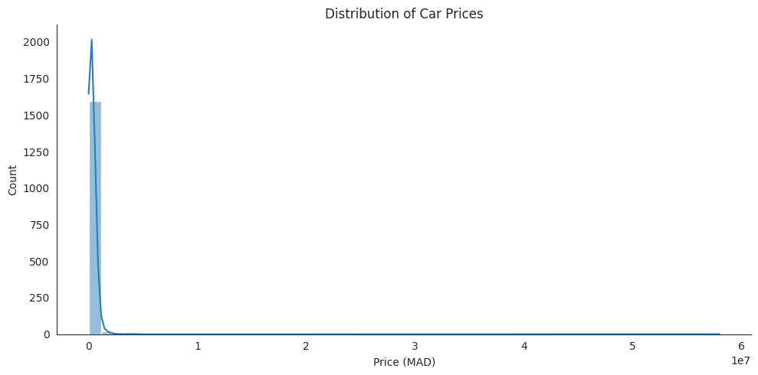
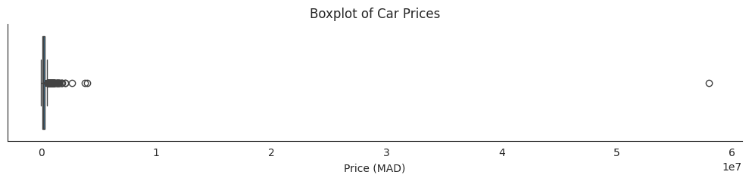
Data Exploratory Analysis (EDA)
Dataset shape: 2010 observations, 13 variables
Data types:
Numerical (5): Price, Year, Mileage, Power, Doors
Categorical (8): Brand, Model, City, Fuel, Transmission, etc.
Tools: Pandas, Matplotlib, Seaborn, Missingno
Key statistics:
> Mean: Very high due to outliers
> Median: More representative
> Min: 100 MAD (error)
> Max: 58,000,000 MAD (extreme outlier)
> Skewness: Very positive (asymmetric distribution)

Slide 6
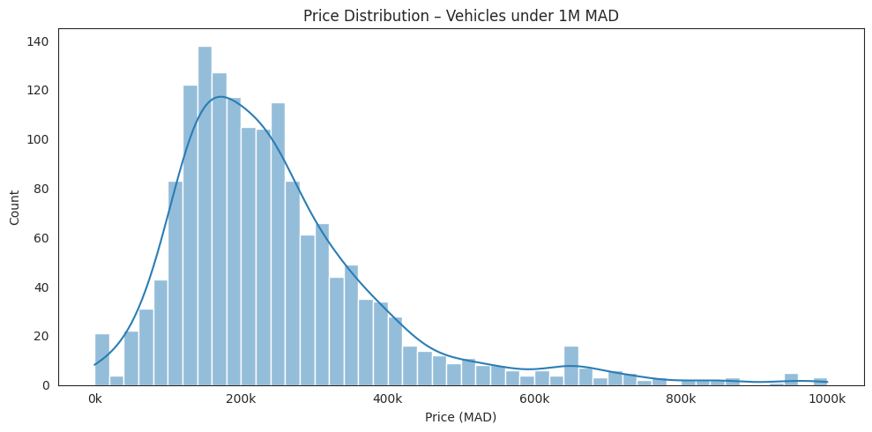
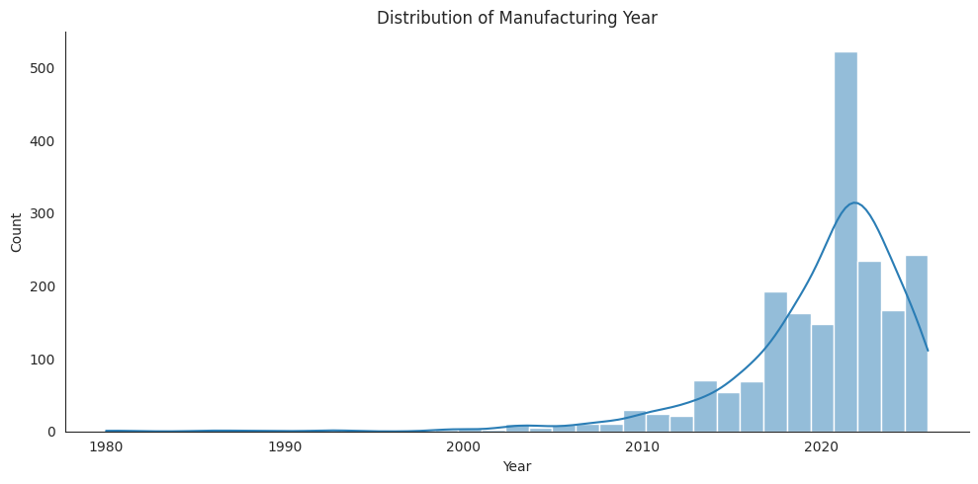
Price Distribution (Zoom)
Concentration: 100k - 350k MAD
Peak: 150k - 200k MAD
Distribution: Right-skewed
Insight: Majority of cars are in this price range
Method: Outlier filtering + KDE (Kernel Density Estimation)
Distribution: Left-skewed (concentration on recent years)
Dominant period: 2015-2024
Peak: Around 2022
Outliers: Few vehicles before 2010
Interpretation: Market dominated by recent vehicles

Slide 7
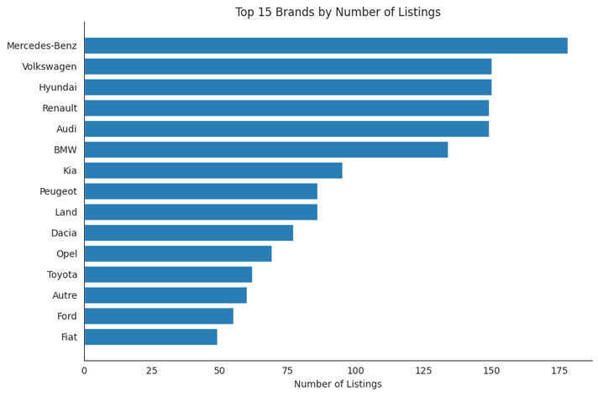
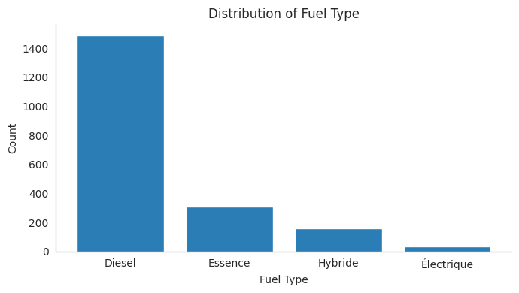
Categorial Variables
Price vs Year:
- Positive correlation (newer = more expensive)
- Pearson: 0.07 (weak due to outliers)
Price vs Mileage:
- Slight negative trend
- Pearson: -0.037
- Masked by brand/year effect
Price vs Brand:
- Mercedes, BMW, Audi > 350k MAD (median)
- Dacia, Renault, Fiat < 150k MAD
Tools: Scatter plots, Boxplots, Correlation heatmap
1 - Brand
2 - Fuel & Transmission
Diversity: 58 unique brands
Leaders:
Mercedes-Benz (178)
Volkswagen (150)
Hyundai (150)
Renault (149)
Audi (149)
Mix: Premium brands + mass market
> Fuel:
Diesel: 74.2% (dominant)
Petrol: 15.5%
Hybrid: 7.9%
Electric: 1.8%
> Transmission:
Automatic: 71.0%
Manual: 25.8%
Semi-auto: 0.1%
> Interpretation: Moroccan market oriented toward diesel and automatic

Slide 8
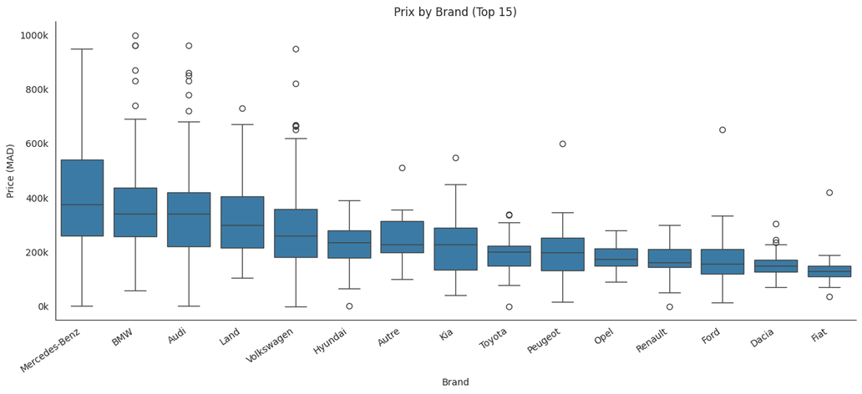
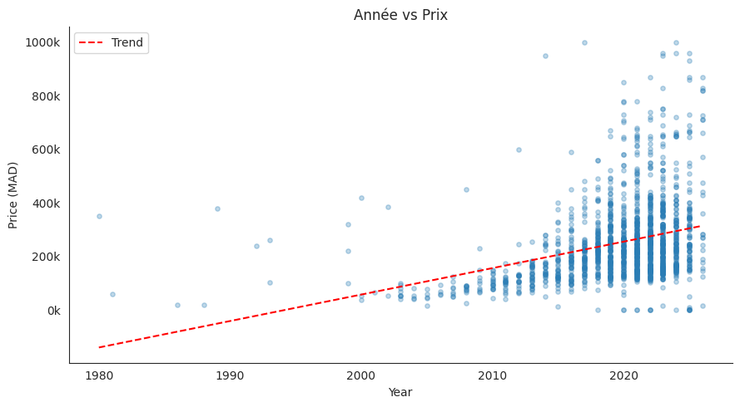
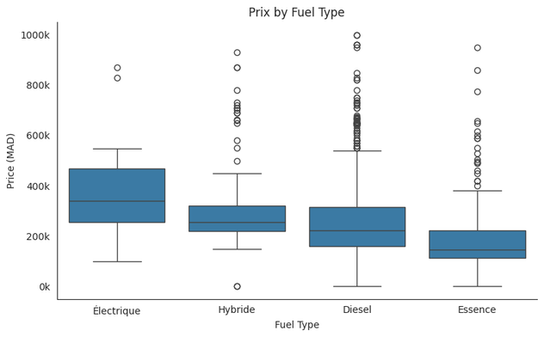
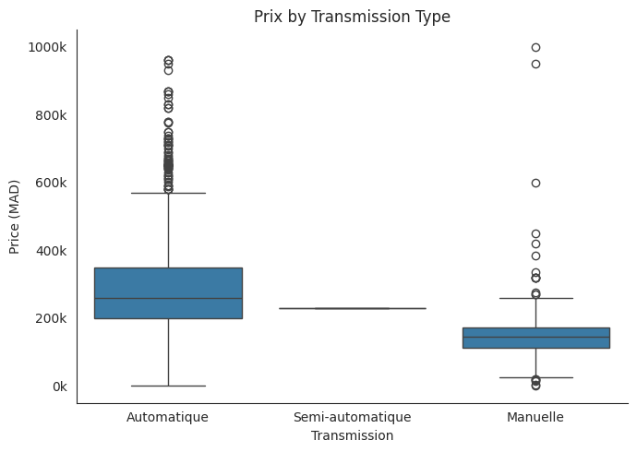
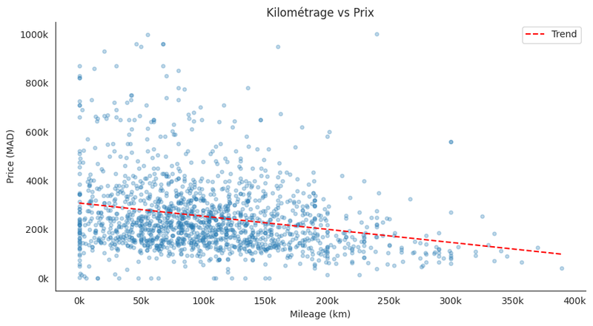
LOU HUET
CÉLIA NAUDIN

Slide 9
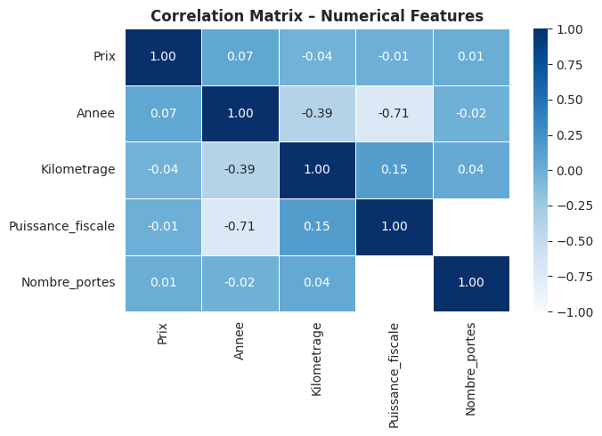
Correlation Matrix
Price-Year: 0.07 (weak)
Price-Mileage: -0.04 (weak)
Year-Mileage: -0.39 (expected negative)
Year-Power: -0.71 (strong, but missing data)
Insight: Weak correlations suggest non-linear relationships

Slide 10
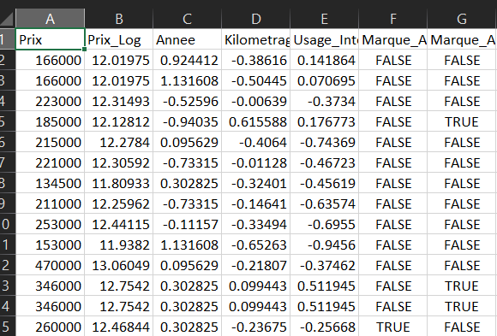
Preprocessing
Data Cleaning
Remove missing prices: 391 rows
Filter prices < 5000 MAD: Data entry errors
Outlier treatment (IQR):
Q1, Q3, IQR calculated
- Removal: Price > Q3 + 1.5×IQR
- Fix "Land Rover": Parsing error corrected
Result: Reduced but cleaner dataset
Handling Missing Values
> Columns removed:
Fiscal_power (98.6% missing)
Condition (constant value)
Title, URL (non-predictive)
Number_of_doors (69% missing)
> Group-based imputation:
Method: Median/Mode by (Brand, Model)
Fallback: Global median/mode from training set
Anti-leakage: Calculation only on X_train
Tools: groupby(), apply()

Slide 11
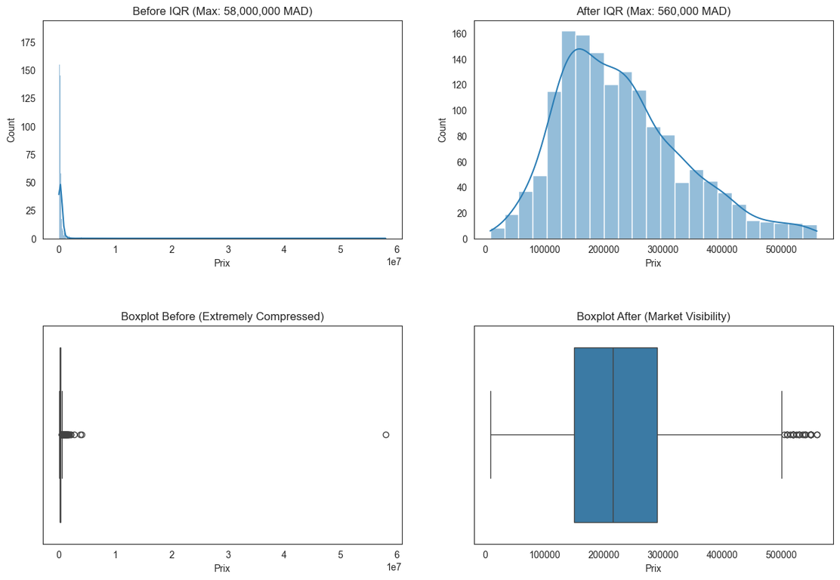
Encoding and Partitioning
Feature Importance
Target Transformation:
Price_Log = log1p(Price)
Objective: Reduce skewness
Train-Test Split:
80% Train (1196 samples)
20% Test (300 samples)
random_state=42
One-Hot Encoding:
Categorical variables → Binary variables
Total final features: 39 columns
Train/test alignment
Top features:
Manufacturing year
Brand (dummy variables)
Mileage
Usage_Intensity
Transmission
Fuel

Slide 12
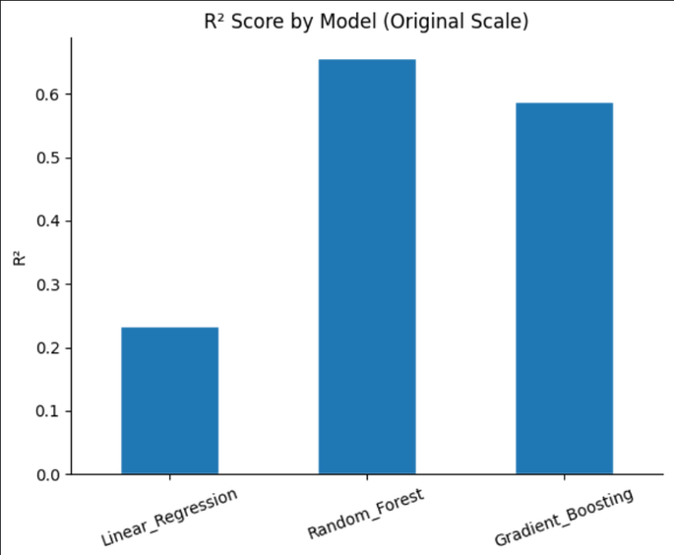
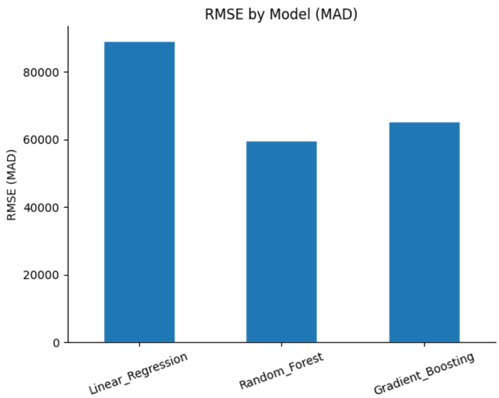
Modeling - Algorithms
Model Building : 3 algorithms tested
> Linear Regression
Simple and interpretable baseline
Hypothesis: Linear relationship
> Random Forest Regressor
Ensemble learning
Handles non-linearities
Robust to outliers
> Gradient Boosting Regressor
Sequential ensemble
High potential accuracy
Evaluation Metrics
> Metrics used:
R² (R-squared): Quality of fit
RMSE (Root Mean Square Error): Quadratic error
MAE (Mean Absolute Error): Absolute error
MAPE (Mean Absolute Percentage Error): Error in %
> Scale:
On log-transformed data
On original data (MAD)

Slide 13
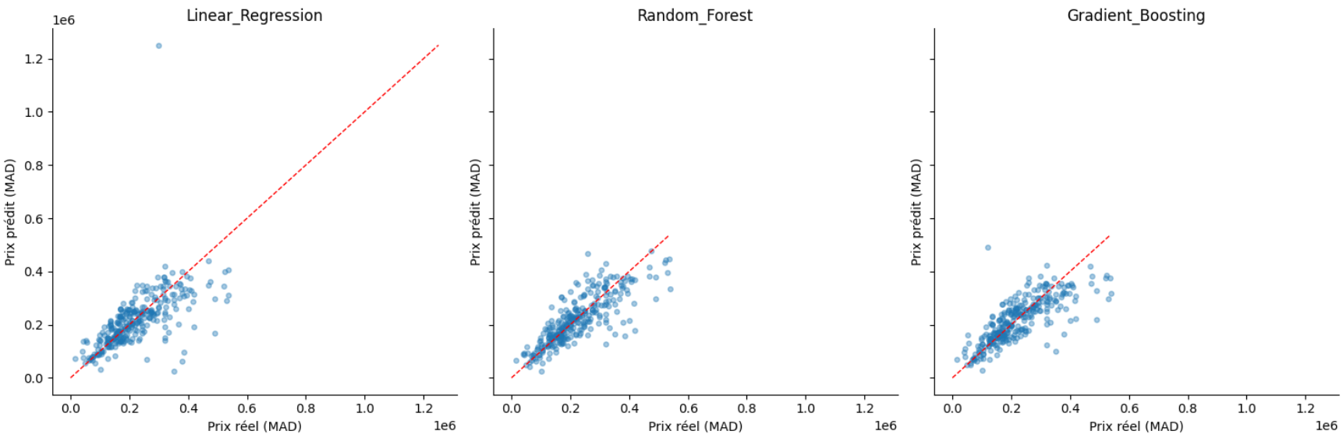
Predicted vs Actual Visualization
Scatter plots: 3 models side by side
Red line: y = x (perfect prediction)
Observations:
Random Forest: Points closer to diagonal
Linear Regression: More dispersion
Underestimation of very high prices (all models)

Slide 14
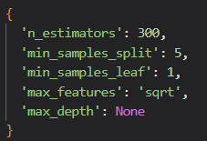
Methodology:
K = 5 folds
Shuffle + random_state=42
Metrics: R² and RMSE
Insight: Models are closer in CV than in single test split
K-Fold Cross-Validation
Parameters tested (Random Forest):
n_estimators: [100, 200, 300, 400]
max_depth: [None, 10, 15, 20, 25]
min_samples_split: [2, 5, 10]
min_samples_leaf: [1, 2, 4]
max_features: ['sqrt', 'log2', None]
Result: CV R² improved from 0.61 → 0.65
Hyperparameter Tuning

Slide 15
Final Model Selection
Selected model: Random Forest (non-tuned) =>
Best performance on test set (R² = 0.656)
Tuned model slightly underperformed on this specific test set
Inherent variance in small test sets (300 samples)
Cross-validation remains the most reliable indicator

Slide 16

Thank You!

