Slide 1
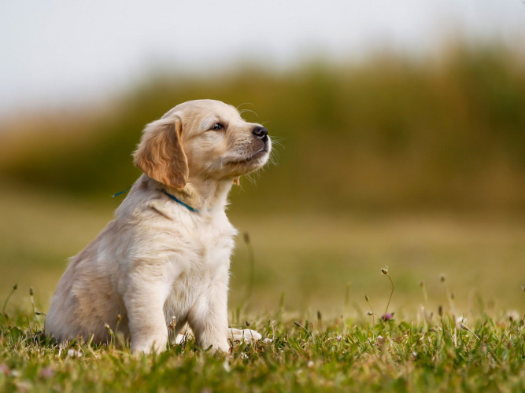
PUPS
PET GROOMING STUDIO

Slide 2

ABOUT US
Pups pet grooming shop has been introduced in 2000
And our quality services made us reach the top 1 grooming shop
all over New South Wales. We take care of pets like our
Own, feeds them and plays with them. We also do the
Adoption to help the dogs to help their own loving family
And a much better environment.

Slide 3


SERVICES
Pets grooming shop offers different variety
of services your pets will surely enjoy

Slide 4
ADOPTION
Pups Believe pets are precious and needs care and love
In order to adopt dogs, you need to qualify the following
1
Make sure that you really need a pet
3
Make sure that you should be caring .
2
Make sure that you are able to supply their needs
4
Test yourself that you are able to give love like a mom

Slide 5
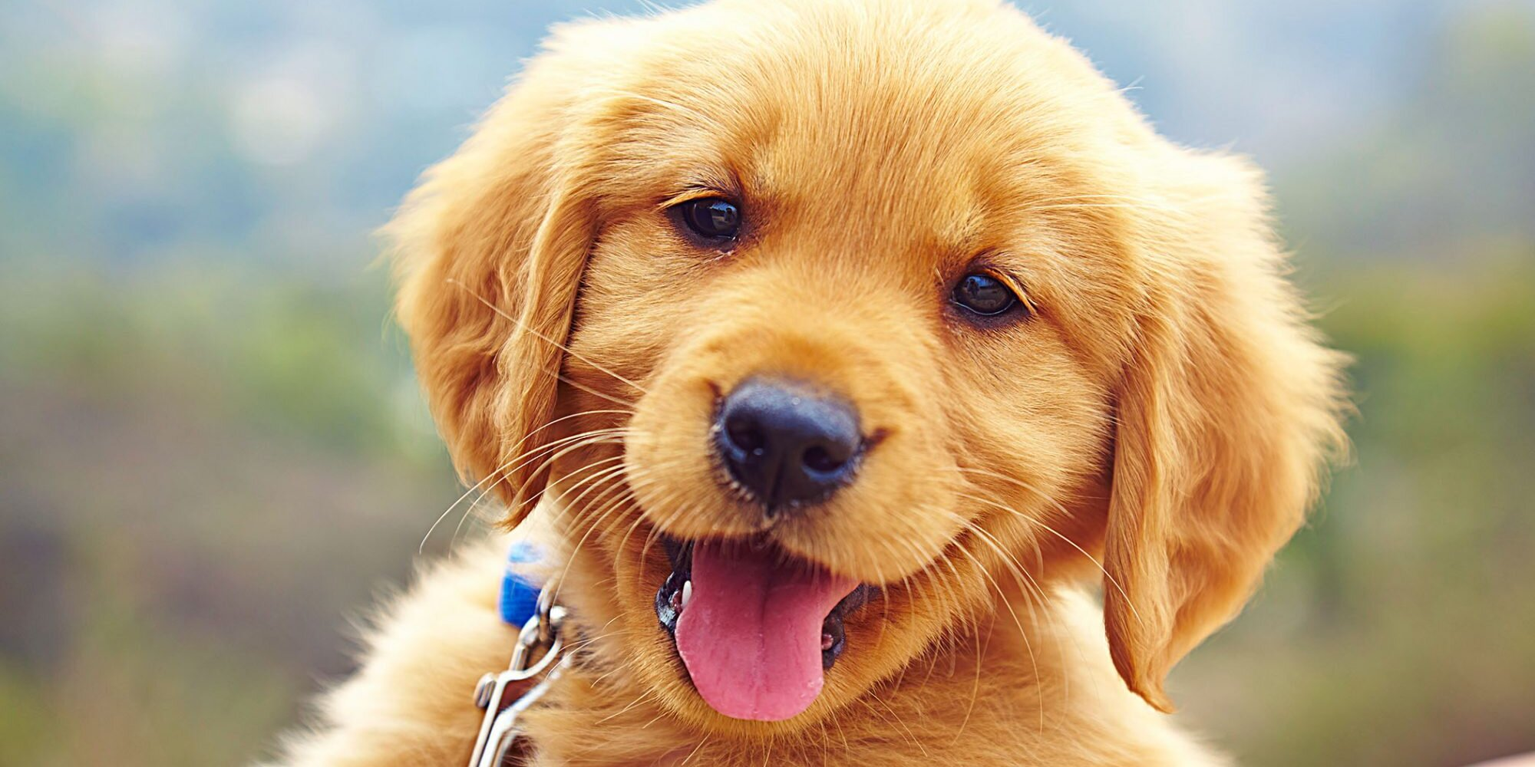
signs your pet is suffering
From
Allergies!

Slide 6
1. Runny red eyes

Slide 7
2. Itchy red skin

Slide 8
3. Constant
Itching

Slide 9
4. Inflamed
Ears

Slide 10
5. Swollen
Ears

Slide 11
6. Sneezing

Slide 12
7. Asthma

Slide 13
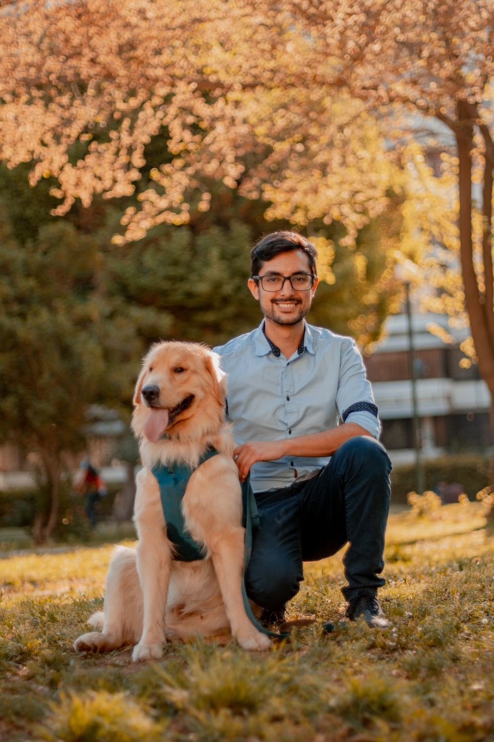
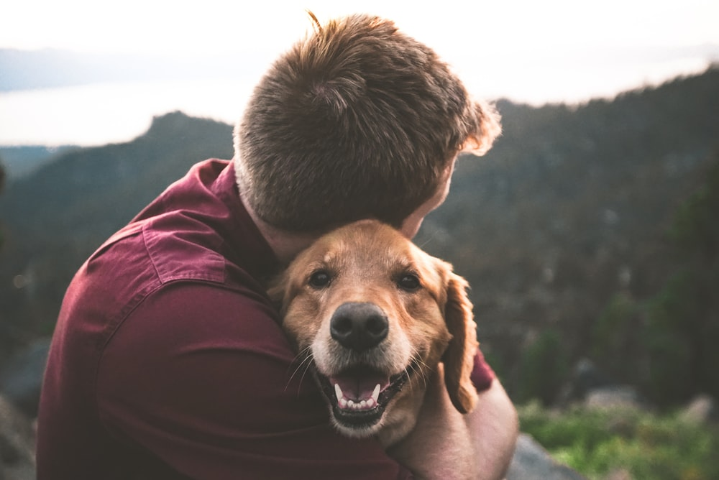
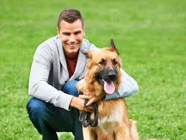
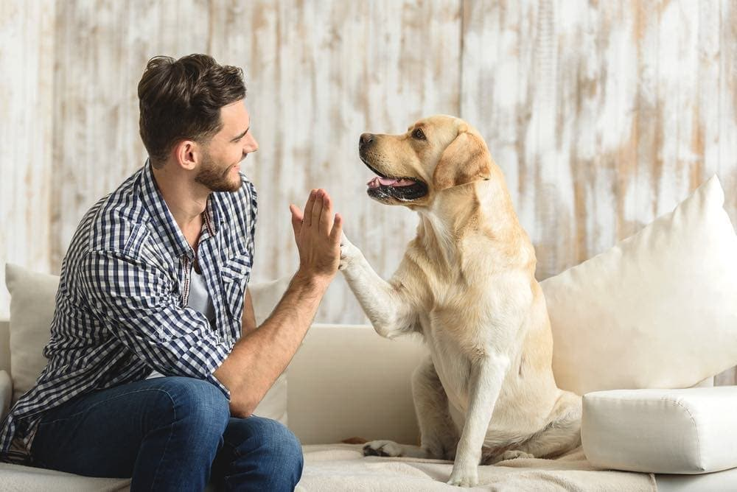


Contact us
466767776673785
https://www.instagram.com/puppies.website

Slide 14


