Slide 1

Football League

Slide 2

Introduction
Database Design
To create a Football League database design based on raw data.
ER Diagram to show relations, constraints and assumptions.
Implementation & Testing
Create schema for database system.
Test queries to ensure that implementation was successful.

Slide 3
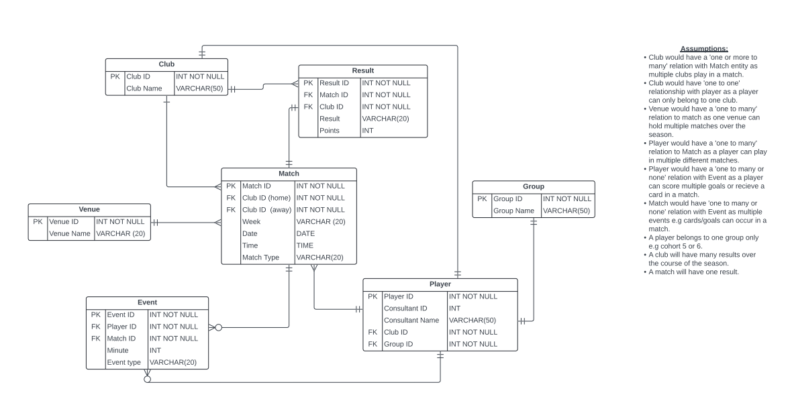
Original ER Design
Feedback
Multiple relations needed to be revised e.g. club to player.
Removal of a relation between Club and Result suggested.

Slide 4
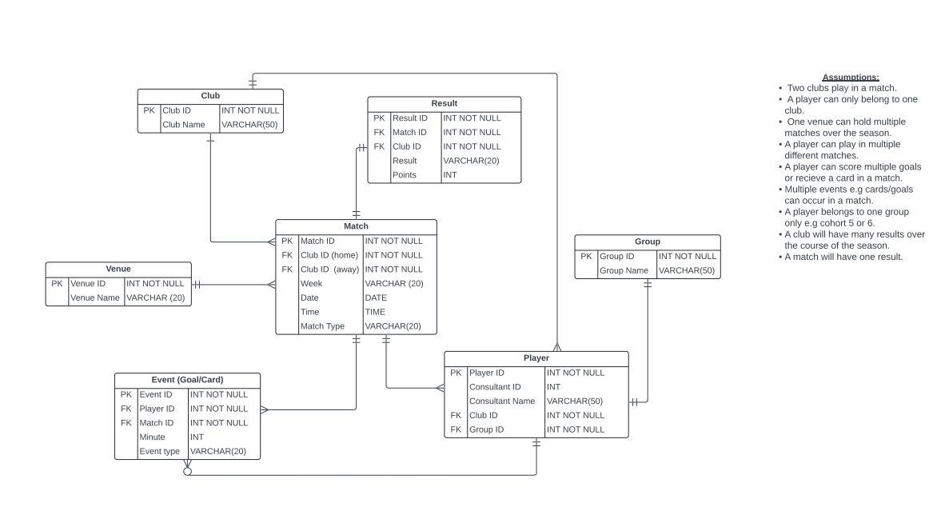
Updated ER Design
Updates Made
Relations revised between Club to Player, Match to Event.
Club to Result relation removed.
Goal/Card clarified in Event entity.

Slide 5
Assumptions Updated
INITIAL
UPDATED

Slide 6

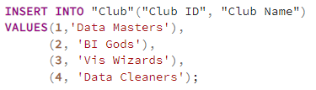
Implementation of updated design
Creation of tables based on normalised 3NF form of database design.
Use of DDL for the creation of tables
Example Code:
Use of DML for the insertion of values
Example Code:
Domains and constraints such as data type, and the assignment of primary and foreign keys were conducted in this step.
Use of DDL language such as CREATE.
Use of DML language such as INSERT.

Slide 7
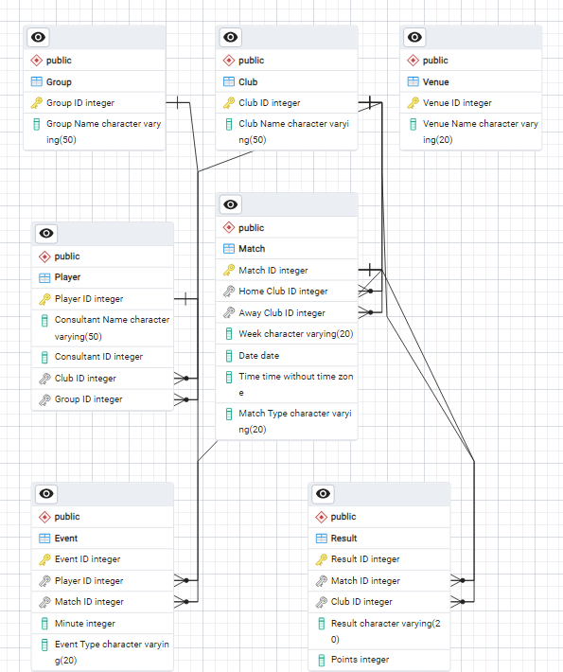
PostgreSQL Diagram

Slide 8
Technical Document
Data Dictionary
Document containing:
Initial database design and updates, including ER Diagrams.
Implementation and creation of schema along with full code.
Testing of database implementation based on questions given to determine success.
Document containing:
Entities, attributes, description and example of data being used.
Important for other’s interpretation of data and guidance.
Useful for management and organisation of data.
(Full technical document and data dictionary submitted in project folder.)

Slide 9
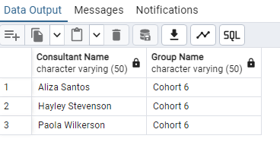
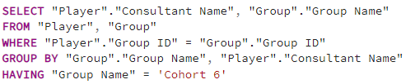
Testing implementation
Testing is important to ensure that implementation of database system has been successful.
Q1) List students from Cohort 6
Expected outcome:
Filtered students by Cohort 6 and names returned.
CODE:
Actual outcome:
Test successful as expected outcome returned.

Slide 10
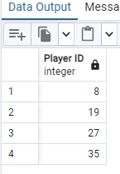
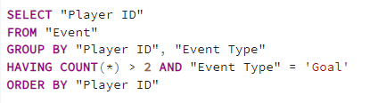
Testing implementation
Q3) List players who have scored more than 2 goals.
Expected outcome:
Players filtered by those who have scored more than 2 goals.
CODE:
Actual outcome:
Test successful as expected outcome returned.

Slide 11
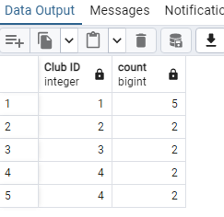
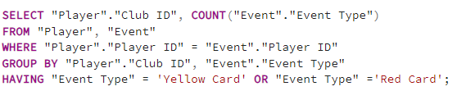
Testing implementation
Q5) List number of red and yellow cards per team.
Expected outcome:
Cards counted and grouped by clubs.
CODE:
Actual outcome:
Test successful as expected outcome returned.
However, was not able to group Club ID 4 together so cards show separately.

Slide 12

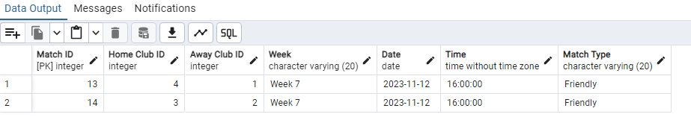
Testing implementation
Q6) Return games that will be played as ‘Friendly’.
Expected outcome:
If match type is friendly, game information is returned.
CODE:
Test successful as expected outcome returned.
Actual outcome:

Slide 13


Conclusion
Reflection
Database design updated based on feedback.
Implementation using DDL and DML to create schema and populate tables.
Queries tested success of implementation.
Venue ID added to Match table would have allowed for completion of Q2. This could have been done with ALTER TABLE commands.
Goal recording could have been broken down further to allow for completion of Q4.
However, other queries were successful.
Lessons Learnt
Checking syntax is important e.g. commas and case sensitive words.
Assignment of primary and foreign keys.

Slide 14

Questions?

