Slide 1
LambdaIDS: The Immune System for the Edge
Securing the Critical Infrastructure of Tomorrow with TinyML
We enable secure, autonomous, and compliant IoT at the edge.
Ahmad Mostafavi | Soroush Safaei | Hossein Fotouhi

Slide 2
The Problem: The 'Smart' World is Critically Vulnerable
Explosion of Attack Surface: 75 Billion IoT devices by 2025.
Resource Constraints: Existing security tools (agents, firewalls) are too heavy for microcontrollers.
The Result: 98% of IoT traffic is unencrypted or vulnerable.
Critical Risk: Ransomware in hospitals, grid shutdowns, industrial espionage.

Slide 3
Why Now? The Regulatory Tsunami
EU Cyber Resilience Act (CRA): Mandatory cybersecurity for ALL connected products by 2025/2026.
IEC 62443: Moving from 'nice-to-have' to 'must-have' for industrial compliance.
The Market Gap: Manufacturers are entering a panic mode. They lack the expertise to build compliant security from scratch.
Opportunity: Compliance is no longer optional—it is a license to operate.

Slide 4
The Solution: LambdaIDS
Autonomous On-Device Security: An AI agent that lives ON the microcontroller.
Real-time Anomaly Detection: Detects zero-day attacks instantly without cloud latency.
Ultra-Lightweight: Runs on <100KB RAM. Consumes negligible battery.
Compliance-Ready: Built to satisfy IEC 62443 and CRA requirements out of the box.

Slide 5
How It Works: Edge AI vs. Cloud Security
Traditional (Cloud): High latency, privacy risks, high data cost, fails offline.
LambdaIDS (Edge): Zero latency, privacy-preserving, works offline, 100x more energy efficient.
Tech Stack: Proprietary TinyML algorithms optimized for ARM Cortex-M and RISC-V.

Slide 6
Market Opportunity
Total Addressable Market (TAM): $30B+ IoT Security Market (growing 25% YoY).
Serviceable Available Market (SAM): $4B Industrial & Utility IoT Security.
Serviceable Obtainable Market (SOM): $100M (Nordic + MENA Critical Infrastructure).
Target Segments: Industrial Automation (IIoT), Smart Energy, Automotive.

Slide 7
Business Model
B2B Licensing & SDK: Per-device license fee for OEMs.
Tiered Subscription: Basic (Detection) vs. Pro (Prevention + Fleet Analytics).
Pilot Strategy: Paid pilots with Tier 1 manufacturers to validate and customize.
Scalability: High-margin software model (80%+ gross margin at scale).

Slide 8
Traction & Validation
Key Partners: Collaboration with Combitech & RISE (Research Institutes of Sweden).
Academic Validation: Backed by cutting-edge research in Embedded AI.
Funding: Secured early grant funding (Vinnova/VFT). Validation of tech novelty.
Pipeline: Discussions with major players in Industrial Automation (ABB, Siemens ecosystem).

Slide 9
Competitive Landscape
Cloud-Based (Darktrace, etc.): Too heavy, high latency. (LambdaIDS wins on Speed/Size).
Embedded Legacy (Firewalls): Static rules, can't stop zero-days. (LambdaIDS wins on Adaptability).
The LambdaIDS Advantage: The only solution combining TinyML + IEC 62443 Compliance + <100KB Footprint.
Moat: Proprietary quantization algorithms & curated attack datasets.

Slide 10
Roadmap: Path to Scale
Q1-Q2 2025: Finalize SDK v1.0. Complete Pilot with Combitech/RISE.
Q3-Q4 2025: First Commercial Deployments (Industrial Sector). Achieve IEC 62443 Cert.
2026: Expansion to MENA region. Series A for Global Scale.
2027: Integration with major Chip Vendors (ST, NXP).

Slide 11
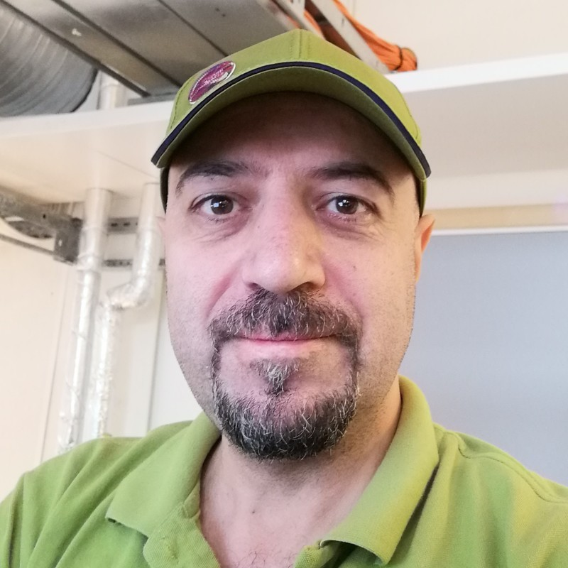
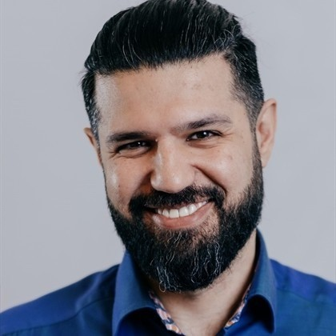
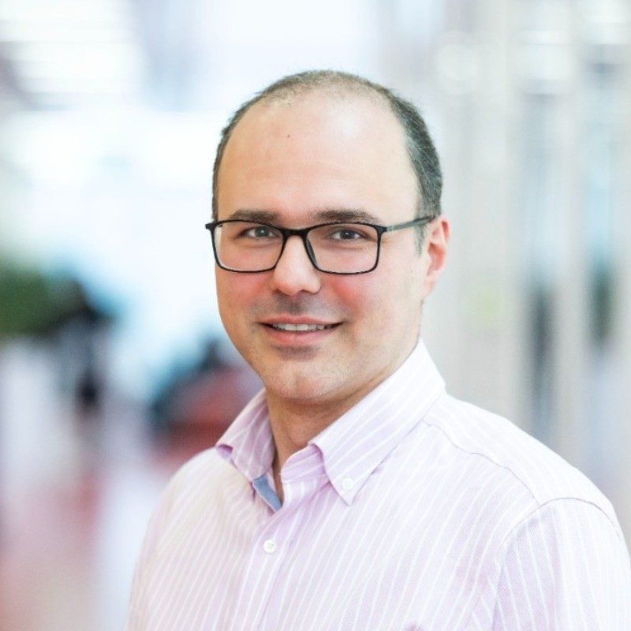
The Team
Ahmad Mostafavi
CEO & Founder
Deep tech expert in Embedded Systems & Security.
Soroush Safaei
Co-Founder
Expertise in AI Strategy & Market Development.
Hossein Fotouhi
Co-Founder
Associate Professor at MDU, Expert in IoT & Edge Computing.
Why Us: We bridge the gap between AI, Hardware constraints, and Academic Innovation.

Slide 12
The Ask
Seeking: $500K - $1M (Seed / Pre-Seed).
Use of Funds:
40% R&D (SDK refinement, Certification).
30% Business Dev (Pilot execution, Partnership management).
30% Operations & Legal (IP Protection).
Opportunity: Join us in defining the standard for Edge AI Security.

Slide 13
Contact
Let's build a secure future together.
Ahmad Mostafavi, Soroush Safaei, Hossein Fotouhi
LambdaIDS
www.lambdaids.se

