Slide 1
Checkpoint
Fait par Safa Aloui

Slide 2
How the web works
The web is everywhere!
We use it more than we ever did before - also in many places where you might not see it. Because “the web” is more than just websites you visit by entering a URL in your browser.
The web browser connects to the web server and sends an HTTP request (via the protocol stack) for the desired web page. The web server receives the request and checks for the desired page. If the page exists, the web server sends it. If the server cannot find the requested page, it will send an HTTP 404 error message.

Slide 3
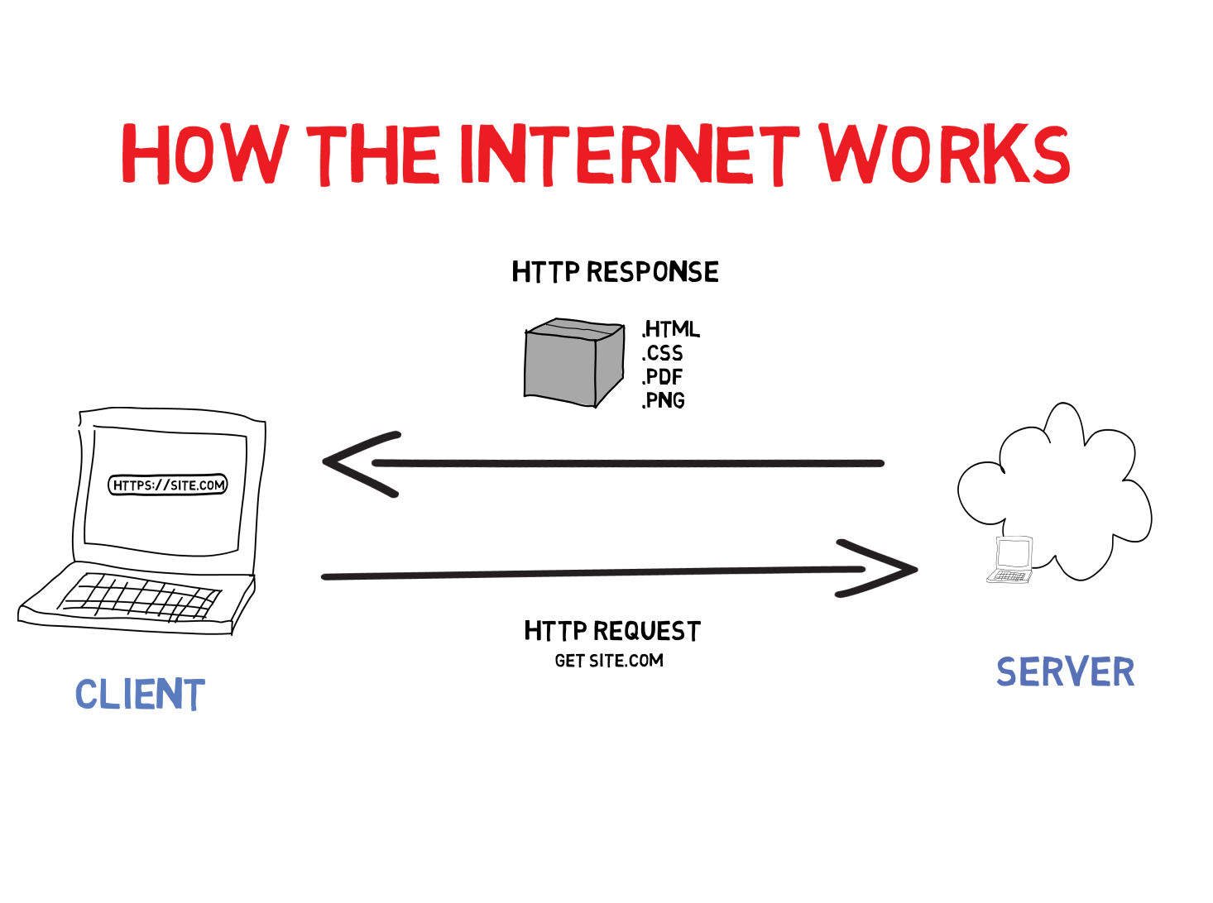

Slide 4
What does a web developer do?
Also known as web programmers or web coders, web developers essentially make a website work by building the functionality, interactivity and visible structure of the site, normally based on the vision of designers and other key roles.
Web developers are also responsible for ensuring a site functions correctly on all browsers - both desktop and mobile - through testing. Once a site is live, a developer carries out updates and other maintenance tasks as necessary.

Slide 5
What qualifications do you need to become a web developer?
User experience (UX)
User interface (UI)
Visual design.
Coding languages including HTML and CSS.
Frontend web programing languages and skills such as JavaScript, Ajax and web animation techniques.
Backend web programing languages such as C# or Java, PHP and Ruby.

