Slide 1
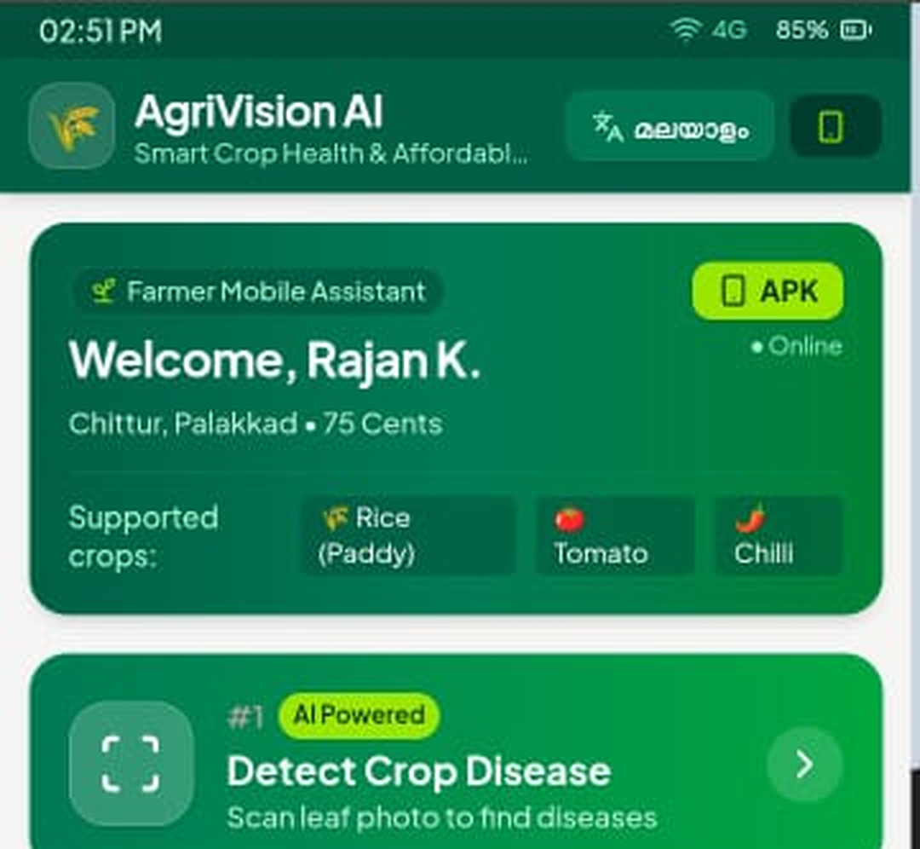
AgriVision AI
Smart crop health and affordable farming for small farmers
AI detection | Offline library | Malayalam & English
Project presentation
Notes:
Introduce AgriVision AI: a mobile farming assistant for Kerala farmers, built in Google AI Studio and installable as an APK.

Slide 2
The problem and our solution
The problem
AgriVision AI
Disease is often noticed too late
Experts can be far from the farm
Internet is weak in rural areas
Most apps are English-only
Scan a leaf photo to find possible disease
Malayalam and English support
Guides and reports work offline
Direct line to Kisan Call Centre
Notes:
Contrast the farmer's challenges with how the app responds.

Slide 3
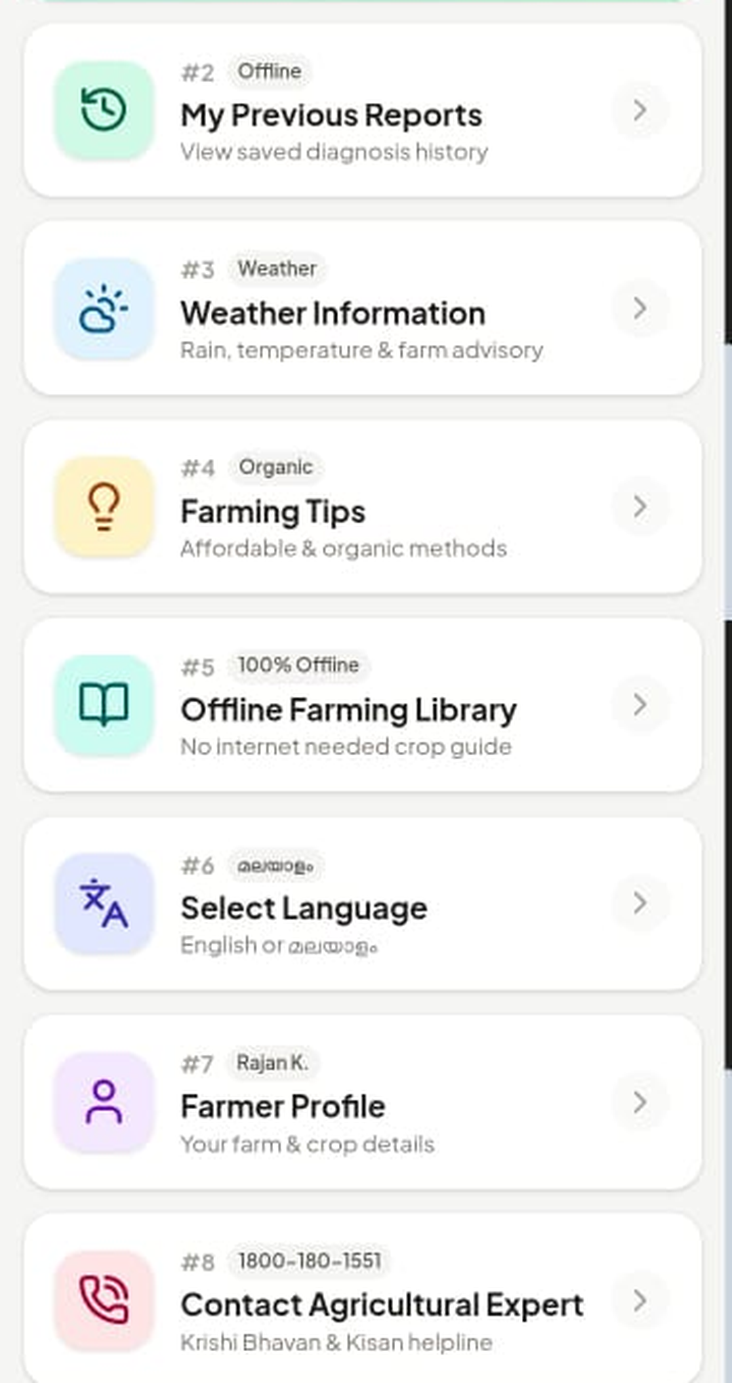
The home screen
Personal welcome
Farmer name, location, farm size and supported crops: Rice (Paddy), Tomato, Chilli
One-tap detection
Large AI Powered button at the top
Eight clear features
Reports, weather, tips, library, language, profile and expert contact
Notes:
Real screenshot of the home screen. Point out the simple big buttons, badges (AI Powered, Offline, Weather, Organic) and the Malayalam toggle in the header.

Slide 4
How detection works
1
2
3
4
5
6
Open app
Pick crop
Scan leaf
AI analyses
Get result
Save / ask
Choose Malayalam or English
Rice, Tomato or Chilli
Take or upload a clear photo
Photo checked for known diseases
Possible disease, symptoms, advice
Save report or call an expert
Results say "possible disease" with a confidence score, never a final diagnosis.
Notes:
Walk through the process. The Detect button on the home screen starts step 3; the result screen explains the possible problem, symptoms and what to do.

Slide 5
Eight features in one app
#1 Detect Crop Disease
#2 My Previous Reports
#3 Weather Information
#4 Farming Tips
AI Powered: scan leaf photo
Offline: saved diagnosis history
Rain, temperature, farm advisory
Organic, affordable methods
#5 Offline Farming Library
#6 Select Language
#7 Farmer Profile
#8 Contact Expert
100% offline crop guide
English or Malayalam
Your farm and crop details
Krishi Bhavan and Kisan helpline
Notes:
These eight items match the numbered cards on the real home screen.

Slide 6
Offline access and local language
1
Works with poor internet
Offline Farming Library and saved reports need no connection
2
Malayalam and English
Switch language from the header or the Select Language card
3
Simple wording
Big buttons, short text and clear badges for farmers new to apps
4
Online features
Live weather and expert contact use the internet
Notes:
Offline library and reports are marked 100% Offline / Offline on the home screen. Live AI analysis and weather need internet unless an on-device model is added.

Slide 7
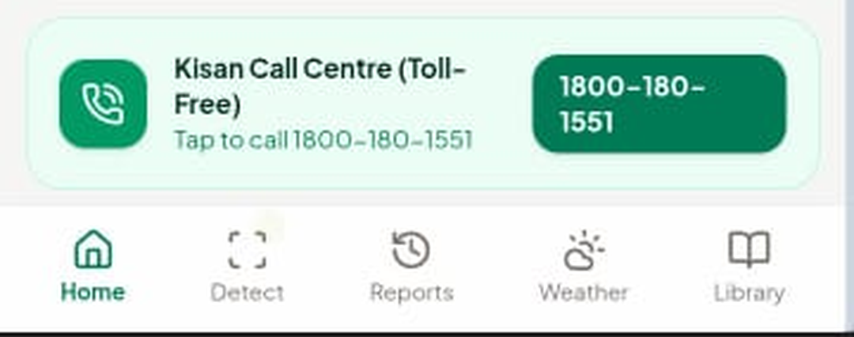
Expert help and honest AI
Kisan Call Centre
Toll-free 1800-180-1551, tap to call from the home screen
Honest AI
Shows possible disease and confidence, warns when the photo is unclear
Safe advice
Prefers low-cost, organic steps and follows local agricultural guidance
Navigation: Home, Detect, Reports, Weather, Library
Bottom bar keeps every main feature one tap away.
Notes:
The call card is real. Emphasise that AI can be wrong, so farmers are pointed to Krishi Bhavan and Kisan Call Centre.

Slide 8
Technology and next steps
Built with
Next: on-device AI
Next: grow
Google AI Studio, Gemini vision for leaf analysis, installable as an APK
TensorFlow Lite model for true offline disease detection
More crops, live weather, voice read-aloud, more languages
Thank you | Questions?
Notes:
Confirm the AI model details with your own build before presenting.

