Slide 1
تحليل بيانات أفلام باستخدام بايثون
Safa mohammed IBRAHIM

Slide 2
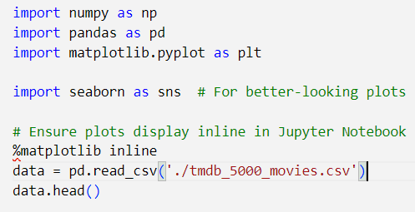
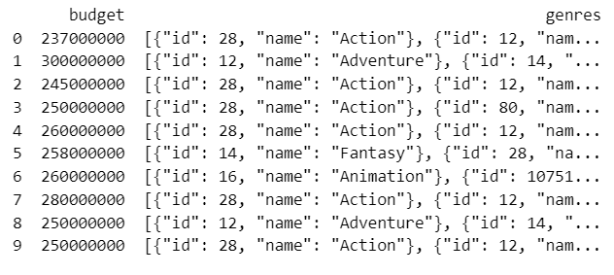
استدعاء مكتبات بايثون

Slide 3

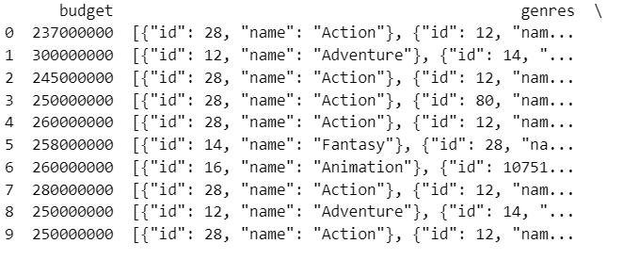
Open Your CSV file and print the first 10 rows in a good format

Slide 4

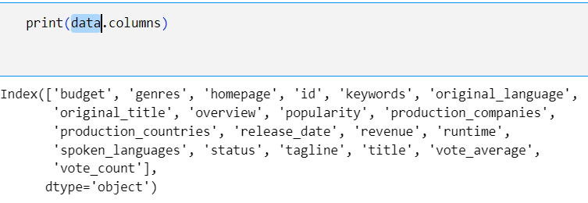
Exploring data

Slide 5

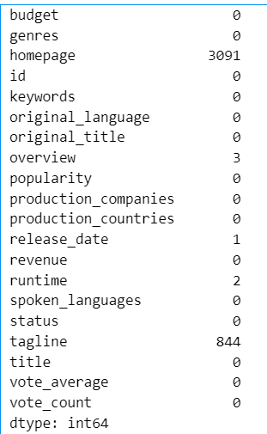
Check if any NANs in your dataset and fill them with a good filer

Slide 6
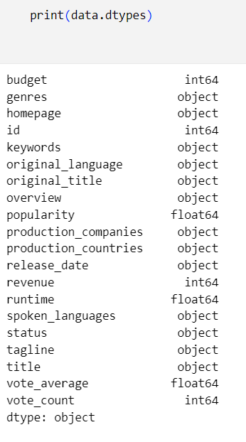
Discover the types of each columns and modify them if needed

Slide 7
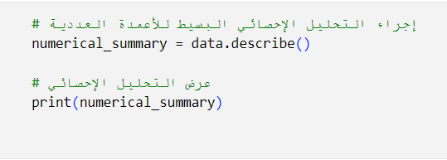
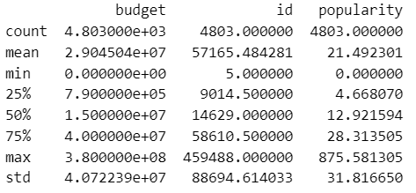
Give a very simple statistical analsys for the numerical columns

Slide 8
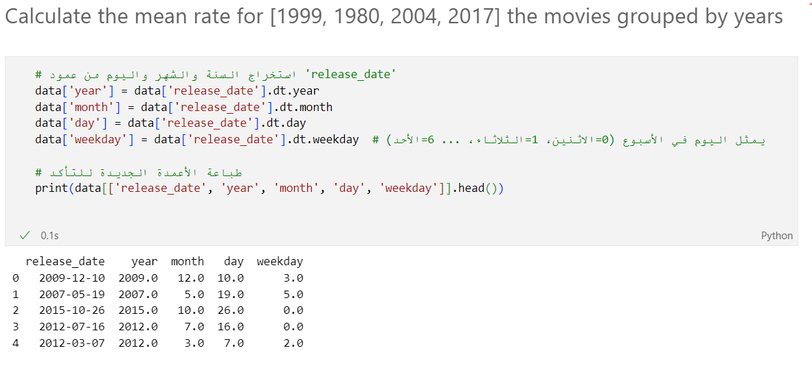

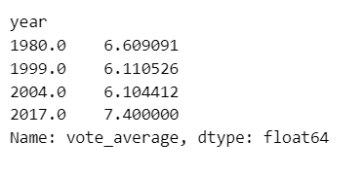
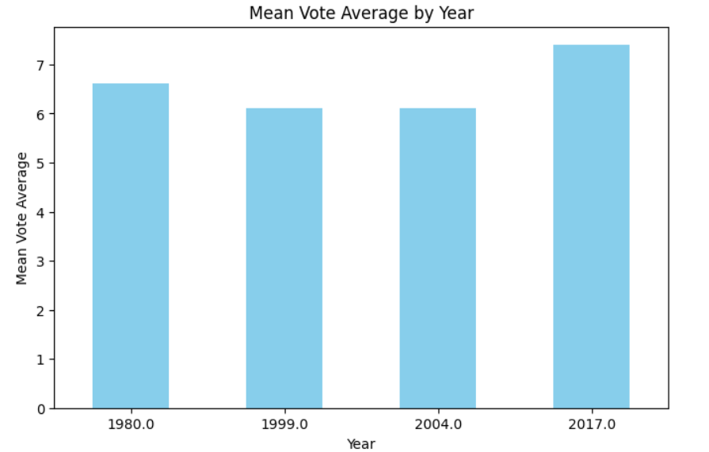
Calculate the mean rate for [1999, 1980, 2004, 2017] the movies grouped by years

Slide 9

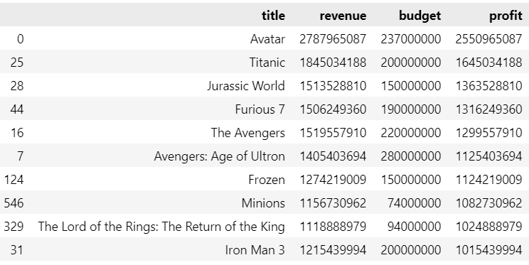
Rearange the dataframe based on revenue - budget values

Slide 10
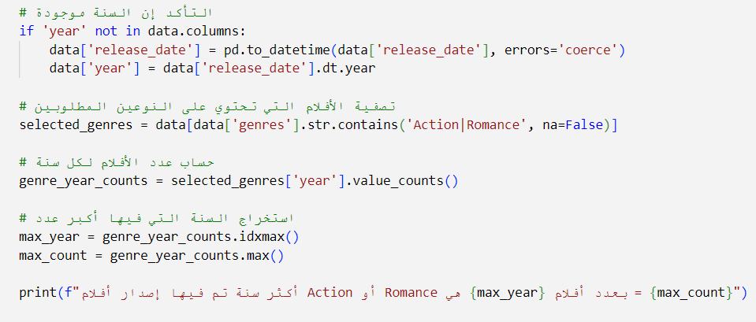
Allocate the year with the largest movies In ['Action', 'Romance']

Slide 11
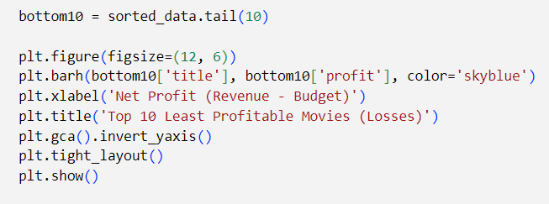
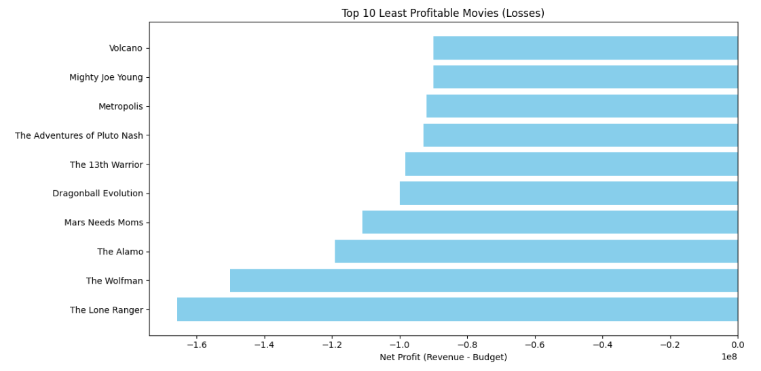

Slide 12

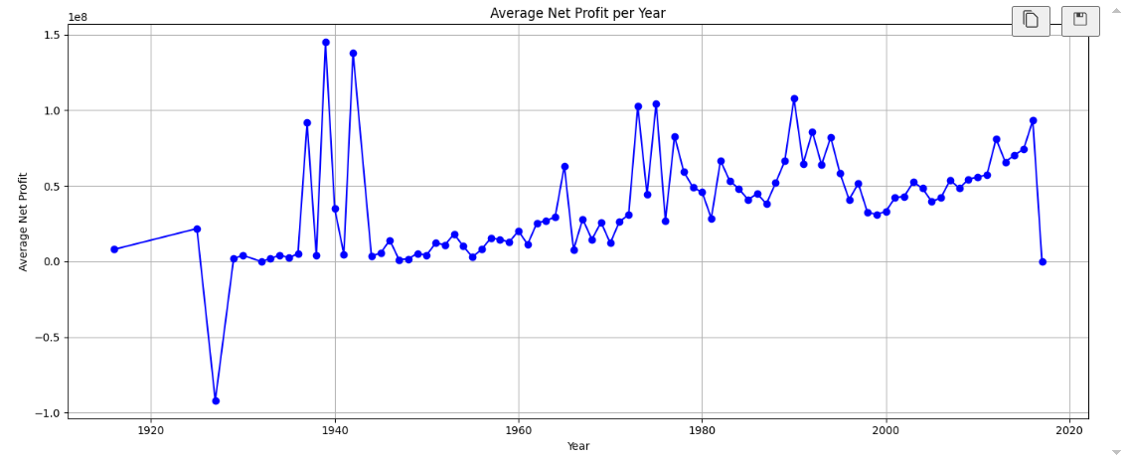

Slide 13

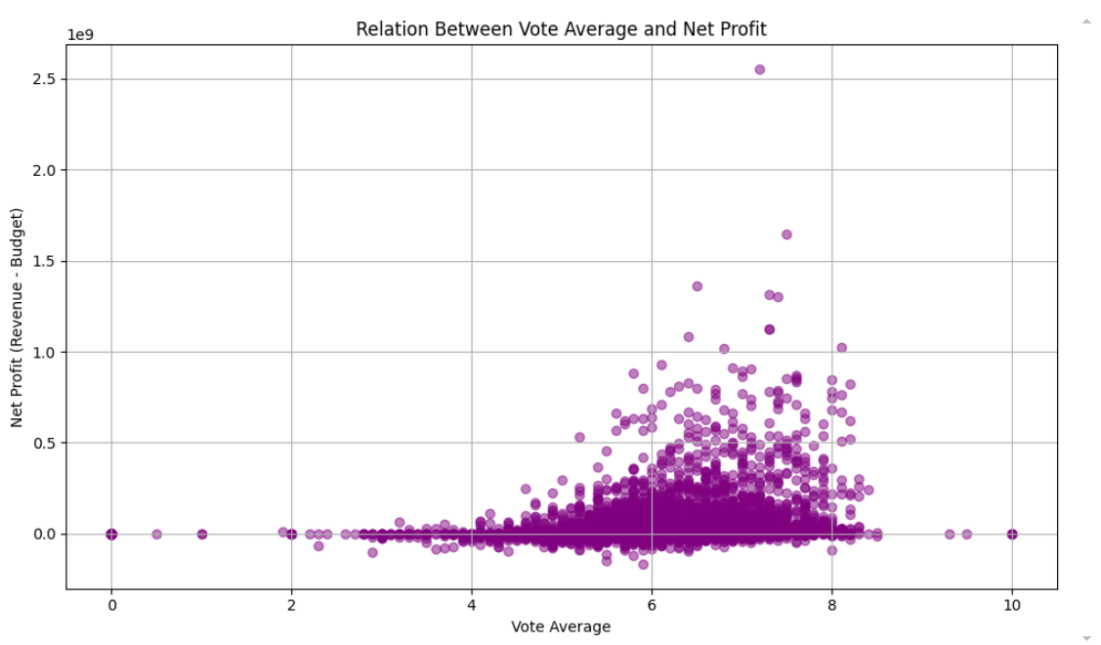

Slide 14
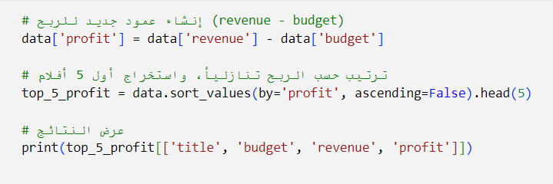
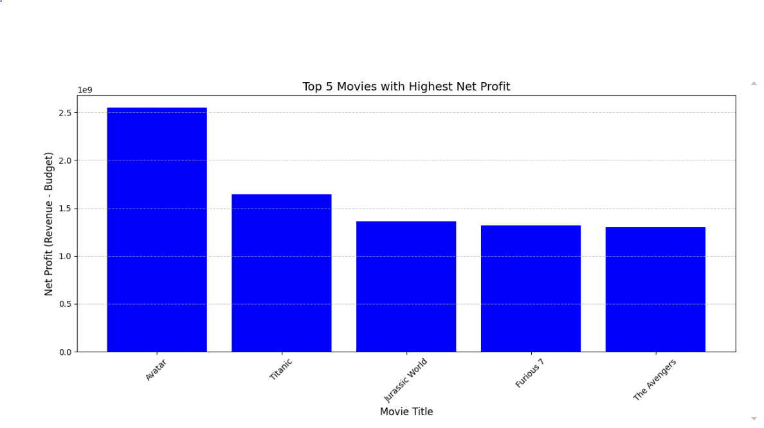
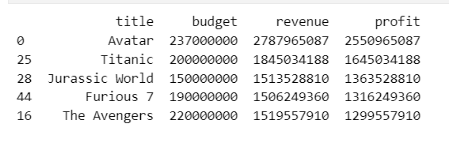
### Find the movies with top 5 revenue - budget value ###

Slide 15
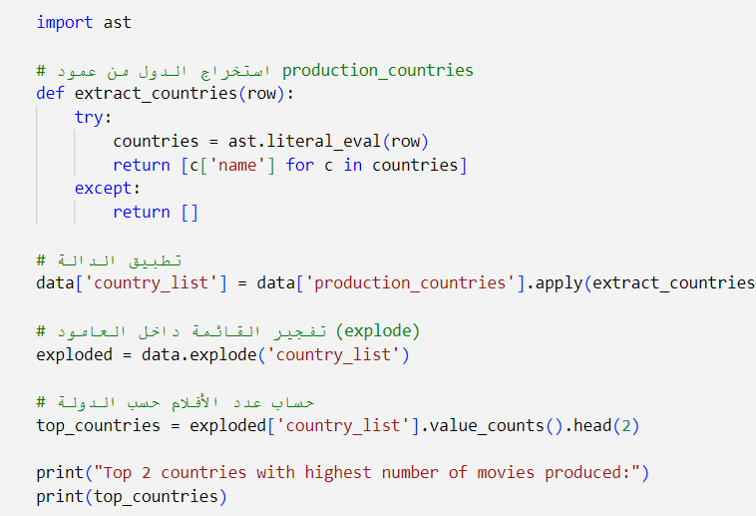

Find the top 2 countries with the highest production movies number

Slide 16
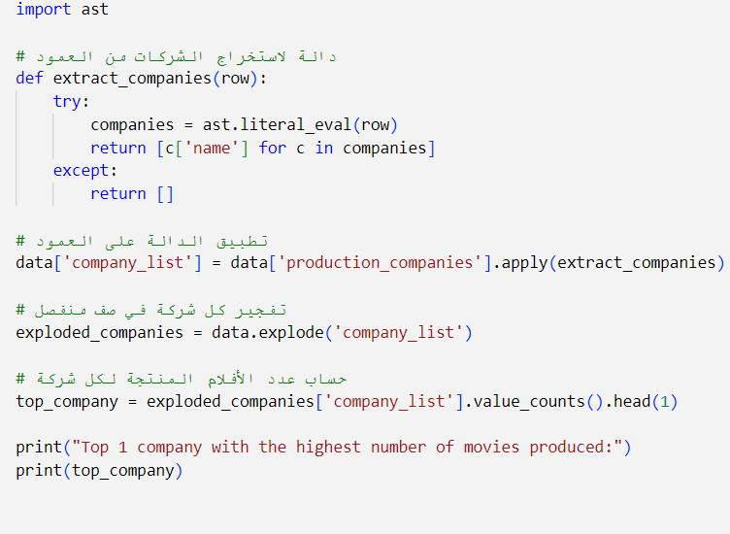

Find the top 1 company with the highest production movies number

Slide 17

Is there any relation between the runtime and average vote value

Slide 18

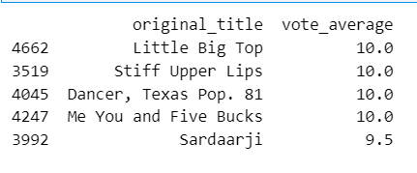
Find the top 5 movies with the highest rate, and find if there anything common between them.

Slide 19


Find the most unsuccessful movie along time in terms of revenue - budget

Slide 20
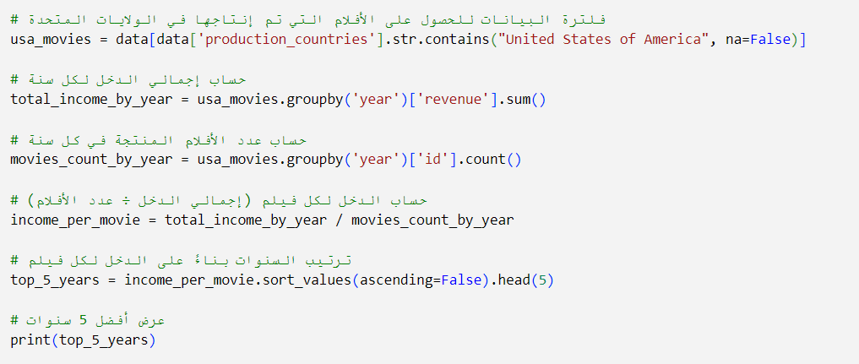
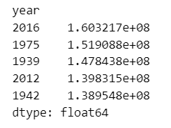
### Find the top 5 successful years for the USA cinema based on the total income devided by number of movies ###

Slide 21


### Find the most succesfull movie in [USA, UK] ###

