Slide 1
ניהול פרויקטים בתוכנה
Software Projects Management
2021
CICD measurements&metrics
דר' הדס שוורץ-חסידים
Notes:
GSMFQQWN2

Slide 2

Agenda
Metrics, measurements &KPIs
Agile measurements
CICD measurements

Slide 3
Measures, Metrics, & Indicators
Metrology- the study of measurement
Measure - A quantitative indication of the extent, amount, dimension, capacity, or size of some attribute of a product or process
Measurement- The act of determining a measure
Metric - A quantitative measure of the degree to which a system, component, or process possesses a given attribute
Indicator -A metric or combination of metrics that provides insight into the software process, a software project, or the product itself

Slide 4
Measures, Metrics, & Indicators
SW engineering Process
Data Collection
Measures
SW Projects
Metrics Computation
Metrics
SW Products
Metrics Evaluation
Indicators

Slide 5
Activities of a Measurement Process
Formulation
The derivation of appropriate software measures and metrics Collection
Accumulate data required to derive the formulated metrics
Analysis
The computation of metrics using also mathematical tools
Interpretation
The evaluation of metrics to gain insight into the quality
Feedback
Recommendations derived from the interpretation of product metrics and passed on to the software development team

Slide 6
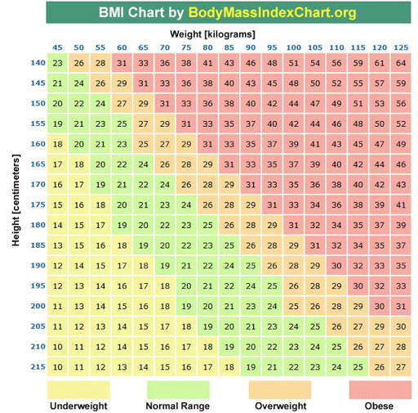

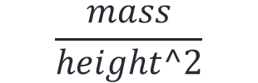
A General Example
Daniel weights 50 kg. Is it a lot?...
How can we know?
Human weight -- can be measured in Kg/pound/Stone/Microgram…
If his height is 140 cm?
If his height is 160 cm?
So, what do we measure?
What are the attributes?
What is the metric?
The chart is our indicator☺
$$\frac{mass}{height^2}$$

Slide 7
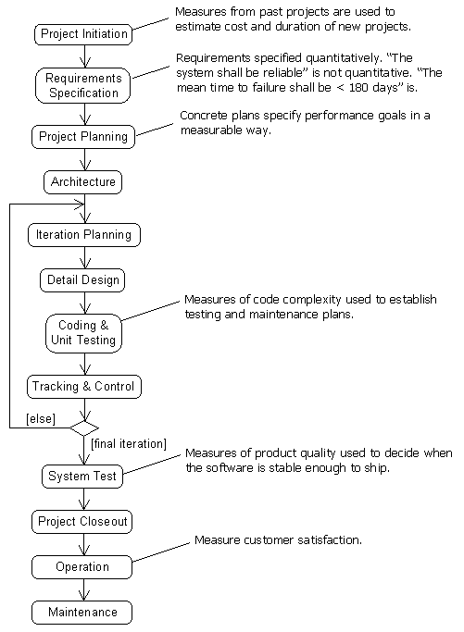
Measurements During the Software Life Cycle

Slide 8

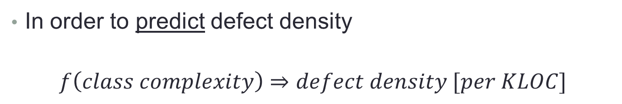
An example
In order to predict defect density
$$f\left(class complexity\right)⇒defect density [per KLOC]$$
e.g., Coupling Between Object (CBO) classes
So in this case- what is the role of f(class complexity)?

Slide 9
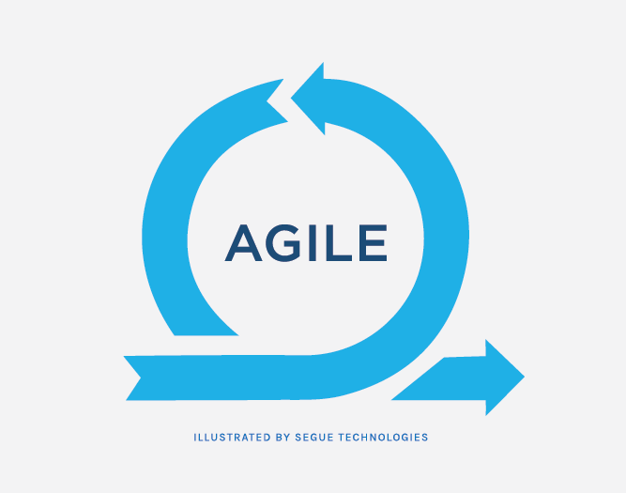


Continuous Activities
The principles of continuous integration can be applied to any iterative programming model in the agile development
Business strategy
Development
Operations
BisDev
DevOps
What are the implications of Continuous Integration (+/-)?
continuous Testing
continuous integration
continuous use
continuous Planning
continuous deployment
continuous trust
continuous delivery
continuous exploration
continuous security
continuous monitor
continuous compliance
continuous Activities

Slide 10
Why to Use Metrics?
To make decisions in business
To challenge team members
Team members can be proud of the results
To determine success
It increases satisfaction
It helps to change the behavior of teammates
What should be measured?

Slide 11

PRODUCT
STRATEGIC
PROCESS
TEST
RESOURCE
CODE
AUTOMATION
ITERATION
PROJECT

Slide 12
Agile Metrics
Product Metrics (size, architecture, structure metrics)
Resource Metrics deal with personnel metrics (effort, etc), software and hardware, and performance metrics.
Process Metrics Maturity, management and life cycle.
Project Metrics: Earned business value, cost, time, quality, risk, ROI, etc.
Strategic metrics (net present value, earned business value, return on investment, etc.)

Slide 13
Agile Metrics
Engineer metrics (scope burn up, cost per iteration)
Test metrics (unit tests per user story, acceptance tests per user story, defect counts per user story, test times to run, time to fix tests, escaped bugs, etc).
Iteration metrics (velocity based on story points velocity, backlog size, etc).
Automation metrics (code coverage, number of builds per day, number of failed and succeeded builds, etc).
Code metrics (lines of code size, code duplication).
Project management metrics (schedule variance, performance variance, cycle time, etc.)

Slide 14
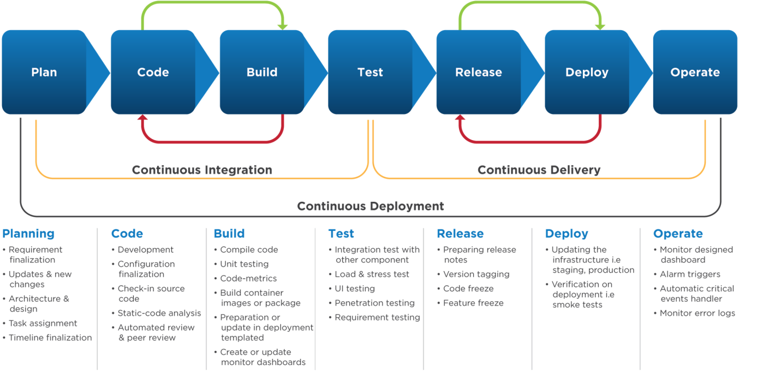
CICD Flow Train –Reminder

Slide 15
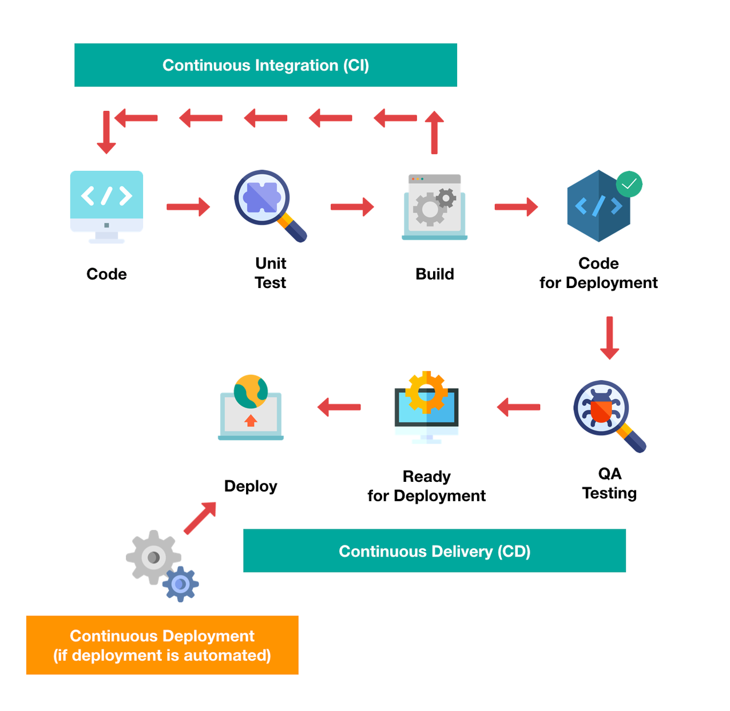




Slide 16
What Goals To Achieve in CI
Reduce build and test time
Increase visibility and awareness on build and test results in ci
Support (semi-) automated continuous testing
Detect violations, flaws and faults in the CI
Address security and scalability issues in deployment pipeline
Improve dependability and reliability of deployment process

Slide 17
Factors for a Good DevOps Metric?
Obtainable: A metric that can't be measured is useless.
Incorruptible: It should be free from influence of teams and team members.
Reviewable: It must be relevant to the business and stand up to scrutiny.
Actionable: It should suggest improvements to workflows, policies, incentives, tools, etc.
Traceable: It should be possible to trace the metric to root causes.

Slide 18


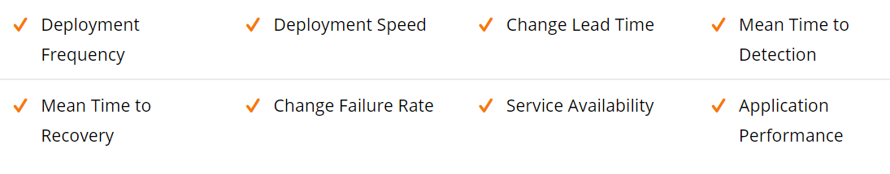
DevOps KPIs to Measure Success
Notes:
הגדרת מטרות כמותיות המסמנות יעדי איכות ותוצאות הוא אחד היעדים המבוקשים להלן רשימה חלקית של נושאים להם עלינו להגדירם
בשקפים הבאים נרד לפירוט יותר באשר לכל אחד מהם.
Deployment Frequency The code deployment frequency provides a picture of how rapidly new features and capabilities roll out in an organization. It should remain stable or trend upward over time. A decrease could indicate a bottleneck somewhere within the DevOps team structure. The capacity to make code changes quickly, and effortlessly is a critical competitive advantage for a company that needs to deliver new features speedily to customers.
Deployment Speed The deployment speed shows how long it takes for a specific deployment to move from commit to code, which is successfully running in production. Businesses with better deployment speed can increase revenue by using that extra time to develop more value-added services
Change Lead Time The change lead time is the time it takes a change, e.g., a bug fix or new feature to move from inception to production. The lengthy lead times means inefficient processes that inhibit change implementations.
Mean Time to Detection The average time between deployment and discovering the first failure in a production environment. A low change failure rate is not good enough if it takes too long to detect a problem. If MTTD is decreasing over time, then it's a healthy sign and shows that an organization’s DevOps processes are mature.
Mean Time to Recovery The average time between an environment's crash and recovery in production. DevOps businesses follow the principle that frequent, incremental changes are easier to deploy and fix when something goes wrong. The potential to recover swiftly can make a huge difference to business results.
Change Failure Rate Changes must roll out without a hitch. DevOps keeps the failure rate for changes deployed into production applications as low as possible. The cost of critical application failure could be in millions per hour & failed deployments can take services down, consequently lost revenue and frustrated customers.
Service Availability Application uptime is crucial for every IT organization. Service-level agreements (SLAs) require that the infrastructure, services & supporting applications meet a high goal of availability. Services should be available with an uptime goal as high as 99.99%.
Application Performance Storage blockage, CPU spikes, high memory consumption & network latency are the side effects of a surge in application usage. It is important to monitor these standard performance aspects of the servers that support an application. If the performance declines without additional user requests, then it could be due to bugs or inefficient changes from development and release that are bogging down the app.

Slide 19
CICD Metrics
1. Response to customer change -number of user stories added and removed based on customer priority and preference change
2. Pre/post release defect density
3. Error rates
Tracking error rates during development (%of user stories)
Bugs – Identify new exceptions being thrown in your code after a deployment (number, per severity, priority)
Notes:
Response to customer change indicate the flexibility of the projects and the ability to accept/implement changes.
Internally-visible quality (Bugs prior deployment)
Externally-visible quality (detected by customer)

Slide 20
CICD Metrics
4. Automated tests pass (%)
To increase velocity, it is highly recommended that your team makes extensive usage of unit and functional testing automatic.
5. Availability
Tracking the downtime as part of scheduled maintenance {tracking planned & unplanned outages}.

Slide 21
CICD Measurements- Customer
6. Defect escape rate
How many software defects are being found in production versus QA (escaped defects rate%)
7. Customer tickets
The best and worst indicator of application problems is customer support tickets and feedback.
8. Customer satisfaction

Slide 22
CICD Metrics
9. Deployment Frequency
Tracking how often you do deployments {smaller deployments as often as possible}.
Separating the production and non-production deployments
How often you deploy to QA or pre-production environments {deployment should be early}

Slide 23
CICD Metrics
10. Deployment Time/Lead Time
Tracking how long it takes to do an actual deployment {identify potential problems}
Lead time as the amount of time that occurs between starting on a work item until it is deployed.
11. Velocity –per iteration time to complete a user story (or more)
12. Sprint time

Slide 24
Measurements- Application Performance
13. After a deployment usage
examine major changes in the usage of specific SQL queries, web service calls, and other application dependencies .
Tools like Retrace can provide valuable visualizations that helps make it easy to spot problems.
Proportion of CICD in the project

Slide 25
Metrics for Detection & Recovery
14. Mean time to detection (MTTD)
Having robust application monitoring and good coverage enables to detect and fix issues
15. Mean time to recovery (MTTR)
This metric helps you track how long it takes to recover from failures. A key metric for the business is keeping failures to a minimum and being able to recover from them quickly (work hours)
Notes:
Mean time to detection (MTTD)
When problems do happen, it is important that you identify them quickly. The last thing you want is to have a major partial or broad system outage and not know about it. Having robust application monitoring and good coverage in place will help you detect issues quickly. Once you detect them, you also have to fix them quickly!
Mean time to recovery (MTTR)
This metric helps you track how long it takes to recover from failures. A key metric for the business is keeping failures to a minimum and being able to recover from them quickly. It is typically measured in hours and may refer to business hours, not clock hours.
Having good application monitoring tools in place to quickly identify issues and quickly deploy the fix is important to reducing your MTTR.

Slide 26
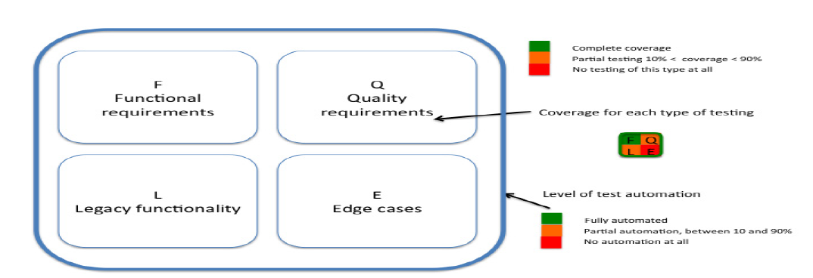
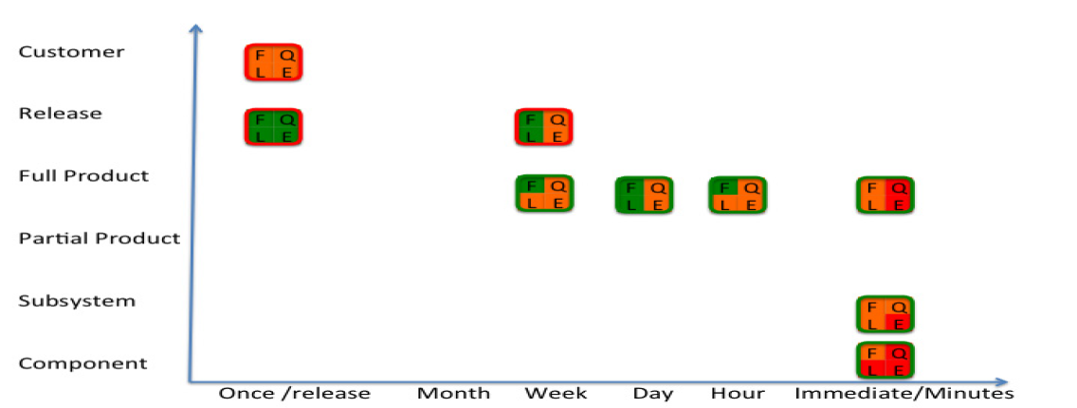
Visualization- Dashboard
Nilsson, Agneta, Jan Bosch, and Christian Berger. "Visualizing testing activities to support continuous integration: A multiple case study." International Conference on Agile Software Development. Springer, Cham, 2014.
Notes:
המשוב על בסיס זמן-תדירות הבדיקות ותכולה
Based on the work of
Nilsson, Agneta, Jan Bosch, and Christian Berger. "Visualizing testing activities to support continuous integration: A multiple case study." International Conference on Agile Software Development. Springer, Cham, 2014.

Slide 27
Plan Your CI Process-suggestions…
Do you perform unit testing sporadically, periodically, or continually?
How often do you run your full unit, component, and system test coverage review?
Are you continuously performing automated design reviews with tools like JDepend and NDepend?
Are you automating code audits with tools like PMD, Checkstyle
Are you monitoring code duplication/coverage/complexity?
Do you know what percentage of your code has CI?
Is your build properly configured to produce coverage reports?

Slide 28
Automation of the Testing
Unit test
Integration test
More than one module
Sub system
Component
Example (Jira)
Sprint initiation
Issue
Reports (burn down chart)

Slide 29
ניהול פרויקטים בתוכנה
Software Projects Management
2020
CICD measurements
דר' הדס שוורץ-חסידים
Notes:
GSMFQQWN2

