Slide 1
Dubai Health
USE CASE
Detecting Performance Risks
Before They Reach Production
AI-Assisted
Code
Performance/Review
Analysis
Using artificial intelligence to analyze source code and identify
performance inefficiencies before they impact production systems.
Safaa Soliman
Dubai Health Authority
Performance
AI Review
API Quality
Security

Slide 2
Problem Statement
Dubai Health
Why AI-Assisted Code Performance Analysis?
Our code are a main part of applications, but potential performance issues are not always identified early during development.
Without advanced monitoring or telemetry, teams rely heavily on manual code review and developer experience to detect inefficiencies.
This increases the risk of performance issues, scalability limitations, and delayed optimization after deployment.
⚠ Late Detection
Issues found after deployment
👁 Manual Review
Relies on developer experience
📉 Scale Risk
Scalability limits undetected
⏱ Delayed Fix
Optimization happens too late

Slide 3
Expected Benefits & Key Audience
Dubai Health
Expected Benefits
• Detect performance risks earlier in the development lifecycle
• Reduce manual effort in code review
• Improve code design and implementation quality
• Identify security and performance issues before deployment
• Support developers with AI-powered fix suggestions
• Improve scalability and maintainability of code
• Reduce future troubleshooting and incident response effort
• Enforce Dubai Health coding standards automatically on every PR
• Generate full audit trail for compliance evidence
Key Audience
💻 API Developers
Primary users of AI code review and fix suggestions
🛡 Software Engineers
Benefit from automated quality enforcement
🏗 Technical Leads
Visibility into team code health and DORA metrics
📊 Solution Architects
Architecture-aware rules and compliance evidence
💼 Management
ROI visibility, risk reduction, compliance assurance
Dubai Health — Internal

Slide 4
Top 10 Things AI Can Do in This Use Case
Dubai Health
01
Detect Inefficient Queries
02
Find Missing Pagination
Identify code triggering slow or repeated DB queries (N+1 issues)
Flag endpoints returning very large datasets
03
Highlight Blocking Operations
04
Identify Loops with Repeated Calls
Detect synchronous code slowing request handling
Spot patterns that multiply execution time
05
Review External Dependencies
06
Suggest Caching Opportunities
Highlight inefficient calls to other services
Recommend where caching could reduce repeated work
07
Detect Heavy Payload Risks
08
Identify Poor Memory Processing
Flag large responses or unnecessary data fields
Highlight in-memory filtering done inefficiently
09
Recommend Architecture Improvements
10
Generate Code Review Summaries
Suggest better design patterns for scalability
Structured summary of performance risks found

Slide 5
AI Tools Evaluated
Dubai Health
Two solutions evaluated — presented separately based on Dubai Health’s existing infrastructure and procurement context
🤖 CodeAnt AI
AI-native code health platform
Key strengths:
• AI-native PR review with inline comments
• Custom AI rules in plain English
• DORA metrics and engineering productivity
• Jira auto-ticket creation from findings
• SOC2 Type II + HIPAA compliant
• Quality Gates block unsafe PRs
Context:
New vendor — requires procurement approval. Code reviewed under enterprise contract terms. Richer AI-native features than SonarQube.
📊 SonarQube Enterprise + Azure OpenAI
Existing licensed tool — unlocking AI CodeFix
Key strengths:
• Already licensed — no new procurement needed
• AI CodeFix included in Enterprise license
• Code stays in Dubai Health Azure network
• Fix suggestions in VS Code and IntelliJ IDE
• Nearly 20 years of proven enterprise analysis
• Uses DH’s own Azure OpenAI deployment
Context:
Existing vendor — configuration change only. Zero new vendor approval. Deployable in days. Recommended first step.
Dubai Health — Internal

Slide 6
CodeAnt — Verified Facts for DHA Decision
Dubai Health
Confirmed — Official Docs
Requires Enterprise Contract
SOC 2 Type II + HIPAA + VAPT certified — on official pricing page
Zero code storage — Privacy by design — stated on cybersecurity page
Azure DevOps self-hosted supported — full setup in official docs
Real-time IDE + PR review — documented in CLI and IDE sections
Quality Gates block merge on violations — Premium plan feature
Custom org-wide security rules — Code Governance + .codeant/configuration.json
Air-gapped / offline deployment — Confirmed: official enterprise page + Commvault air-gapped deployment case. prise contract required — contact sales.
Standard plan: code goes to CodeAnt cloud — “Without internet” claim on Slide 4 applies ONLY after Enterprise air-gapped contract is signed. Not default behavior.
On-Prem / VPC deployment — Enterprise plan only (Contact Us pricing). Not in Premium or Free tiers.
DHA Action Required: For UAE/DHA context: HIPAA is a US standard — DHA compliance requires UAE PDPL + ISO 27001 assessment. Obtain DPA + air-gap deployment confirmation from CodeAnt before procurement.on before any code is shared. Reference: codeant.ai/customer-story/commvault

Slide 7
CodeAnt AI
AI Code Health Platform
AI Code Review
AI Code Security
AI Code Quality
Developer 360
• Instant PR Summary
• Contextual PR Chat
• Jira Ticket Scope Match
• Inline AI Review
• AI SAST for PR
• AI Secret Scan for PR
• AI IaC Drift Scan
• Review Insights Dashboard
• CI/CD Review Hook
• Custom AI Review Rules
• AI PR Feedback
• SAST
• IaC & Cloud Misconfig Scanning
• SCA
• End of Life Dependency Detection
• Secret Scanning
• Code Security Gating
• Code Security Dashboard
• PDF Report
• AI Code Security Review
• Security Reporting
• Static Code Analysis
• Code Complexity Analysis
• Code Test Coverage
• AI Analysis
• DORA Metrics
• Organisation Wide Report
• PDF Report
• Custom Rules
• Generate Docstrings
• Dead Code Analysis
• Duplicate Code Analysis
• Code Quality Gates
• AI Developer Summaries
• Contribution Metrics
• Throughput Comparison
• Developer Leaderboard
• Org-Wide Metrics
• CI/CD Pipeline
• Pull Request Analytics

Slide 8
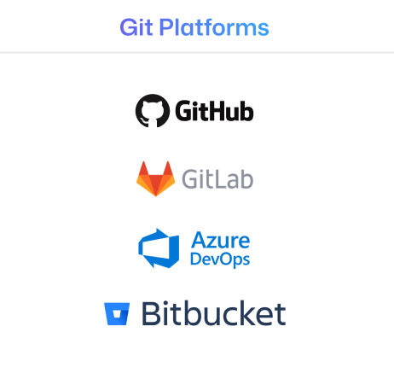
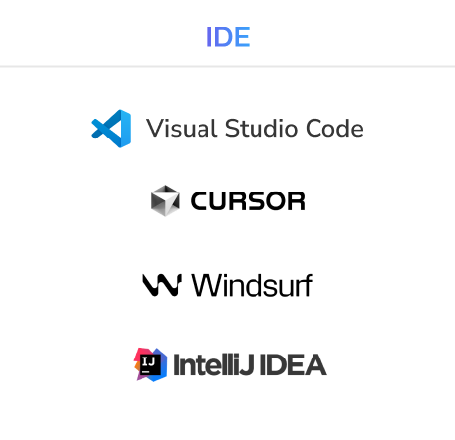
CodeAnt AI
Integrations

Slide 9
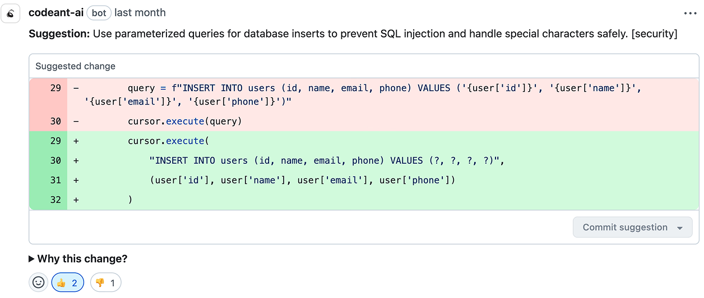
CodeAnt AI
Reduce code review time by up to 50%
Before CodeAnt
• Senior developer reviews every PR manually
• Average review: 45 - 90 minutes per PR
• Security issues caught after merge — expensive to fix
• No enforcement — depends on reviewer knowledge
• Inconsistent standards across the team
After CodeAnt
• AI reviews every PR in 2 - 3 minutes automatically
• Senior developers focus only on flagged critical issues
• Security issues blocked before merge — cheap to fix
• Quality Gates enforce standards automatically
• Every PR reviewed against Dubai Health standards
Result: Senior developers focus on architecture and innovation — not line-by-line code review.
Dubai Health — Internal

Slide 10
Live Demo Results
Dubai Health
⚠ Note: Analysis performed on an intentionally vulnerable open-source ASP.NET Core demo project. This is NOT Dubai Health code. Shown to demonstrate CodeAnt detection capabilities on a C# codebase similar to Dubai Health technology stack.
🛡 Security Findings
5 SQL Injection HIGH | CWE-89 | OWASP A03:2021
5 Sensitive Data Exposure HIGH | EPSS 91.51%
2 CSRF Vulnerabilities MEDIUM | CWE-352
1 Missing Authorization MEDIUM | CWE-862
7 Hardcoded Secrets DB passwords, API keys, JWT
📦 Supply Chain Risk
CVE-2021-26701 CVSS 9.8 | Remote Code Execution
log4net XXE CVSS 9.8 | Critical
⚙ Infrastructure
3 CI/CD Shell Injection Risks GitHub Actions pipeline
📊 Scan Summary
Lines Analyzed: 1,097 lines of C#
Scan Time: Under 3 minutes
Total Issues Found: 22 potential issues
False Positives Removed: 6 (with reasoning)
Confirmed Issues: 16 actionable findings
Signal Ratio: 73% real issues surfaced
🧠 AI Noise Reduction
Each dismissed finding includes transparent AI reasoning explaining why it was filtered. No silent suppression.
Code Quality: 12 antipatterns detected
Packages Scanned: 8 NuGet packages analyzed
Dubai Health — Internal

Slide 11
Understanding EPSS Score
Dubai Health
EPSS = Exploit Prediction Scoring System
The probability that a specific vulnerability will be actively exploited in the wild within the next 30 days. Published daily by FIRST.org using machine learning on real-world threat intelligence data.
91.51%
EPSS Score
Finding: Sensitive Data Exposure
API endpoint returning raw database entity without DTO mapping — exposing internal fields to API consumers.
What 91.51% means:
91.51% of similar vulnerabilities found in other organizations have been actively exploited by attackers within 30 days.
CodeAnt doesn’t just find vulnerabilities.
It tells you which ones attackers are actively targeting right now — so you prioritize the right fixes first.
Dubai Health — Internal

Slide 12
Custom AI Rules — Tailored for Dubai Health
Dubai Health
These rules apply automatically to every pull request — no developer needs to remember them. Every PR is reviewed against Dubai Health standards.
🛡 Security Rules
• Flag any endpoint returning patient data without [Authorize] attribute
• Flag state-changing endpoints missing antiforgery token validation
• Flag any endpoint returning full exception messages to end users
• Flag hardcoded credentials in configuration files or source code
• Flag SQL queries built using string concatenation with user input
• Flag API responses returning raw database entities without DTO mapping
⚡ Performance Rules
• Flag database queries executing inside loops (N+1 pattern)
• Flag synchronous blocking calls in async ASP.NET Core controllers
• Flag API endpoints returning unbounded datasets without pagination
• Flag deprecated WebClient usage instead of HttpClient
• Flag missing CancellationToken on long-running operations
• Flag methods with multiple sequential database round trips
• Flag SELECT * queries without WHERE clause or row limit
Dubai Health — Internal

Slide 13
SonarQube Enterprise: Unlocking AI You Already Own
Dubai Health
✅ Dubai Health already has SonarQube Enterprise — AI CodeFix is included in that license and has never been enabled
What AI CodeFix Does
• SonarQube finds an issue in your C# code
• Developer clicks “Generate AI Fix” button
• AI generates a complete code fix in seconds
• Developer clicks “Open in IDE” → fix appears in VS Code
• Developer reviews, accepts, and commits
Supported Languages
C# ✓ Java ✓ JavaScript ✓ TypeScript ✓
Python ✓ HTML ✓ CSS ✓ C++ ✓
LLM Options
• GPT-5.1 (Sonar hosted — recommended)
• GPT-4o (Sonar hosted)
• Your own Azure OpenAI → code stays in DH network
How to Enable — 3 Steps
Step 1 — Admin enables the feature
Administration → Configuration → General Settings → AI CodeFix → Enable
Step 2 — Select Azure OpenAI as LLM
Enter DH Azure OpenAI endpoint and API key. Code never leaves Dubai Health network.
Step 3 — Developers install SonarQube for VS Code
Connect to SonarQube Server in Connected Mode. AI fix suggestions appear directly inside VS Code. Also available in IntelliJ.
Zero new vendor approvals required.
SonarQube Enterprise is already approved. Azure OpenAI is already approved. This is a configuration change, not a procurement process. 🚀 Roadmap: SonarQube 2026.1 LTA introduced direct IDE agent integration — future capability for deeper IDE querying once approved at Dubai Health.
Dubai Health — Internal

Slide 14
Advanced Architecture: Zero-Trust AI Security Gateway for Dubai Health
Dubai Health
DEVELOPER ZONE
DMZ — ZERO TRUST GATEWAY
TRUSTED ZONE — Private VNet (UAE North)
💻 VS Code
SonarQube Extension
Connected Mode
Intune managed
No SQ token stored
🛡 WAF — Azure App Gateway
Rate limiting • TLS termination
OWASP rules • IP allowlist
TRUST BOUNDARY
📊 SonarQube
Enterprise DC
Private subnet
Azure AD SAML
🔑 Key Vault
Service tokens
Rotated 24h
No dev access
JWT+HTTPS
Verified
🔒 AI SECURITY GATEWAY
✔ JWT Verify (Azure JWKS)
✔ RBAC engine (by AD claim)
✔ DLP Engine (regex + ML)
✔ Audit log → Sentinel
Azure Container Apps (UAE North)
✨ Azure OpenAI — Private Endpoint
UAE North • codefix-model • GPT-4o
Zero retention • BAA signed • No public internet
🔍 Azure Sentinel SIEM (UAE North)
All proxy logs • DLP alerts • Anomaly detection
What the AI Security Gateway Does — and Why It’s Essential
✔ SonarQube token NEVER touches a developer machine
✔ DLP engine intercepts secrets in code snippets BEFORE they reach Azure OpenAI
✔ Every AI request logged: developer ID, project, DLP verdict, issue IDs
✔ RBAC prevents developers from accessing projects outside their scope
✔ Key rotation every 24h — breach window minimized
Built on Azure Container Apps (UAE North). No Cursor, Windsurf, or cloud AI IDEs permitted.
Implementation Roadmap (18 weeks)
P1 Wk 1–4: Foundation — Azure AD, VS Code managed, SonarQube Enterprise DC (private subnet UAE North)
P2 Wk 5–10: AI Security Gateway — JWT, RBAC, DLP, Key Vault token rotation, Sentinel logging
P3 Wk 11–14: Azure OpenAI private endpoint, managed identity, Microsoft BAA, red team exercise
P4 Wk 15–18: IDE rollout — internal VS Code extension, MDM push, security training
Non-Negotiable Requirements: No code sent to Sonar-hosted AI without CISO sign-off • All AI changes require human review before merge • Every AI request individually logged • Azure OpenAI: zero retention + Microsoft BAA before activation • Developer machines NEVER hold SonarQube service tokens
Architecture: Zero-Trust AI Security Gateway • SonarQube Enterprise DC • Azure OpenAI Private Endpoint • Azure Sentinel SIEM • All components: UAE North

Slide 15
SonarQube AI CodeFix — Developer Experience in VS Code (Connected Mode)
Dubai Health
SONARQUBE ISSUES (3)
──────────────────
✘ HIGH ✨
SQL Injection
HomeController.cs:37
──────────────────
✘ HIGH ✨
Hardcoded Secret
appsettings.json:8
──────────────────
⚠ MED ✨
Missing [Authorize]
HomeController.cs:75
──────────────────
✨ = AI CodeFix available
// HomeController.cs line 35-42
[HttpGet]
public IActionResult SearchPatient(string name) {
REFACTOR PREVIEW ✨
- var q = "SELECT * FROM Patients"
- + " WHERE Name='" + name + "'";
+ var q = "SELECT * FROM Patients
+ WHERE Name = @name";
+ cmd.Parameters.AddWithValue(
+ "@name", name);
[ ✔ Apply ] [ ✘ Discard ]
RULE | AI CODEFIX ✨
────────────────
csharpsquid:S3649
SQL Injection Risk
Severity: HIGH | Security
SQL query built using string concatenation with user input. Replace with parameterized query to prevent injection attacks.
────────────────
[ ✨ Generate Fix ]
Using: DH Azure OpenAI sonar-demo-openai codefix-model (GPT-4.1)
Code stays in DH network ✔
✓ SonarQube Connected: DH SonarQube Enterprise | LLM: sonar-demo-openai / codefix-model | C# | Ln 37
Workflow: SonarQube flags issue in IDE → Developer clicks ✨ Generate Fix → Azure OpenAI generates parameterized query → Developer clicks Apply → Issue resolved. Code never left Dubai Health network.

Slide 16
Data Sovereignty: Why Azure OpenAI Matters
Dubai Health
Option A — Using Sonar’s LLM
Data flow:
Code snippets → api.sonarqube.io → Sonar’s GPT-5.1 → fix returned
Characteristics:
• Easiest to set up — no config needed
• Monthly usage limits apply
• Code snippets leave Dubai Health network
• Requires DPA review for healthcare compliance
Verdict: Not recommended for Dubai Health
Patient data context in code snippets may violate UAE PDPL and DHA data governance policies.
Option B — Your Own Azure OpenAI ✅
Data flow:
Code snippets → DH Azure OpenAI (sonar-demo-openai) → fix returned
Characteristics:
• Code never leaves Dubai Health network
• Uses DH’s own Azure subscription — already approved
• No monthly limits — rate limits only from DH’s own Azure
• Full control — DH owns the endpoint and the data
• No new DPA needed — Microsoft already signed
Already provisioned:
Resource: sonar-demo-openai (East US) ⚠ For full UAE data residency compliance, move to UAE North Azure region
Deployment: codefix-model (GPT-4.1) ✓ Succeeded
Verdict: Recommended for Dubai Health
Dubai Health — Internal

Slide 17
Solution Comparison: Two Approaches for Dubai Health
Dubai Health
Criteria
🤖 CodeAnt AI
Enterprise / VPC / Air-gapped
📊 SonarQube + Azure OpenAI
Already licensed — Enable AI CodeFix
New vendor approval?
⚠ Yes — Enterprise contract required
✔ No — Already using SonarQube Enterprise
Code leaves DH network?
✔ No — On-prem / VPC deployment
✔ No — Stays in DH Azure tenant
Additional licensing cost?
⚠ Yes — Enterprise subscription (contact sales)
✔ No — AI CodeFix included in Enterprise license
UAE PDPL cross-border risk?
✔ Eliminated — On-prem / VPC deployment
✔ Eliminated — DH Azure tenant (BYO model)
DHA AI Policy approval?
⚠ Required — Any AI tool needs DHA governance
⚠ Required — Any AI tool needs DHA governance
AI PR review (inline comments)?
✔ Yes — Native AI-native feature
⚠ Alpha — Sonar Review (2026, not GA yet)
AI fix suggestions in IDE?
✔ Yes — Fix in IDE (VS Code + IntelliJ)
✔ Yes — Generate AI Fix button (VS Code + IntelliJ)
Engineering metrics / DORA?
✔ Yes — Full DORA dashboard built-in
➖ Not included — Use Azure DevOps analytics
Implementation time?
⚠ 2–4 weeks — Procurement + deployment setup
✔ Days — Configuration change only
🎯 Recommendation: Phase 1 — Enable SonarQube AI CodeFix now (zero friction, days to deploy). Phase 2 — Pilot CodeAnt for AI-native PR review and DORA metrics.
Dubai Health — Internal

Slide 18
Recommended Next Steps for Dubai Health
Dubai Health
✔ Phase 1 — Do This Now
SonarQube Enterprise + Azure OpenAI
Timeline: Days — Configuration change only
Action items:
① Confirm DH SonarQube version is 2025.1+ (Enterprise)
② Admin enables AI CodeFix: Administration → Configuration → General Settings → AI CodeFix → Enable
③ Select BYO Azure OpenAI → enter sonar-demo-openai endpoint + API key
④ Whitelist outbound to api.sonarqube.io (for prompt templates)
⑤ Developers install SonarQube for VS Code + Connected Mode
⑥ Submit DHA AI governance notification (required for any AI tool)
⑦ Move Azure OpenAI resource to UAE North region for full data residency
✔ No new vendor. ✔ No new budget. ✔ Code stays in DH network.
📊 Phase 2 — Evaluate in Parallel
CodeAnt AI Enterprise / VPC Pilot
Timeline: 2–4 weeks — Procurement + VPC setup
Action items:
① Contact CodeAnt sales — request Enterprise VPC/air-gap quote
② Confirm: LLM model used in air-gap mode (contractual NDA/DPA)
③ Request VPC deployment inside DH Azure subscription (UAE North)
④ Run 2-week pilot on one real internal project with Azure DevOps
⑤ Measure: PR review quality, DORA metrics, Jira integration value
⑥ Submit DHA AI governance approval for CodeAnt (required)
⑦ Sign DPA with no-training clause + UAE PDPL compliance confirmation
Evaluate for: AI-native PR review, DORA metrics, engineering productivity.
Dubai Health — Internal

Slide 19
Secure Implementation in a Government Environment
Dubai Health
🏢
Private Enterprise Only
🚫
No Public AI Tools
Use AI exclusively within DH private infrastructure. DHA AI Policy (2021) governance approval required before any AI tool deployment.
Do not upload code to public AI tools. Enterprise on-prem or VPC deployment required. Ensure DPA and air-gap contract in place.
🔒
Mask Sensitive Data
🔑
Exclude Credentials
Mask org names, URLs, tokens, secrets, and connection strings
Exclude production credentials and sensitive config files
✋
Human Approval Required
📋
Audit Logging
AI suggestions and fix proposals require developer review and explicit approval before applying. No automatic merges without human decision.
Record and keep a trace of every code review activity done by the AI for (accountability , traceability)

