Slide 1
Dubai Health
USE CASE
Detecting Performance Risks
Before They Reach Production
AI-Assisted
Code
Performance/Review
Analysis
Using artificial intelligence to analyze source code and identify
performance inefficiencies before they impact production systems.
Safaa Soliman
Dubai Health Authority
Performance
AI Review
API Quality
Security

Slide 2
Problem Statement
Dubai Health
Why AI-Assisted Code Performance Analysis?
Our code are a main part of applications, but potential performance issues are not always identified early during development.
Without advanced monitoring or telemetry, teams rely heavily on manual code review and developer experience to detect inefficiencies.
This increases the risk of performance issues, scalability limitations, and delayed optimization after deployment.
⚠ Late Detection
Issues found after deployment
👁 Manual Review
Relies on developer experience
📉 Scale Risk
Scalability limits undetected
⏱ Delayed Fix
Optimization happens too late

Slide 3
Expected Benefits & Key Audience
Dubai Health
Expected Benefits
• Detect performance risks earlier in the development lifecycle
• Reduce manual effort in code review
• Improve code design and implementation quality
• Identify security and performance issues before deployment
• Support developers with AI-powered fix suggestions
• Improve scalability and maintainability of code
• Reduce future troubleshooting and incident response effort
• Enforce Dubai Health coding standards automatically on every PR
• Generate full audit trail for compliance evidence
Key Audience
💻 API Developers
Primary users of AI code review and fix suggestions
🛡 Software Engineers
Benefit from automated quality enforcement
🏗 Technical Leads
Visibility into team code health and DORA metrics
📊 Solution Architects
Architecture-aware rules and compliance evidence
💼 Management
ROI visibility, risk reduction, compliance assurance
Dubai Health — Internal

Slide 4
Top 10 Things AI Can Do in This Use Case
Dubai Health
01
Detect Inefficient Queries
02
Find Missing Pagination
Identify code triggering slow or repeated DB queries (N+1 issues)
Flag endpoints returning very large datasets
03
Highlight Blocking Operations
04
Identify Loops with Repeated Calls
Detect synchronous code slowing request handling
Spot patterns that multiply execution time
05
Review External Dependencies
06
Suggest Caching Opportunities
Highlight inefficient calls to other services
Recommend where caching could reduce repeated work
07
Detect Heavy Payload Risks
08
Identify Poor Memory Processing
Flag large responses or unnecessary data fields
Highlight in-memory filtering done inefficiently
09
Recommend Architecture Improvements
10
Generate Code Review Summaries
Suggest better design patterns for scalability
Structured summary of performance risks found

Slide 5
AI Tools Evaluated
Dubai Health
Two solutions evaluated — presented separately based on Dubai Health’s existing infrastructure and procurement context
🤖 CodeAnt AI
AI-native code health platform
Key strengths:
• AI-native PR review with inline comments
• Custom AI rules in plain English
• DORA metrics and engineering productivity
• Jira auto-ticket creation from findings
• SOC2 Type II + HIPAA compliant
• Quality Gates block unsafe PRs
Context:
New vendor — requires procurement approval. Code reviewed under enterprise contract terms. Richer AI-native features than SonarQube.
📊 SonarQube Enterprise + Azure OpenAI
Existing licensed tool — unlocking AI CodeFix
Key strengths:
• Already licensed — no new procurement needed
• AI CodeFix included in Enterprise license
• Code stays in Dubai Health Azure network
• Fix suggestions in VS Code and IntelliJ IDE
• Nearly 20 years of proven enterprise analysis
• Uses DH’s own Azure OpenAI deployment
Context:
Existing vendor — upgrade from Developer to Enterprise Edition required for AI CodeFix. Budget approval, license upgrade, and DH Azure OpenAI provisioning needed before AI features are available.
Dubai Health — Internal

Slide 6
CodeAnt — Verified Facts for DHA Decision
Dubai Health
Confirmed — Official Docs
Requires Enterprise Contract
SOC 2 Type II + HIPAA + VAPT certified — on official pricing page
Zero code storage — Privacy by design — stated on cybersecurity page
Azure DevOps self-hosted supported — full setup in official docs
Real-time IDE + PR review — documented in CLI and IDE sections
Quality Gates block merge on violations — Premium plan feature
Custom org-wide security rules — Code Governance + .codeant/configuration.json
Air-gapped / offline deployment — Confirmed: official enterprise page + Commvault air-gapped deployment case. prise contract required — contact sales.
Standard plan: code goes to CodeAnt cloud — “Without internet” claim on Slide 4 applies ONLY after Enterprise air-gapped contract is signed. Not default behavior.
On-Prem / VPC deployment — Enterprise plan only (Contact Us pricing). Not in Premium or Free tiers.
DHA Action Required: For UAE/DHA context: HIPAA is a US standard — DHA compliance requires UAE PDPL + ISO 27001 assessment. Obtain DPA + air-gap deployment confirmation from CodeAnt before procurement.on before any code is shared. Reference: codeant.ai/customer-story/commvault

Slide 7
CodeAnt AI
AI Code Health Platform
AI Code Review
AI Code Security
AI Code Quality
Developer 360
• Instant PR Summary
• Contextual PR Chat
• Jira Ticket Scope Match
• Inline AI Review
• AI SAST for PR
• AI Secret Scan for PR
• AI IaC Drift Scan
• Review Insights Dashboard
• CI/CD Review Hook
• Custom AI Review Rules
• AI PR Feedback
• SAST
• IaC & Cloud Misconfig Scanning
• SCA
• End of Life Dependency Detection
• Secret Scanning
• Code Security Gating
• Code Security Dashboard
• PDF Report
• AI Code Security Review
• Security Reporting
• Static Code Analysis
• Code Complexity Analysis
• Code Test Coverage
• AI Analysis
• DORA Metrics
• Organisation Wide Report
• PDF Report
• Custom Rules
• Generate Docstrings
• Dead Code Analysis
• Duplicate Code Analysis
• Code Quality Gates
• AI Developer Summaries
• Contribution Metrics
• Throughput Comparison
• Developer Leaderboard
• Org-Wide Metrics
• CI/CD Pipeline
• Pull Request Analytics

Slide 8
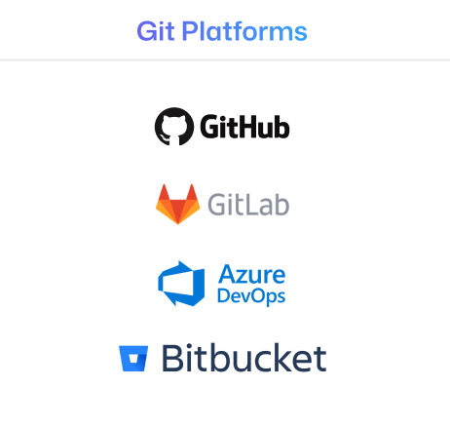
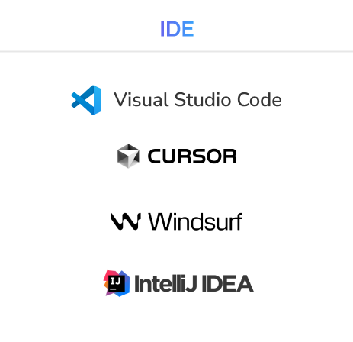
CodeAnt AI
Integrations

Slide 9
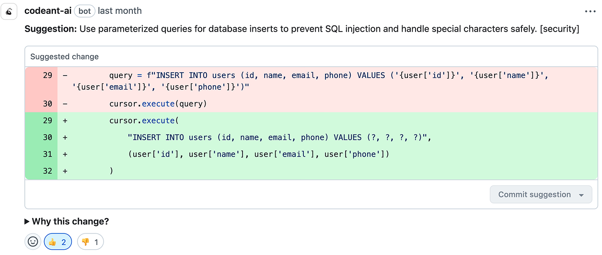
CodeAnt AI
Reduce code review time by up to 50%
Before CodeAnt
• Senior developer reviews every PR manually
• Average review: 45 - 90 minutes per PR
• Security issues caught after merge — expensive to fix
• No enforcement — depends on reviewer knowledge
• Inconsistent standards across the team
After CodeAnt
• AI reviews every PR in 2 - 3 minutes automatically
• Senior developers focus only on flagged critical issues
• Security issues blocked before merge — cheap to fix
• Quality Gates enforce standards automatically
• Every PR reviewed against Dubai Health standards
Result: Senior developers focus on architecture and innovation — not line-by-line code review.
Dubai Health — Internal

Slide 10
Live Demo Results
Dubai Health
⚠ Note: Analysis performed on an intentionally vulnerable open-source ASP.NET Core demo project. This is NOT Dubai Health code. Shown to demonstrate CodeAnt detection capabilities on a C# codebase similar to Dubai Health technology stack.
🛡 Security Findings
5 SQL Injection HIGH | CWE-89 | OWASP A03:2021
5 Sensitive Data Exposure HIGH | EPSS 91.51%
2 CSRF Vulnerabilities MEDIUM | CWE-352
1 Missing Authorization MEDIUM | CWE-862
7 Hardcoded Secrets DB passwords, API keys, JWT
📦 Supply Chain Risk
CVE-2021-26701 CVSS 9.8 | Remote Code Execution
log4net XXE CVSS 9.8 | Critical
⚙ Infrastructure
3 CI/CD Shell Injection Risks GitHub Actions pipeline
📊 Scan Summary
Lines Analyzed: 1,097 lines of C#
Scan Time: Under 3 minutes
Total Issues Found: 22 potential issues
False Positives Removed: 6 (with reasoning)
Confirmed Issues: 16 actionable findings
Signal Ratio: 73% real issues surfaced
🧠 AI Noise Reduction
Each dismissed finding includes transparent AI reasoning explaining why it was filtered. No silent suppression.
Code Quality: 12 antipatterns detected
Packages Scanned: 8 NuGet packages analyzed
Dubai Health — Internal

Slide 11
CodeAnt AI: How It Prioritizes Findings — EPSS Score
Dubai Health
EPSS = Exploit Prediction Scoring System
The probability that a specific vulnerability will be actively exploited in the wild within the next 30 days. Published daily by FIRST.org using machine learning on real-world threat intelligence data.
91.51%
EPSS Score
Finding: Sensitive Data Exposure
API endpoint returning raw database entity without DTO mapping — exposing internal fields to API consumers.
What 91.51% means:
91.51% of similar vulnerabilities found in other organizations have been actively exploited by attackers within 30 days.
CodeAnt doesn’t just find vulnerabilities.
It tells you which ones attackers are actively targeting right now — so you prioritize the right fixes first.
Dubai Health — Internal

Slide 12
CodeAnt AI: Custom Rules — Tailored for Dubai Health
Dubai Health
CodeAnt AI rules — written in plain English, applied on every PR. Demo environment only. Pending DH procurement approval. Note: These are CodeAnt-specific — SonarQube uses a different rule format.
🛡 Security Rules
• Flag any endpoint returning patient data without [Authorize] attribute
• Flag state-changing endpoints missing antiforgery token validation
• Flag any endpoint returning full exception messages to end users
• Flag hardcoded credentials in configuration files or source code
• Flag SQL queries built using string concatenation with user input
• Flag API responses returning raw database entities without DTO mapping
⚡ Performance Rules
• Flag database queries executing inside loops (N+1 pattern)
• Flag synchronous blocking calls in async ASP.NET Core controllers
• Flag API endpoints returning unbounded datasets without pagination
• Flag deprecated WebClient usage instead of HttpClient
• Flag missing CancellationToken on long-running operations
• Flag methods with multiple sequential database round trips
• Flag SELECT * queries without WHERE clause or row limit
Dubai Health — Internal

Slide 13
SonarQube at Dubai Health: Current State & AI Upgrade Path
Dubai Health
⚠ Dubai Health currently has SonarQube Developer Edition. AI CodeFix requires an upgrade to Enterprise Edition.
✔ Developer Edition (Current)
Source: sonarsource.com/plans-and-pricing/sonarqube
✔ 34 languages including C# and all DH stack
✔ Branch analysis and PR decoration (Azure DevOps)
✔ Quality gates — block substandard code in CI/CD
✔ Taint analysis (SQL injection, XSS cross-file tracking)
✔ Secrets detection (400+ patterns)
✔ IDE sync with SonarQube for IDE (VS Code)
✔ Detect issues in AI generated code
✔ DevOps platform integration
✘ AI CodeFix — Enterprise only
✘ Portfolio management — Enterprise only
✘ Security & regulatory reports — Enterprise only
✘ SCIM provisioning (Okta/Azure AD) — Enterprise only
↗ Enterprise Edition (Upgrade Target)
Everything in Developer Edition, plus:
AI Features:
• AI CodeFix — one-click AI fix suggestions in IDE and UI
• LLM options: Sonar GPT-5.1, GPT-5.1, Azure OpenAI, AWS Bedrock, or self-hosted gateway
Governance & Reporting:
• Portfolio management — aggregate all projects in one view
• Security reports (OWASP, CWE Top 25, SANS Top 25)
• Regulatory reports and audit logs
Enterprise Scale:
• 40 languages (adds Apex, COBOL, PL/I, RPG, VB6)
• SCIM provisioning with Okta and Azure AD
• Unlimited DevOps platform integrations
• Custom security engine configuration
• MISRA C++:2023 compliance
• 24/7 white glove support available
Note: Advanced Security (SCA, Advanced SAST, SBOM) is an additional paid add-on available only from Enterprise Edition onwards. Developer Edition cannot access it at any price.
Source: sonarsource.com/plans-and-pricing/sonarqube • Dubai Health — Internal

Slide 14
SonarQube Enterprise: What the Upgrade Unlocks
Dubai Health
All features below verified from official source: sonarsource.com/plans-and-pricing/sonarqube. Enterprise Edition includes everything in Developer Edition, plus the following.
✨ AI Features
AI CodeFix
One-click AI fix suggestions in IDE and SonarQube UI. LLM options confirmed in docs:
• Sonar’s GPT-5.1 (recommended, hosted by Sonar)
• Sonar’s GPT-5.1 (hosted by Sonar)
• Azure OpenAI (BYO — recommended for DH)
• AWS Bedrock (BYO)
• Self-hosted gateway (Ollama, LiteLLM, vLLM)
Supported languages: Java, C#, JavaScript, TypeScript, Python, HTML, CSS, C++
Note: Even with BYO Azure OpenAI, SonarQube still requires outbound internet to Sonar servers for prompt templates. Firewall whitelist needed.
📊 Reporting & Governance
• Portfolio management — aggregate all projects and applications into a single executive view
• Project, application, and executive portfolio reports
• Security reports for common security standards
• Regulatory reports and audit logs
🛡 Security
• Custom configure the security engine for more powerful taint analysis
• Create custom rules to detect private secret patterns
• MISRA C++:2023 compliance
Advanced Security (SCA, SBOM, dependency scanning) is a separate paid add-on available only from Enterprise Edition onwards. Not available in Developer Edition at any price.
🏗 Enterprise Scale
• 40 languages and frameworks (adds Apex, COBOL, JCL, PL/I, RPG, VB6 on top of Developer’s 34)
• Recommended for 1M+ lines of code
• Integrate with unlimited numbers of DevOps platforms
• Consolidate projects into a central instance
👤 Identity & Access
• Automatically provision users and groups through SCIM with Okta and Azure AD
• Set rule priority to uphold your coding standards
• 24/7 white glove support available
• Detailed project health insights
• Pull request decoration and guided setup for monorepos
• Analyze with parallel processing for large teams
Source: sonarsource.com/plans-and-pricing/sonarqube • docs.sonarsource.com • Dubai Health — Internal

Slide 15
AI Input Sanitizer: Protecting Code Before It Reaches the AI
Dubai Health
⚠ The Problem: SonarQube sends the raw code snippet to the AI model without stripping secrets, credentials, or sensitive patterns. The sanitizer sits in between and cleans the snippet first.
📊 SonarQube
Finds security issue
Extracts code snippet
(may contain secrets, passwords, connection strings)
🔒 AI Input Sanitizer
LiteLLM + Microsoft Presidio
✔ Strip connection strings
✔ Strip API keys and tokens
✔ Strip Emirates IDs / MRN
✔ Strip hardcoded passwords
✔ Replace with [REDACTED]
✔ Block prompt injection attempts
✔ Log every request to audit trail
✨ Azure OpenAI
DH tenant
UAE North region
GPT-5.1
Generates AI fix suggestion
⚠ DH approval required
raw snippet
clean snippet
fix returned
✘ Without Sanitizer — What AI Sees
string query = "SELECT * FROM
Patients WHERE Name='" + name;
// Server=prod-dh-db.database.
// windows.net;Password=DHA@123!
Production password exposed to AI model
✔ With Sanitizer — What AI Sees
string query = "SELECT * FROM
Patients WHERE Name='" + name;
// Server=[REDACTED];Password=
// [REDACTED]
✔ SQL injection issue visible. Credentials hidden.
✔ AI fixes the issue without seeing secrets.
Implementation reference: github.com/aisecuritygateway/aisecuritygateway • LiteLLM + Microsoft Presidio (open source) • SonarQube supports LiteLLM as a self-hosted LLM gateway (confirmed in official docs)
Dubai Health — Internal

Slide 16
SonarQube AI CodeFix — Developer Experience in VS Code (Connected Mode)
Dubai Health
SONARQUBE ISSUES (3)
──────────────────
✘ HIGH ✨
SQL Injection
HomeController.cs:37
──────────────────
✘ HIGH ✨
Hardcoded Secret
appsettings.json:8
──────────────────
⚠ MED ✨
Missing [Authorize]
HomeController.cs:75
──────────────────
✨ = AI CodeFix available
// HomeController.cs line 35-42
[HttpGet]
public IActionResult SearchPatient(string name) {
REFACTOR PREVIEW ✨
- var q = "SELECT * FROM Patients"
- + " WHERE Name='" + name + "'";
+ var q = "SELECT * FROM Patients
+ WHERE Name = @name";
+ cmd.Parameters.AddWithValue(
+ "@name", name);
[ ✔ Apply ] [ ✘ Discard ]
RULE | AI CODEFIX ✨
────────────────
csharpsquid:S3649
SQL Injection Risk
Severity: HIGH | Security
SQL query built using string concatenation with user input. Replace with parameterized query to prevent injection attacks.
────────────────
[ ✨ Generate Fix ]
Target state: DH Azure OpenAI (UAE North) — approval + provisioning required
Code stays in DH network ✔
⚠ Target State — Requires: Enterprise Edition upgrade + DH Azure OpenAI approval + AI Security Gateway | C# | Ln 37
Workflow: Target State: SonarQube (Enterprise) flags issue → AI Security Gateway sanitizes snippet → DH Azure OpenAI generates fix → Developer reviews and applies. Requires Enterprise Edition upgrade + DH Azure OpenAI approval.

Slide 17
Data Sovereignty: Why Azure OpenAI Matters
Dubai Health
Option A — Using Sonar’s LLM
Data flow:
Code snippets → api.sonarqube.io → Sonar’s GPT-5.1 → fix returned
Characteristics:
• Easiest to set up — no config needed
• Monthly usage limits apply
• Code snippets leave Dubai Health network
• Requires DPA review for healthcare compliance
Verdict: Not recommended for Dubai Health
Patient data context in code snippets may violate UAE PDPL and DHA data governance policies.
Option B — DH Azure OpenAI ⚠ Approval + Provisioning Required
Data flow:
Code snippets → AI Security Gateway (sanitize) → DH Azure OpenAI (UAE North) → fix returned
Characteristics:
• Code never leaves Dubai Health network
• Uses DH’s own Azure subscription — already approved
• No monthly limits — rate limits only from DH’s own Azure
• Full control — DH owns the endpoint and the data
• Microsoft Azure DPA already covers Azure OpenAI service
To be provisioned by DH (not yet done):
DH must request and provision own Azure OpenAI resource in UAE North region through internal approval process. Production resource must be separate from any POC. for production.
Recommended model: GPT-5.1 or equivalent via Azure OpenAI in UAE North.
Verdict: Recommended path — but DH must obtain their own Azure OpenAI resource and internal approval first
Dubai Health — Internal

Slide 18
Solution Comparison: Two Approaches for Dubai Health
Dubai Health
Criteria
🤖 CodeAnt AI
Enterprise / VPC / Air-gapped
📊 SonarQube + Azure OpenAI
Already licensed — Enable AI CodeFix
New vendor approval?
⚠ Yes — Enterprise contract required
✔ No — Already using SonarQube Enterprise
Code leaves DH network?
✔ No — On-prem / VPC deployment
✔ No — Stays in DH Azure tenant
Additional licensing cost?
⚠ Yes — Enterprise subscription (contact sales)
⚠ Yes — Upgrade Developer → Enterprise + Azure OpenAI provisioning
UAE PDPL cross-border risk?
✔ Eliminated — On-prem / VPC deployment
✔ Eliminated — DH Azure tenant (BYO model)
DHA AI Policy approval?
⚠ Required — Any AI tool needs DHA governance
⚠ Required — Any AI tool needs DHA governance
AI PR review (inline comments)?
✔ Yes — Native AI-native feature
⚠ Alpha — Sonar Review (2026, not GA yet)
AI fix suggestions in IDE?
✔ Yes — Fix in IDE (VS Code + IntelliJ)
✔ Yes — Generate AI Fix button (VS Code + IntelliJ)
Engineering metrics / DORA?
✔ Yes — Full DORA dashboard built-in
➖ Not included — Use Azure DevOps analytics
Implementation time?
⚠ 2–4 weeks — Procurement + deployment setup
⚠ Weeks — Edition upgrade + Azure OpenAI approval + gateway
🎯 Recommendation: Phase 1 — Upgrade SonarQube to Enterprise + obtain DH Azure OpenAI approval + deploy AI Security Gateway. Phase 2 — Pilot CodeAnt for AI-native PR review and DORA metrics.
Dubai Health — Internal

Slide 19
Recommended Next Steps for Dubai Health
Dubai Health
📋 Phase 1 — Prerequisites (4–8 Weeks)
Upgrade SonarQube + Obtain Azure OpenAI Approval
Timeline: 4–8 weeks — Upgrade + approvals + gateway setup
Action items:
① Request SonarQube upgrade: Developer → Enterprise Edition (contact SonarSource sales for pricing)
② Admin enables AI CodeFix: Administration → Configuration → General Settings → AI CodeFix → Enable
③ DH provisions own Azure OpenAI resource in UAE North (sonar-demo-openai is POC only — not for production)
④ Whitelist outbound to api.sonarqube.io (for prompt templates)
⑤ Developers install SonarQube for VS Code + Connected Mode
⑥ Submit DHA AI governance notification (required for any AI tool)
⑦ Move Azure OpenAI resource to UAE North region for full data residency
⚠ Budget required: Enterprise license upgrade + Azure OpenAI resource. ✔ AI Security Gateway sanitizes all code before reaching AI model.
📊 Phase 2 — Evaluate in Parallel
CodeAnt AI Enterprise / VPC Pilot
Timeline: 2–4 weeks — Procurement + VPC setup
Action items:
① Contact CodeAnt sales — request Enterprise VPC/air-gap quote
② Confirm: LLM model used in air-gap mode (contractual NDA/DPA)
③ Request VPC deployment inside DH Azure subscription (UAE North)
④ Run 2-week pilot on one real internal project with Azure DevOps
⑤ Measure: PR review quality, DORA metrics, Jira integration value
⑥ Submit DHA AI governance approval for CodeAnt (required)
⑦ Sign DPA with no-training clause + UAE PDPL compliance confirmation
Evaluate for: AI-native PR review, DORA metrics, engineering productivity.
Dubai Health — Internal

Slide 20
Secure Implementation in a Government Environment
Dubai Health
🏢
Private Enterprise Only
🚫
No Public AI Tools
Use AI exclusively within DH private infrastructure. DHA AI Policy (2021) governance approval required before any AI tool deployment.
Do not upload code to public AI tools. Enterprise on-prem or VPC deployment required. Ensure DPA and air-gap contract in place.
🔒
Mask Sensitive Data
🔑
Exclude Credentials
The AI Security Gateway automatically sanitizes code snippets — stripping secrets, connection strings, and sensitive patterns before reaching the AI model. Developers should additionally avoid committing production credentials to source control.
Exclude production credentials and sensitive config files
✋
Human Approval Required
📋
Audit Logging
AI suggestions and fix proposals require developer review and explicit approval before applying. No automatic merges without human decision.
Record and keep a trace of every code review activity done by the AI for (accountability , traceability)

