Slide 1
HUBSPOT CRM
Existing experience
evaluation
Managing a qualified deal through the pipeline — from review and follow-up to a recorded outcome.
PRODUCT
PRIMARY USER
WORKFLOW
EVALUATOR
HubSpot CRM
Sales representative
Qualified To Buy → Closed Won / Closed Lost
Safa Badamchi
PHASE 1 · FINAL COURSE SUBMISSION
01

Slide 2
PRESENTATION MAP
02
One workflow, traced from action to outcome
The report connects existing behavior, walkthrough evidence, affinity themes, and four priorities.
01
02
03
04
Existing workflow
Cognitive walkthrough
Synthesis
Prioritized findings
→
→
→
What does the representative do now?
What happens at each step?
What patterns repeat across the experience?
What matters most for Phase 2?
SCOPE
One existing qualified deal — from record review through closure. Lead generation, marketing, forecasting, pipeline administration, and post-sale delivery are excluded.
HubSpot CRM · Phase 1
02 / 26

Slide 3
1 · EXISTING WORKFLOW
03
A tightly scoped end-to-end task
One qualified deal: review the record, update it, record activity, follow up, change stage, and close.
PRIMARY USER
USER GOAL
Sales representative managing an existing qualified opportunity in HubSpot CRM
Understand status, update information, record activity, follow up, and respond to new evidence
BEGINNING
ENDING
Qualified To Buy — the representative opens the active deal and assesses what needs attention
Closed Won or Closed Lost — the observed walkthrough ended in Closed Lost
EVALUATION QUESTION
How well does the workflow help the representative understand the current state, take the next action, and trust the recorded outcome?
HubSpot CRM · Phase 1
03 / 26

Slide 4
1 · EXISTING WORKFLOW
04
Seven steps from review to a recorded outcome
The path is linear until the customer does not respond. The October 2 reply was captured later, after the deal had closed.
01
02
03
04
05
06
07
Open & review
Update deal info
Record activity
Contact & follow up
Review response
Advance stage
Close deal
Record open
Amount updated
Activity recorded
Follow-up pending
Response reviewed
Presentation scheduled
Closed Lost
CRITICAL BRANCH
After Closed Lost, the customer replied “move forward.” The reply was recorded in the timeline, but the board, notification centre, and follow-up surfaces remained quiet.
HubSpot CRM · Phase 1
04 / 26

Slide 5
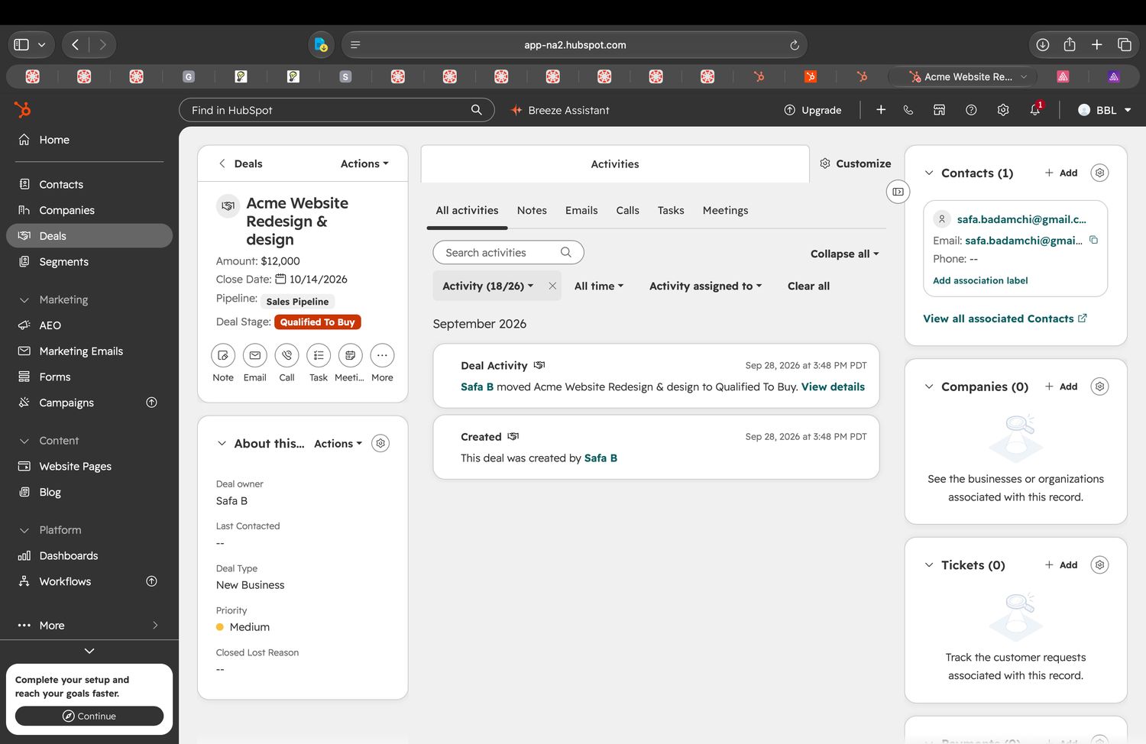
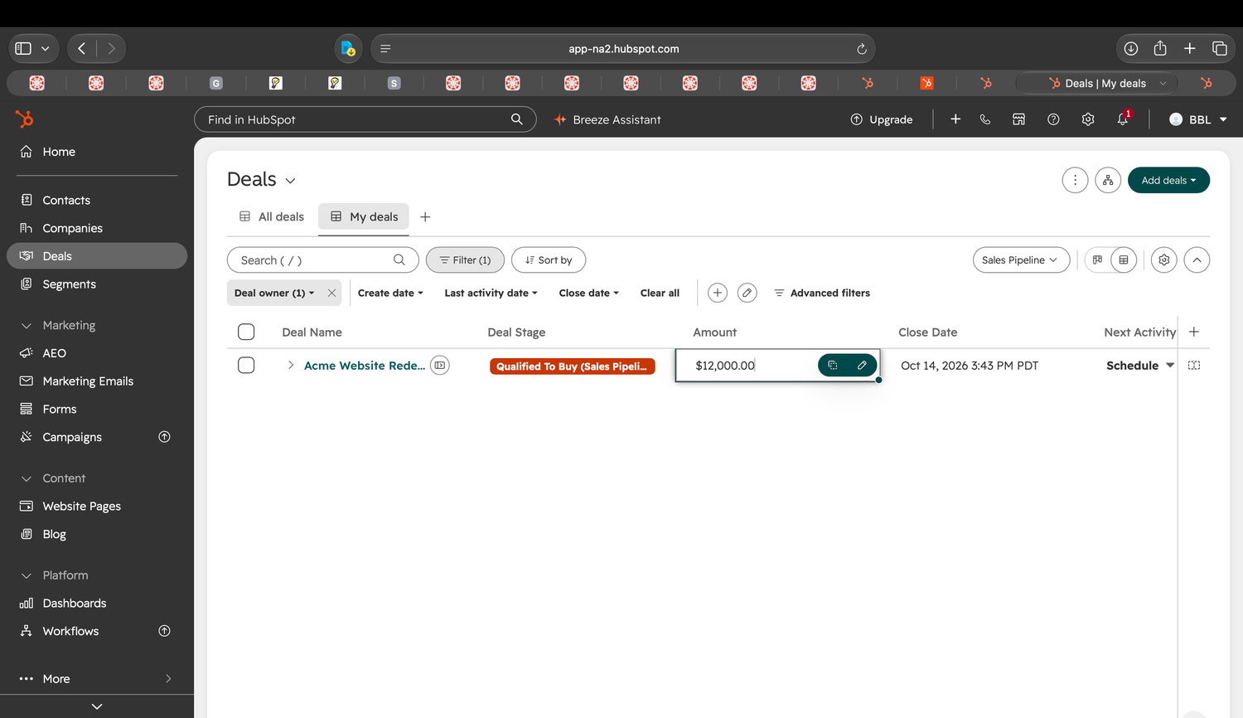
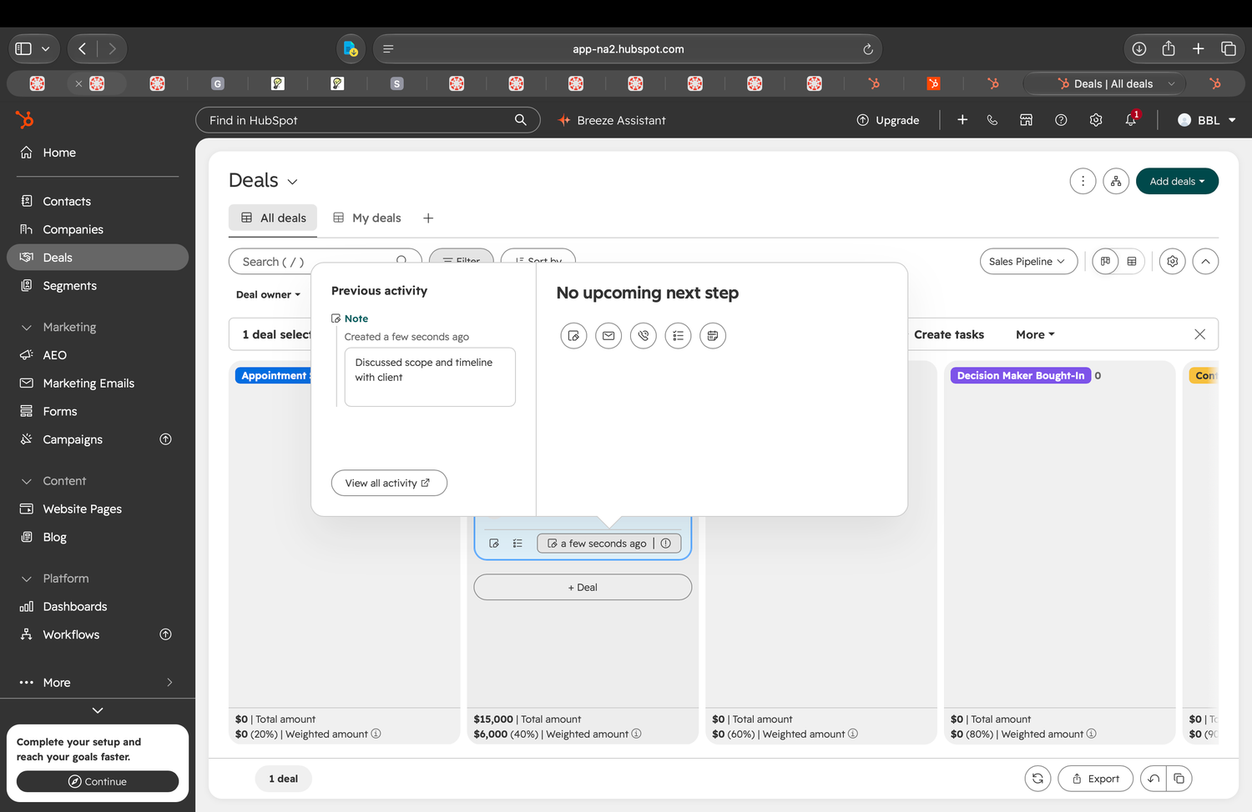
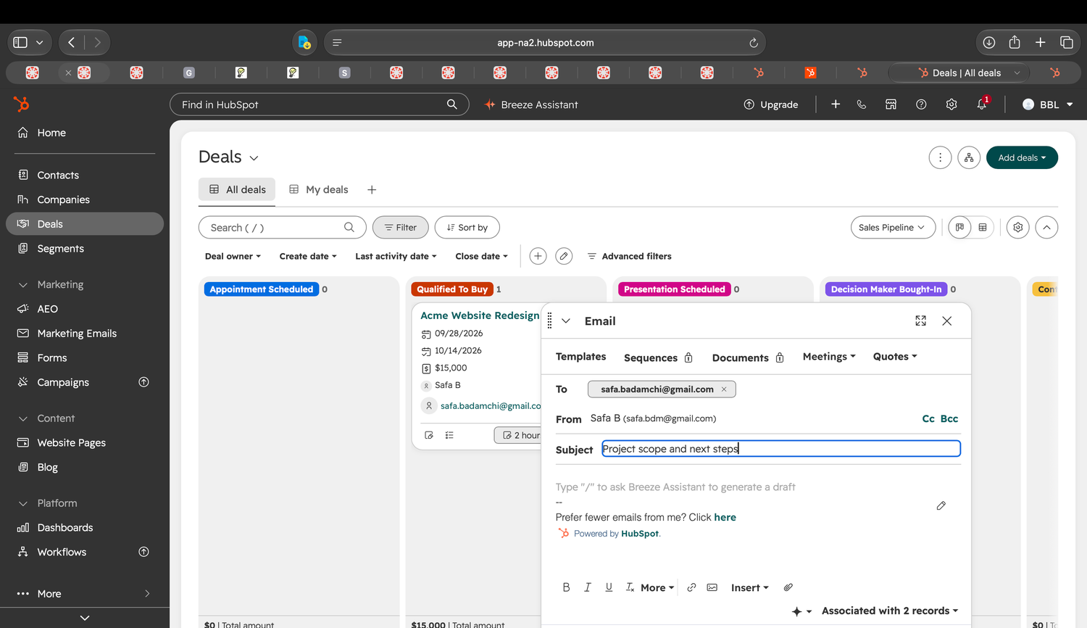
1 · EXISTING WORKFLOW
05
Review, update, record, and follow up
Steps 01–04. Evidence labels from the original workflow map are retained.
01 Open & review
02 Update deal info
03 Record activity
04 Contact & follow up
Open the deal and review stage, amount, activity, and associations.
Update Amount from the Deals table.
Create a note documenting the client conversation.
Send email and select “Create a task to follow up.”
K3
K4–K5
K6
K7–K8
DECISION
DECISION
DECISION
DECISION
Overview / Activities / Emails / Calls
Amount / Close Date / Stage / Owner
Note / Email / Call / Task / Meeting
Create task to follow up / No task
STATE
STATE
STATE
STATE
Qualified To Buy; record open
Qualified To Buy; amount updated
Activity recorded; no next step
Email sent; follow-up pending
RESPONSE
RESPONSE
RESPONSE
RESPONSE
Properties, timeline, and associations are displayed.
The new value is reflected on the deal.
The note appears in the timeline with a timestamp.
A task is created, due in three days, with no reminder.
HubSpot CRM · Phase 1
05 / 26

Slide 6
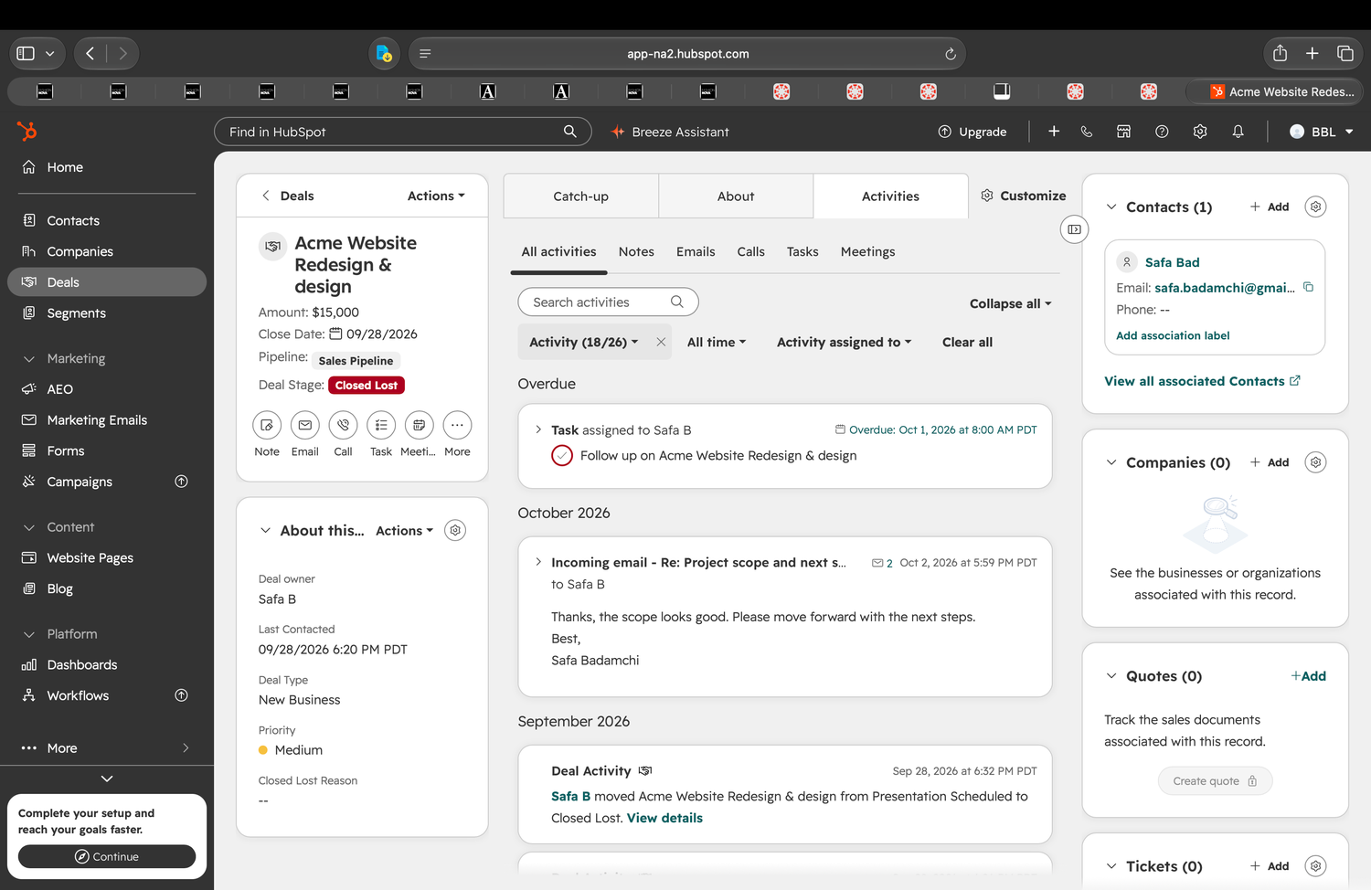
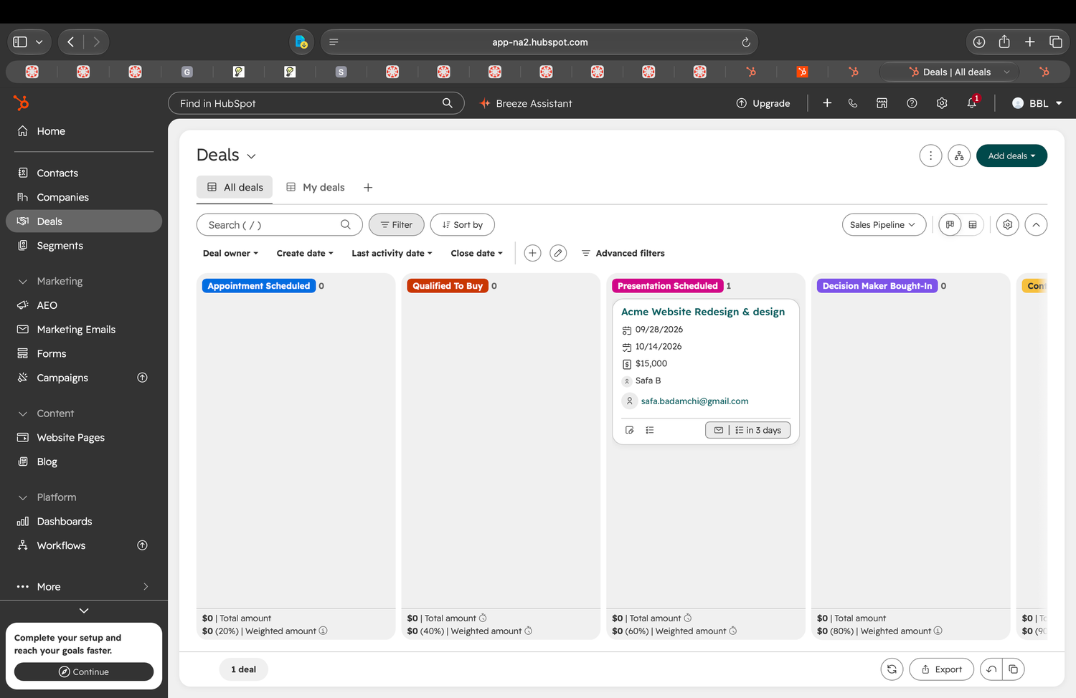
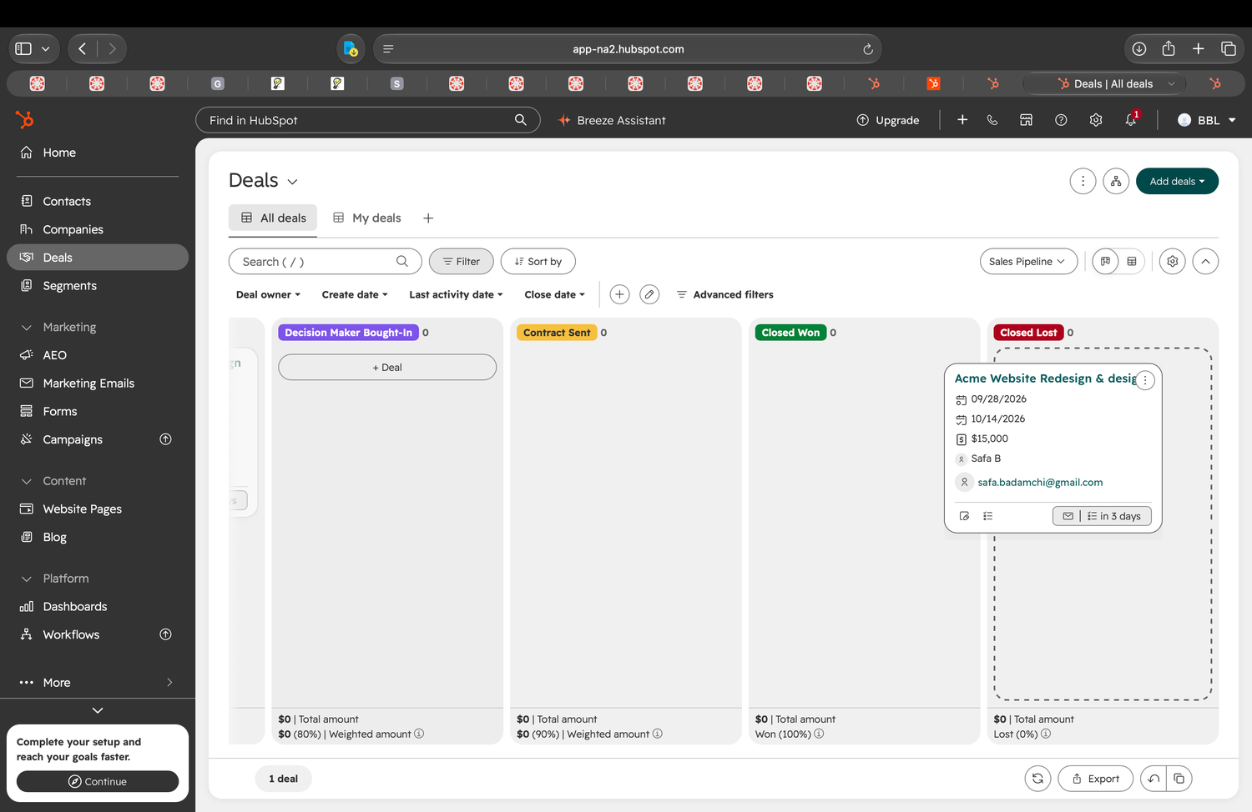
1 · EXISTING WORKFLOW
06
Review the response, advance, and close
Steps 05–07. The response capture belongs to the later post-closure branch, not the original closure sequence.
05 Review response K11
06 Advance stage K9
07 Close deal K10–K12
Review the timeline for a customer response.
Drag the deal to Presentation Scheduled.
Drag the deal to Closed Lost and verify the outcome.
DECISION
DECISION
DECISION
Incoming email / Note / Task
Appointment through Closed Won / Closed Lost
Closed Won / Closed Lost
STATE
STATE
STATE
Awaiting / reviewing response
Presentation Scheduled
Closed Lost; outcome recorded
RESPONSE
RESPONSE
RESPONSE
A reply appears in the timeline when available.
Card position and column counts update.
The stage updates; no confirmation or undo is shown.
No response: step 05 returns to step 04 to follow up again. Observed closure: Closed Lost.
HubSpot CRM · Phase 1
06 / 26

Slide 7
2 · COGNITIVE WALKTHROUGH
07
Evaluate each step from the user’s perspective
At each step: the goal, the visible action, the expected result, the feedback, and where confusion could occur.
01
Goal
Can the representative connect this step to the intended outcome?
02
Action
Is the appropriate action visible and understandable?
03
Expectation
Can the representative predict what the action will do?
04
Feedback
Does the system clearly communicate the resulting state?
05
Risk
Where could friction, uncertainty, or error occur?
Terminology Signposts / Wayfinding · Keep Distances Short · Direct Manipulation · Effectively Invisible Element · Inviting Dead End
HubSpot CRM · Phase 1
07 / 26

Slide 8
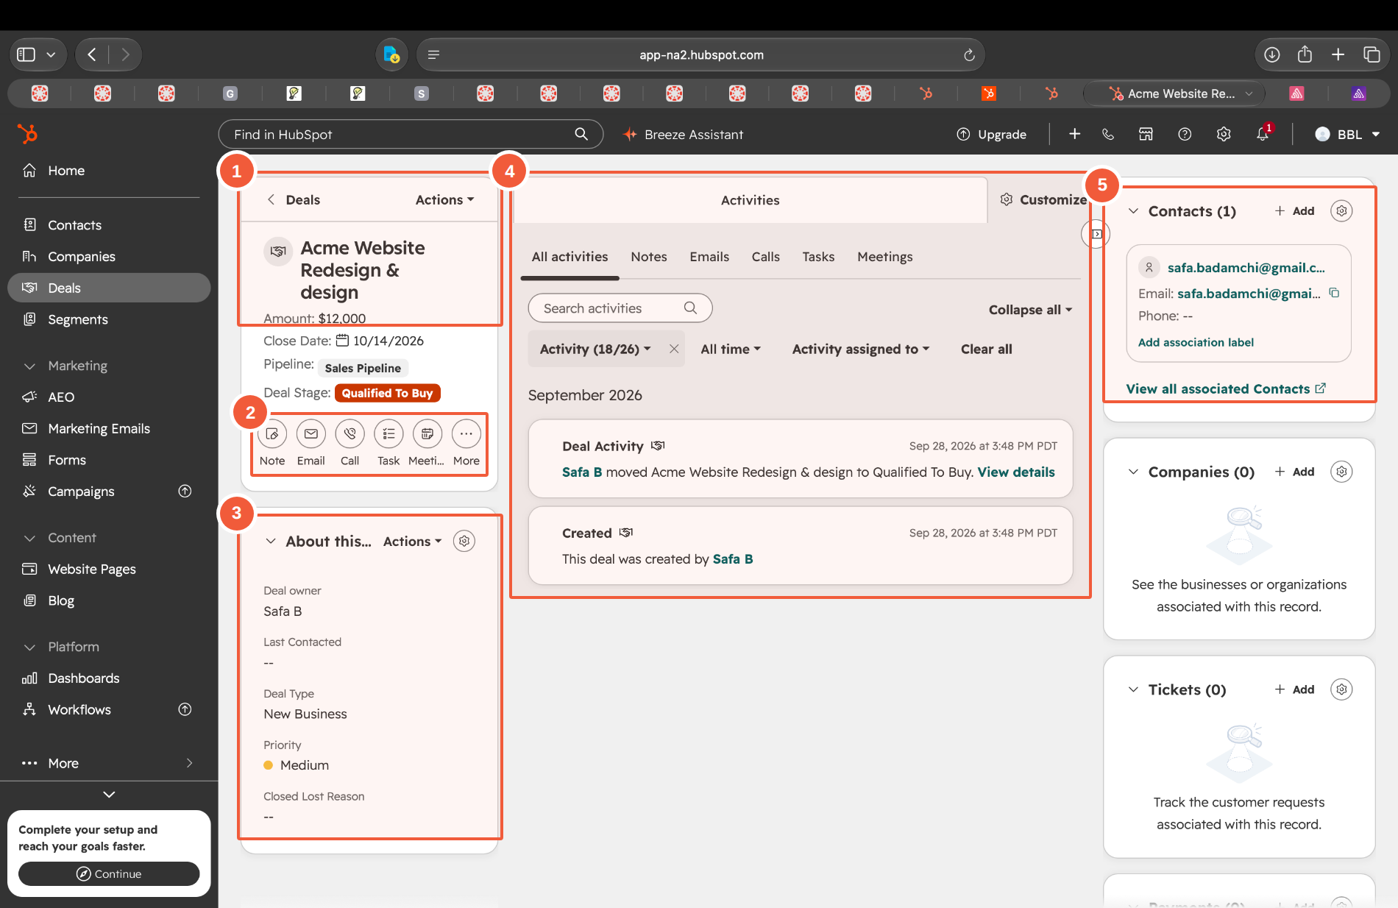
2 · COGNITIVE WALKTHROUGH
08
The deal record: five regions to keep track of
This annotated record locates the main information areas. The walkthrough also uses the Deals table and board.
1
Deal summary
Amount, close date, pipeline, and Deal Stage. Steps 01, 02, 06, and 07 all read or change the deal’s state from here.
2
Activity icon row
Note, Email, Call, Task, Meeting. The only route into steps 03 and 04. These icons are labelled here, but not on the screen in step 03.
3
About this deal
Deal owner, Last Contacted, deal type, priority, Closed Lost Reason. The last two stay blank or stale through the entire walkthrough.
4
Activity timeline
Where the saved note, the sent email, and the October 2 reply all land. Step 05 happens here — the only surface that shows the reply.
5
Contacts panel
The associated contact the email is sent to.
Free tier only. Paid-tier behavior was not tested. The later reply is separate from the original closure.
08 / 26

Slide 9
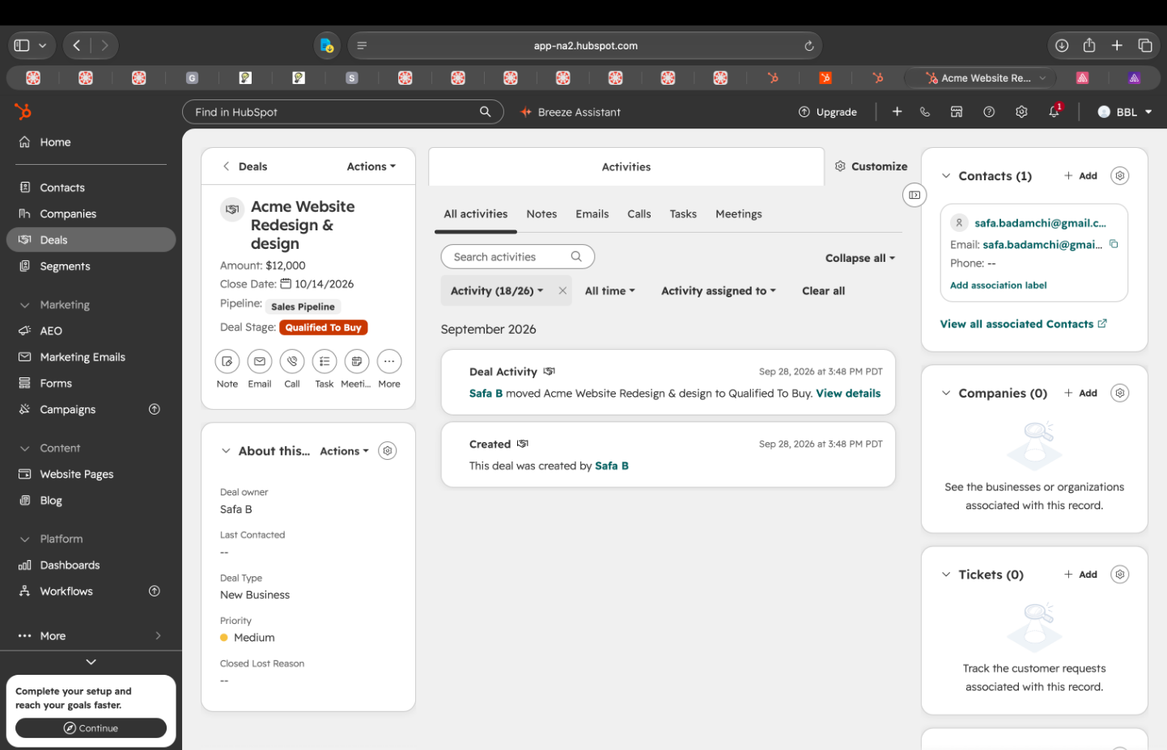
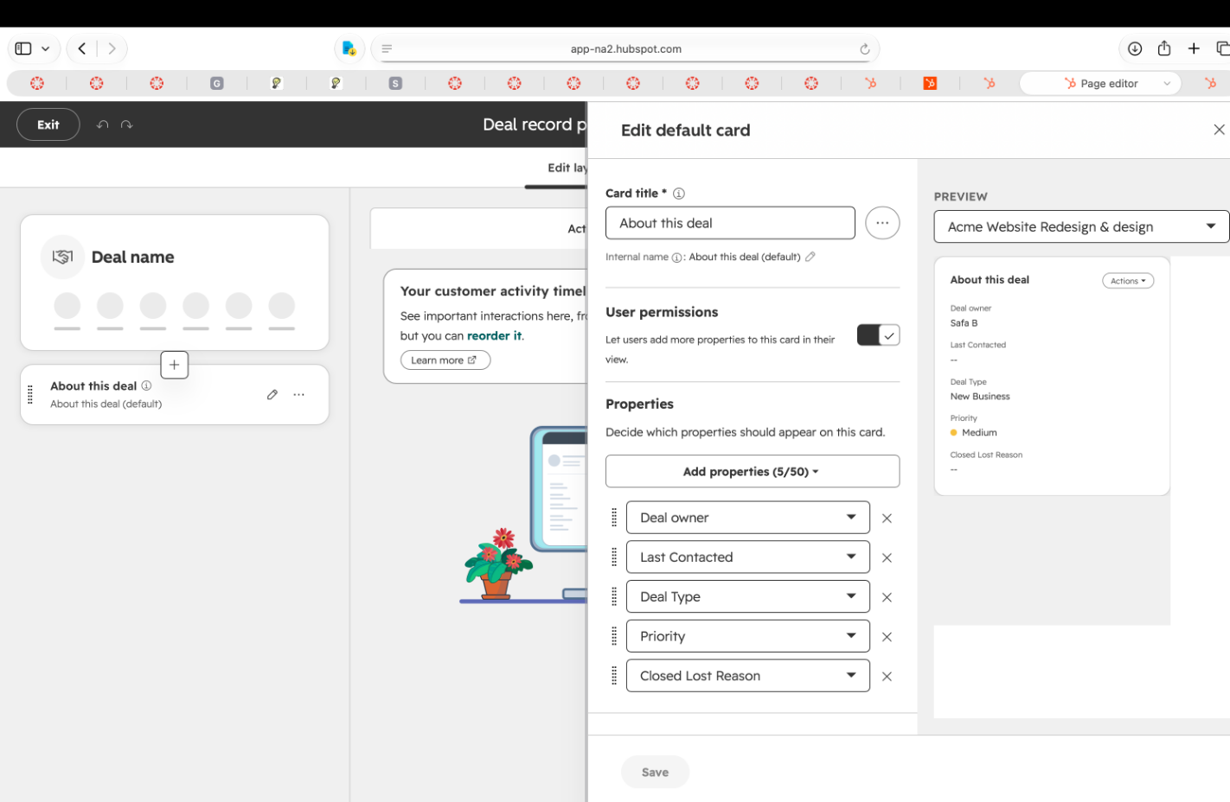
2 · COGNITIVE WALKTHROUGH
09
Steps 01–02 · Review and update
Stage is visible, but context is spread out. The first amount-edit path leads away from the task.
01 OPEN & REVIEW
PARTLY
02 UPDATE DEAL INFO
PARTLY
Goal. Understand the deal before acting.
Action. Review stage, amount, activity, and contact.
Feedback. Stage and amount are visible, but the full context is spread across three panes.
Goal. Update Amount.
Action. The first control opens page settings. The Deals table is the working edit path.
Feedback. The table shows the value in an editable field. The first path does not match the intended edit.
Signposts
Keep Distances Short · Inviting Dead End
K3 open record · K4 layout settings · K5 Deals table
09 / 26

Slide 10
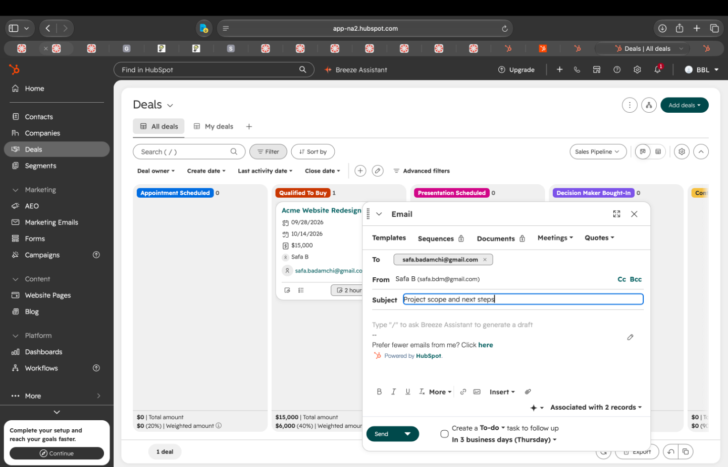
2 · COGNITIVE WALKTHROUGH
10
Steps 03–04 · Record and follow up
The note saves. Planning the next action still has to be discovered.
03 RECORD ACTIVITY
PARTLY
04 CONTACT & FOLLOW UP
PARTLY
Goal. Record the conversation.
Action. Save a note.
Feedback. The note appears with a timestamp. “No upcoming next step” remains, so recording activity does not establish the next action.
Goal. Contact the customer and plan follow-up.
Action. Send the email and select the follow-up checkbox beside Send.
Feedback. A task is created. The checkbox is less prominent than Send, and the task has no reminder.
Wayfinding
Signposts · Effectively Invisible Element
K6 saved note · K7–K8 follow-up task
10 / 26

Slide 11
2 · COGNITIVE WALKTHROUGH
11
Steps 05–07 · Respond, advance, and close
Step 05 uses the later reply. Steps 06–07 are the stage changes from the original walkthrough.
05 REVIEW RESPONSE
YES
06 ADVANCE STAGE
PARTLY
07 CLOSE DEAL
PARTLY
Goal. Assess the customer reply.
Action. Open the deal timeline.
Feedback. The incoming email is labeled and dated. In the later capture, the reply says “move forward” while the deal still reads Closed Lost.
Goal. Advance the deal.
Action. Drag it to Presentation Scheduled.
Feedback. The card moves and column counts update. No separate confirmation or undo was visible.
Goal. Record the outcome.
Action. Drag the deal to Closed Lost.
Feedback. The stage changes. Closure uses the same gesture as progression. No separate confirmation or undo was visible.
Signposts
Direct Manipulation
Keep Distances Short
HubSpot CRM · Phase 1
11 / 26

Slide 12
3 · SYNTHESIS
12
Affinity themes A–B · context and safeguards
All original observations are retained. Color is the walkthrough step. A check marks where the interface works.
✓ interface works
01 Review
02 Update
03 Activity
04 Follow up
05 Response
06 Advance
07 Close
THEME A LAYOUT & GROUPING
THEME B CONTROLS & RECOVERY
Status is fragmented across surfaces
Consequential changes have weak safeguards
Carries forward to Finding 04
Carries forward to Finding 02
1 No single screen carries the whole state
3 A one-number edit leads away from the task
Activity, contact, and the outcome fields live in three separate panels.
The control nearest Amount opens page layout settings.
The same value is editable in the Deals table instead.
High information density slows scanning of the record.
✓ Deal Stage and Amount are readable at the top of the panel.
4 Closure has no friction at the point of no return
Closing uses the same drag gesture as any stage move.
2 Status must be reconstructed across surfaces
No confirmation appears and no undo follows the drag.
The board card and the export each show a partial view.
Closed Lost Reason stays blank; placement and labelling hide it.
Last Contacted still reads 09/28 after the reply arrives.
✓ Settings counts one change and offers Cancel before writing.
Theme A spans steps 01, 05, and 06: no single screen accounts for the whole state.
12 / 26

Slide 13
3 · SYNTHESIS
13
Affinity themes C–D · follow-up and new evidence
Priority is unchanged: Theme D → 01, B → 02, C → 03, A → 04.
✓ interface works
01 Review
02 Update
03 Activity
04 Follow up
05 Response
06 Advance
07 Close
THEME C VISUAL HIERARCHY
THEME D FEEDBACK & CONSISTENCY
Follow-up exists but may not call attention
New evidence is disconnected from outcome
Carries forward to Finding 03
Carries forward to Finding 01
5 The control that creates the next step is the quietest
7 A post-closure reply does not challenge the outcome
The follow-up checkbox sits beside Send, unticked and low in contrast.
The customer replied four days after the deal was Closed Lost.
The reply sits in the timeline; no indicator on the board card.
After the note saves, the area still reads “No upcoming next step”.
No notification surfaces it, though the system holds it.
✓ The saved note appears under Previous activity with a timestamp.
The export shows the deal as lost and nothing else.
6 The mechanism meant to protect follow-up is silent
The task the checkbox creates reads “No reminder”.
✓ The incoming email is labelled and dated in the timeline.
It stayed Not Started and became Overdue after closure.
What the board does well, for contrast
✓ Dragging updates position and column counts at once.
✓ The task itself is concrete: due date, owner, To-do, status.
A new user must still learn that dragging changes the stage.
Five of seven Theme D notes concern the later reply. Theme C spans steps 03–04.
13 / 26

Slide 14
4 · PRIORITIZED FINDINGS
14
Four findings carry forward into Phase 2
The priority order is unchanged. Each finding links back to its affinity theme and original evidence.
01
A post-closure reply does not challenge the recorded outcome
THEME D
Observed. The Oct 2 “move forward” reply appears only after the record is opened.
Why it matters. An active opportunity may continue to be treated as lost.
02
THEME B
03
THEME C
04
THEME A
Closing a deal has little error prevention or visible recovery
Follow-up exists but may not call attention
Status is fragmented across surfaces
The user closes with the same drag gesture used for progression.
The task has no reminder and remains Not Started and Overdue.
Stage, activity, task state, and reply evidence are separated.
A consequential state can be recorded accidentally or prematurely.
A representative can miss the next action and lose momentum.
The user must reconcile conflicting signals before acting.
D → 01 outcome · B → 02 safeguards · C → 03 follow-up · A → 04 fragmented status
14 / 26

Slide 15
FINDING 01 · THEME D · FEEDBACK & CONSISTENCY
15
A later reply leaves the recorded outcome unchanged
The October 2 “move forward” reply was found by opening the closed deal. Closed Lost remained visible.
Sep 28 · 18:20
Sep 28 · 18:32
Oct 01 · 08:00
Oct 02 · 17:59
Oct 04
Follow-up sent
Closed Lost
Task overdue
Customer replies
Reply discovered
Email sent; follow-up task created.
Deal closed by dragging the card.
Not Started. No reminder.
“The scope looks good. Please move forward.”
Found by manually opening the closed deal.
RECORDED STATE
NEW CUSTOMER EVIDENCE
Closed Lost
CONTRADICTS
“Please move forward.”
No warning, flag, badge, or prompt connects the two.
OBSERVATION
WHY IT MATTERS
The reply is in the timeline, but the board card and notification center did not bring it to attention in the captured session.
A representative or manager could continue treating the opportunity as lost. This is a potential consequence, not an observed user outcome.
Theme D, cluster 7 → Finding 01. Evidence K13, K16, K17–K20, K22. Later post-closure captures.
15 / 26

Slide 16
FINDING 01 · SUPPORTING EVIDENCE
16
Where the reply did and did not appear
Inference and unverified items stay explicitly labeled. They are not findings.
Deal record
Board card
Recorded, but unlinked
K13
No new-reply indicator
K16
Notification centre
Exported report
No reply notification
K17–K20
No reply; Next Activity empty
K22
K22 · EXPORTED CSV · generated 2026-10-04
The managerial record still reads Closed Lost.
DEAL STAGE
AMOUNT
CLOSE DATE
NEXT ACTIVITY
DEAL OWNER
Closed Lost
15000.0
2026-09-28
Empty
Safa B
INFERENCE · NOT A FINDING
STILL UNVERIFIED
The connected personal inbox may record the reply as activity rather than a conversation. This possible mechanism was not observed.
Reopening behavior, Home / Catch-up / mobile visibility, and differences on a paid tier were not tested.
HubSpot CRM · Phase 1
16 / 26

Slide 17
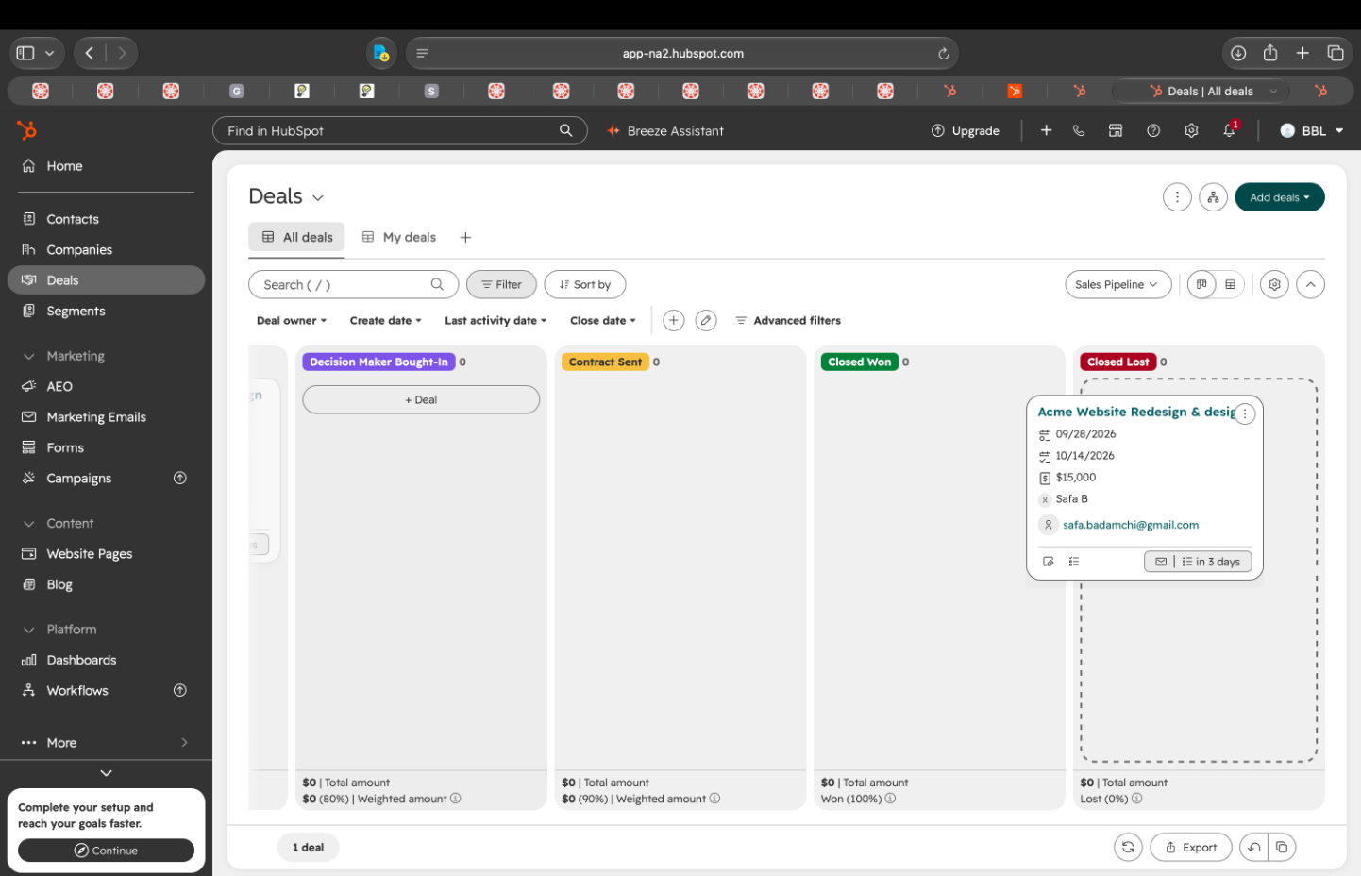
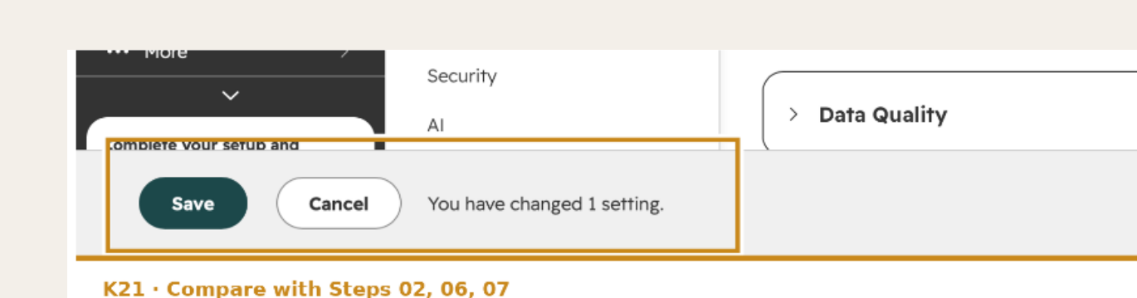
FINDING 02 · THEME B · CONTROLS & RECOVERY
17
Closing the deal offers little visible protection
The closure gesture matches ordinary stage progression. No separate confirmation or undo was visible.
K21. Settings shows Save and Cancel, and counts one change before anything is written.
WHY IT MATTERS
A consequential outcome could be recorded accidentally or too soon. Recovery was unclear in this walkthrough.
K10. The deal is dragged into Closed Lost — the same gesture used to advance a stage.
Theme B, cluster 4 → Finding 02. Direct Manipulation · Error prevention · Recovery.
17 / 26

Slide 18
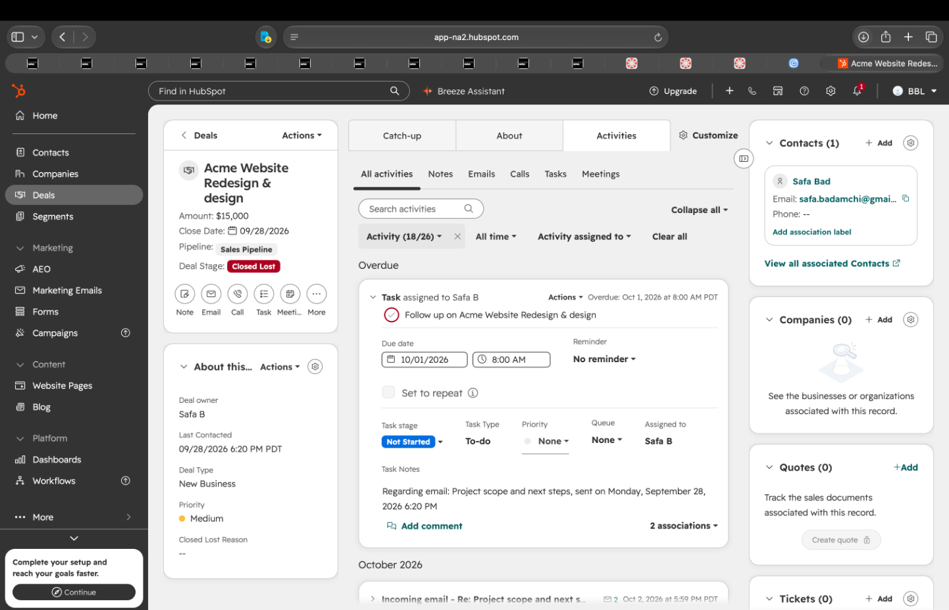
FINDING 03 · THEME C · VISUAL HIERARCHY
18
Follow-up exists but may not call attention
The task is created, but the captured follow-up cues are easy to overlook.
K7. The follow-up checkbox sits beside Send, unticked and lower in contrast.
K15. The task reads “No reminder,” due Oct 1, and still Not Started.
OBSERVED
WHY IT MATTERS
EVIDENCE
The checkbox is visually quiet beside Send. The created task has no reminder and remains Not Started and Overdue.
A representative can miss the next action and lose momentum.
K6, K7, K8, K15. Signposts · Effectively Invisible Element · Feedback.
Theme C, clusters 5–6 → Finding 03. Original priority 03.
18 / 26

Slide 19
FINDING 04 · THEME A · LAYOUT & GROUPING
19
Status is fragmented across surfaces
The representative must scan and reconcile multiple areas to understand what is true now.
OBSERVED
Stage, amount, activity, contact, task state, and reply evidence are distributed across the record and the pipeline.
TERMINOLOGY
Wayfinding · Signposts · Visibility of system status
WHY IT MATTERS
The user spends effort reconstructing context and may act on an incomplete or stale understanding.
Theme A, clusters 1–2 → Finding 04. Record, board, task, and reply must be read together.
19 / 26

Slide 20
EVIDENCE APPENDIX
20
Steps 01–02 · Review and update
Full-resolution captures behind the first two walkthrough observations.
01 · OPEN & REVIEW
02 · UPDATE DEAL INFO
K3. The deal record on open. Stage and amount are visible; activity and contact sit in separate panels.
K4. The first attempt to edit Amount opened the page layout editor instead.
Supporting interface captures · Existing product evidence · No invented research
20 / 26

Slide 21
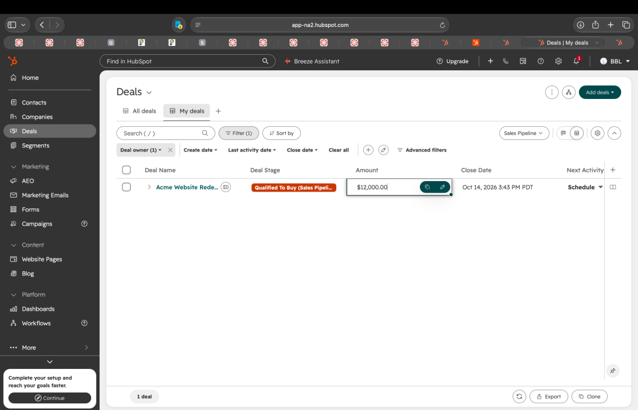
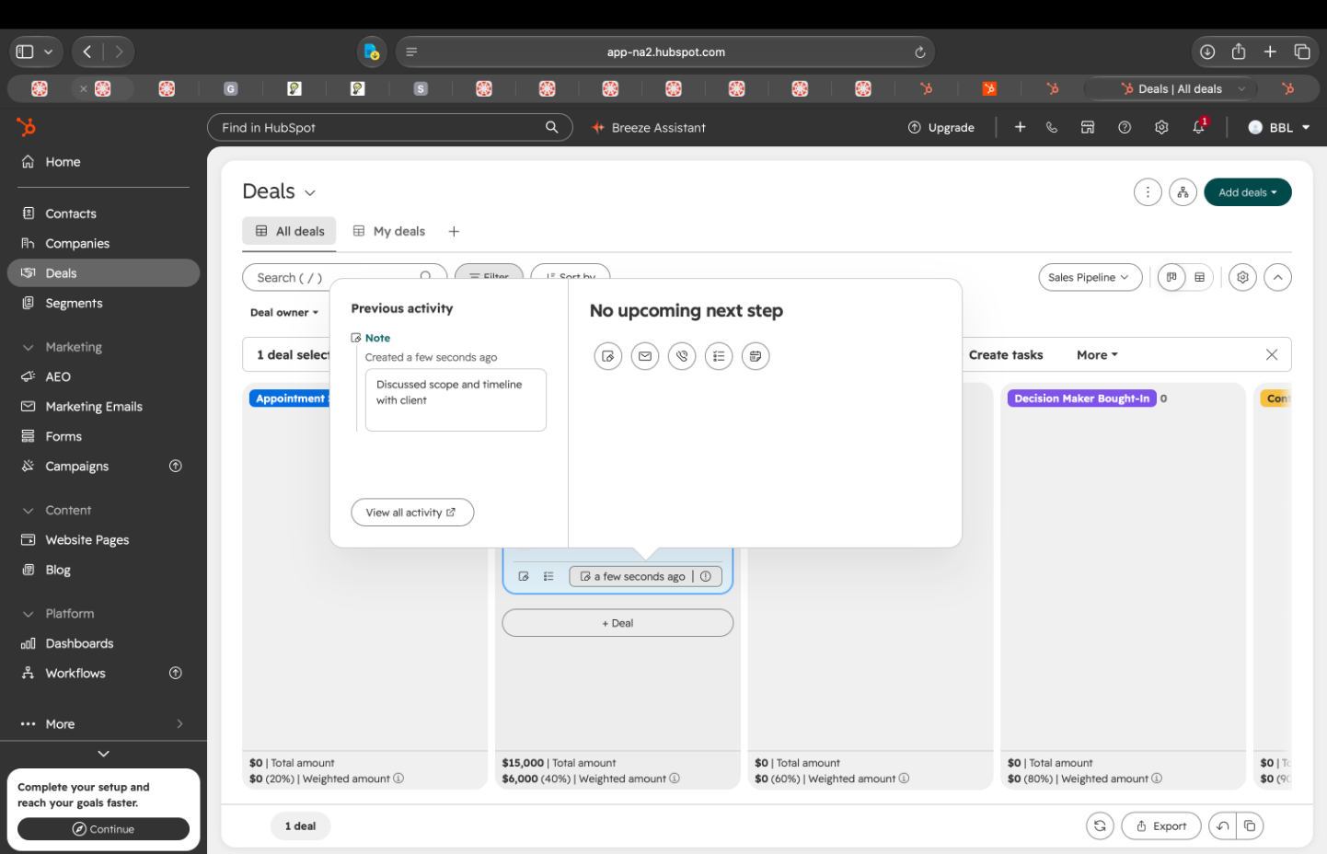
EVIDENCE APPENDIX
21
Steps 02–03 · Update and record
Full-resolution captures behind the editing path and the saved note.
02 · UPDATE DEAL INFO
03 · RECORD ACTIVITY
K5. The same value is editable directly in the Deals table.
K6. The note is saved and “No upcoming next step” is still showing.
Supporting interface captures · Existing product evidence · No invented research
21 / 26

Slide 22
EVIDENCE APPENDIX
22
Step 04 · Contact and follow up
Full-resolution captures behind the follow-up observations.
04 · CONTACT & FOLLOW UP
04 · CONTACT & FOLLOW UP
K7. The follow-up checkbox sits beside Send, unticked by default and lower in contrast.
K15. Reminder reads “No reminder.” The task was due Oct 1 and still Not Started.
Supporting interface captures · Existing product evidence · No invented research
22 / 26

Slide 23
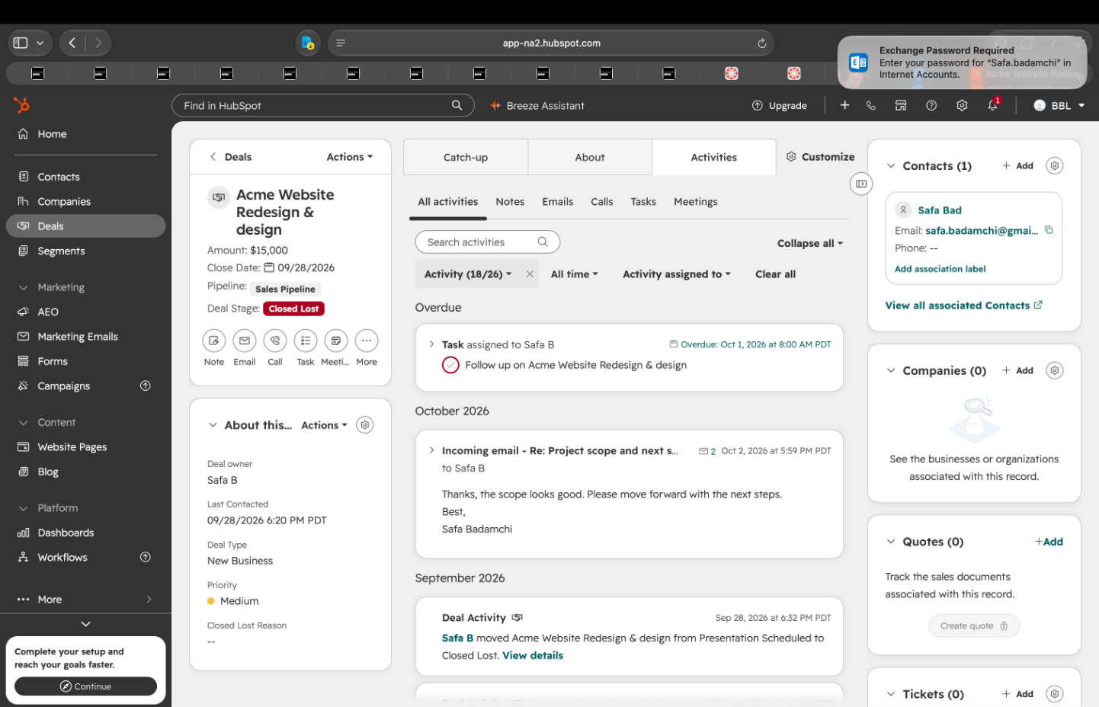
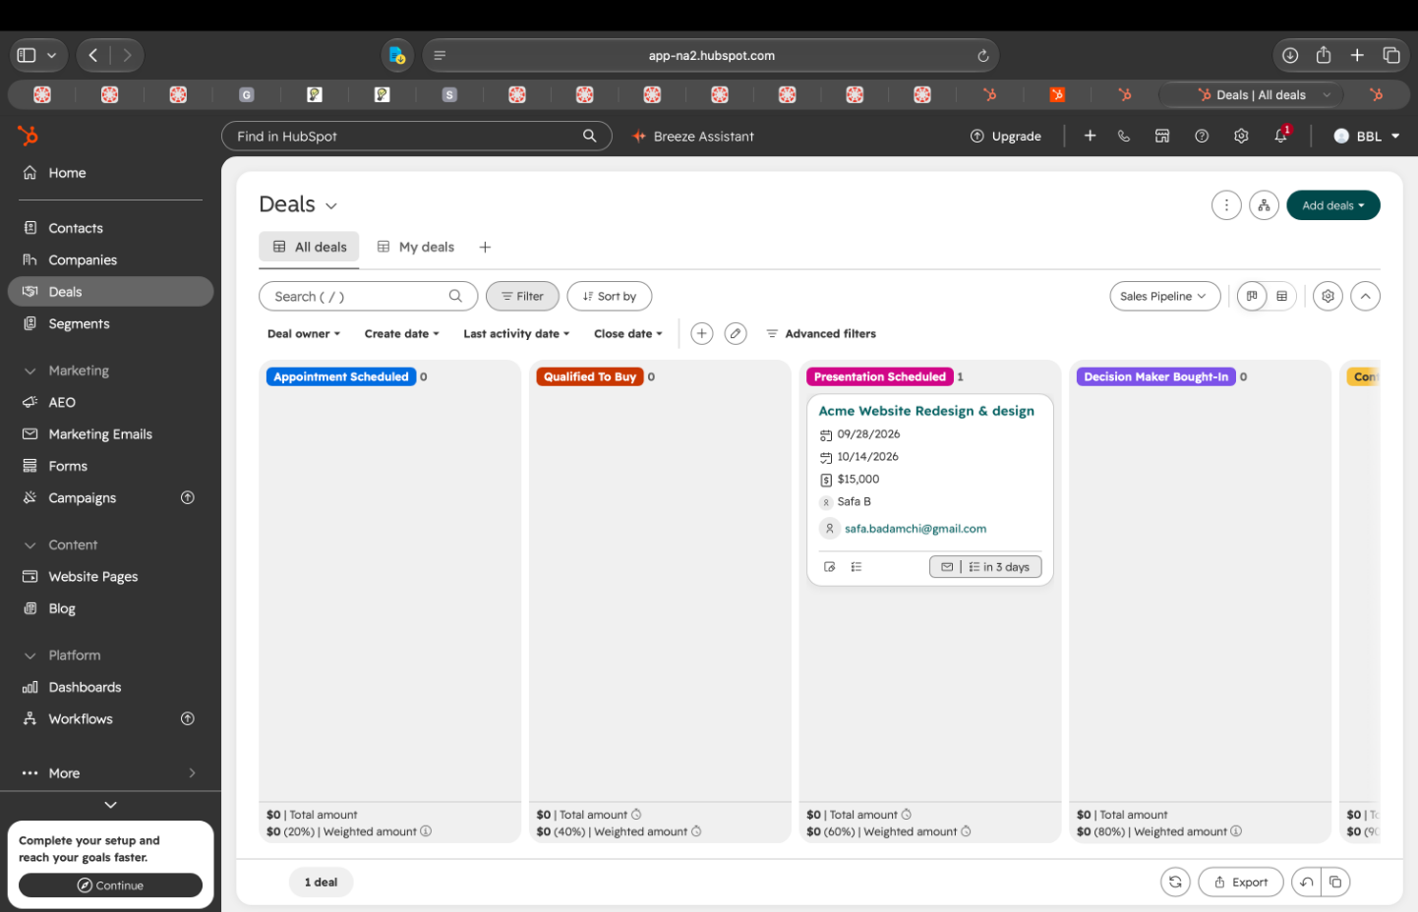
EVIDENCE APPENDIX
23
Steps 05–06 · Respond and advance
Full-resolution captures behind the response branch and the stage change.
05 · REVIEW RESPONSE
06 · ADVANCE STAGE
K13. The Oct 2 reply sits on the record beside the stage Closed Lost. Last Contacted still reads 09/28.
K9. After the drag, the card is in the new column and the counts update. No confirmation appears.
Supporting interface captures · Existing product evidence · No invented research
23 / 26

Slide 24
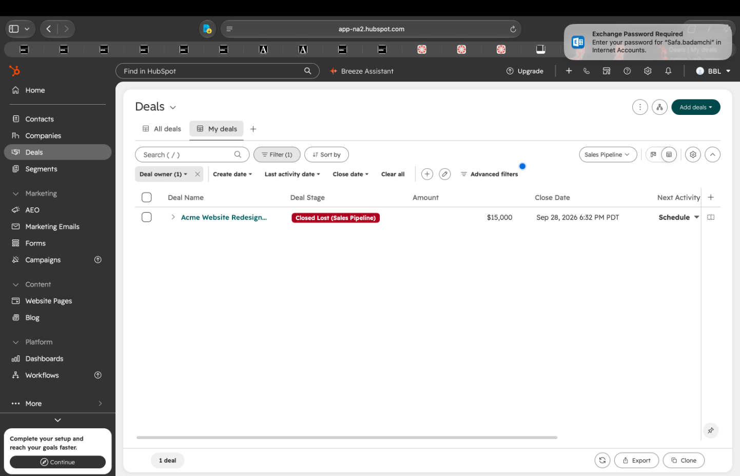
EVIDENCE APPENDIX
24
Step 07 · Close deal
Full-resolution captures behind the closure observations.
07 · CLOSE DEAL
07 · CLOSE DEAL
K10. Closing uses the same unguarded drag gesture as any other stage change.
K12. The final row: Closed Lost, $15,000, close date 09/28/2026. The loss reason is blank.
Supporting interface captures · Existing product evidence · No invented research
24 / 26

Slide 25
EVIDENCE APPENDIX · CROSS-STEP SUMMARY
25
Supporting observations across the workflow
Rebuilt from the original captures. Full-screen originals are on slides 20–24.
K3
K4–K5
K6
Status is distributed
The first edit path fails; the table works
Note saved, next step empty
Qualified To Buy and $12,000 are visible, while Last Contacted and Closed Lost Reason both read “—” across separate panels.
The direct amount edit appears only after the record-page attempt opened layout settings.
The timeline confirms the note while the interface still reads “No upcoming next step.”
K7–K8
K9
K10 + K21
Follow-up created without a reminder
Stage change relies on position
Closure is unguarded; settings are protected
The quiet checkbox creates a task whose expanded state says “No reminder.”
Card position and the updated column counts are the only confirmation. No separate message is shown.
Closing offers no confirmation and no undo, while Settings counts one change and offers Cancel.
HubSpot CRM · Phase 1
25 / 26

Slide 26
SUBMISSION RECORD
26
Rubric coverage, evidence boundaries, and AI attribution
One evaluation, grounded in the supplied HubSpot interface evidence. No new findings were added in this redesign.
RUBRIC COVERAGE
EVIDENCE BOUNDARY
Existing workflow — slides 03–06
One existing qualified deal, walked end to end on the free tier of HubSpot.
Cognitive walkthrough — slides 07–11
The observed workflow ends in Closed Lost.
Synthesis and affinity map — slides 12–13
The October 2 reply is a walkthrough branch, captured after closure.
Prioritized findings — slides 14–19
Evidence appendix — slides 20–25
No user research, participant study, or behavioral claim is invented.
DESIGN TERMINOLOGY APPLIED
AI USE
Signposts & wayfinding — the saved note, the empty next step, and the reply that never leaves the timeline.
Tools used on the original submission: Claude (Anthropic), ChatGPT (OpenAI), Figma Make.
Keep Distances Short — the Amount edit and the closure gesture.
Used for organizing observations, clarifying terminology, editing wording, and producing layout.
Direct Manipulation — the drag that advances the stage, and the same drag that ends the deal.
OCR recovered wording from captures the evaluator had already taken.
Effectively Invisible Element · Inviting Dead End · Potential Error — the follow-up checkbox, the page-layout detour, and the unguarded close.
AI did not conduct the walkthrough, analyze the interface, or generate findings. Observations, evidence, and conclusions are Safa Badamchi’s.
This file is a visual redesign. Wording, evidence, and findings are unchanged. No new walkthrough was added.
26 / 26

